Slide 1
Île de France
Mardi 4 Février 2025

Slide 2
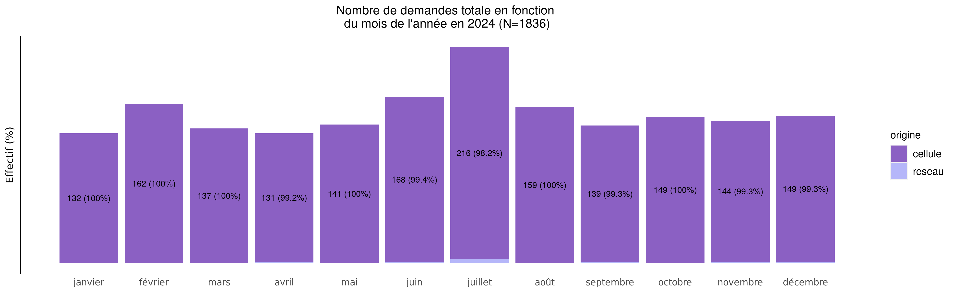
Nombre de demandes de TIU en 2024
04/02/2025
origine | janvier | février | mars | avril | mai | juin | juillet | août | septembre | octobre | novembre | décembre | Total
cellule | 132 (7.2%) | 162 (8.9%) | 137 (7.5%) | 131 (7.2%) | 141 (7.7%) | 168 (9.2%) | 216 (11.8%) | 159 (8.7%) | 139 (7.6%) | 149 (8.2%) | 144 (7.9%) | 149 (8.2%) | 1827
reseau | 0 (0.0%) | 0 (0.0%) | 0 (0.0%) | 1 (11.1%) | 0 (0.0%) | 1 (11.1%) | 4 (44.4%) | 0 (0.0%) | 1 (11.1%) | 0 (0.0%) | 1 (11.1%) | 1 (11.1%) | 9
Total | 132 (7.2%) | 162 (8.8%) | 137 (7.5%) | 132 (7.2%) | 141 (7.7%) | 169 (9.2%) | 220 (12.0%) | 159 (8.7%) | 140 (7.6%) | 149 (8.1%) | 145 (7.9%) | 150 (8.2%) | 1836

Slide 3
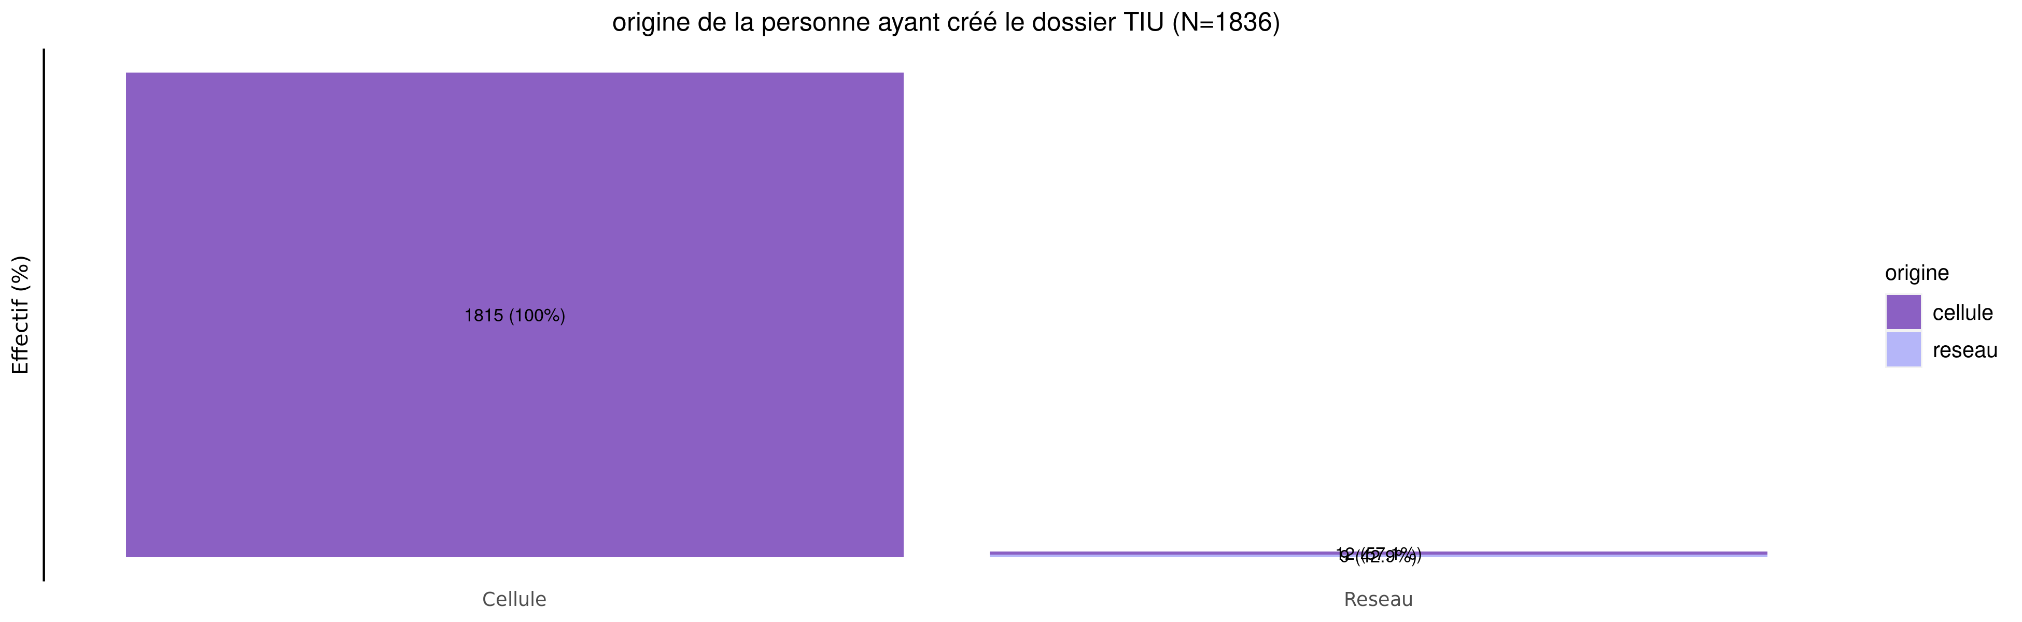
origine des demandes de TIU en 2024
04/02/2025
origine | Cellule | Reseau | Total
cellule | 1815 (99.3%) | 12 (0.7%) | 1827
reseau | 0 (0.0%) | 9 (100.0%) | 9
Total | 1815 (98.9%) | 21 (1.1%) | 1836

Slide 4
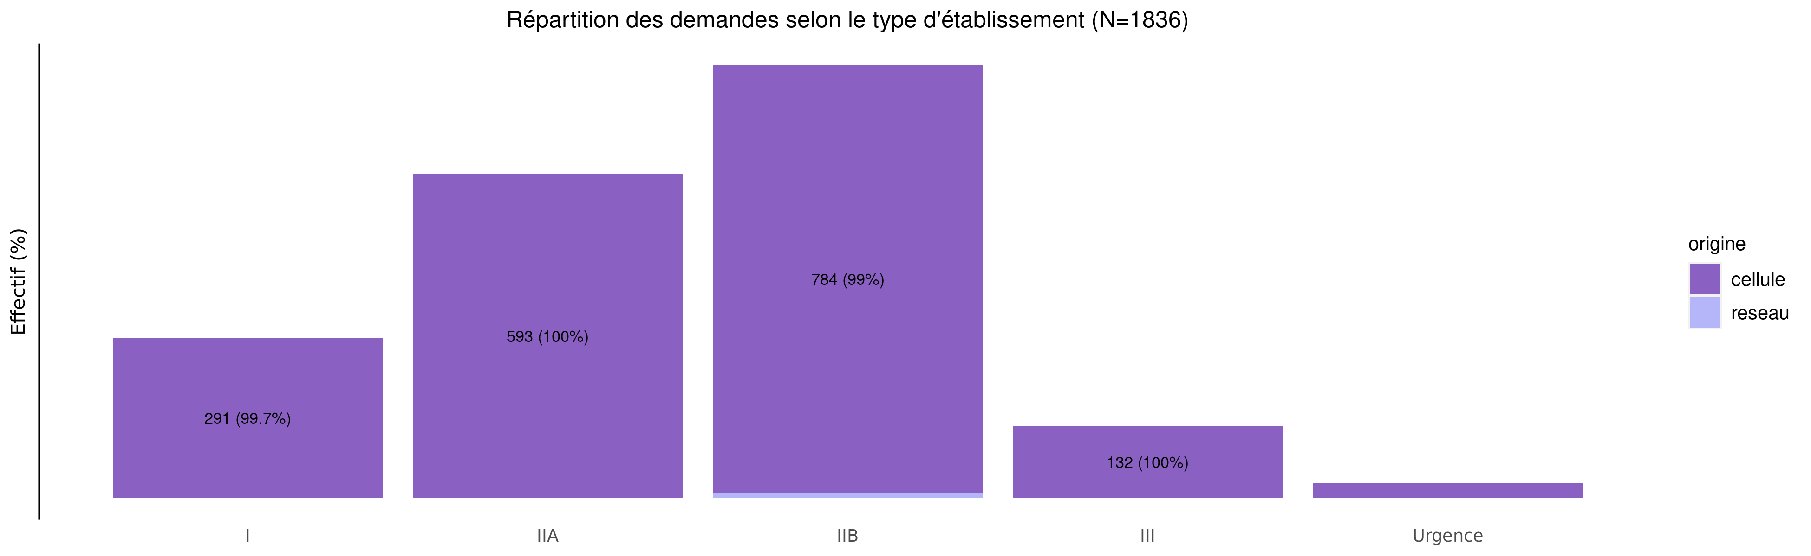
TIU par type d'établissement demandeur en 2024
04/02/2025
origine | I | IIA | IIB | III | Urgence | Inconnu | Total
cellule | 291 (15.9%) | 593 (32.5%) | 784 (42.9%) | 132 (7.2%) | 27 (1.5%) | 0 (0%) | 1827
reseau | 1 (11.1%) | 0 (0.0%) | 8 (88.9%) | 0 (0.0%) | 0 (0.0%) | 0 (0%) | 9
Total | 292 (15.9%) | 593 (32.3%) | 792 (43.1%) | 132 (7.2%) | 27 (1.5%) | 0 (0%) | 1836

Slide 5
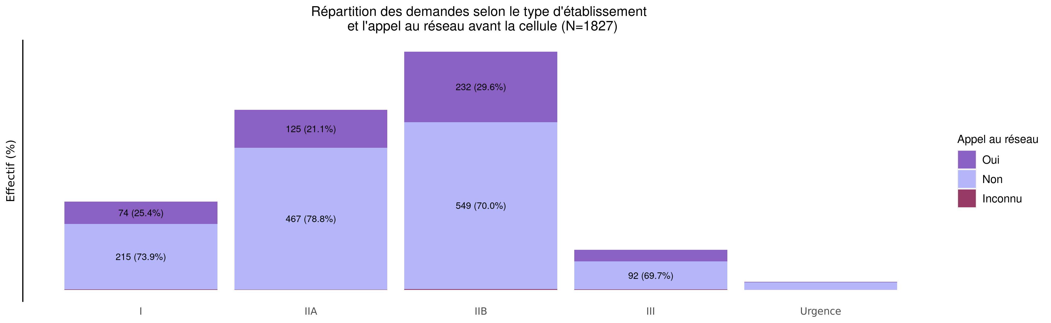
L'établissement a-t-il appelé le réseau avant la cellule?
04/02/2025
Appel | I | IIA | IIB | III | Urgence | Inconnu | Total
Oui | 74 (15.7%) | 125 (26.5%) | 232 (49.3%) | 38 (8.1%) | 2 (0.4%) | 0 (0%) | 471
Non | 215 (15.9%) | 467 (34.6%) | 549 (40.7%) | 92 (6.8%) | 25 (1.9%) | 0 (0%) | 1348
Inconnu | 2 (25.0%) | 1 (12.5%) | 3 (37.5%) | 2 (25.0%) | 0 (0.0%) | 0 (0%) | 8
Total | 291 (15.9%) | 593 (32.5%) | 784 (42.9%) | 132 (7.2%) | 27 (1.5%) | 0 (0%) | 1827

Slide 6
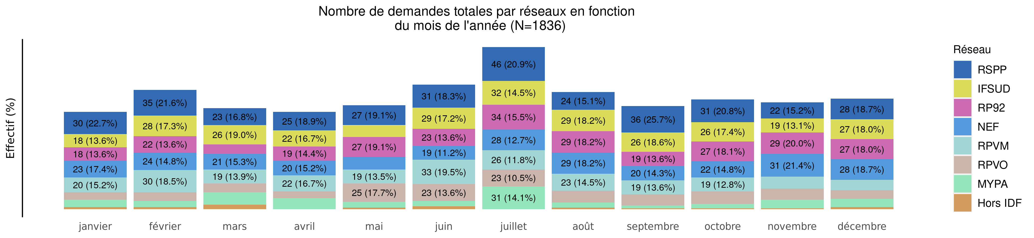
Nombre de demandes de TIU par réseau en 2024 (Total des transferts)
04/02/2025
Reseau | janvier | février | mars | avril | mai | juin | juillet | août | septembre | octobre | novembre | décembre | Total
RSPP | 30 (8.4%) | 35 (9.8%) | 23 (6.4%) | 25 (7.0%) | 27 (7.5%) | 31 (8.7%) | 46 (12.8%) | 24 (6.7%) | 36 (10.1%) | 31 (8.7%) | 22 (6.1%) | 28 (7.8%) | 358
IFSUD | 18 (6.0%) | 28 (9.4%) | 26 (8.7%) | 22 (7.4%) | 16 (5.4%) | 29 (9.7%) | 32 (10.7%) | 29 (9.7%) | 26 (8.7%) | 26 (8.7%) | 19 (6.4%) | 27 (9.1%) | 298
RP92 | 18 (6.3%) | 22 (7.7%) | 13 (4.5%) | 19 (6.6%) | 27 (9.4%) | 23 (8.0%) | 34 (11.8%) | 29 (10.1%) | 19 (6.6%) | 27 (9.4%) | 29 (10.1%) | 27 (9.4%) | 287
NEF | 23 (8.2%) | 24 (8.5%) | 21 (7.4%) | 20 (7.1%) | 17 (6.0%) | 19 (6.7%) | 28 (9.9%) | 29 (10.3%) | 20 (7.1%) | 22 (7.8%) | 31 (11.0%) | 28 (9.9%) | 282
RPVM | 20 (7.7%) | 30 (11.5%) | 19 (7.3%) | 22 (8.5%) | 19 (7.3%) | 33 (12.7%) | 26 (10.0%) | 23 (8.8%) | 19 (7.3%) | 19 (7.3%) | 16 (6.2%) | 14 (5.4%) | 260
RPVO | 10 (5.3%) | 12 (6.3%) | 12 (6.3%) | 9 (4.8%) | 25 (13.2%) | 23 (12.2%) | 23 (12.2%) | 16 (8.5%) | 15 (7.9%) | 17 (9.0%) | 15 (7.9%) | 12 (6.3%) | 189
MYPA | 10 (7.4%) | 8 (5.9%) | 17 (12.5%) | 15 (11.0%) | 8 (5.9%) | 7 (5.1%) | 31 (22.8%) | 7 (5.1%) | 4 (2.9%) | 6 (4.4%) | 12 (8.8%) | 11 (8.1%) | 136
Hors IDF | 3 (11.5%) | 3 (11.5%) | 6 (23.1%) | 0 (0.0%) | 2 (7.7%) | 4 (15.4%) | 0 (0.0%) | 2 (7.7%) | 1 (3.8%) | 1 (3.8%) | 1 (3.8%) | 3 (11.5%) | 26
Inconnu | 0 (0.0%) | 0 (0.0%) | 0 (0.0%) | 0 (0.0%) | 0 (0.0%) | 0 (0.0%) | 0 (0.0%) | 0 (0.0%) | 0 (0.0%) | 0 (0.0%) | 0 (0.0%) | 0 (0.0%) | 0
Total | 132 (7.2%) | 162 (8.8%) | 137 (7.5%) | 132 (7.2%) | 141 (7.7%) | 169 (9.2%) | 220 (12.0%) | 159 (8.7%) | 140 (7.6%) | 149 (8.1%) | 145 (7.9%) | 150 (8.2%) | 1836

Slide 7

Nombre de demandes de TIU par réseau en 2024 (Transferts cellule)
04/02/2025
Variable | janvier | février | mars | avril | mai | juin | juillet | août | septembre | octobre | novembre | décembre | Total
RSPP | 30 (8.4%) | 35 (9.8%) | 23 (6.4%) | 25 (7.0%) | 27 (7.5%) | 31 (8.7%) | 46 (12.8%) | 24 (6.7%) | 36 (10.1%) | 31 (8.7%) | 22 (6.1%) | 28 (7.8%) | 358
IFSUD | 18 (6.1%) | 28 (9.4%) | 26 (8.8%) | 21 (7.1%) | 16 (5.4%) | 29 (9.8%) | 32 (10.8%) | 29 (9.8%) | 26 (8.8%) | 26 (8.8%) | 19 (6.4%) | 27 (9.1%) | 297
RP92 | 18 (6.3%) | 22 (7.7%) | 13 (4.5%) | 19 (6.6%) | 27 (9.4%) | 23 (8.0%) | 34 (11.8%) | 29 (10.1%) | 19 (6.6%) | 27 (9.4%) | 29 (10.1%) | 27 (9.4%) | 287
NEF | 23 (8.2%) | 24 (8.6%) | 21 (7.5%) | 20 (7.2%) | 17 (6.1%) | 19 (6.8%) | 28 (10.0%) | 29 (10.4%) | 19 (6.8%) | 22 (7.9%) | 30 (10.8%) | 27 (9.7%) | 279
RPVM | 20 (7.7%) | 30 (11.6%) | 19 (7.3%) | 22 (8.5%) | 19 (7.3%) | 32 (12.4%) | 26 (10.0%) | 23 (8.9%) | 19 (7.3%) | 19 (7.3%) | 16 (6.2%) | 14 (5.4%) | 259
RPVO | 10 (5.3%) | 12 (6.3%) | 12 (6.3%) | 9 (4.8%) | 25 (13.2%) | 23 (12.2%) | 23 (12.2%) | 16 (8.5%) | 15 (7.9%) | 17 (9.0%) | 15 (7.9%) | 12 (6.3%) | 189
MYPA | 10 (7.6%) | 8 (6.1%) | 17 (12.9%) | 15 (11.4%) | 8 (6.1%) | 7 (5.3%) | 27 (20.5%) | 7 (5.3%) | 4 (3.0%) | 6 (4.5%) | 12 (9.1%) | 11 (8.3%) | 132
Hors IDF | 3 (11.5%) | 3 (11.5%) | 6 (23.1%) | 0 (0.0%) | 2 (7.7%) | 4 (15.4%) | 0 (0.0%) | 2 (7.7%) | 1 (3.8%) | 1 (3.8%) | 1 (3.8%) | 3 (11.5%) | 26
Inconnu | 0 (0.0%) | 0 (0.0%) | 0 (0.0%) | 0 (0.0%) | 0 (0.0%) | 0 (0.0%) | 0 (0.0%) | 0 (0.0%) | 0 (0.0%) | 0 (0.0%) | 0 (0.0%) | 0 (0.0%) | 0
Total | 132 (7.2%) | 162 (8.9%) | 137 (7.5%) | 131 (7.2%) | 141 (7.7%) | 168 (9.2%) | 216 (11.8%) | 159 (8.7%) | 139 (7.6%) | 149 (8.2%) | 144 (7.9%) | 149 (8.2%) | 1827

Slide 8
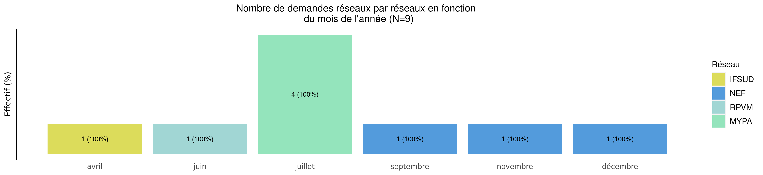
Nombre de demandes de TIU par réseau en 2024 (Transferts réseaux)
04/02/2025
Reseau | janvier | février | mars | avril | mai | juin | juillet | août | septembre | octobre | novembre | décembre | Total
RSPP | 0 (0.0%) | 0 (0.0%) | 0 (0.0%) | 0 (0.0%) | 0 (0.0%) | 0 (0.0%) | 0 (0.0%) | 0 (0.0%) | 0 (0.0%) | 0 (0.0%) | 0 (0.0%) | 0 (0.0%) | 0
IFSUD | 0 (0%) | 0 (0%) | 0 (0%) | 1 (100.0%) | 0 (0%) | 0 (0.0%) | 0 (0.0%) | 0 (0%) | 0 (0.0%) | 0 (0%) | 0 (0.0%) | 0 (0.0%) | 1
RP92 | 0 (0.0%) | 0 (0.0%) | 0 (0.0%) | 0 (0.0%) | 0 (0.0%) | 0 (0.0%) | 0 (0.0%) | 0 (0.0%) | 0 (0.0%) | 0 (0.0%) | 0 (0.0%) | 0 (0.0%) | 0
NEF | 0 (0%) | 0 (0%) | 0 (0%) | 0 (0.0%) | 0 (0%) | 0 (0.0%) | 0 (0.0%) | 0 (0%) | 1 (33.3%) | 0 (0%) | 1 (33.3%) | 1 (33.3%) | 3
RPVM | 0 (0%) | 0 (0%) | 0 (0%) | 0 (0.0%) | 0 (0%) | 1 (100.0%) | 0 (0.0%) | 0 (0%) | 0 (0.0%) | 0 (0%) | 0 (0.0%) | 0 (0.0%) | 1
RPVO | 0 (0.0%) | 0 (0.0%) | 0 (0.0%) | 0 (0.0%) | 0 (0.0%) | 0 (0.0%) | 0 (0.0%) | 0 (0.0%) | 0 (0.0%) | 0 (0.0%) | 0 (0.0%) | 0 (0.0%) | 0
MYPA | 0 (0%) | 0 (0%) | 0 (0%) | 0 (0.0%) | 0 (0%) | 0 (0.0%) | 4 (100.0%) | 0 (0%) | 0 (0.0%) | 0 (0%) | 0 (0.0%) | 0 (0.0%) | 4
Hors IDF | 0 (0.0%) | 0 (0.0%) | 0 (0.0%) | 0 (0.0%) | 0 (0.0%) | 0 (0.0%) | 0 (0.0%) | 0 (0.0%) | 0 (0.0%) | 0 (0.0%) | 0 (0.0%) | 0 (0.0%) | 0
Inconnu | 0 (0.0%) | 0 (0.0%) | 0 (0.0%) | 0 (0.0%) | 0 (0.0%) | 0 (0.0%) | 0 (0.0%) | 0 (0.0%) | 0 (0.0%) | 0 (0.0%) | 0 (0.0%) | 0 (0.0%) | 0
Total | 0 (0%) | 0 (0%) | 0 (0%) | 1 (11.1%) | 0 (0%) | 1 (11.1%) | 4 (44.4%) | 0 (0%) | 1 (11.1%) | 0 (0%) | 1 (11.1%) | 1 (11.1%) | 9

Slide 9
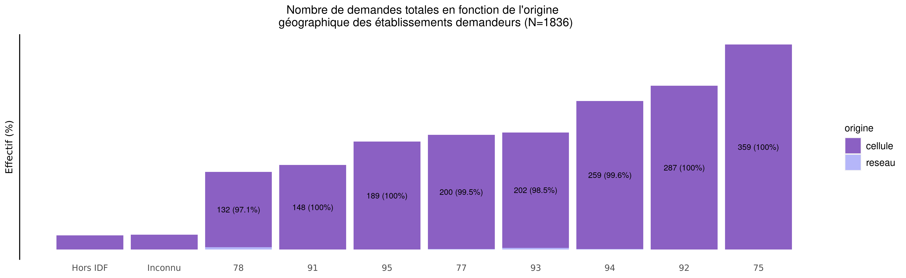
origine géographique des établissements demandeurs de TIU en 2024
04/02/2025
origine | Hors IDF | Inconnu | 78 | 91 | 95 | 77 | 93 | 94 | 92 | 75 | Total
cellule | 25 (1.4%) | 26 (1.4%) | 132 (7.2%) | 148 (8.1%) | 189 (10.3%) | 200 (10.9%) | 202 (11.1%) | 259 (14.2%) | 287 (15.7%) | 359 (19.6%) | 1827
reseau | 0 (0.0%) | 0 (0.0%) | 4 (44.4%) | 0 (0.0%) | 0 (0.0%) | 1 (11.1%) | 3 (33.3%) | 1 (11.1%) | 0 (0.0%) | 0 (0.0%) | 9
Total | 25 (1.4%) | 26 (1.4%) | 136 (7.4%) | 148 (8.1%) | 189 (10.3%) | 201 (10.9%) | 205 (11.2%) | 260 (14.2%) | 287 (15.6%) | 359 (19.6%) | 1836

Slide 10
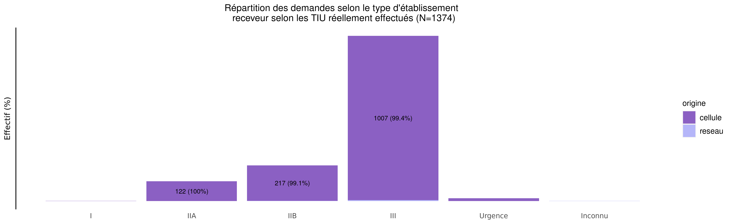
TIU par type d'établissement receveur en 2024
04/02/2025
origine | I | IIA | IIB | III | Urgence | Inconnu | Total
cellule | 1 (0.1%) | 122 (8.9%) | 217 (15.9%) | 1007 (73.8%) | 18 (1.3%) | 0 (0.0%) | 1365
reseau | 0 (0.0%) | 0 (0.0%) | 2 (22.2%) | 6 (66.7%) | 0 (0.0%) | 1 (11.1%) | 9
Total | 1 (0.1%) | 122 (8.9%) | 219 (15.9%) | 1013 (73.7%) | 18 (1.3%) | 1 (0.1%) | 1374

Slide 11
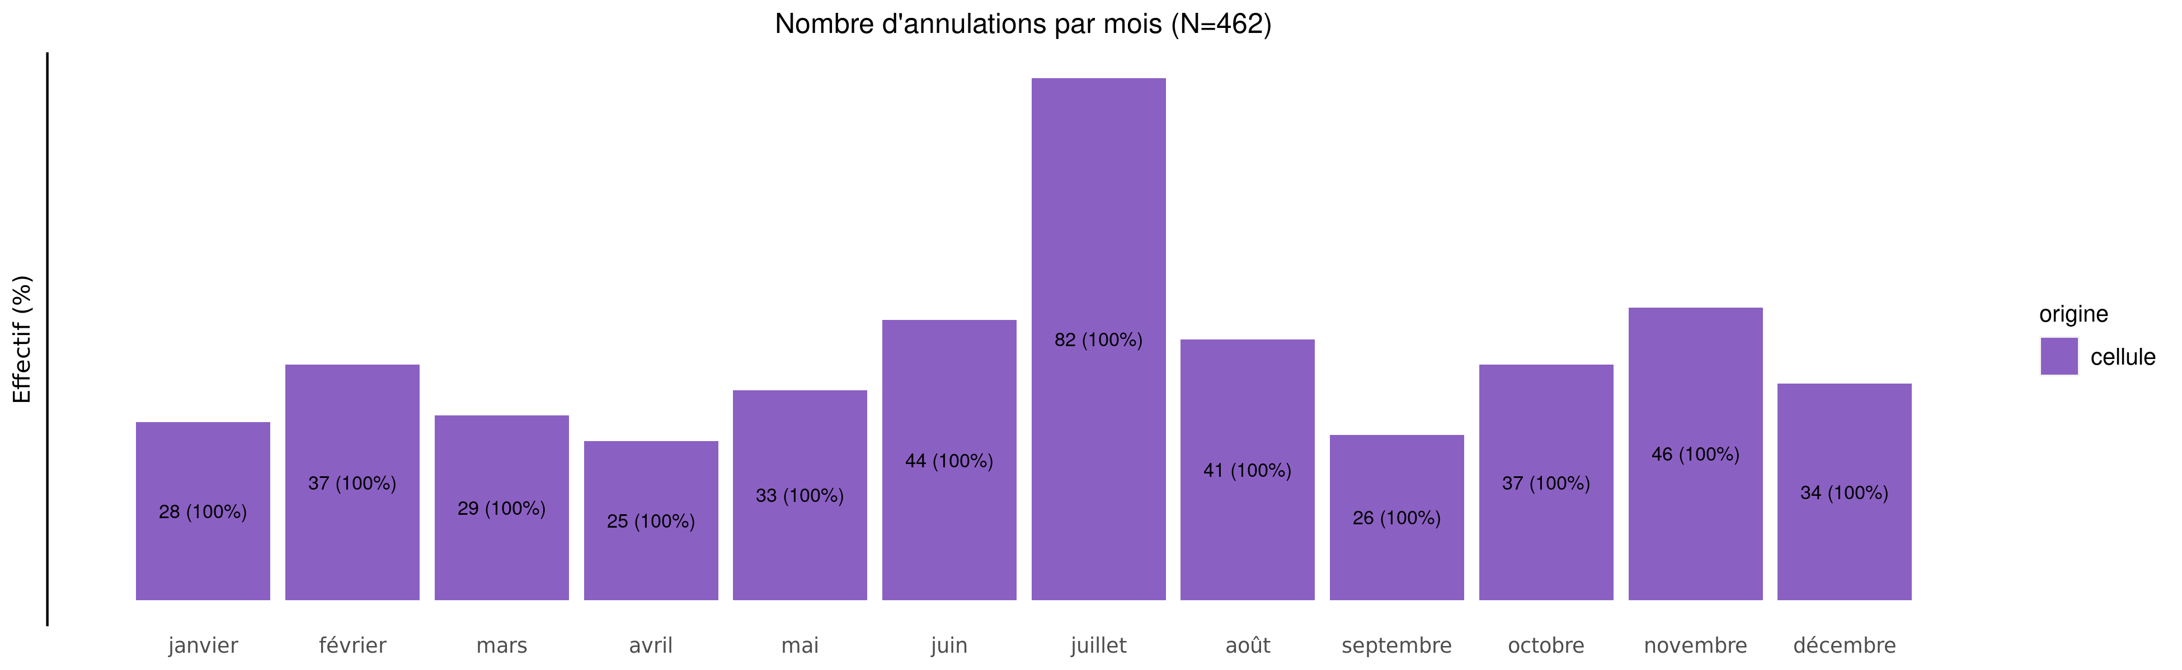
Annulation des demandes de TIU en 2024
04/02/2025
origine | janvier | février | mars | avril | mai | juin | juillet | août | septembre | octobre | novembre | décembre | Total
cellule | 28 (6.1%) | 37 (8%) | 29 (6.3%) | 25 (5.4%) | 33 (7.1%) | 44 (9.5%) | 82 (17.7%) | 41 (8.9%) | 26 (5.6%) | 37 (8%) | 46 (10%) | 34 (7.4%) | 462
Total | 28 (6.1%) | 37 (8%) | 29 (6.3%) | 25 (5.4%) | 33 (7.1%) | 44 (9.5%) | 82 (17.7%) | 41 (8.9%) | 26 (5.6%) | 37 (8%) | 46 (10%) | 34 (7.4%) | 462

Slide 12
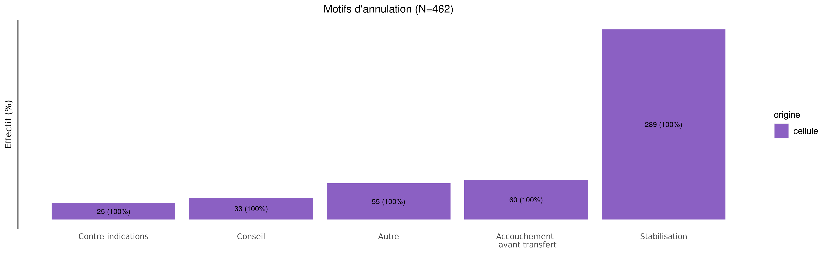
Motif d'annulation des demandes de TIU en 2024
04/02/2025
origine | Contre-indications | Conseil | Autre | Accouchement avant transfert | Stabilisation | Total
cellule | 25 (5.4%) | 33 (7.1%) | 55 (11.9%) | 60 (13%) | 289 (62.6%) | 462
Total | 25 (5.4%) | 33 (7.1%) | 55 (11.9%) | 60 (13%) | 289 (62.6%) | 462

Slide 13
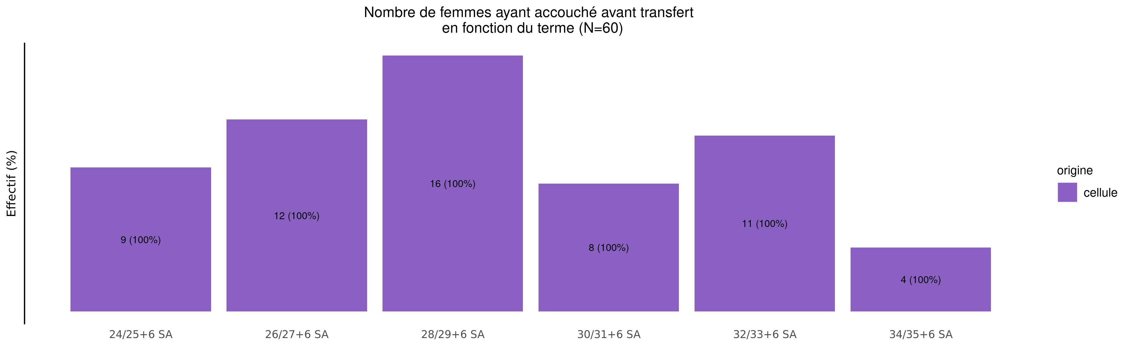
Termes des femmes ayant accouché avant transfert en 2024 (64 N.nés cellule et 0 N.nés réseaux)
04/02/2025
origine | Moins de 24 SA | 24/25+6 SA | 26/27+6 SA | 28/29+6 SA | 30/31+6 SA | 32/33+6 SA | 34/35+6 SA | Plus de 36 SA | Inconnu | Total
cellule | 0 (0%) | 9 (15%) | 12 (20%) | 16 (26.7%) | 8 (13.3%) | 11 (18.3%) | 4 (6.7%) | 0 (0%) | 0 (0%) | 60
Total | 0 (0%) | 9 (15%) | 12 (20%) | 16 (26.7%) | 8 (13.3%) | 11 (18.3%) | 4 (6.7%) | 0 (0%) | 0 (0%) | 60

Slide 14
Répartition des TIU en 2024 (Total des transferts)
04/02/2025
189 (10.3%)
69 (5.0%)
136 (7.4%)
282 (15.4%)
70 (5.1%)
225 (16.4%)
287 (15.6%)
358 (19.5%)
260 (18.9%)
419 (30.5%)
260 (14.2%)
195 (14.2%)
298 (16.2%)
26 (1.4%)
61 (4.4%)
74 (5.4%)
0 (0.0%)
1 (0.1%)

Slide 15
Répartition des TIU en 2024 (Transferts cellule)
04/02/2025
189 (10.3%)
69 (5.1%)
132 (7.2%)
279 (15.3%)
68 (5.0%)
222 (16.3%)
287 (15.7%)
358 (19.6%)
260 (19.0%)
419 (30.7%)
259 (14.2%)
194 (14.2%)
297 (16.3%)
26 (1.4%)
61 (4.5%)
72 (5.3%)
0 (0.0%)
0 (0.0%)

Slide 16
Répartition des TIU en 2024 (Transferts réseaux)
04/02/2025
0 (0.0%)
0 (0.0%)
4 (44.4%)
3 (33.3%)
2 (22.2%)
3 (33.3%)
0 (0.0%)
0 (0.0%)
0 (0.0%)
0 (0.0%)
1 (11.1%)
1 (11.1%)
1 (11.1%)
0 (0.0%)
0 (0.0%)
2 (22.2%)
0 (0.0%)
1 (11.1%)

Slide 17
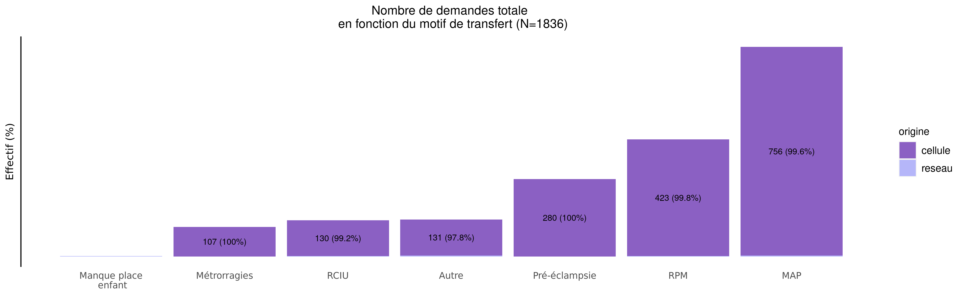
Motif de transfert principal en 2024
04/02/2025
origine | Manque place enfant | Métrorragies | RCIU | Autre | Pré-éclampsie | RPM | MAP | Total
cellule | 0 (0.0%) | 107 (5.9%) | 130 (7.1%) | 131 (7.2%) | 280 (15.3%) | 423 (23.2%) | 756 (41.4%) | 1827
reseau | 1 (11.1%) | 0 (0.0%) | 1 (11.1%) | 3 (33.3%) | 0 (0.0%) | 1 (11.1%) | 3 (33.3%) | 9
Total | 1 (0.1%) | 107 (5.8%) | 131 (7.1%) | 134 (7.3%) | 280 (15.3%) | 424 (23.1%) | 759 (41.3%) | 1836

Slide 18
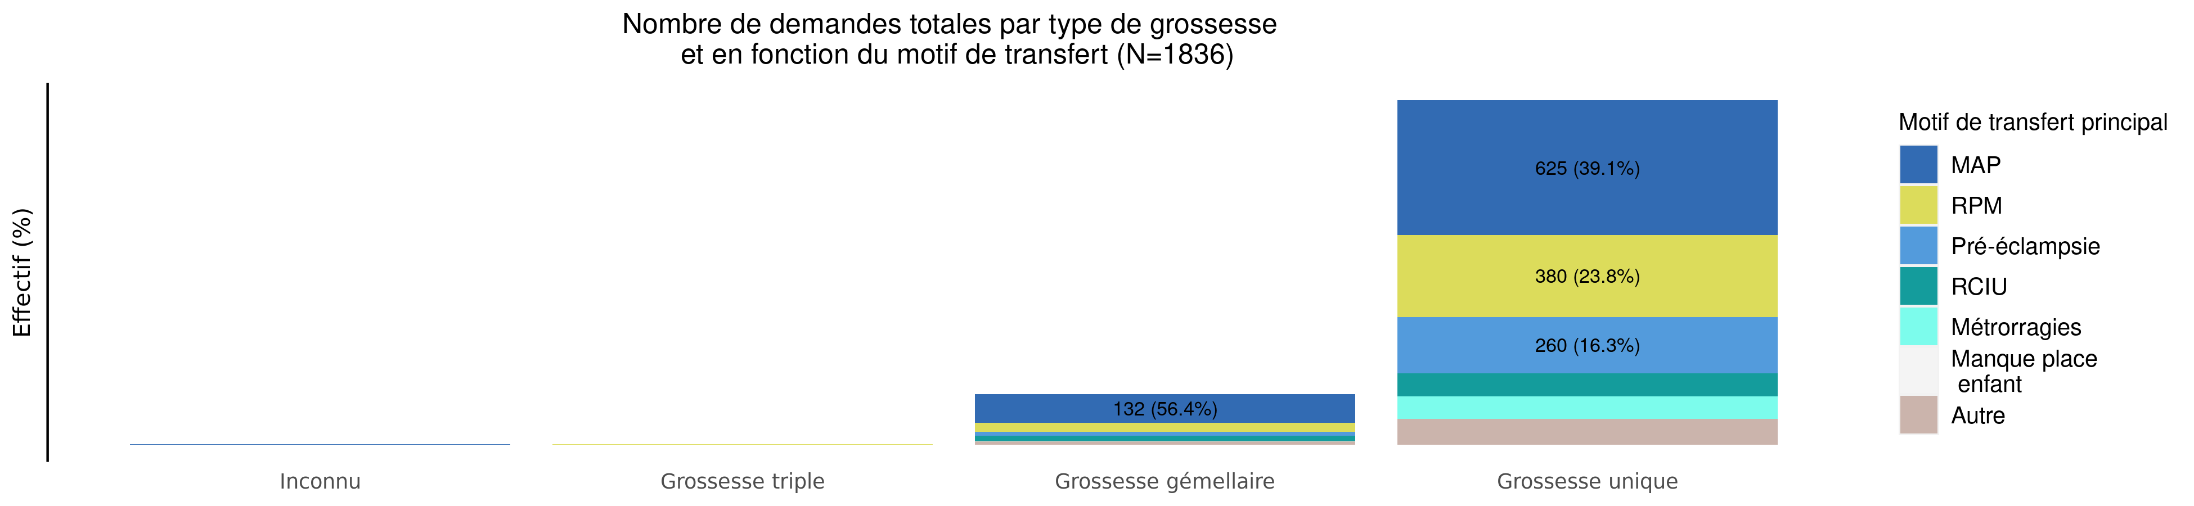
Type de grossesse par motif de transfert en 2024 (Total des transferts)
04/02/2025
Motif | Inconnu | Grossesse triple | Grossesse gémellaire | Grossesse unique | Total
MAP | 2 (0.3%) | 0 (0.0%) | 132 (17.4%) | 625 (82.3%) | 759
RPM | 0 (0.0%) | 2 (0.5%) | 42 (9.9%) | 380 (89.6%) | 424
Pré-éclampsie | 0 (0.0%) | 1 (0.4%) | 19 (6.8%) | 260 (92.9%) | 280
RCIU | 0 (0.0%) | 0 (0.0%) | 23 (17.6%) | 108 (82.4%) | 131
Métrorragies | 0 (0.0%) | 0 (0.0%) | 3 (2.8%) | 104 (97.2%) | 107
Manque place mère | 0 (0.0%) | 0 (0.0%) | 0 (0.0%) | 0 (0.0%) | 0
Manque place enfant | 0 (0.0%) | 0 (0.0%) | 0 (0.0%) | 1 (100.0%) | 1
HPP | 0 (0.0%) | 0 (0.0%) | 0 (0.0%) | 0 (0.0%) | 0
Autre | 0 (0.0%) | 0 (0.0%) | 15 (11.2%) | 119 (88.8%) | 134
Inconnu | 0 (0.0%) | 0 (0.0%) | 0 (0.0%) | 0 (0.0%) | 0
Total | 2 (0.1%) | 3 (0.2%) | 234 (12.7%) | 1597 (87.0%) | 1836

Slide 19
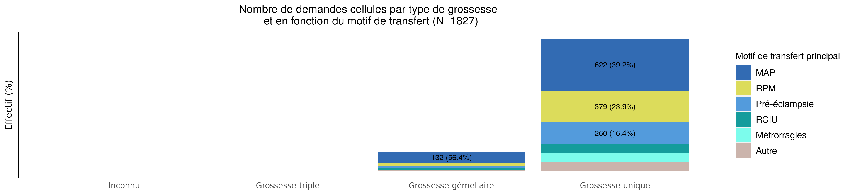
Type de grossesse par motif de transfert en 2024 (Transferts cellule)
04/02/2025
Motif | Inconnu | Grossesse triple | Grossesse gémellaire | Grossesse unique | Total
MAP | 2 (0.3%) | 0 (0.0%) | 132 (17.5%) | 622 (82.3%) | 756
RPM | 0 (0.0%) | 2 (0.5%) | 42 (9.9%) | 379 (89.6%) | 423
Pré-éclampsie | 0 (0.0%) | 1 (0.4%) | 19 (6.8%) | 260 (92.9%) | 280
RCIU | 0 (0.0%) | 0 (0.0%) | 23 (17.7%) | 107 (82.3%) | 130
Métrorragies | 0 (0.0%) | 0 (0.0%) | 3 (2.8%) | 104 (97.2%) | 107
Manque place mère | 0 (0.0%) | 0 (0.0%) | 0 (0.0%) | 0 (0.0%) | 0
Manque place enfant | 0 (0.0%) | 0 (0.0%) | 0 (0.0%) | 0 (0.0%) | 0
HPP | 0 (0.0%) | 0 (0.0%) | 0 (0.0%) | 0 (0.0%) | 0
Autre | 0 (0.0%) | 0 (0.0%) | 15 (11.5%) | 116 (88.5%) | 131
Inconnu | 0 (0.0%) | 0 (0.0%) | 0 (0.0%) | 0 (0.0%) | 0
Total | 2 (0.1%) | 3 (0.2%) | 234 (12.8%) | 1588 (86.9%) | 1827

Slide 20
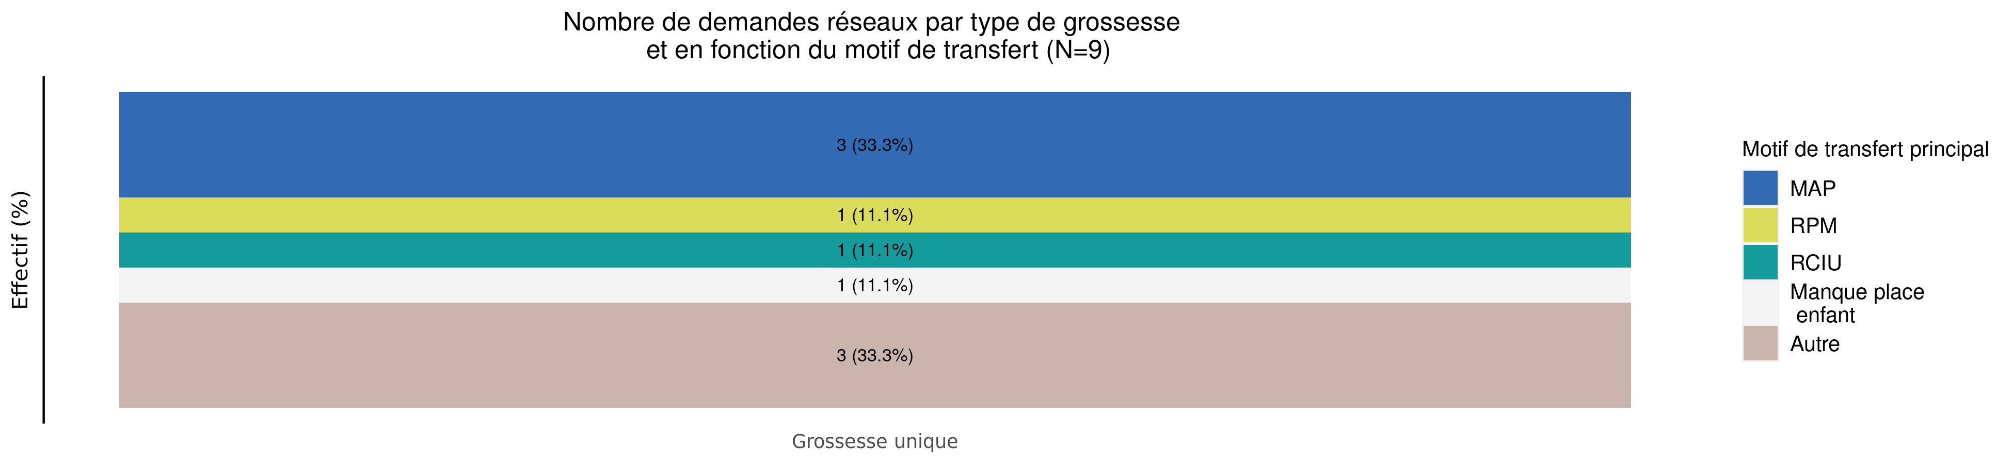
Type de grossesse par motif de transfert en 2024 (Transferts réseaux)
04/02/2025
Motif | Grossesse unique | Total
MAP | 3 (100%) | 3
RPM | 1 (100%) | 1
Pré-éclampsie | 0 (0.0%) | 0
RCIU | 1 (100%) | 1
Métrorragies | 0 (0.0%) | 0
Manque place mère | 0 (0.0%) | 0
Manque place enfant | 1 (100%) | 1
HPP | 0 (0.0%) | 0
Autre | 3 (100%) | 3
Inconnu | 0 (0.0%) | 0
Total | 9 (100%) | 9

Slide 21
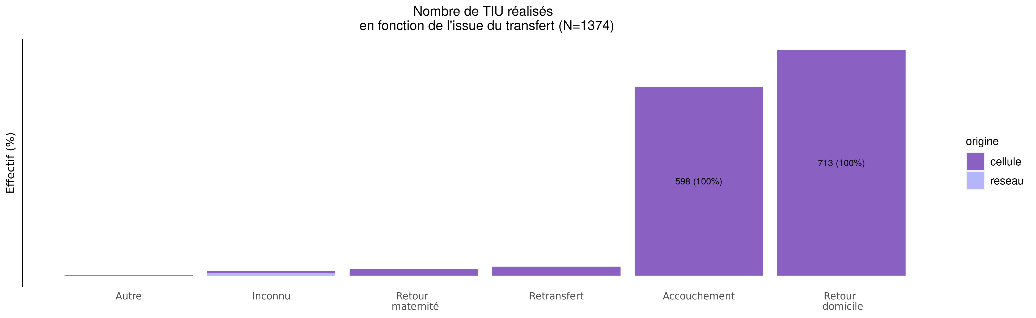
issue des transferts réalisés en 2024
04/02/2025
origine | Autre | Inconnu | Retour maternité | Retransfert | Accouchement | Retour domicile | Total
cellule | 1 (0.1%) | 5 (0.4%) | 20 (1.5%) | 28 (2.1%) | 598 (43.8%) | 713 (52.2%) | 1365
reseau | 0 (0.0%) | 9 (100.0%) | 0 (0.0%) | 0 (0.0%) | 0 (0.0%) | 0 (0.0%) | 9
Total | 1 (0.1%) | 14 (1.0%) | 20 (1.5%) | 28 (2.0%) | 598 (43.5%) | 713 (51.9%) | 1374

Slide 22
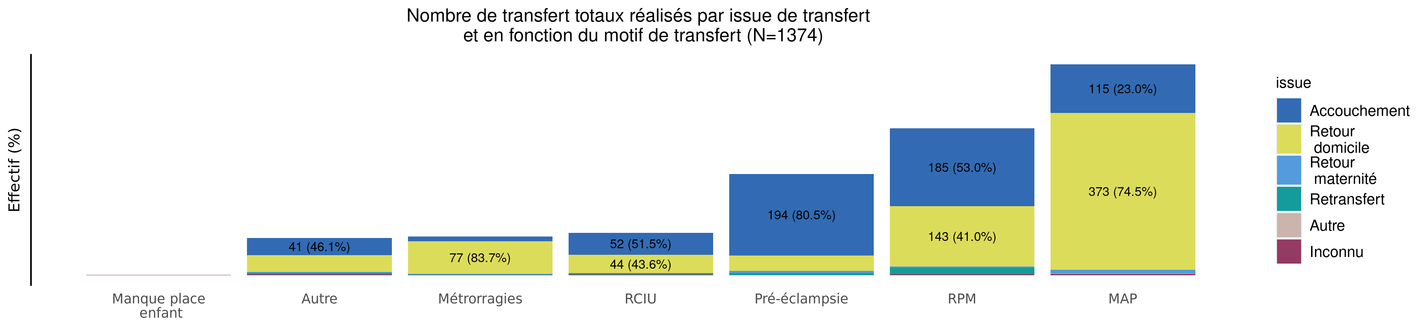
Issue de transfert réalisé selon le motif de TIU en 2024 (Total des transferts)
04/02/2025
issue | Manque place enfant | Autre | Métrorragies | RCIU | Pré-éclampsie | RPM | MAP | Total
Accouchement | 0 (0.0%) | 41 (6.9%) | 11 (1.8%) | 52 (8.7%) | 194 (32.4%) | 185 (30.9%) | 115 (19.2%) | 598
Retour domicile | 0 (0.0%) | 40 (5.6%) | 77 (10.8%) | 44 (6.2%) | 36 (5.0%) | 143 (20.1%) | 373 (52.3%) | 713
Retour maternité | 0 (0.0%) | 2 (10.0%) | 2 (10.0%) | 0 (0.0%) | 6 (30.0%) | 3 (15.0%) | 7 (35.0%) | 20
Retransfert | 0 (0.0%) | 3 (10.7%) | 1 (3.6%) | 3 (10.7%) | 5 (17.9%) | 15 (53.6%) | 1 (3.6%) | 28
Autre | 0 (0.0%) | 0 (0.0%) | 0 (0.0%) | 0 (0.0%) | 0 (0.0%) | 0 (0.0%) | 1 (100.0%) | 1
Inconnu | 1 (7.1%) | 3 (21.4%) | 1 (7.1%) | 2 (14.3%) | 0 (0.0%) | 3 (21.4%) | 4 (28.6%) | 14
Total | 1 (0.1%) | 89 (6.5%) | 92 (6.7%) | 101 (7.4%) | 241 (17.5%) | 349 (25.4%) | 501 (36.5%) | 1374

Slide 23
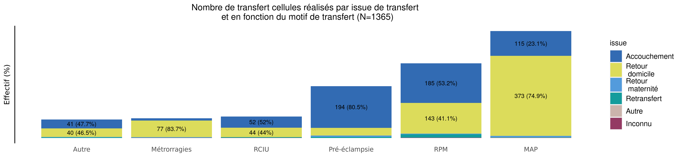
Issue de transfert réalisé selon le motif de TIU en 2024 (Transferts cellule)
04/02/2025
issue | Autre | Métrorragies | RCIU | Pré-éclampsie | RPM | MAP | Total
Accouchement | 41 (6.9%) | 11 (1.8%) | 52 (8.7%) | 194 (32.4%) | 185 (30.9%) | 115 (19.2%) | 598
Retour domicile | 40 (5.6%) | 77 (10.8%) | 44 (6.2%) | 36 (5.0%) | 143 (20.1%) | 373 (52.3%) | 713
Retour maternité | 2 (10.0%) | 2 (10.0%) | 0 (0.0%) | 6 (30.0%) | 3 (15.0%) | 7 (35.0%) | 20
Retransfert | 3 (10.7%) | 1 (3.6%) | 3 (10.7%) | 5 (17.9%) | 15 (53.6%) | 1 (3.6%) | 28
Autre | 0 (0.0%) | 0 (0.0%) | 0 (0.0%) | 0 (0.0%) | 0 (0.0%) | 1 (100.0%) | 1
Inconnu | 0 (0.0%) | 1 (20.0%) | 1 (20.0%) | 0 (0.0%) | 2 (40.0%) | 1 (20.0%) | 5
Total | 86 (6.3%) | 92 (6.7%) | 100 (7.3%) | 241 (17.7%) | 348 (25.5%) | 498 (36.5%) | 1365

Slide 24
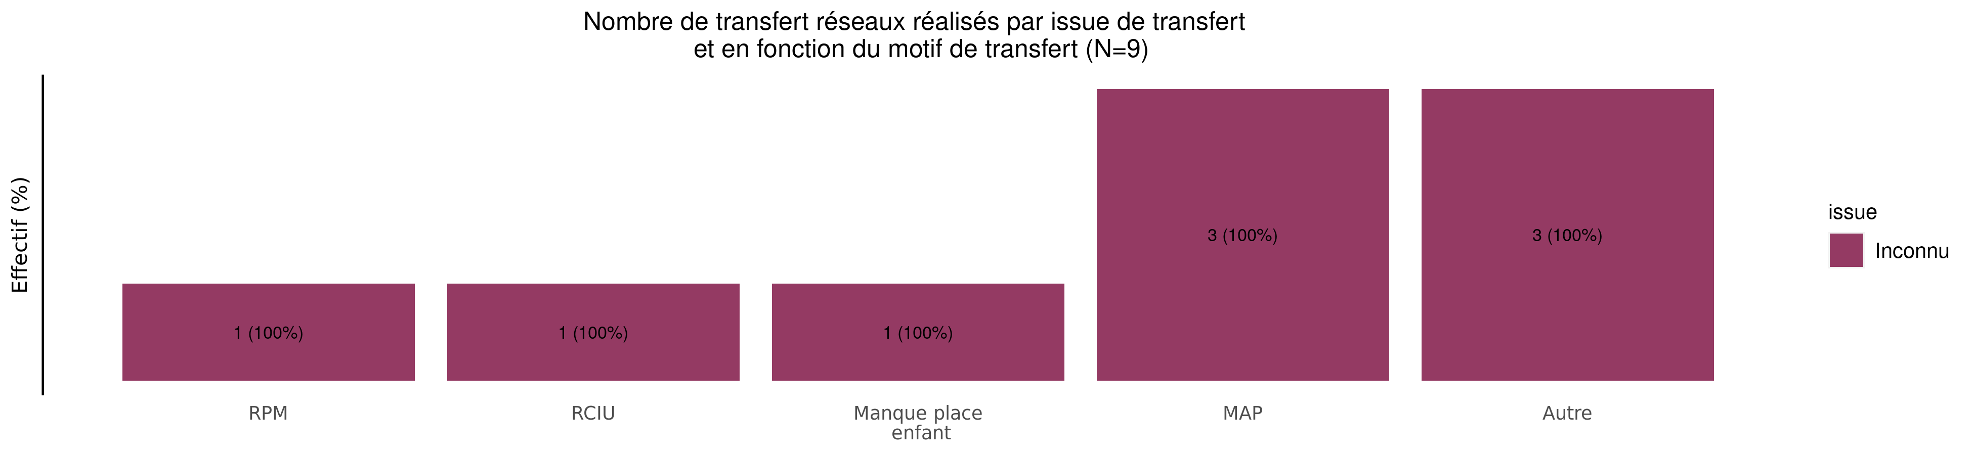
Issue de transfert réalisé selon le motif de TIU en 2024 (Transferts réseaux)
04/02/2025
issue | RPM | RCIU | Manque place enfant | MAP | Autre | Total
Accouchement | 0 (0.0%) | 0 (0.0%) | 0 (0.0%) | 0 (0.0%) | 0 (0.0%) | 0
Retour domicile | 0 (0.0%) | 0 (0.0%) | 0 (0.0%) | 0 (0.0%) | 0 (0.0%) | 0
Retour maternité | 0 (0.0%) | 0 (0.0%) | 0 (0.0%) | 0 (0.0%) | 0 (0.0%) | 0
Retransfert | 0 (0.0%) | 0 (0.0%) | 0 (0.0%) | 0 (0.0%) | 0 (0.0%) | 0
Autre | 0 (0.0%) | 0 (0.0%) | 0 (0.0%) | 0 (0.0%) | 0 (0.0%) | 0
Inconnu | 1 (11.1%) | 1 (11.1%) | 1 (11.1%) | 3 (33.3%) | 3 (33.3%) | 9
Total | 1 (11.1%) | 1 (11.1%) | 1 (11.1%) | 3 (33.3%) | 3 (33.3%) | 9

Slide 25
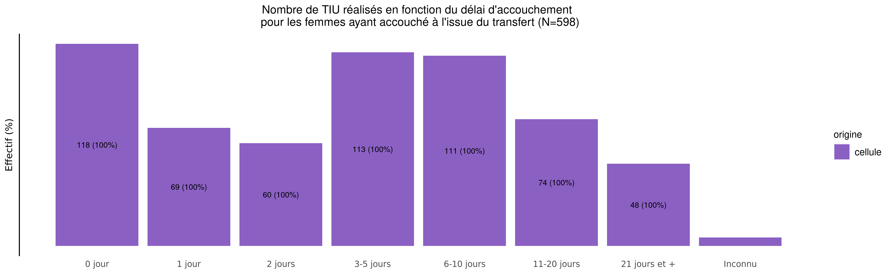
Délai d'accouchement des TIU réalisés en 2024
04/02/2025
origine | 0 jour | 1 jour | 2 jours | 3-5 jours | 6-10 jours | 11-20 jours | 21 jours et + | Inconnu | Total
cellule | 118 (19.7%) | 69 (11.5%) | 60 (10%) | 113 (18.9%) | 111 (18.6%) | 74 (12.4%) | 48 (8%) | 5 (0.8%) | 598
Total | 118 (19.7%) | 69 (11.5%) | 60 (10%) | 113 (18.9%) | 111 (18.6%) | 74 (12.4%) | 48 (8%) | 5 (0.8%) | 598

Slide 26
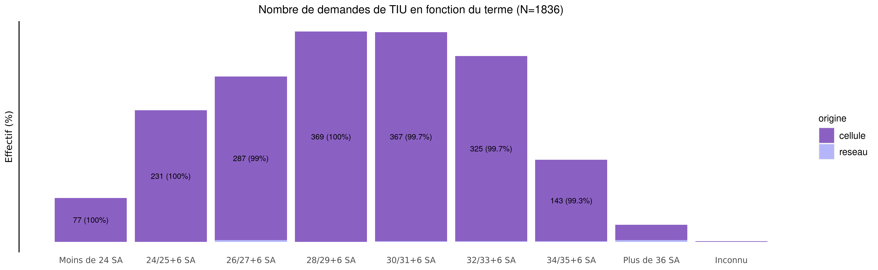
Termes des demandes de transfert en 2024
04/02/2025
origine | Moins de 24 SA | 24/25+6 SA | 26/27+6 SA | 28/29+6 SA | 30/31+6 SA | 32/33+6 SA | 34/35+6 SA | Plus de 36 SA | Inconnu | Total
cellule | 77 (4.2%) | 231 (12.6%) | 287 (15.7%) | 369 (20.2%) | 367 (20.1%) | 325 (17.8%) | 143 (7.8%) | 27 (1.5%) | 1 (0.1%) | 1827
reseau | 0 (0.0%) | 0 (0.0%) | 3 (33.3%) | 0 (0.0%) | 1 (11.1%) | 1 (11.1%) | 1 (11.1%) | 3 (33.3%) | 0 (0.0%) | 9
Total | 77 (4.2%) | 231 (12.6%) | 290 (15.8%) | 369 (20.1%) | 368 (20.0%) | 326 (17.8%) | 144 (7.8%) | 30 (1.6%) | 1 (0.1%) | 1836

Slide 27
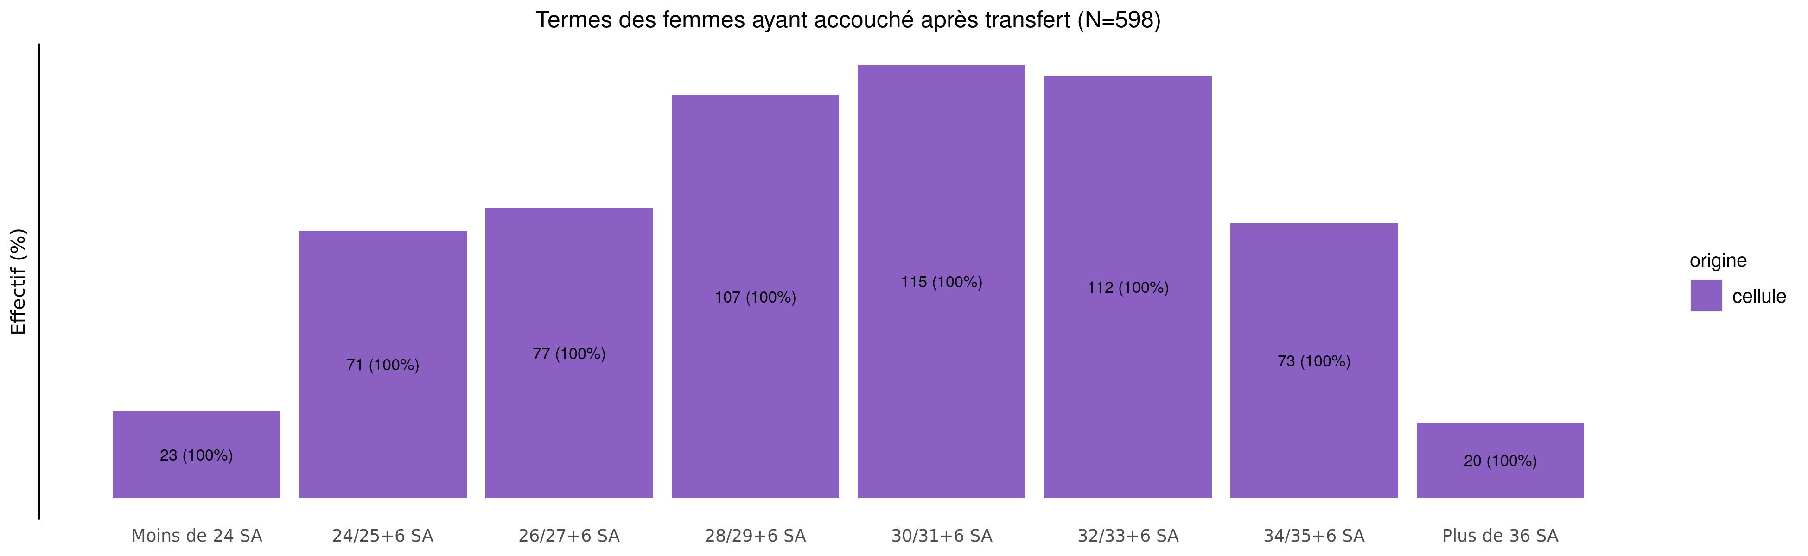
Les accouchements suite à TIU en 2024 - terme
04/02/2025
origine | Moins de 24 SA | 24/25+6 SA | 26/27+6 SA | 28/29+6 SA | 30/31+6 SA | 32/33+6 SA | 34/35+6 SA | Plus de 36 SA | Inconnu | Total
cellule | 23 (3.8%) | 71 (11.9%) | 77 (12.9%) | 107 (17.9%) | 115 (19.2%) | 112 (18.7%) | 73 (12.2%) | 20 (3.3%) | 0 (0%) | 598
Total | 23 (3.8%) | 71 (11.9%) | 77 (12.9%) | 107 (17.9%) | 115 (19.2%) | 112 (18.7%) | 73 (12.2%) | 20 (3.3%) | 0 (0%) | 598

Slide 28
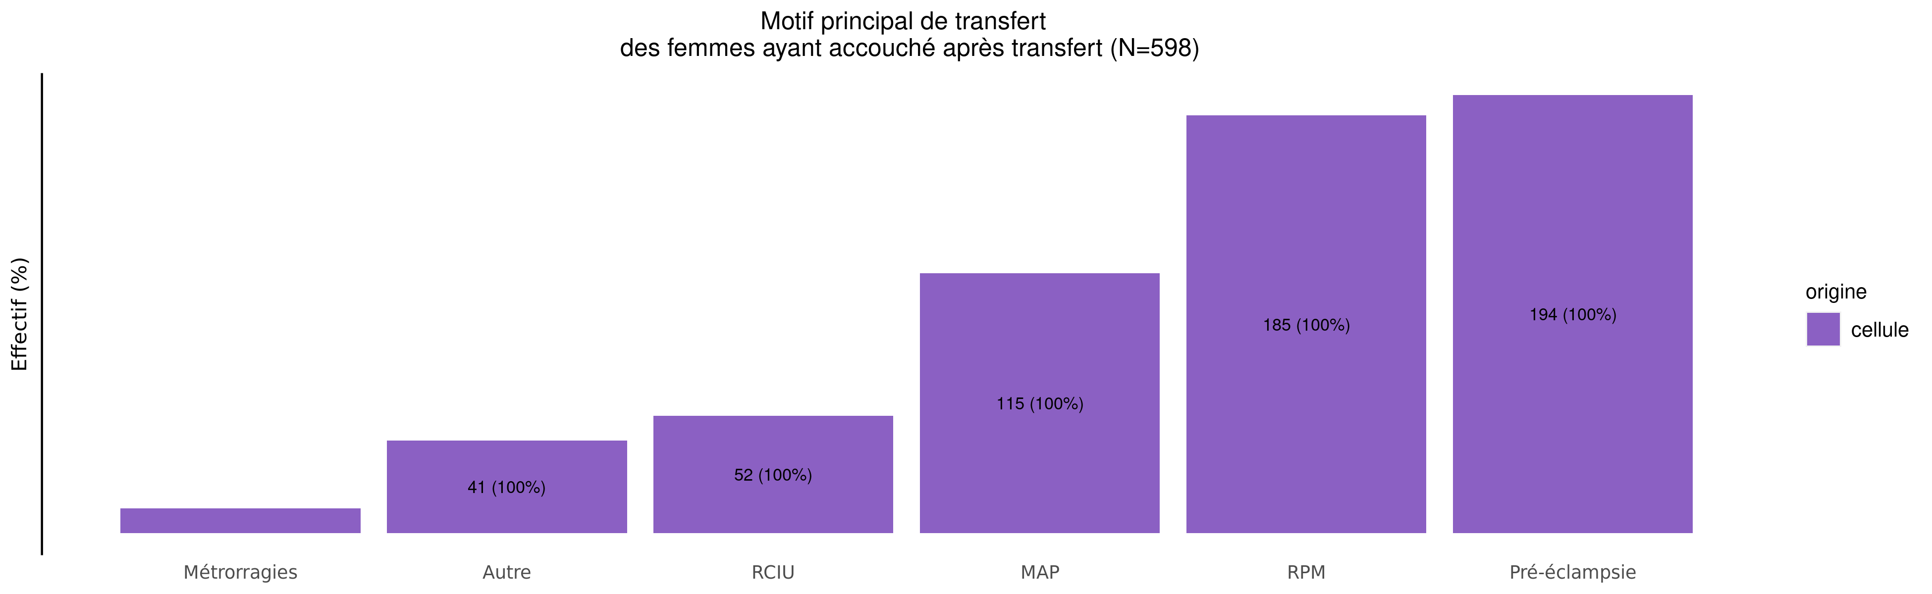
Les accouchements suite à TIU en 2024 - motif de transfert
04/02/2025
origine | MAP | RPM | Pré-éclampsie | RCIU | Métrorragies | Manque place mère | Manque place enfant | HPP | Autre | Inconnu | Total
cellule | 115 (19.2%) | 185 (30.9%) | 194 (32.4%) | 52 (8.7%) | 11 (1.8%) | 0 (0%) | 0 (0%) | 0 (0%) | 41 (6.9%) | 0 (0%) | 598
Total | 115 (19.2%) | 185 (30.9%) | 194 (32.4%) | 52 (8.7%) | 11 (1.8%) | 0 (0%) | 0 (0%) | 0 (0%) | 41 (6.9%) | 0 (0%) | 598

Slide 29
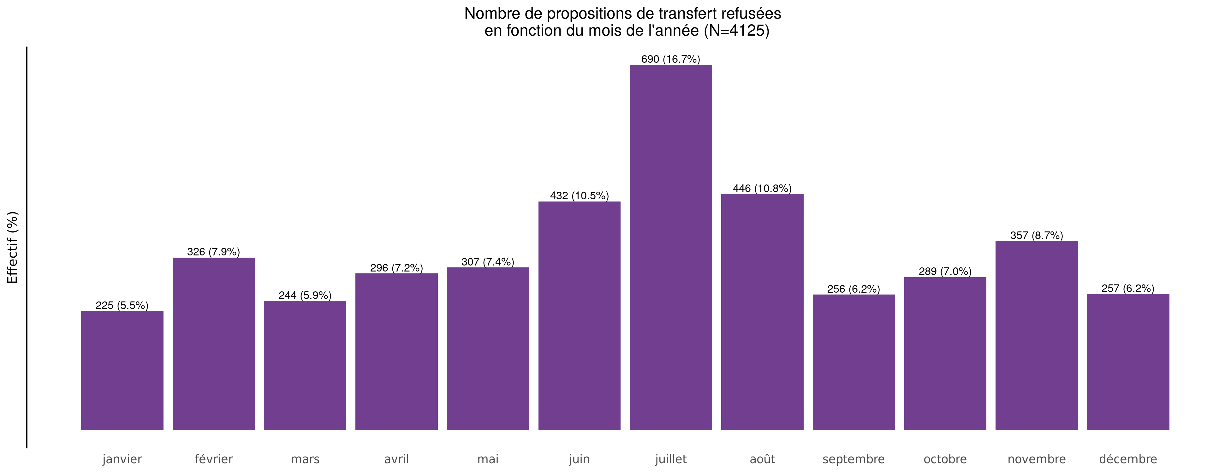
Nombre de propositions de transfert refusées en 2024
04/02/2025

Slide 30
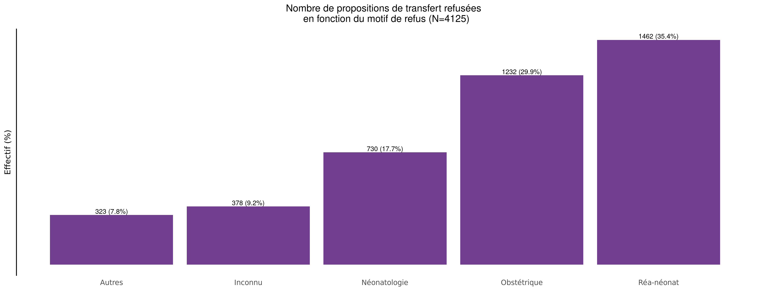
Motif des propositions de transfert refusées en 2024
04/02/2025

Slide 31
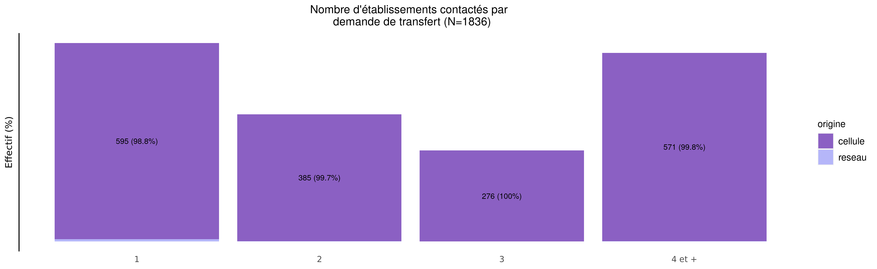
Nombre d'établissements contactés par demande en 2024
04/02/2025
origine | 1 | 2 | 3 | 4 et + | Total
cellule | 595 (32.6%) | 385 (21.1%) | 276 (15.1%) | 571 (31.3%) | 1827
reseau | 7 (77.8%) | 1 (11.1%) | 0 (0.0%) | 1 (11.1%) | 9
Total | 602 (32.8%) | 386 (21.0%) | 276 (15.0%) | 572 (31.2%) | 1836

Slide 32
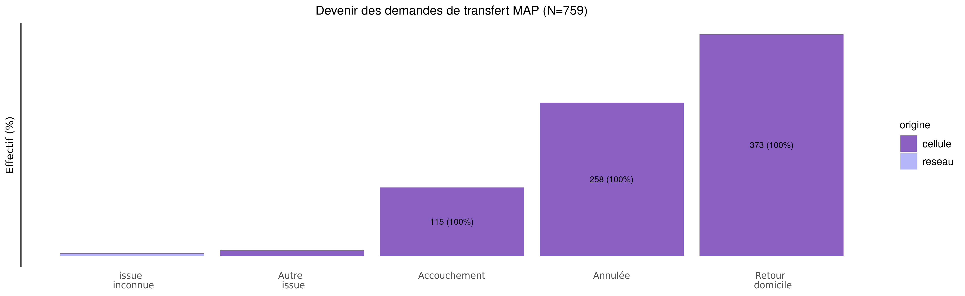
Devenir des demandes de MAP en 2024
04/02/2025
origine | issue inconnue | Autre issue | Accouchement | Annulée | Retour domicile | Total
cellule | 1 (0.1%) | 9 (1.2%) | 115 (15.2%) | 258 (34.1%) | 373 (49.3%) | 756
reseau | 3 (100.0%) | 0 (0.0%) | 0 (0.0%) | 0 (0.0%) | 0 (0.0%) | 3
Total | 4 (0.5%) | 9 (1.2%) | 115 (15.2%) | 258 (34.0%) | 373 (49.1%) | 759

Slide 33
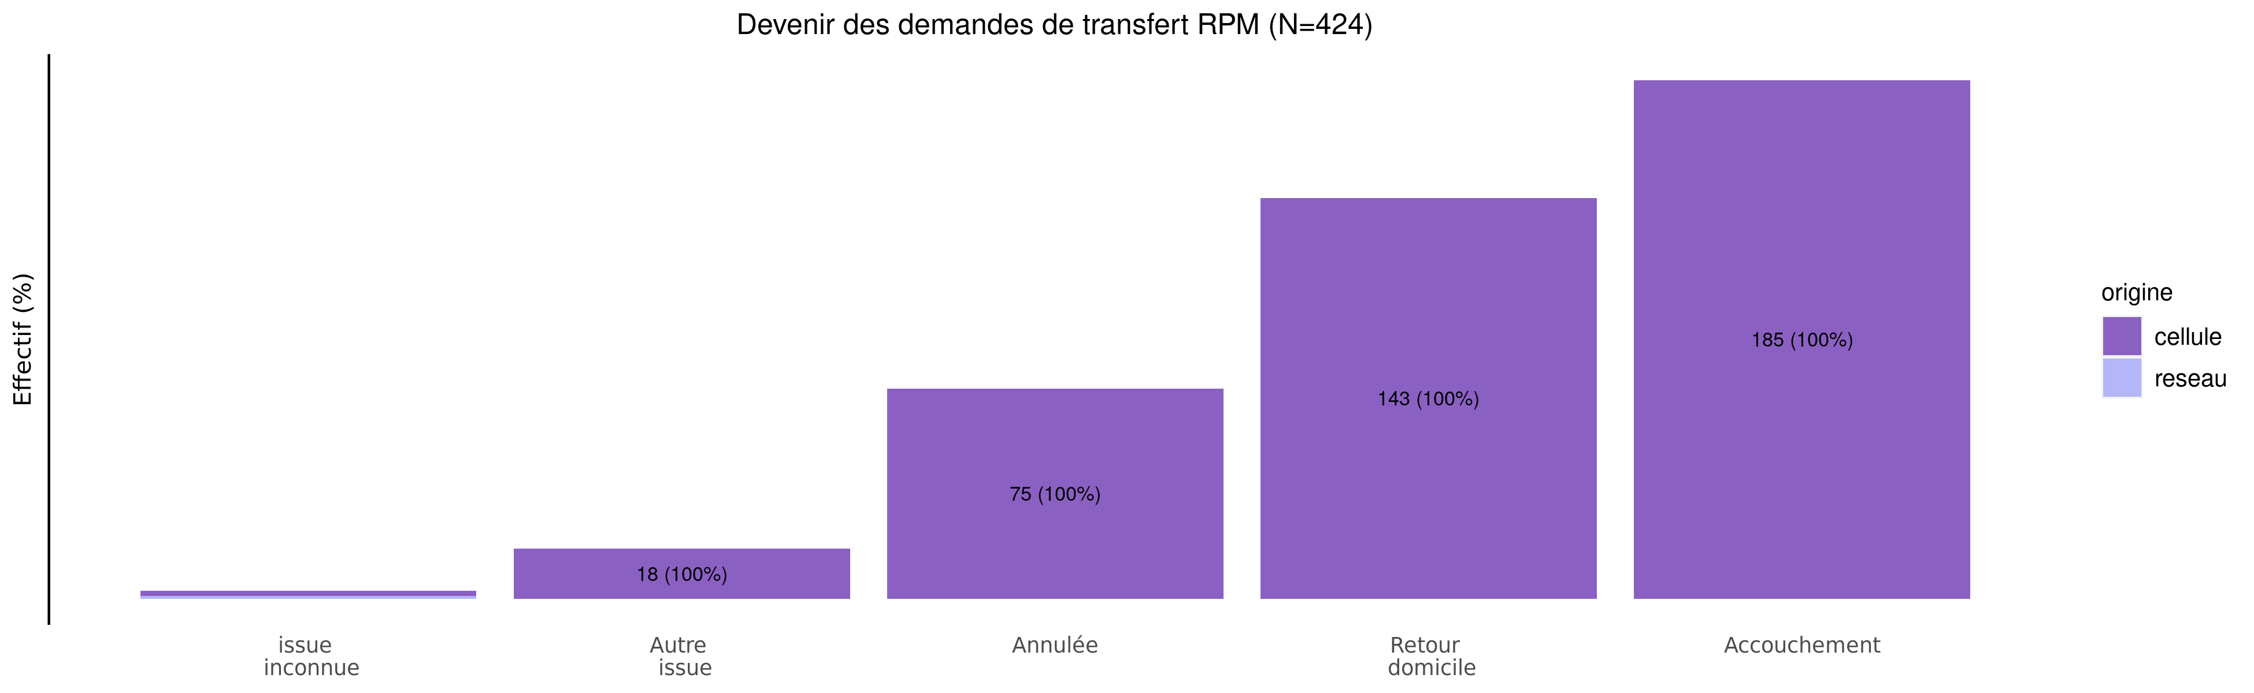
Devenir des demandes de RPM en 2024
04/02/2025
origine | issue inconnue | Autre issue | Annulée | Retour domicile | Accouchement | Total
cellule | 2 (0.5%) | 18 (4.3%) | 75 (17.7%) | 143 (33.8%) | 185 (43.7%) | 423
reseau | 1 (100.0%) | 0 (0.0%) | 0 (0.0%) | 0 (0.0%) | 0 (0.0%) | 1
Total | 3 (0.7%) | 18 (4.2%) | 75 (17.7%) | 143 (33.7%) | 185 (43.6%) | 424

