Slide 1
Île de France
Lundi 4 Mars 2024

Slide 2
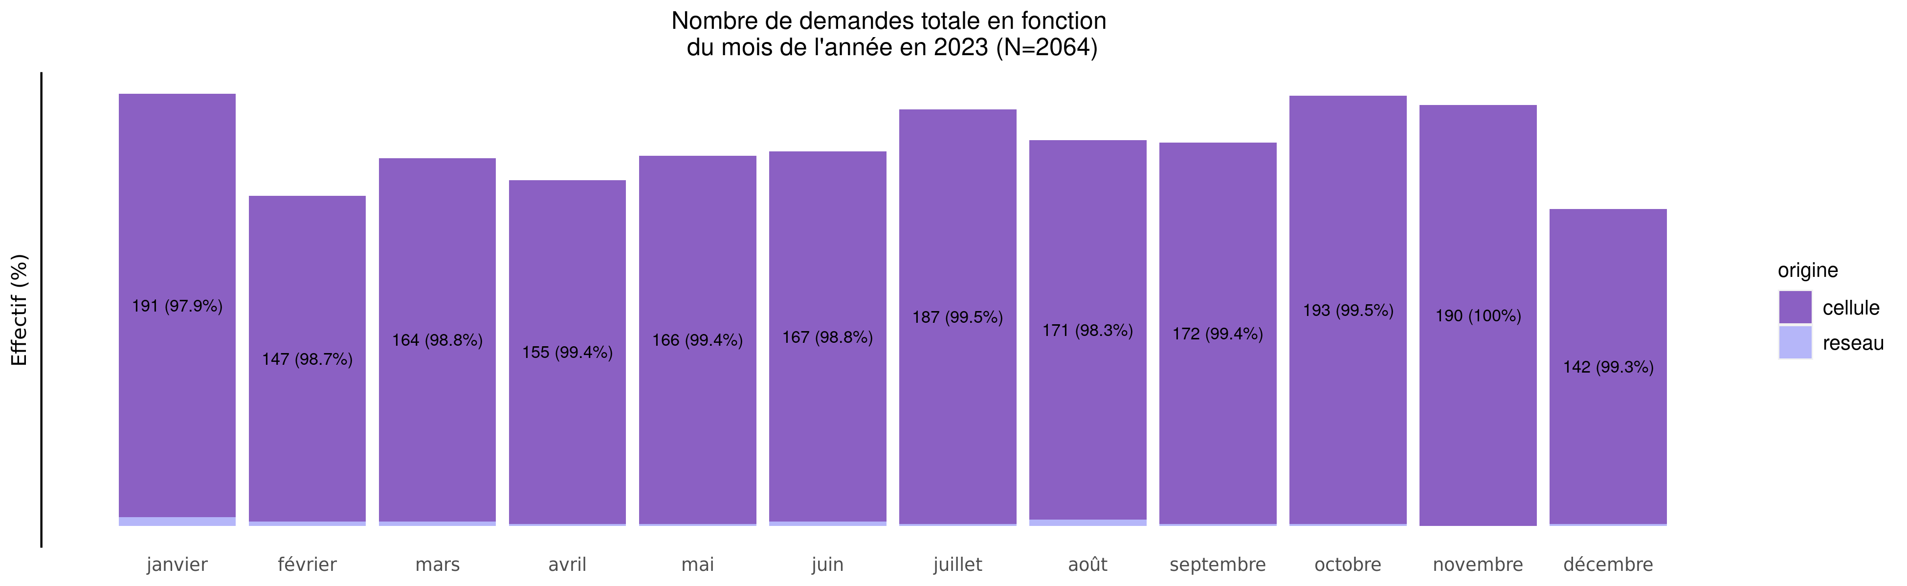
Nombre de demandes de TIU en 2023
04/03/2024
origine | janvier | février | mars | avril | mai | juin | juillet | août | septembre | octobre | novembre | décembre | Total
cellule | 191 (9.3%) | 147 (7.2%) | 164 (8.0%) | 155 (7.6%) | 166 (8.1%) | 167 (8.2%) | 187 (9.1%) | 171 (8.4%) | 172 (8.4%) | 193 (9.4%) | 190 (9.3%) | 142 (6.9%) | 2045
reseau | 4 (21.1%) | 2 (10.5%) | 2 (10.5%) | 1 (5.3%) | 1 (5.3%) | 2 (10.5%) | 1 (5.3%) | 3 (15.8%) | 1 (5.3%) | 1 (5.3%) | 0 (0.0%) | 1 (5.3%) | 19
Total | 195 (9.4%) | 149 (7.2%) | 166 (8.0%) | 156 (7.6%) | 167 (8.1%) | 169 (8.2%) | 188 (9.1%) | 174 (8.4%) | 173 (8.4%) | 194 (9.4%) | 190 (9.2%) | 143 (6.9%) | 2064

Slide 3
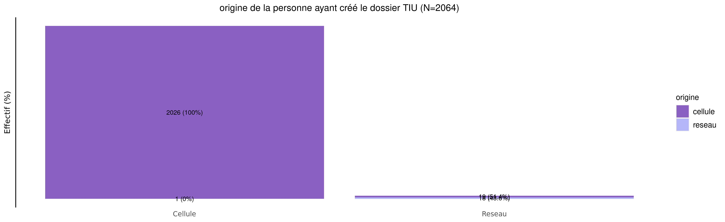
origine des demandes de TIU en 2023
04/03/2024
origine | Cellule | Reseau | Total
cellule | 2026 (99.1%) | 19 (0.9%) | 2045
reseau | 1 (5.3%) | 18 (94.7%) | 19
Total | 2027 (98.2%) | 37 (1.8%) | 2064

Slide 4
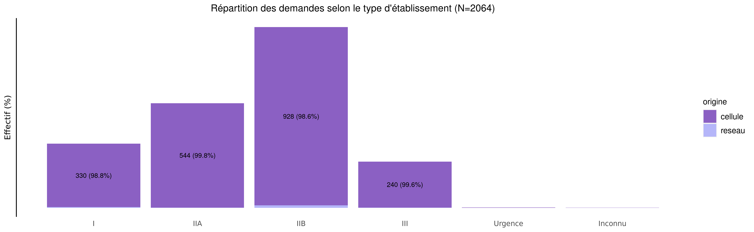
TIU par type d'établissement demandeur en 2023
04/03/2024
origine | I | IIA | IIB | III | Urgence | Inconnu | Total
cellule | 330 (16.1%) | 544 (26.6%) | 928 (45.4%) | 240 (11.7%) | 2 (0.1%) | 1 (0%) | 2045
reseau | 4 (21.1%) | 1 (5.3%) | 13 (68.4%) | 1 (5.3%) | 0 (0.0%) | 0 (0%) | 19
Total | 334 (16.2%) | 545 (26.4%) | 941 (45.6%) | 241 (11.7%) | 2 (0.1%) | 1 (0%) | 2064

Slide 5
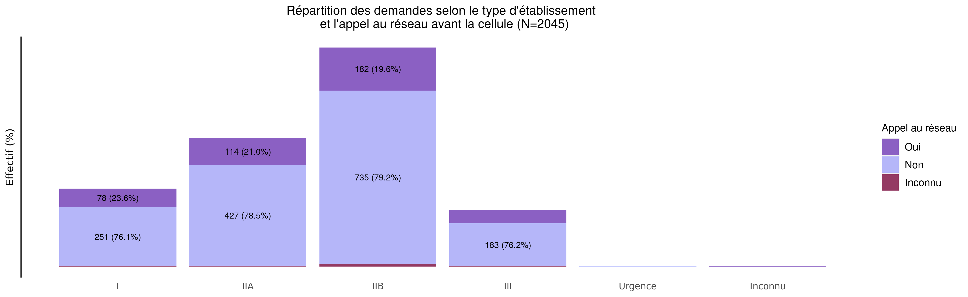
L'établissement a-t-il appelé le réseau avant la cellule?
04/03/2024
Appel | I | IIA | IIB | III | Urgence | Inconnu | Total
Oui | 78 (18.1%) | 114 (26.4%) | 182 (42.1%) | 56 (13.0%) | 1 (0.2%) | 1 (0.2%) | 432
Non | 251 (15.7%) | 427 (26.7%) | 735 (46.0%) | 183 (11.5%) | 1 (0.1%) | 0 (0.0%) | 1597
Inconnu | 1 (6.2%) | 3 (18.8%) | 11 (68.8%) | 1 (6.2%) | 0 (0.0%) | 0 (0.0%) | 16
Total | 330 (16.1%) | 544 (26.6%) | 928 (45.4%) | 240 (11.7%) | 2 (0.1%) | 1 (0.0%) | 2045

Slide 6
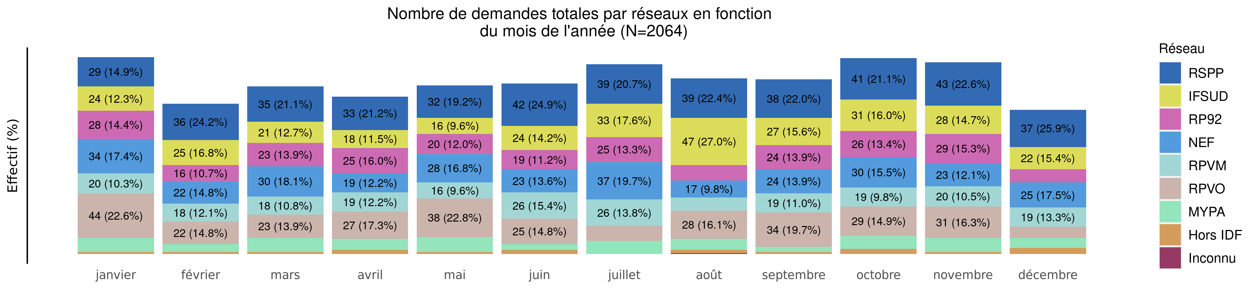
Nombre de demandes de TIU par réseau en 2023 (Total des transferts)
04/03/2024
Reseau | janvier | février | mars | avril | mai | juin | juillet | août | septembre | octobre | novembre | décembre | Total
RSPP | 29 (6.5%) | 36 (8.1%) | 35 (7.9%) | 33 (7.4%) | 32 (7.2%) | 42 (9.5%) | 39 (8.8%) | 39 (8.8%) | 38 (8.6%) | 41 (9.2%) | 43 (9.7%) | 37 (8.3%) | 444
IFSUD | 24 (7.6%) | 25 (7.9%) | 21 (6.6%) | 18 (5.7%) | 16 (5.1%) | 24 (7.6%) | 33 (10.4%) | 47 (14.9%) | 27 (8.5%) | 31 (9.8%) | 28 (8.9%) | 22 (7.0%) | 316
RP92 | 28 (10.6%) | 16 (6.1%) | 23 (8.7%) | 25 (9.5%) | 20 (7.6%) | 19 (7.2%) | 25 (9.5%) | 15 (5.7%) | 24 (9.1%) | 26 (9.9%) | 29 (11.0%) | 13 (4.9%) | 263
NEF | 34 (10.9%) | 22 (7.1%) | 30 (9.6%) | 19 (6.1%) | 28 (9.0%) | 23 (7.4%) | 37 (11.9%) | 17 (5.4%) | 24 (7.7%) | 30 (9.6%) | 23 (7.4%) | 25 (8.0%) | 312
RPVM | 20 (8.6%) | 18 (7.7%) | 18 (7.7%) | 19 (8.2%) | 16 (6.9%) | 26 (11.2%) | 26 (11.2%) | 13 (5.6%) | 19 (8.2%) | 19 (8.2%) | 20 (8.6%) | 19 (8.2%) | 233
RPVO | 44 (13.5%) | 22 (6.7%) | 23 (7.0%) | 27 (8.3%) | 38 (11.6%) | 25 (7.6%) | 15 (4.6%) | 28 (8.6%) | 34 (10.4%) | 29 (8.9%) | 31 (9.5%) | 11 (3.4%) | 327
MYPA | 14 (10.4%) | 8 (6.0%) | 14 (10.4%) | 11 (8.2%) | 15 (11.2%) | 6 (4.5%) | 13 (9.7%) | 11 (8.2%) | 5 (3.7%) | 13 (9.7%) | 14 (10.4%) | 10 (7.5%) | 134
Hors IDF | 2 (5.9%) | 2 (5.9%) | 2 (5.9%) | 4 (11.8%) | 2 (5.9%) | 4 (11.8%) | 0 (0.0%) | 3 (8.8%) | 2 (5.9%) | 5 (14.7%) | 2 (5.9%) | 6 (17.6%) | 34
Inconnu | 0 (0.0%) | 0 (0.0%) | 0 (0.0%) | 0 (0.0%) | 0 (0.0%) | 0 (0.0%) | 0 (0.0%) | 1 (100.0%) | 0 (0.0%) | 0 (0.0%) | 0 (0.0%) | 0 (0.0%) | 1
Total | 195 (9.4%) | 149 (7.2%) | 166 (8.0%) | 156 (7.6%) | 167 (8.1%) | 169 (8.2%) | 188 (9.1%) | 174 (8.4%) | 173 (8.4%) | 194 (9.4%) | 190 (9.2%) | 143 (6.9%) | 2064

Slide 7
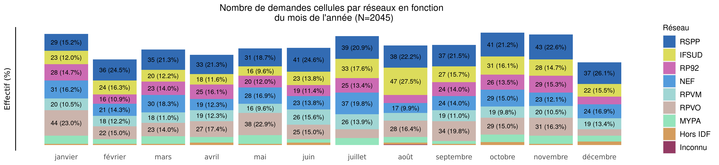
Nombre de demandes de TIU par réseau en 2023 (Transferts cellule)
04/03/2024
Variable | janvier | février | mars | avril | mai | juin | juillet | août | septembre | octobre | novembre | décembre | Total
RSPP | 29 (6.6%) | 36 (8.2%) | 35 (8.0%) | 33 (7.5%) | 31 (7.0%) | 41 (9.3%) | 39 (8.9%) | 38 (8.6%) | 37 (8.4%) | 41 (9.3%) | 43 (9.8%) | 37 (8.4%) | 440
IFSUD | 23 (7.4%) | 24 (7.7%) | 20 (6.4%) | 18 (5.8%) | 16 (5.1%) | 23 (7.4%) | 33 (10.6%) | 47 (15.1%) | 27 (8.7%) | 31 (9.9%) | 28 (9.0%) | 22 (7.1%) | 312
RP92 | 28 (10.7%) | 16 (6.1%) | 23 (8.8%) | 25 (9.5%) | 20 (7.6%) | 19 (7.3%) | 25 (9.5%) | 14 (5.3%) | 24 (9.2%) | 26 (9.9%) | 29 (11.1%) | 13 (5.0%) | 262
NEF | 31 (10.1%) | 21 (6.9%) | 30 (9.8%) | 19 (6.2%) | 28 (9.2%) | 23 (7.5%) | 37 (12.1%) | 17 (5.6%) | 24 (7.8%) | 29 (9.5%) | 23 (7.5%) | 24 (7.8%) | 306
RPVM | 20 (8.6%) | 18 (7.7%) | 18 (7.7%) | 19 (8.2%) | 16 (6.9%) | 26 (11.2%) | 26 (11.2%) | 13 (5.6%) | 19 (8.2%) | 19 (8.2%) | 20 (8.6%) | 19 (8.2%) | 233
RPVO | 44 (13.5%) | 22 (6.7%) | 23 (7.0%) | 27 (8.3%) | 38 (11.6%) | 25 (7.6%) | 15 (4.6%) | 28 (8.6%) | 34 (10.4%) | 29 (8.9%) | 31 (9.5%) | 11 (3.4%) | 327
MYPA | 14 (10.8%) | 8 (6.2%) | 13 (10.0%) | 10 (7.7%) | 15 (11.5%) | 6 (4.6%) | 12 (9.2%) | 10 (7.7%) | 5 (3.8%) | 13 (10.0%) | 14 (10.8%) | 10 (7.7%) | 130
Hors IDF | 2 (5.9%) | 2 (5.9%) | 2 (5.9%) | 4 (11.8%) | 2 (5.9%) | 4 (11.8%) | 0 (0.0%) | 3 (8.8%) | 2 (5.9%) | 5 (14.7%) | 2 (5.9%) | 6 (17.6%) | 34
Inconnu | 0 (0.0%) | 0 (0.0%) | 0 (0.0%) | 0 (0.0%) | 0 (0.0%) | 0 (0.0%) | 0 (0.0%) | 1 (100.0%) | 0 (0.0%) | 0 (0.0%) | 0 (0.0%) | 0 (0.0%) | 1
Total | 191 (9.3%) | 147 (7.2%) | 164 (8.0%) | 155 (7.6%) | 166 (8.1%) | 167 (8.2%) | 187 (9.1%) | 171 (8.4%) | 172 (8.4%) | 193 (9.4%) | 190 (9.3%) | 142 (6.9%) | 2045

Slide 8
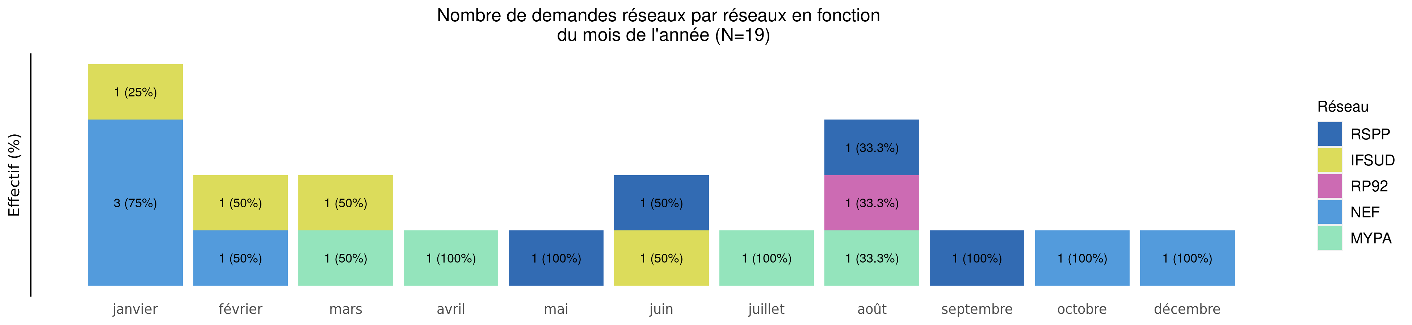
Nombre de demandes de TIU par réseau en 2023 (Transferts réseaux)
04/03/2024
Reseau | janvier | février | mars | avril | mai | juin | juillet | août | septembre | octobre | novembre | décembre | Total
RSPP | 0 (0.0%) | 0 (0.0%) | 0 (0.0%) | 0 (0.0%) | 1 (25.0%) | 1 (25.0%) | 0 (0.0%) | 1 (25.0%) | 1 (25.0%) | 0 (0.0%) | 0 (0%) | 0 (0.0%) | 4
IFSUD | 1 (25.0%) | 1 (25.0%) | 1 (25.0%) | 0 (0.0%) | 0 (0.0%) | 1 (25.0%) | 0 (0.0%) | 0 (0.0%) | 0 (0.0%) | 0 (0.0%) | 0 (0%) | 0 (0.0%) | 4
RP92 | 0 (0.0%) | 0 (0.0%) | 0 (0.0%) | 0 (0.0%) | 0 (0.0%) | 0 (0.0%) | 0 (0.0%) | 1 (100.0%) | 0 (0.0%) | 0 (0.0%) | 0 (0%) | 0 (0.0%) | 1
NEF | 3 (50.0%) | 1 (16.7%) | 0 (0.0%) | 0 (0.0%) | 0 (0.0%) | 0 (0.0%) | 0 (0.0%) | 0 (0.0%) | 0 (0.0%) | 1 (16.7%) | 0 (0%) | 1 (16.7%) | 6
RPVM | 0 (0.0%) | 0 (0.0%) | 0 (0.0%) | 0 (0.0%) | 0 (0.0%) | 0 (0.0%) | 0 (0.0%) | 0 (0.0%) | 0 (0.0%) | 0 (0.0%) | 0 (0.0%) | 0 (0.0%) | 0
RPVO | 0 (0.0%) | 0 (0.0%) | 0 (0.0%) | 0 (0.0%) | 0 (0.0%) | 0 (0.0%) | 0 (0.0%) | 0 (0.0%) | 0 (0.0%) | 0 (0.0%) | 0 (0.0%) | 0 (0.0%) | 0
MYPA | 0 (0.0%) | 0 (0.0%) | 1 (25.0%) | 1 (25.0%) | 0 (0.0%) | 0 (0.0%) | 1 (25.0%) | 1 (25.0%) | 0 (0.0%) | 0 (0.0%) | 0 (0%) | 0 (0.0%) | 4
Hors IDF | 0 (0.0%) | 0 (0.0%) | 0 (0.0%) | 0 (0.0%) | 0 (0.0%) | 0 (0.0%) | 0 (0.0%) | 0 (0.0%) | 0 (0.0%) | 0 (0.0%) | 0 (0.0%) | 0 (0.0%) | 0
Inconnu | 0 (0.0%) | 0 (0.0%) | 0 (0.0%) | 0 (0.0%) | 0 (0.0%) | 0 (0.0%) | 0 (0.0%) | 0 (0.0%) | 0 (0.0%) | 0 (0.0%) | 0 (0.0%) | 0 (0.0%) | 0
Total | 4 (21.1%) | 2 (10.5%) | 2 (10.5%) | 1 (5.3%) | 1 (5.3%) | 2 (10.5%) | 1 (5.3%) | 3 (15.8%) | 1 (5.3%) | 1 (5.3%) | 0 (0%) | 1 (5.3%) | 19

Slide 9
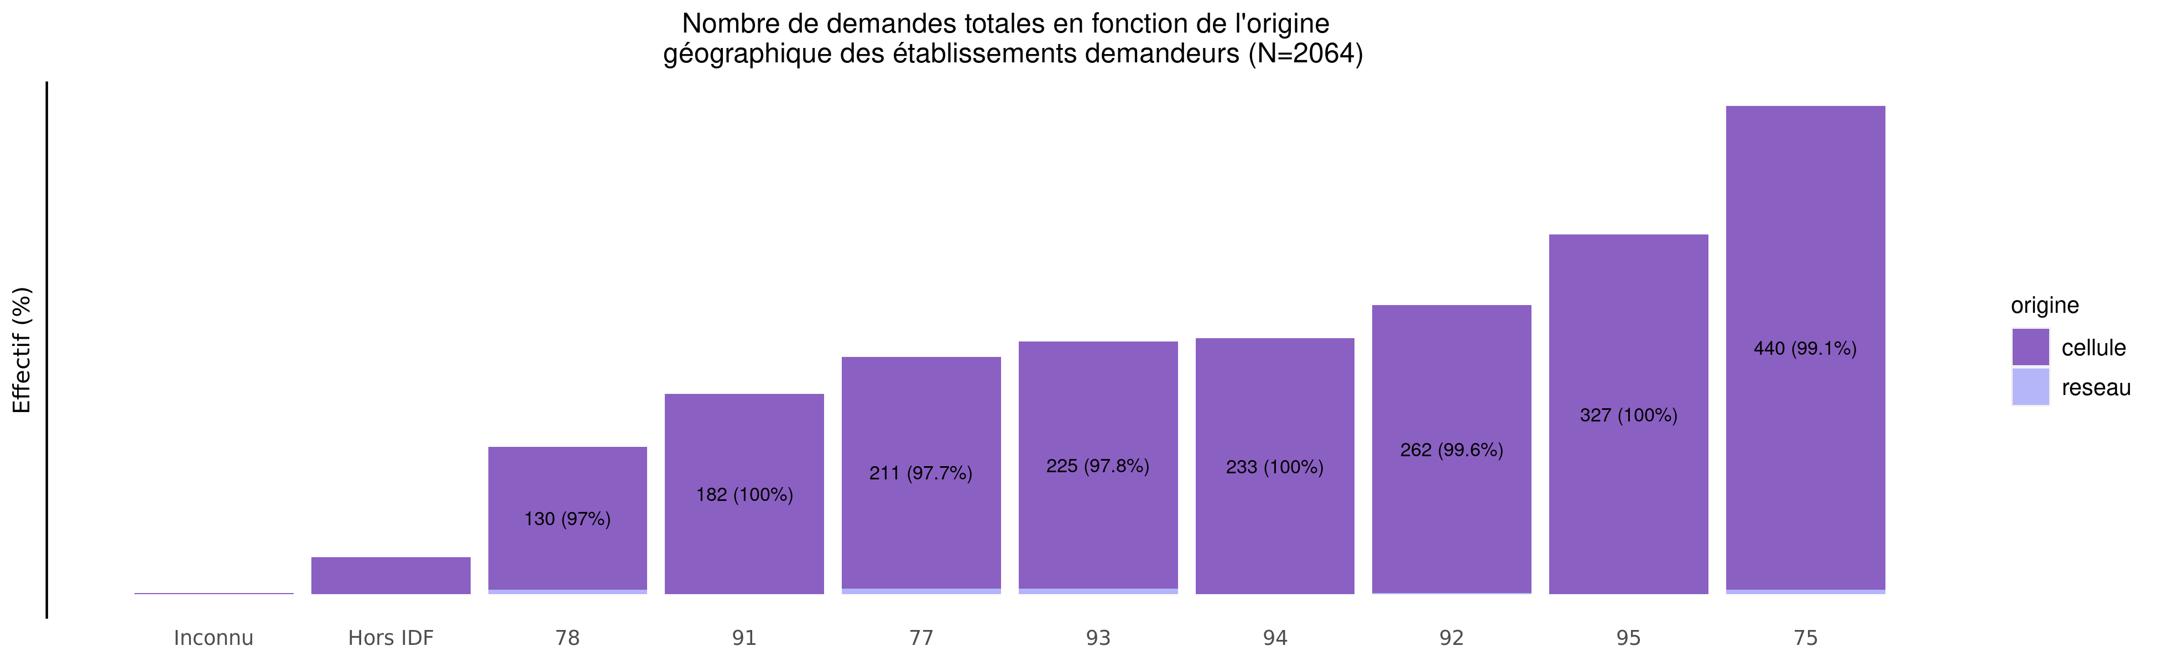
origine géographique des établissements demandeurs de TIU en 2023
04/03/2024
origine | Inconnu | Hors IDF | 78 | 91 | 77 | 93 | 94 | 92 | 95 | 75 | Total
cellule | 1 (0%) | 34 (1.7%) | 130 (6.4%) | 182 (8.9%) | 211 (10.3%) | 225 (11.0%) | 233 (11.4%) | 262 (12.8%) | 327 (16.0%) | 440 (21.5%) | 2045
reseau | 0 (0%) | 0 (0.0%) | 4 (21.1%) | 0 (0.0%) | 5 (26.3%) | 5 (26.3%) | 0 (0.0%) | 1 (5.3%) | 0 (0.0%) | 4 (21.1%) | 19
Total | 1 (0%) | 34 (1.6%) | 134 (6.5%) | 182 (8.8%) | 216 (10.5%) | 230 (11.1%) | 233 (11.3%) | 263 (12.7%) | 327 (15.8%) | 444 (21.5%) | 2064

Slide 10
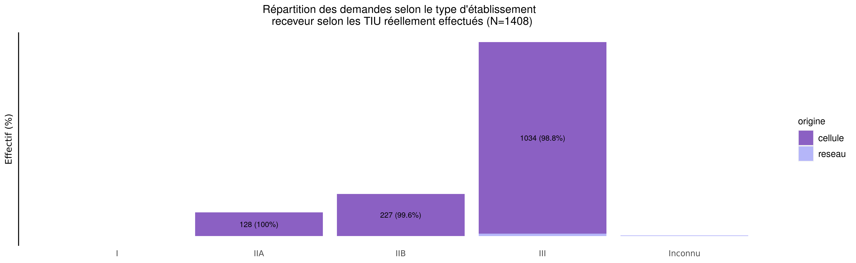
TIU par type d'établissement receveur en 2023
04/03/2024
origine | I | IIA | IIB | III | Urgence | Inconnu | Total
cellule | 1 (0.1%) | 128 (9.2%) | 227 (16.3%) | 1034 (74.4%) | 0 (0%) | 0 (0.0%) | 1390
reseau | 0 (0.0%) | 0 (0.0%) | 1 (5.6%) | 13 (72.2%) | 0 (0%) | 4 (22.2%) | 18
Total | 1 (0.1%) | 128 (9.1%) | 228 (16.2%) | 1047 (74.4%) | 0 (0%) | 4 (0.3%) | 1408

Slide 11
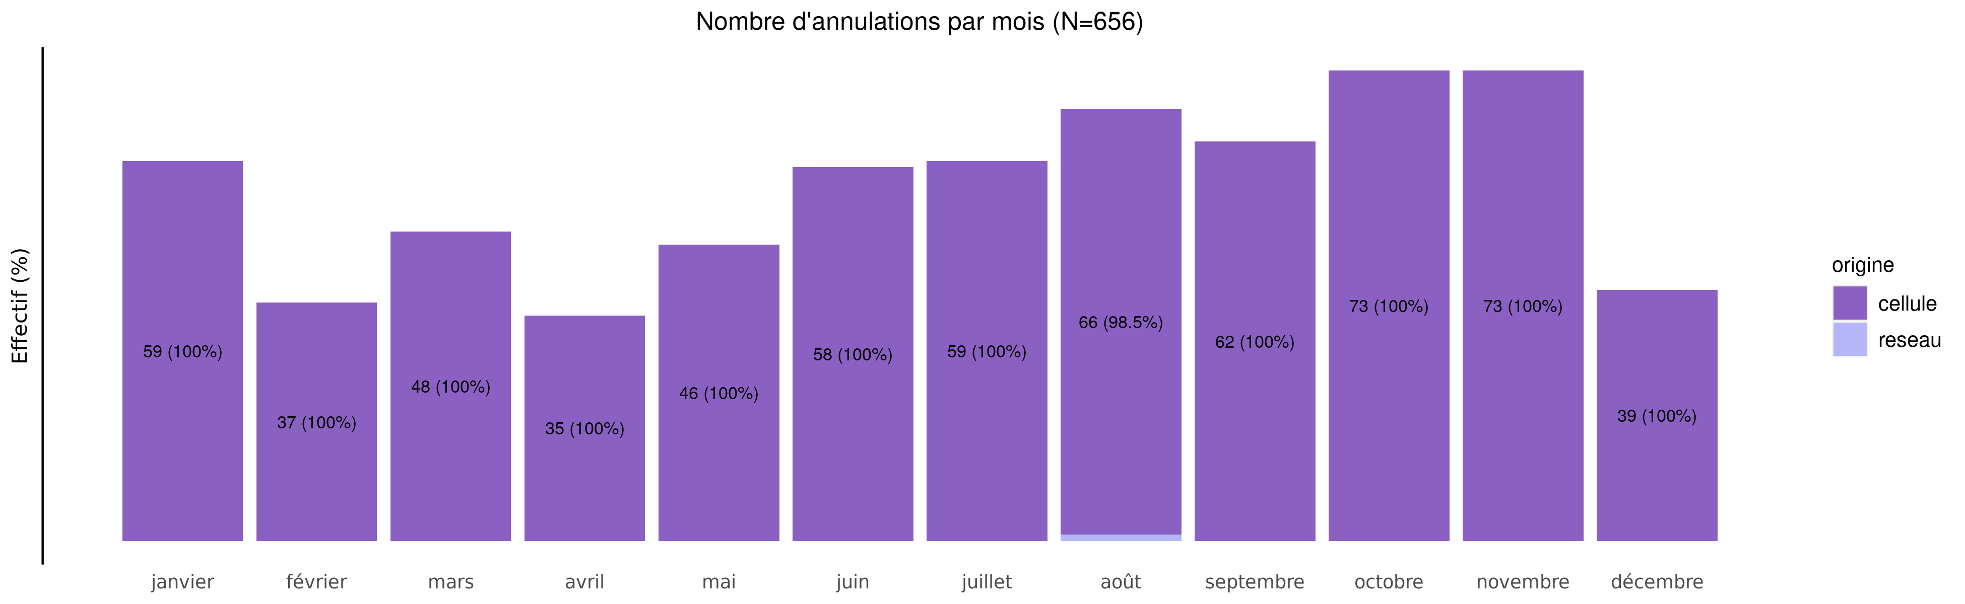
Annulation des demandes de TIU en 2023
04/03/2024
origine | janvier | février | mars | avril | mai | juin | juillet | août | septembre | octobre | novembre | décembre | Total
cellule | 59 (9%) | 37 (5.6%) | 48 (7.3%) | 35 (5.3%) | 46 (7%) | 58 (8.9%) | 59 (9%) | 66 (10.1%) | 62 (9.5%) | 73 (11.1%) | 73 (11.1%) | 39 (6.0%) | 655
reseau | 0 (0%) | 0 (0.0%) | 0 (0.0%) | 0 (0.0%) | 0 (0%) | 0 (0.0%) | 0 (0%) | 1 (100.0%) | 0 (0.0%) | 0 (0.0%) | 0 (0.0%) | 0 (0.0%) | 1
Total | 59 (9%) | 37 (5.6%) | 48 (7.3%) | 35 (5.3%) | 46 (7%) | 58 (8.8%) | 59 (9%) | 67 (10.2%) | 62 (9.5%) | 73 (11.1%) | 73 (11.1%) | 39 (5.9%) | 656

Slide 12
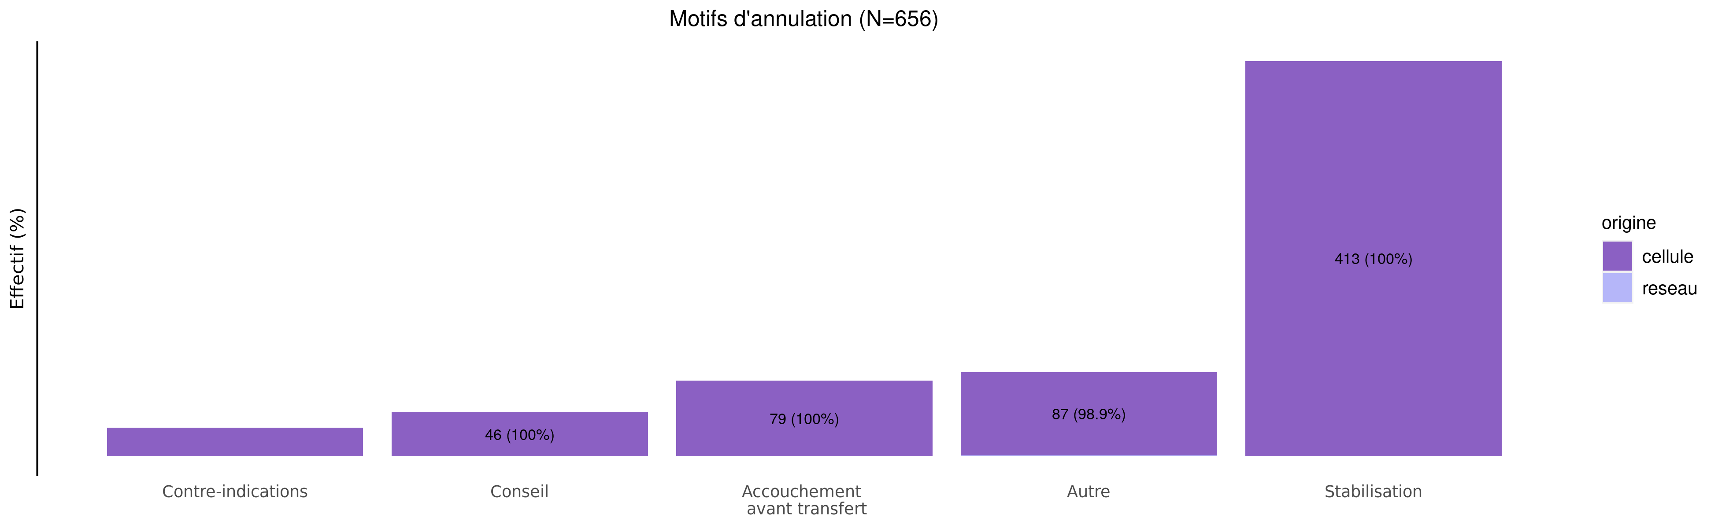
Motif d'annulation des demandes de TIU en 2023
04/03/2024
origine | Contre-indications | Conseil | Accouchement avant transfert | Autre | Stabilisation | Total
cellule | 30 (4.6%) | 46 (7%) | 79 (12.1%) | 87 (13.3%) | 413 (63.1%) | 655
reseau | 0 (0.0%) | 0 (0%) | 0 (0.0%) | 1 (100.0%) | 0 (0.0%) | 1
Total | 30 (4.6%) | 46 (7%) | 79 (12.0%) | 88 (13.4%) | 413 (63.0%) | 656

Slide 13
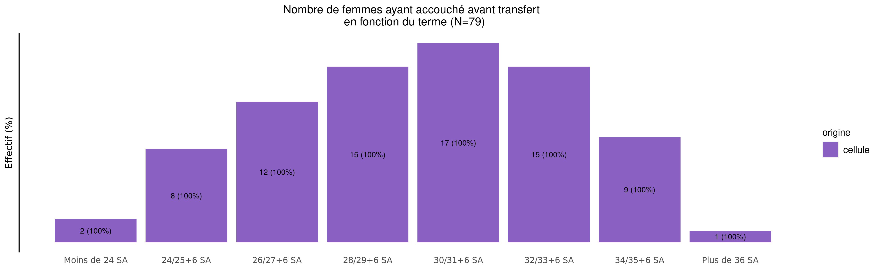
Termes des femmes ayant accouché avant transfert en 2023 (83 N.nés cellule et 0 N.nés réseaux)
04/03/2024
origine | Moins de 24 SA | 24/25+6 SA | 26/27+6 SA | 28/29+6 SA | 30/31+6 SA | 32/33+6 SA | 34/35+6 SA | Plus de 36 SA | Inconnu | Total
cellule | 2 (2.5%) | 8 (10.1%) | 12 (15.2%) | 15 (19%) | 17 (21.5%) | 15 (19%) | 9 (11.4%) | 1 (1.3%) | 0 (0%) | 79
Total | 2 (2.5%) | 8 (10.1%) | 12 (15.2%) | 15 (19%) | 17 (21.5%) | 15 (19%) | 9 (11.4%) | 1 (1.3%) | 0 (0%) | 79

Slide 14
Répartition des TIU en 2023 (Total des transferts)
04/03/2024
327 (15.8%)
59 (4.2%)
134 (6.5%)
312 (15.1%)
73 (5.2%)
221 (15.7%)
263 (12.7%)
444 (21.5%)
247 (17.5%)
410 (29.1%)
233 (11.3%)
248 (17.6%)
316 (15.3%)
34 (1.6%)
66 (4.7%)
80 (5.7%)
1 (0.0%)
4 (0.3%)

Slide 15
Répartition des TIU en 2023 (Transferts cellule)
04/03/2024
327 (16.0%)
59 (4.2%)
130 (6.4%)
306 (15.0%)
69 (5.0%)
215 (15.5%)
262 (12.8%)
440 (21.5%)
247 (17.8%)
406 (29.2%)
233 (11.4%)
248 (17.8%)
312 (15.3%)
34 (1.7%)
66 (4.7%)
80 (5.8%)
1 (0.0%)
0 (0.0%)

Slide 16
Répartition des TIU en 2023 (Transferts réseaux)
04/03/2024
0 (0.0%)
0 (0.0%)
4 (21.1%)
6 (31.6%)
4 (22.2%)
6 (33.3%)
1 (5.3%)
4 (21.1%)
0 (0.0%)
4 (22.2%)
0 (0.0%)
0 (0.0%)
4 (21.1%)
0 (0.0%)
0 (0.0%)
0 (0.0%)
0 (0.0%)
4 (22.2%)

Slide 17
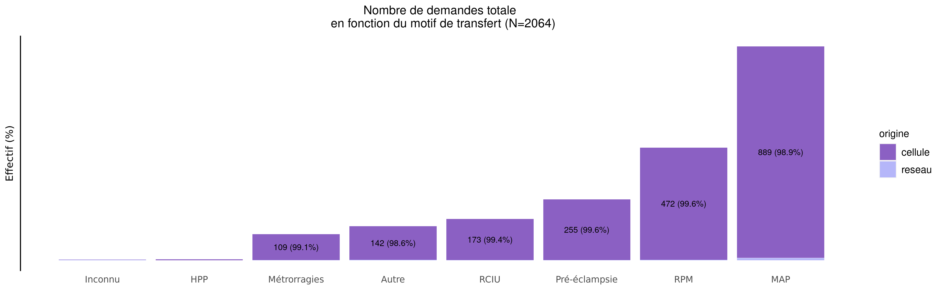
Motif de transfert principal en 2023
04/03/2024
origine | Inconnu | HPP | Métrorragies | Autre | RCIU | Pré-éclampsie | RPM | MAP | Total
cellule | 1 (0.0%) | 4 (0.2%) | 109 (5.3%) | 142 (6.9%) | 173 (8.5%) | 255 (12.5%) | 472 (23.1%) | 889 (43.5%) | 2045
reseau | 2 (10.5%) | 0 (0.0%) | 1 (5.3%) | 2 (10.5%) | 1 (5.3%) | 1 (5.3%) | 2 (10.5%) | 10 (52.6%) | 19
Total | 3 (0.1%) | 4 (0.2%) | 110 (5.3%) | 144 (7.0%) | 174 (8.4%) | 256 (12.4%) | 474 (23.0%) | 899 (43.6%) | 2064

Slide 18
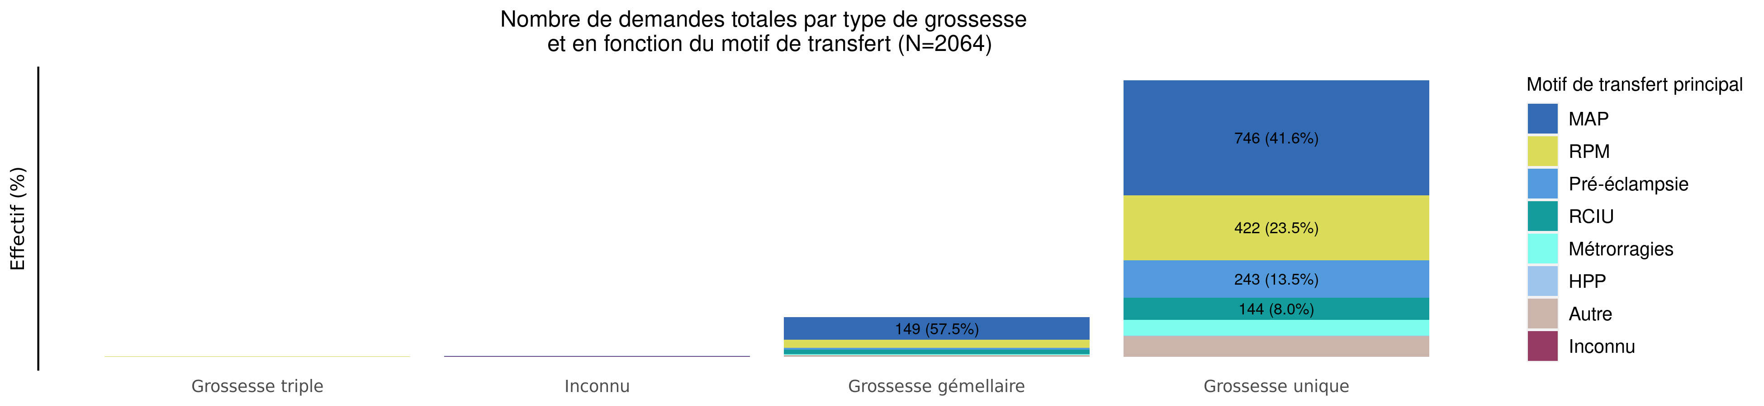
Type de grossesse par motif de transfert en 2023 (Total des transferts)
04/03/2024
Motif | Grossesse triple | Inconnu | Grossesse gémellaire | Grossesse unique | Total
MAP | 2 (0.2%) | 2 (0.2%) | 149 (16.6%) | 746 (83.0%) | 899
RPM | 1 (0.2%) | 0 (0.0%) | 51 (10.8%) | 422 (89.0%) | 474
Pré-éclampsie | 0 (0.0%) | 0 (0.0%) | 13 (5.1%) | 243 (94.9%) | 256
RCIU | 1 (0.6%) | 1 (0.6%) | 28 (16.1%) | 144 (82.8%) | 174
Métrorragies | 0 (0.0%) | 1 (0.9%) | 6 (5.5%) | 103 (93.6%) | 110
Manque place mère | 0 (0.0%) | 0 (0.0%) | 0 (0.0%) | 0 (0.0%) | 0
Manque place enfant | 0 (0.0%) | 0 (0.0%) | 0 (0.0%) | 0 (0.0%) | 0
HPP | 0 (0.0%) | 0 (0.0%) | 1 (25.0%) | 3 (75.0%) | 4
Autre | 0 (0.0%) | 0 (0.0%) | 11 (7.6%) | 133 (92.4%) | 144
Inconnu | 0 (0.0%) | 2 (66.7%) | 0 (0.0%) | 1 (33.3%) | 3
Total | 4 (0.2%) | 6 (0.3%) | 259 (12.5%) | 1795 (87.0%) | 2064

Slide 19
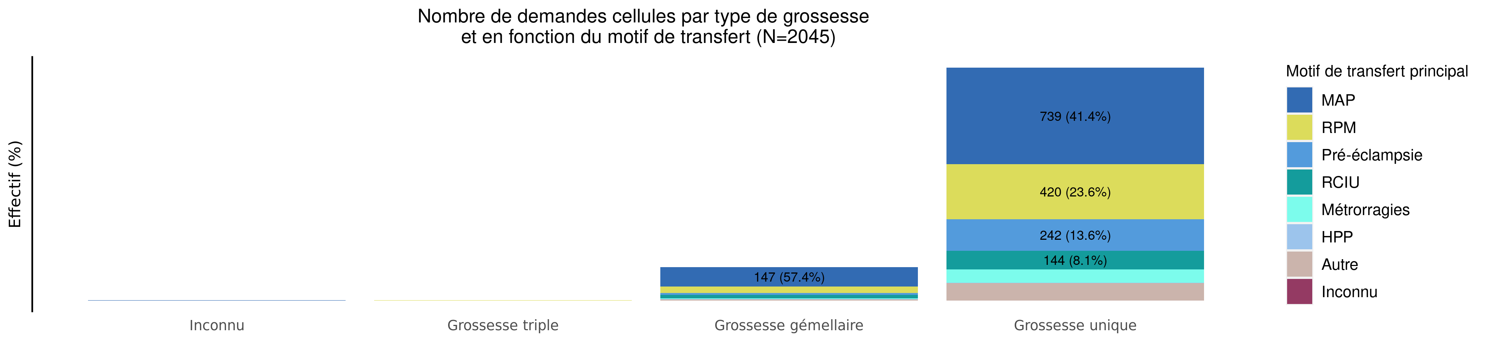
Type de grossesse par motif de transfert en 2023 (Transferts cellule)
04/03/2024
Motif | Inconnu | Grossesse triple | Grossesse gémellaire | Grossesse unique | Total
MAP | 1 (0.1%) | 2 (0.2%) | 147 (16.5%) | 739 (83.1%) | 889
RPM | 0 (0.0%) | 1 (0.2%) | 51 (10.8%) | 420 (89.0%) | 472
Pré-éclampsie | 0 (0.0%) | 0 (0.0%) | 13 (5.1%) | 242 (94.9%) | 255
RCIU | 0 (0.0%) | 1 (0.6%) | 28 (16.2%) | 144 (83.2%) | 173
Métrorragies | 1 (0.9%) | 0 (0.0%) | 6 (5.5%) | 102 (93.6%) | 109
Manque place mère | 0 (0.0%) | 0 (0.0%) | 0 (0.0%) | 0 (0.0%) | 0
Manque place enfant | 0 (0.0%) | 0 (0.0%) | 0 (0.0%) | 0 (0.0%) | 0
HPP | 0 (0.0%) | 0 (0.0%) | 1 (25.0%) | 3 (75.0%) | 4
Autre | 0 (0.0%) | 0 (0.0%) | 10 (7.0%) | 132 (93.0%) | 142
Inconnu | 0 (0.0%) | 0 (0.0%) | 0 (0.0%) | 1 (100.0%) | 1
Total | 2 (0.1%) | 4 (0.2%) | 256 (12.5%) | 1783 (87.2%) | 2045

Slide 20
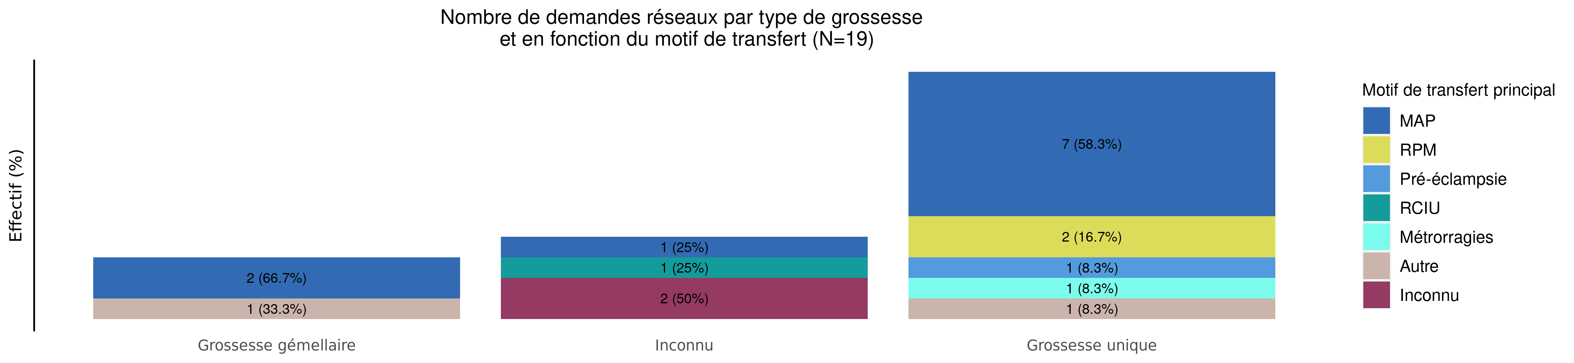
Type de grossesse par motif de transfert en 2023 (Transferts réseaux)
04/03/2024
Motif | Grossesse gémellaire | Inconnu | Grossesse unique | Total
MAP | 2 (20.0%) | 1 (10.0%) | 7 (70.0%) | 10
RPM | 0 (0.0%) | 0 (0.0%) | 2 (100.0%) | 2
Pré-éclampsie | 0 (0.0%) | 0 (0.0%) | 1 (100.0%) | 1
RCIU | 0 (0.0%) | 1 (100.0%) | 0 (0.0%) | 1
Métrorragies | 0 (0.0%) | 0 (0.0%) | 1 (100.0%) | 1
Manque place mère | 0 (0.0%) | 0 (0.0%) | 0 (0.0%) | 0
Manque place enfant | 0 (0.0%) | 0 (0.0%) | 0 (0.0%) | 0
HPP | 0 (0.0%) | 0 (0.0%) | 0 (0.0%) | 0
Autre | 1 (50.0%) | 0 (0.0%) | 1 (50.0%) | 2
Inconnu | 0 (0.0%) | 2 (100.0%) | 0 (0.0%) | 2
Total | 3 (15.8%) | 4 (21.1%) | 12 (63.2%) | 19

Slide 21
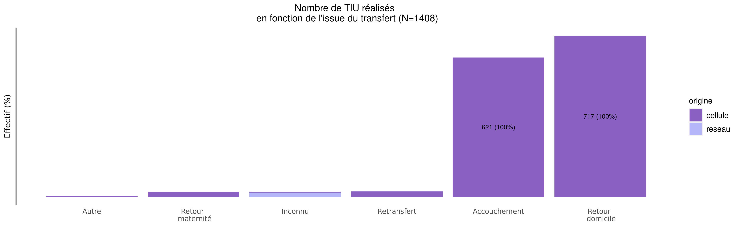
issue des transferts réalisés en 2023
04/03/2024
origine | Autre | Retour maternité | Inconnu | Retransfert | Accouchement | Retour domicile | Total
cellule | 3 (0.2%) | 22 (1.6%) | 4 (0.3%) | 23 (1.7%) | 621 (44.7%) | 717 (51.6%) | 1390
reseau | 0 (0.0%) | 0 (0.0%) | 18 (100.0%) | 0 (0.0%) | 0 (0.0%) | 0 (0.0%) | 18
Total | 3 (0.2%) | 22 (1.6%) | 22 (1.6%) | 23 (1.6%) | 621 (44.1%) | 717 (50.9%) | 1408

Slide 22
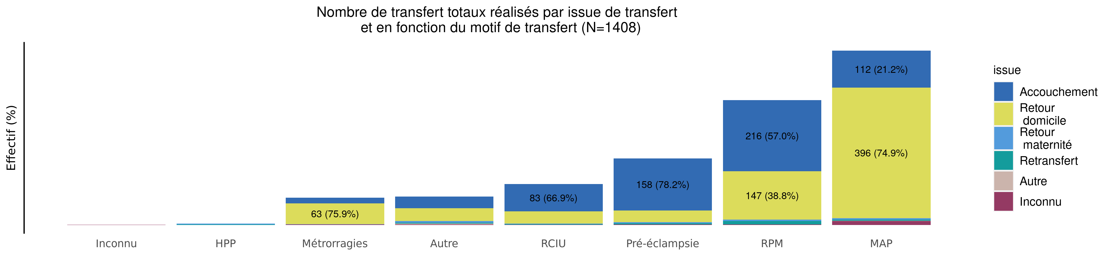
Issue de transfert réalisé selon le motif de TIU en 2023 (Total des transferts)
04/03/2024
issue | Inconnu | HPP | Métrorragies | Autre | RCIU | Pré-éclampsie | RPM | MAP | Total
Accouchement | 0 (0.0%) | 0 (0.0%) | 17 (2.7%) | 35 (5.6%) | 83 (13.4%) | 158 (25.4%) | 216 (34.8%) | 112 (18.0%) | 621
Retour domicile | 0 (0.0%) | 0 (0.0%) | 63 (8.8%) | 39 (5.4%) | 37 (5.2%) | 35 (4.9%) | 147 (20.5%) | 396 (55.2%) | 717
Retour maternité | 0 (0.0%) | 2 (9.1%) | 1 (4.5%) | 5 (22.7%) | 1 (4.5%) | 4 (18.2%) | 4 (18.2%) | 5 (22.7%) | 22
Retransfert | 0 (0.0%) | 2 (8.7%) | 0 (0.0%) | 3 (13.0%) | 2 (8.7%) | 3 (13.0%) | 10 (43.5%) | 3 (13.0%) | 23
Autre | 0 (0.0%) | 0 (0.0%) | 0 (0.0%) | 2 (66.7%) | 0 (0.0%) | 0 (0.0%) | 0 (0.0%) | 1 (33.3%) | 3
Inconnu | 1 (4.5%) | 0 (0.0%) | 2 (9.1%) | 2 (9.1%) | 1 (4.5%) | 2 (9.1%) | 2 (9.1%) | 12 (54.5%) | 22
Total | 1 (0.1%) | 4 (0.3%) | 83 (5.9%) | 86 (6.1%) | 124 (8.8%) | 202 (14.3%) | 379 (26.9%) | 529 (37.6%) | 1408

Slide 23
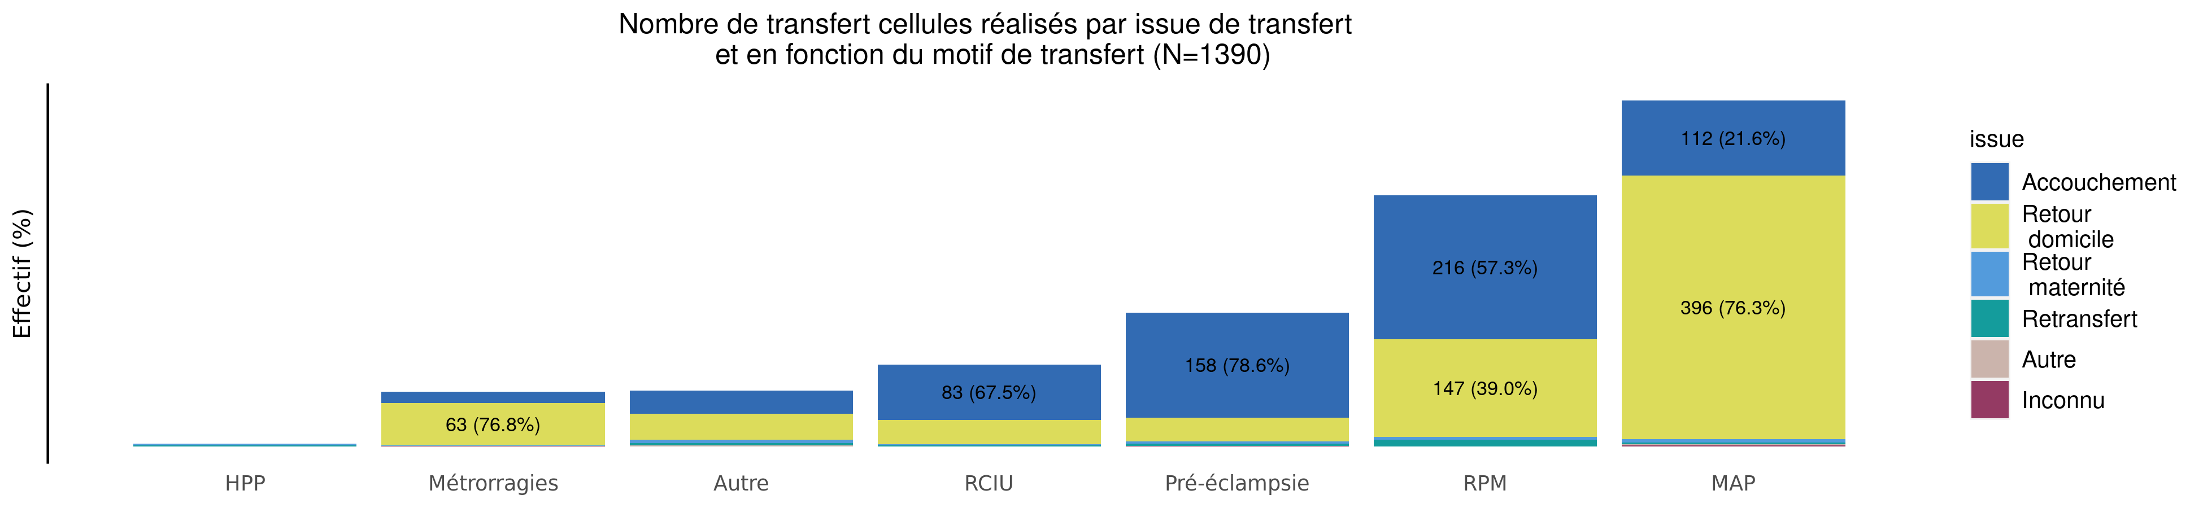
Issue de transfert réalisé selon le motif de TIU en 2023 (Transferts cellule)
04/03/2024
issue | HPP | Métrorragies | Autre | RCIU | Pré-éclampsie | RPM | MAP | Total
Accouchement | 0 (0.0%) | 17 (2.7%) | 35 (5.6%) | 83 (13.4%) | 158 (25.4%) | 216 (34.8%) | 112 (18.0%) | 621
Retour domicile | 0 (0.0%) | 63 (8.8%) | 39 (5.4%) | 37 (5.2%) | 35 (4.9%) | 147 (20.5%) | 396 (55.2%) | 717
Retour maternité | 2 (9.1%) | 1 (4.5%) | 5 (22.7%) | 1 (4.5%) | 4 (18.2%) | 4 (18.2%) | 5 (22.7%) | 22
Retransfert | 2 (8.7%) | 0 (0.0%) | 3 (13.0%) | 2 (8.7%) | 3 (13.0%) | 10 (43.5%) | 3 (13.0%) | 23
Autre | 0 (0.0%) | 0 (0.0%) | 2 (66.7%) | 0 (0.0%) | 0 (0.0%) | 0 (0.0%) | 1 (33.3%) | 3
Inconnu | 0 (0.0%) | 1 (25.0%) | 0 (0.0%) | 0 (0.0%) | 1 (25.0%) | 0 (0.0%) | 2 (50.0%) | 4
Total | 4 (0.3%) | 82 (5.9%) | 84 (6.0%) | 123 (8.8%) | 201 (14.5%) | 377 (27.1%) | 519 (37.3%) | 1390

Slide 24
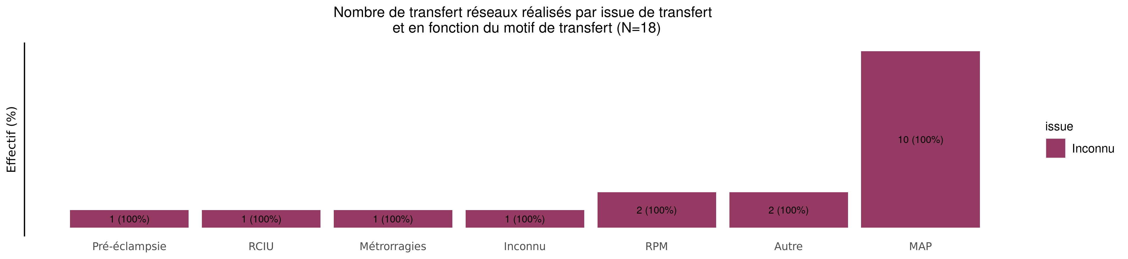
Issue de transfert réalisé selon le motif de TIU en 2023 (Transferts réseaux)
04/03/2024
issue | Pré-éclampsie | RCIU | Métrorragies | Inconnu | RPM | Autre | MAP | Total
Accouchement | 0 (0.0%) | 0 (0.0%) | 0 (0.0%) | 0 (0.0%) | 0 (0.0%) | 0 (0.0%) | 0 (0.0%) | 0
Retour domicile | 0 (0.0%) | 0 (0.0%) | 0 (0.0%) | 0 (0.0%) | 0 (0.0%) | 0 (0.0%) | 0 (0.0%) | 0
Retour maternité | 0 (0.0%) | 0 (0.0%) | 0 (0.0%) | 0 (0.0%) | 0 (0.0%) | 0 (0.0%) | 0 (0.0%) | 0
Retransfert | 0 (0.0%) | 0 (0.0%) | 0 (0.0%) | 0 (0.0%) | 0 (0.0%) | 0 (0.0%) | 0 (0.0%) | 0
Autre | 0 (0.0%) | 0 (0.0%) | 0 (0.0%) | 0 (0.0%) | 0 (0.0%) | 0 (0.0%) | 0 (0.0%) | 0
Inconnu | 1 (5.6%) | 1 (5.6%) | 1 (5.6%) | 1 (5.6%) | 2 (11.1%) | 2 (11.1%) | 10 (55.6%) | 18
Total | 1 (5.6%) | 1 (5.6%) | 1 (5.6%) | 1 (5.6%) | 2 (11.1%) | 2 (11.1%) | 10 (55.6%) | 18

Slide 25
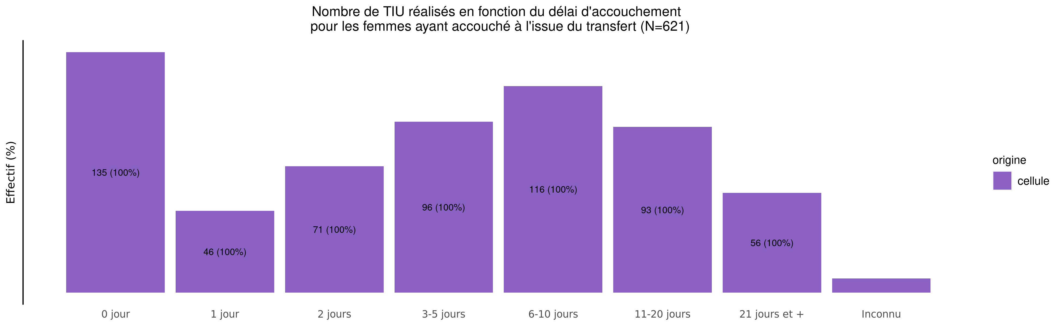
Délai d'accouchement des TIU réalisés en 2023
04/03/2024
origine | 0 jour | 1 jour | 2 jours | 3-5 jours | 6-10 jours | 11-20 jours | 21 jours et + | Inconnu | Total
cellule | 135 (21.7%) | 46 (7.4%) | 71 (11.4%) | 96 (15.5%) | 116 (18.7%) | 93 (15%) | 56 (9%) | 8 (1.3%) | 621
Total | 135 (21.7%) | 46 (7.4%) | 71 (11.4%) | 96 (15.5%) | 116 (18.7%) | 93 (15%) | 56 (9%) | 8 (1.3%) | 621

Slide 26
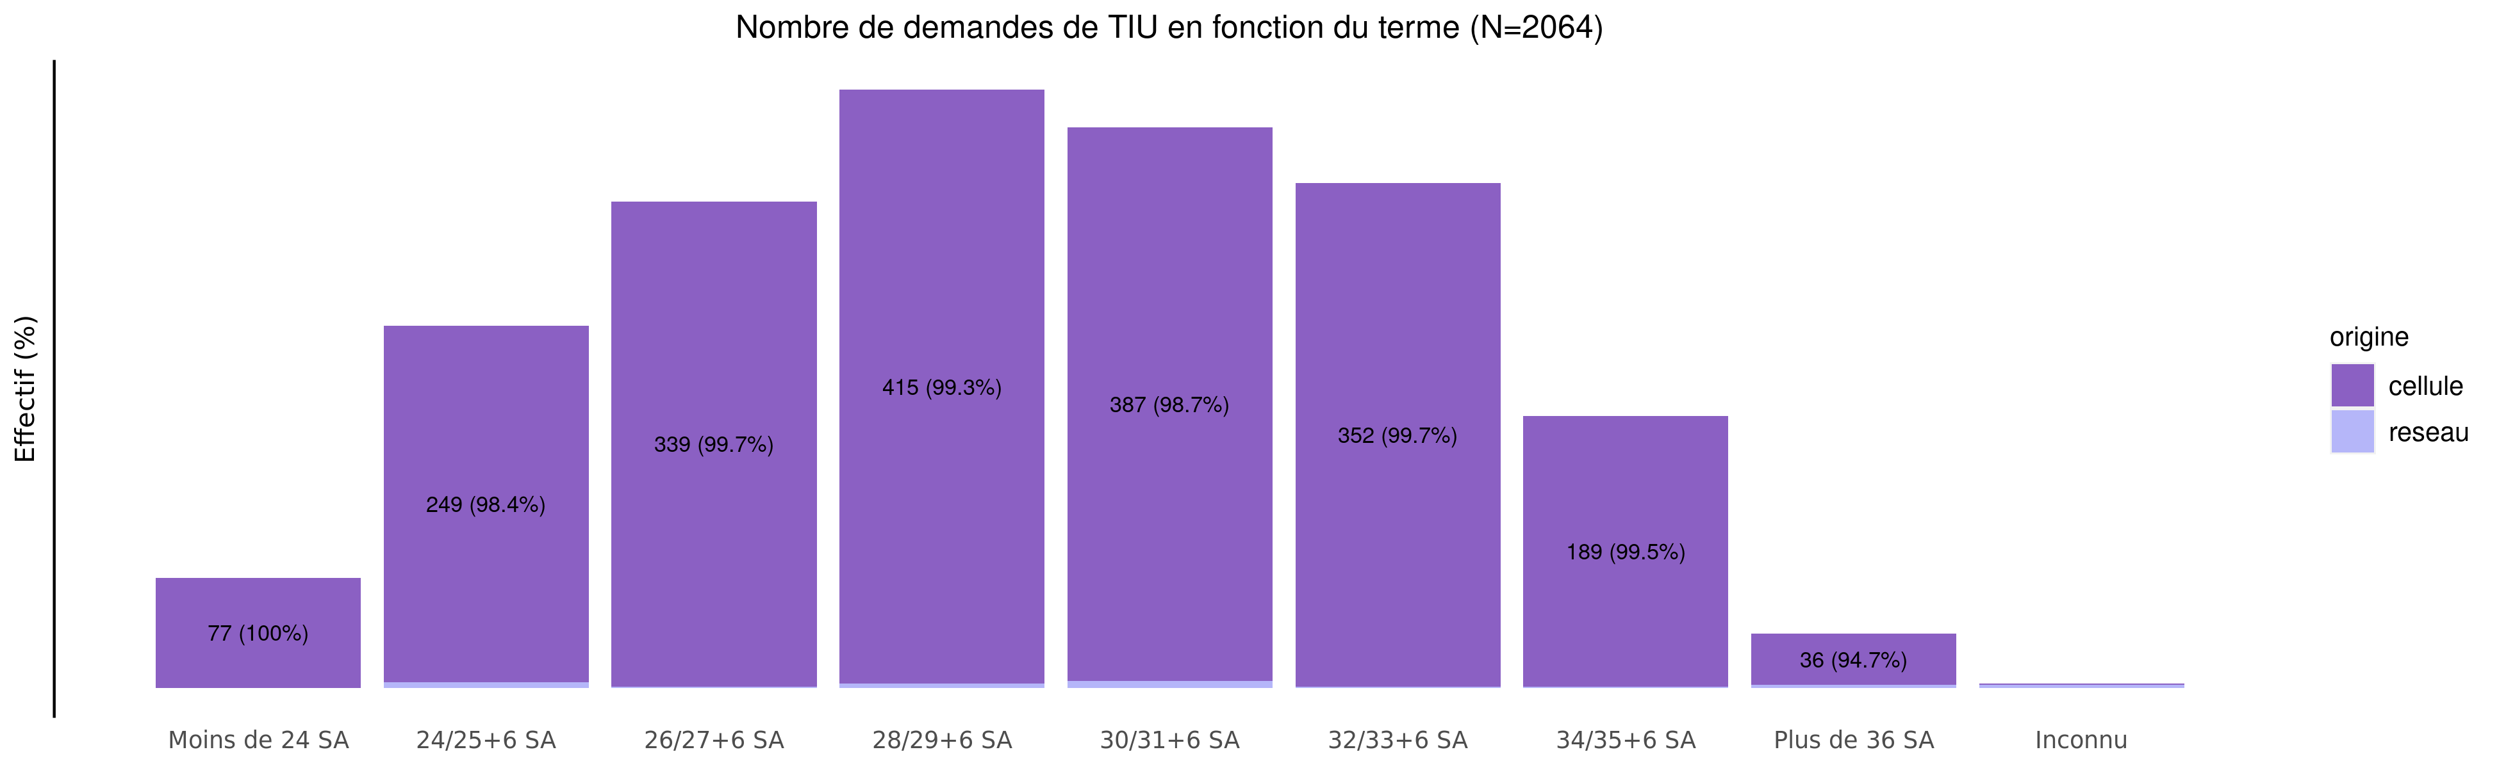
Termes des demandes de transfert en 2023
04/03/2024
origine | Moins de 24 SA | 24/25+6 SA | 26/27+6 SA | 28/29+6 SA | 30/31+6 SA | 32/33+6 SA | 34/35+6 SA | Plus de 36 SA | Inconnu | Total
cellule | 77 (3.8%) | 249 (12.2%) | 339 (16.6%) | 415 (20.3%) | 387 (18.9%) | 352 (17.2%) | 189 (9.2%) | 36 (1.8%) | 1 (0.0%) | 2045
reseau | 0 (0.0%) | 4 (21.1%) | 1 (5.3%) | 3 (15.8%) | 5 (26.3%) | 1 (5.3%) | 1 (5.3%) | 2 (10.5%) | 2 (10.5%) | 19
Total | 77 (3.7%) | 253 (12.3%) | 340 (16.5%) | 418 (20.3%) | 392 (19.0%) | 353 (17.1%) | 190 (9.2%) | 38 (1.8%) | 3 (0.1%) | 2064

Slide 27
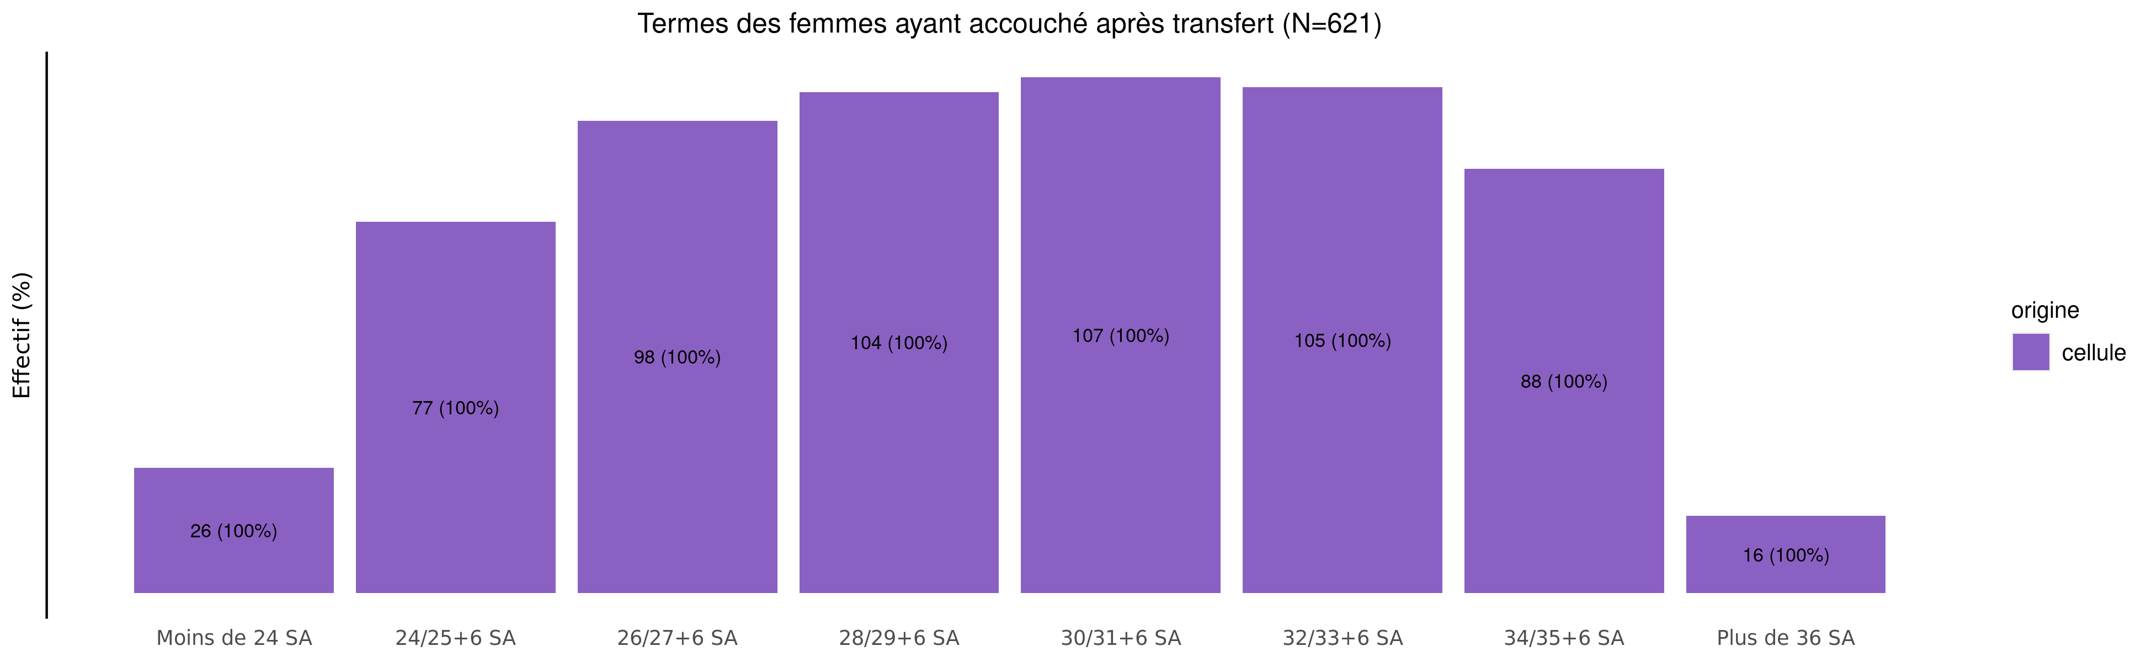
Les accouchements suite à TIU en 2023 - terme
04/03/2024
origine | Moins de 24 SA | 24/25+6 SA | 26/27+6 SA | 28/29+6 SA | 30/31+6 SA | 32/33+6 SA | 34/35+6 SA | Plus de 36 SA | Inconnu | Total
cellule | 26 (4.2%) | 77 (12.4%) | 98 (15.8%) | 104 (16.7%) | 107 (17.2%) | 105 (16.9%) | 88 (14.2%) | 16 (2.6%) | 0 (0%) | 621
Total | 26 (4.2%) | 77 (12.4%) | 98 (15.8%) | 104 (16.7%) | 107 (17.2%) | 105 (16.9%) | 88 (14.2%) | 16 (2.6%) | 0 (0%) | 621

Slide 28
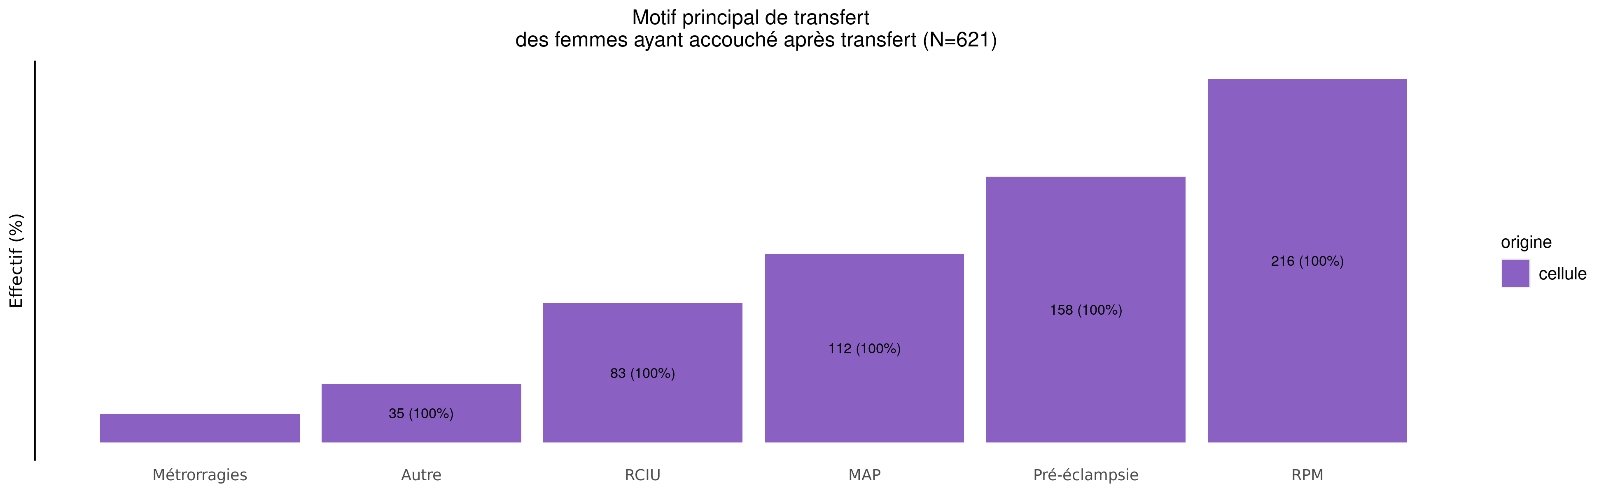
Les accouchements suite à TIU en 2023 - motif de transfert
04/03/2024
origine | MAP | RPM | Pré-éclampsie | RCIU | Métrorragies | Manque place mère | Manque place enfant | HPP | Autre | Inconnu | Total
cellule | 112 (18%) | 216 (34.8%) | 158 (25.4%) | 83 (13.4%) | 17 (2.7%) | 0 (0%) | 0 (0%) | 0 (0%) | 35 (5.6%) | 0 (0%) | 621
Total | 112 (18%) | 216 (34.8%) | 158 (25.4%) | 83 (13.4%) | 17 (2.7%) | 0 (0%) | 0 (0%) | 0 (0%) | 35 (5.6%) | 0 (0%) | 621

Slide 29
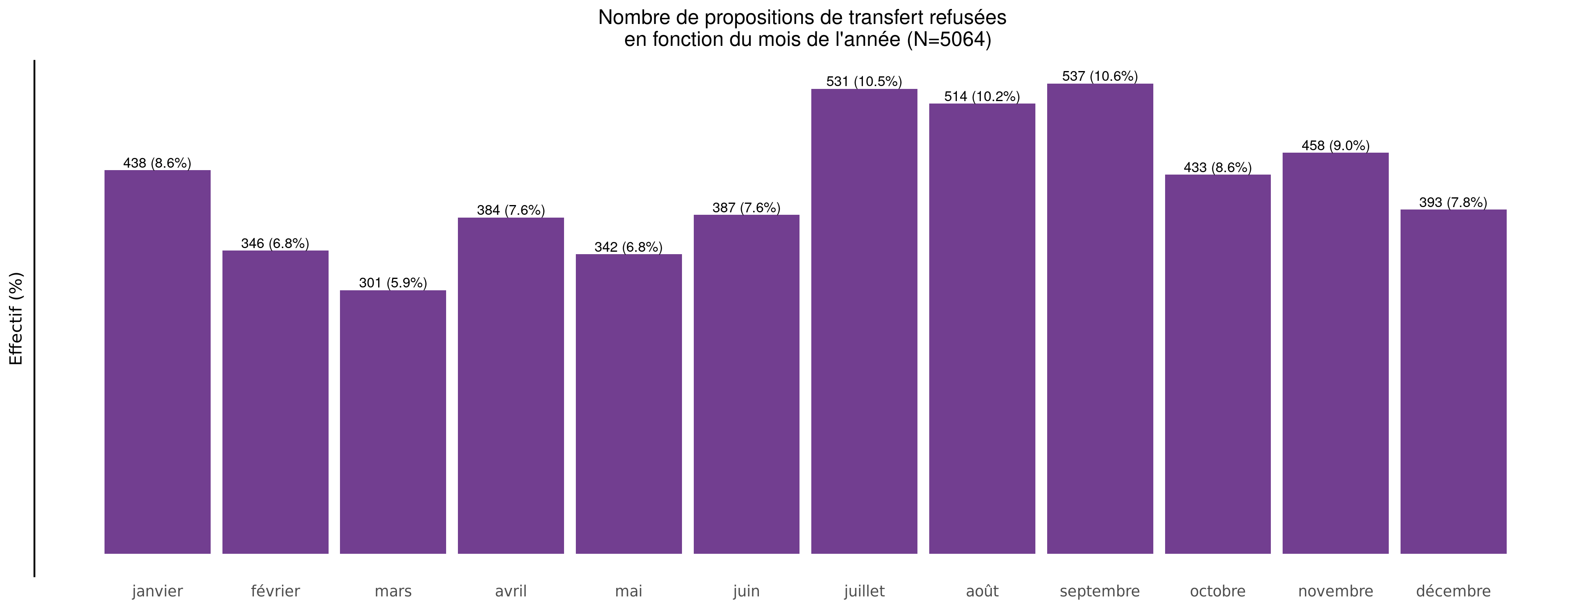
Nombre de propositions de transfert refusées en 2023
04/03/2024

Slide 30
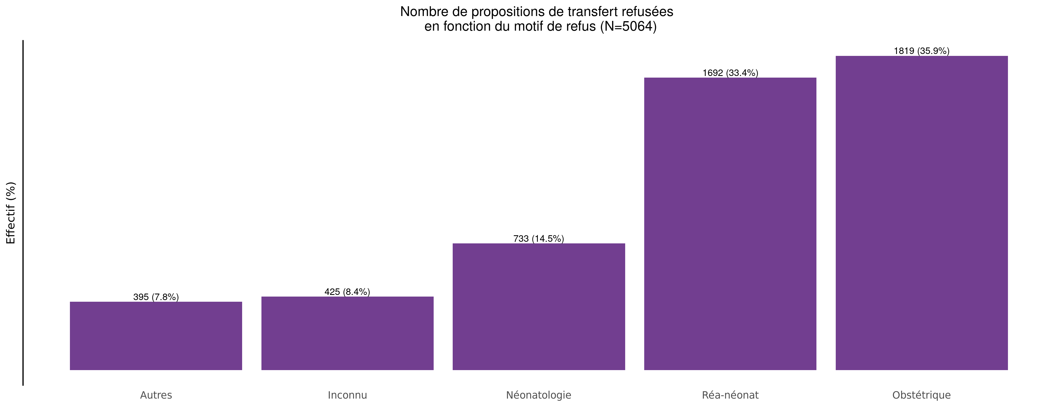
Motif des propositions de transfert refusées en 2023
04/03/2024

Slide 31
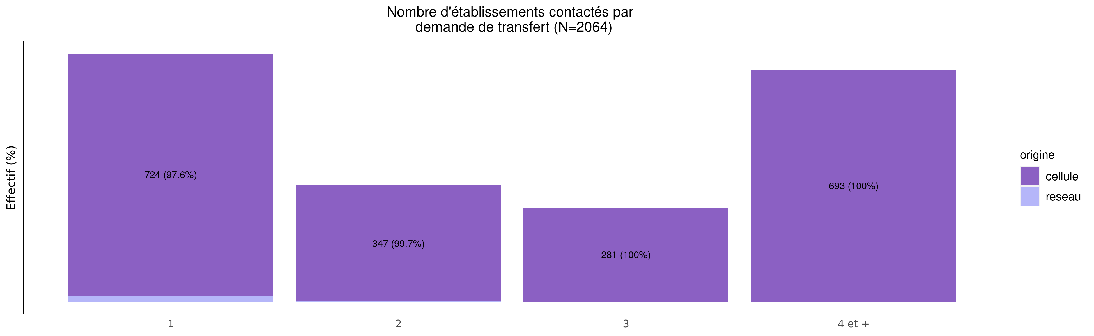
Nombre d'établissements contactés par demande en 2023
04/03/2024
origine | 1 | 2 | 3 | 4 et + | Total
cellule | 724 (35.4%) | 347 (17.0%) | 281 (13.7%) | 693 (33.9%) | 2045
reseau | 18 (94.7%) | 1 (5.3%) | 0 (0.0%) | 0 (0.0%) | 19
Total | 742 (35.9%) | 348 (16.9%) | 281 (13.6%) | 693 (33.6%) | 2064

Slide 32
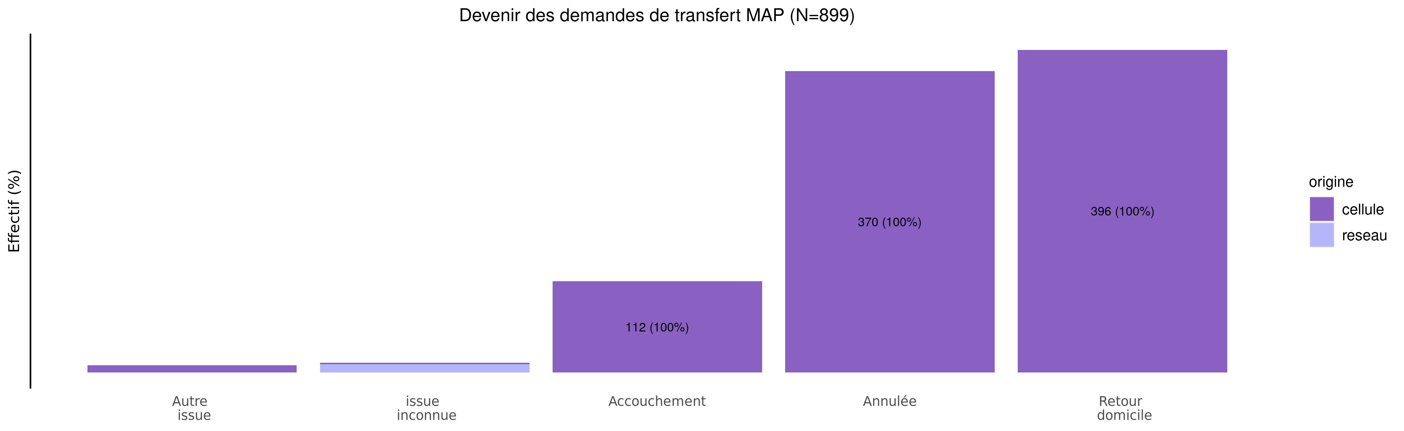
Devenir des demandes de MAP en 2023
04/03/2024
origine | Autre issue | issue inconnue | Accouchement | Annulée | Retour domicile | Total
cellule | 9 (1%) | 2 (0.2%) | 112 (12.6%) | 370 (41.6%) | 396 (44.5%) | 889
reseau | 0 (0%) | 10 (100.0%) | 0 (0.0%) | 0 (0.0%) | 0 (0.0%) | 10
Total | 9 (1%) | 12 (1.3%) | 112 (12.5%) | 370 (41.2%) | 396 (44.0%) | 899

Slide 33
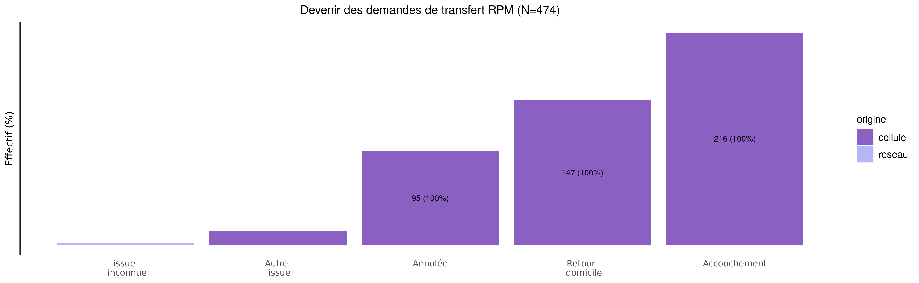
Devenir des demandes de RPM en 2023
04/03/2024
origine | issue inconnue | Autre issue | Annulée | Retour domicile | Accouchement | Total
cellule | 0 (0.0%) | 14 (3%) | 95 (20.1%) | 147 (31.1%) | 216 (45.8%) | 472
reseau | 2 (100.0%) | 0 (0%) | 0 (0.0%) | 0 (0.0%) | 0 (0.0%) | 2
Total | 2 (0.4%) | 14 (3%) | 95 (20.0%) | 147 (31.0%) | 216 (45.6%) | 474

