Slide 1
Île de France
Jeudi 2 Novembre 2023

Slide 2
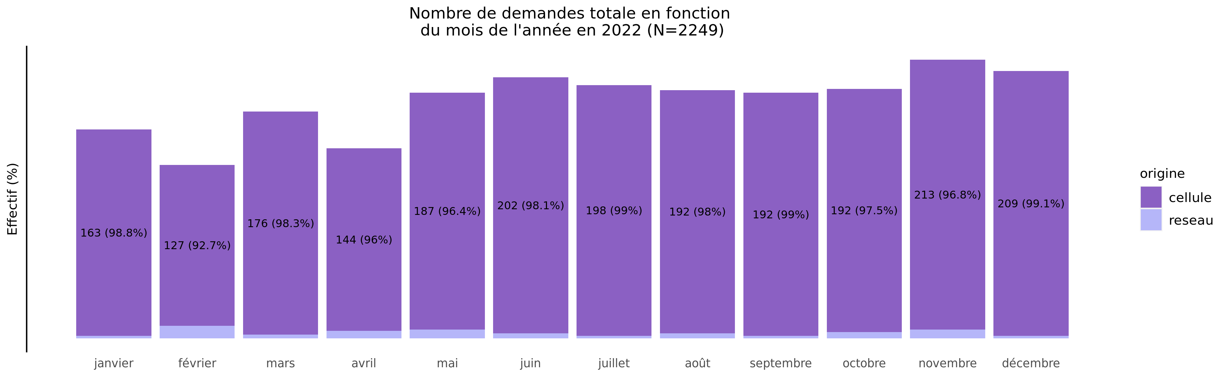
Nombre de demandes de TIU en 2022
02/11/2023
origine | janvier | février | mars | avril | mai | juin | juillet | août | septembre | octobre | novembre | décembre | Total
cellule | 163 (7.4%) | 127 (5.8%) | 176 (8.0%) | 144 (6.6%) | 187 (8.5%) | 202 (9.2%) | 198 (9.0%) | 192 (8.7%) | 192 (8.7%) | 192 (8.7%) | 213 (9.7%) | 209 (9.5%) | 2195
reseau | 2 (3.7%) | 10 (18.5%) | 3 (5.6%) | 6 (11.1%) | 7 (13.0%) | 4 (7.4%) | 2 (3.7%) | 4 (7.4%) | 2 (3.7%) | 5 (9.3%) | 7 (13.0%) | 2 (3.7%) | 54
Total | 165 (7.3%) | 137 (6.1%) | 179 (8.0%) | 150 (6.7%) | 194 (8.6%) | 206 (9.2%) | 200 (8.9%) | 196 (8.7%) | 194 (8.6%) | 197 (8.8%) | 220 (9.8%) | 211 (9.4%) | 2249

Slide 3
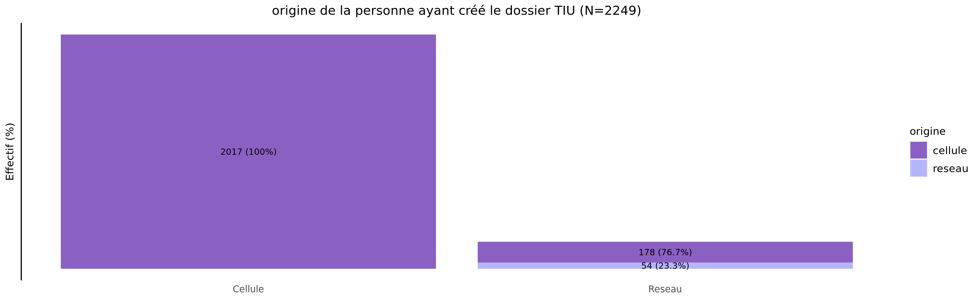
origine des demandes de TIU en 2022
02/11/2023
origine | Cellule | Reseau | Total
cellule | 2017 (91.9%) | 178 (8.1%) | 2195
reseau | 0 (0.0%) | 54 (100.0%) | 54
Total | 2017 (89.7%) | 232 (10.3%) | 2249

Slide 4
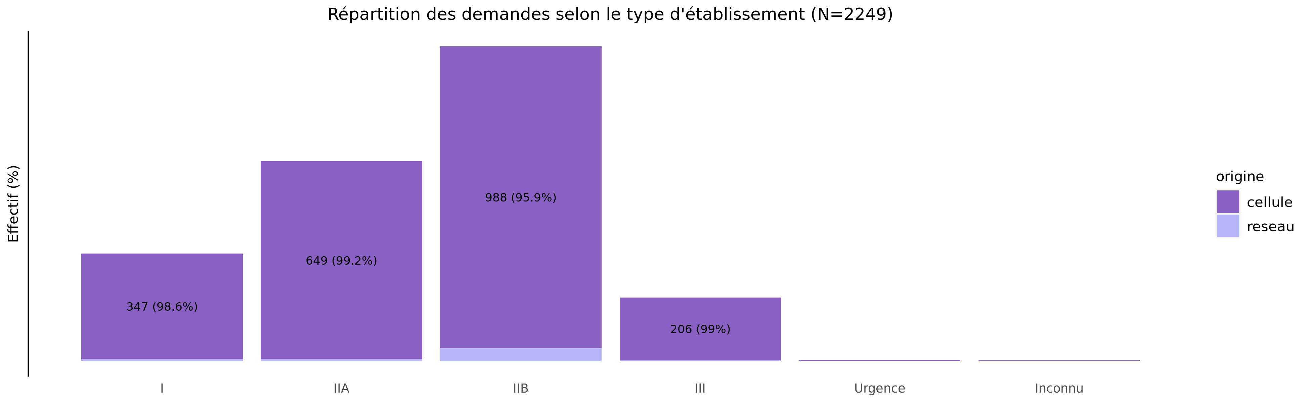
TIU par type d'établissement demandeur en 2022
02/11/2023
origine | I | IIA | IIB | III | Urgence | Inconnu | Total
cellule | 347 (15.8%) | 649 (29.6%) | 988 (45.0%) | 206 (9.4%) | 3 (0.1%) | 2 (0.1%) | 2195
reseau | 5 (9.3%) | 5 (9.3%) | 42 (77.8%) | 2 (3.7%) | 0 (0.0%) | 0 (0.0%) | 54
Total | 352 (15.7%) | 654 (29.1%) | 1030 (45.8%) | 208 (9.2%) | 3 (0.1%) | 2 (0.1%) | 2249

Slide 5
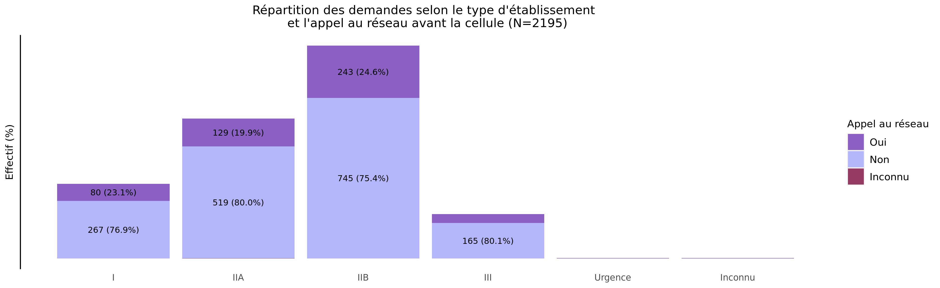
L'établissement a-t-il appelé le réseau avant la cellule?
02/11/2023
Appel | I | IIA | IIB | III | Urgence | Inconnu | Total
Oui | 80 (16.1%) | 129 (25.9%) | 243 (48.8%) | 41 (8.2%) | 3 (0.6%) | 2 (0.4%) | 498
Non | 267 (15.7%) | 519 (30.6%) | 745 (43.9%) | 165 (9.7%) | 0 (0.0%) | 0 (0.0%) | 1696
Inconnu | 0 (0.0%) | 1 (100.0%) | 0 (0.0%) | 0 (0.0%) | 0 (0.0%) | 0 (0.0%) | 1
Total | 347 (15.8%) | 649 (29.6%) | 988 (45.0%) | 206 (9.4%) | 3 (0.1%) | 2 (0.1%) | 2195

Slide 6
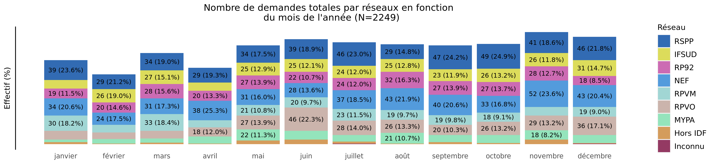
Nombre de demandes de TIU par réseau en 2022 (Total des transferts)
02/11/2023
Reseau | janvier | février | mars | avril | mai | juin | juillet | août | septembre | octobre | novembre | décembre | Total
RSPP | 39 (8.4%) | 29 (6.3%) | 34 (7.4%) | 29 (6.3%) | 34 (7.4%) | 39 (8.4%) | 46 (10.0%) | 29 (6.3%) | 47 (10.2%) | 49 (10.6%) | 41 (8.9%) | 46 (10.0%) | 462
IFSUD | 17 (5.8%) | 26 (8.9%) | 27 (9.3%) | 16 (5.5%) | 25 (8.6%) | 25 (8.6%) | 24 (8.2%) | 25 (8.6%) | 23 (7.9%) | 26 (8.9%) | 26 (8.9%) | 31 (10.7%) | 291
RP92 | 19 (6.5%) | 20 (6.8%) | 28 (9.6%) | 20 (6.8%) | 27 (9.2%) | 22 (7.5%) | 24 (8.2%) | 32 (11.0%) | 27 (9.2%) | 27 (9.2%) | 28 (9.6%) | 18 (6.2%) | 292
NEF | 34 (7.8%) | 24 (5.5%) | 31 (7.1%) | 38 (8.8%) | 31 (7.1%) | 28 (6.5%) | 37 (8.5%) | 43 (9.9%) | 40 (9.2%) | 33 (7.6%) | 52 (12.0%) | 43 (9.9%) | 434
RPVM | 30 (12.1%) | 15 (6.0%) | 33 (13.3%) | 14 (5.6%) | 21 (8.5%) | 20 (8.1%) | 23 (9.3%) | 19 (7.7%) | 19 (7.7%) | 18 (7.3%) | 17 (6.9%) | 19 (7.7%) | 248
RPVO | 17 (5.6%) | 13 (4.3%) | 15 (5.0%) | 18 (6.0%) | 27 (9.0%) | 46 (15.3%) | 28 (9.3%) | 26 (8.6%) | 20 (6.6%) | 26 (8.6%) | 29 (9.6%) | 36 (12.0%) | 301
MYPA | 5 (2.9%) | 9 (5.2%) | 8 (4.6%) | 14 (8.1%) | 22 (12.7%) | 17 (9.8%) | 13 (7.5%) | 21 (12.1%) | 14 (8.1%) | 16 (9.2%) | 18 (10.4%) | 16 (9.2%) | 173
Hors IDF | 4 (8.7%) | 1 (2.2%) | 3 (6.5%) | 1 (2.2%) | 7 (15.2%) | 9 (19.6%) | 4 (8.7%) | 1 (2.2%) | 4 (8.7%) | 2 (4.3%) | 9 (19.6%) | 1 (2.2%) | 46
Inconnu | 0 (0.0%) | 0 (0.0%) | 0 (0.0%) | 0 (0.0%) | 0 (0.0%) | 0 (0.0%) | 1 (50.0%) | 0 (0.0%) | 0 (0.0%) | 0 (0.0%) | 0 (0.0%) | 1 (50.0%) | 2
Total | 165 (7.3%) | 137 (6.1%) | 179 (8.0%) | 150 (6.7%) | 194 (8.6%) | 206 (9.2%) | 200 (8.9%) | 196 (8.7%) | 194 (8.6%) | 197 (8.8%) | 220 (9.8%) | 211 (9.4%) | 2249

Slide 7
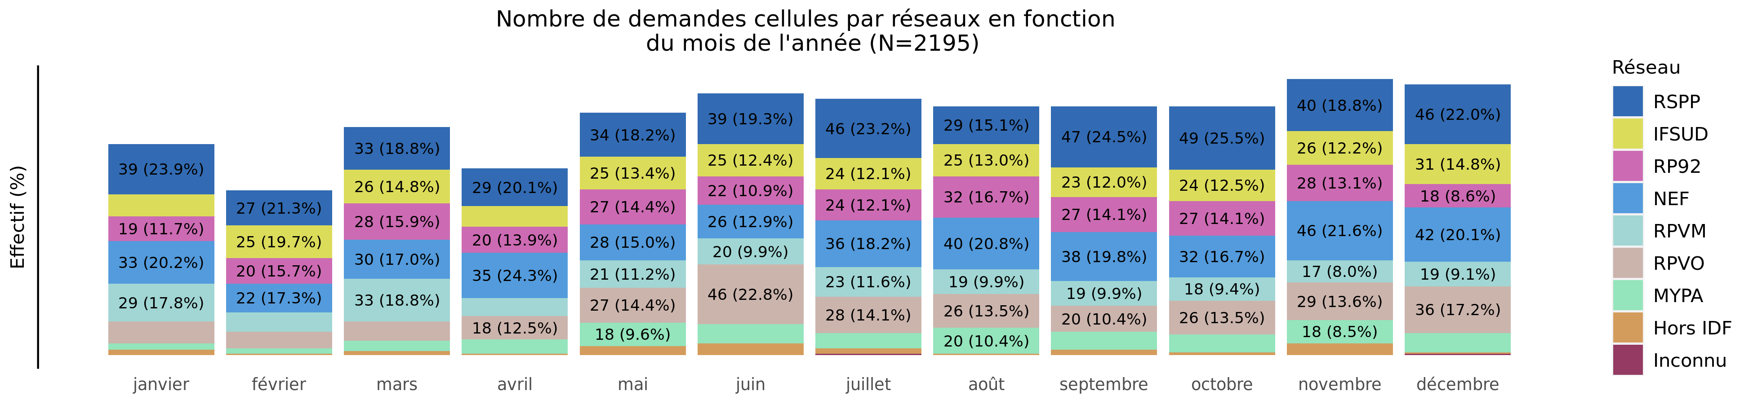
Nombre de demandes de TIU par réseau en 2022 (Transferts cellule)
02/11/2023
Variable | janvier | février | mars | avril | mai | juin | juillet | août | septembre | octobre | novembre | décembre | Total
RSPP | 39 (8.5%) | 27 (5.9%) | 33 (7.2%) | 29 (6.3%) | 34 (7.4%) | 39 (8.5%) | 46 (10.0%) | 29 (6.3%) | 47 (10.3%) | 49 (10.7%) | 40 (8.7%) | 46 (10.0%) | 458
IFSUD | 17 (5.9%) | 25 (8.7%) | 26 (9.1%) | 16 (5.6%) | 25 (8.7%) | 25 (8.7%) | 24 (8.4%) | 25 (8.7%) | 23 (8.0%) | 24 (8.4%) | 26 (9.1%) | 31 (10.8%) | 287
RP92 | 19 (6.5%) | 20 (6.8%) | 28 (9.6%) | 20 (6.8%) | 27 (9.2%) | 22 (7.5%) | 24 (8.2%) | 32 (11.0%) | 27 (9.2%) | 27 (9.2%) | 28 (9.6%) | 18 (6.2%) | 292
NEF | 33 (8.1%) | 22 (5.4%) | 30 (7.4%) | 35 (8.6%) | 28 (6.9%) | 26 (6.4%) | 36 (8.8%) | 40 (9.8%) | 38 (9.3%) | 32 (7.8%) | 46 (11.3%) | 42 (10.3%) | 408
RPVM | 29 (11.7%) | 15 (6.1%) | 33 (13.4%) | 14 (5.7%) | 21 (8.5%) | 20 (8.1%) | 23 (9.3%) | 19 (7.7%) | 19 (7.7%) | 18 (7.3%) | 17 (6.9%) | 19 (7.7%) | 247
RPVO | 17 (5.6%) | 13 (4.3%) | 15 (5.0%) | 18 (6.0%) | 27 (9.0%) | 46 (15.3%) | 28 (9.3%) | 26 (8.6%) | 20 (6.6%) | 26 (8.6%) | 29 (9.6%) | 36 (12.0%) | 301
MYPA | 5 (3.2%) | 4 (2.6%) | 8 (5.2%) | 11 (7.1%) | 18 (11.7%) | 15 (9.7%) | 12 (7.8%) | 20 (13.0%) | 14 (9.1%) | 14 (9.1%) | 18 (11.7%) | 15 (9.7%) | 154
Hors IDF | 4 (8.7%) | 1 (2.2%) | 3 (6.5%) | 1 (2.2%) | 7 (15.2%) | 9 (19.6%) | 4 (8.7%) | 1 (2.2%) | 4 (8.7%) | 2 (4.3%) | 9 (19.6%) | 1 (2.2%) | 46
Inconnu | 0 (0.0%) | 0 (0.0%) | 0 (0.0%) | 0 (0.0%) | 0 (0.0%) | 0 (0.0%) | 1 (50.0%) | 0 (0.0%) | 0 (0.0%) | 0 (0.0%) | 0 (0.0%) | 1 (50.0%) | 2
Total | 163 (7.4%) | 127 (5.8%) | 176 (8.0%) | 144 (6.6%) | 187 (8.5%) | 202 (9.2%) | 198 (9.0%) | 192 (8.7%) | 192 (8.7%) | 192 (8.7%) | 213 (9.7%) | 209 (9.5%) | 2195

Slide 8
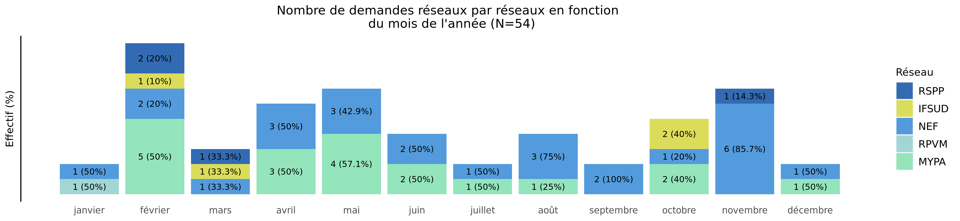
Nombre de demandes de TIU par réseau en 2022 (Transferts réseaux)
02/11/2023
Reseau | janvier | février | mars | avril | mai | juin | juillet | août | septembre | octobre | novembre | décembre | Total
RSPP | 0 (0.0%) | 2 (50.0%) | 1 (25.0%) | 0 (0.0%) | 0 (0.0%) | 0 (0.0%) | 0 (0.0%) | 0 (0.0%) | 0 (0.0%) | 0 (0.0%) | 1 (25.0%) | 0 (0.0%) | 4
IFSUD | 0 (0.0%) | 1 (25.0%) | 1 (25.0%) | 0 (0.0%) | 0 (0.0%) | 0 (0.0%) | 0 (0.0%) | 0 (0.0%) | 0 (0.0%) | 2 (50.0%) | 0 (0.0%) | 0 (0.0%) | 4
RP92 | 0 (0.0%) | 0 (0.0%) | 0 (0.0%) | 0 (0.0%) | 0 (0.0%) | 0 (0.0%) | 0 (0.0%) | 0 (0.0%) | 0 (0.0%) | 0 (0.0%) | 0 (0.0%) | 0 (0.0%) | 0
NEF | 1 (3.8%) | 2 (7.7%) | 1 (3.8%) | 3 (11.5%) | 3 (11.5%) | 2 (7.7%) | 1 (3.8%) | 3 (11.5%) | 2 (7.7%) | 1 (3.8%) | 6 (23.1%) | 1 (3.8%) | 26
RPVM | 1 (100.0%) | 0 (0.0%) | 0 (0.0%) | 0 (0.0%) | 0 (0.0%) | 0 (0.0%) | 0 (0.0%) | 0 (0.0%) | 0 (0.0%) | 0 (0.0%) | 0 (0.0%) | 0 (0.0%) | 1
RPVO | 0 (0.0%) | 0 (0.0%) | 0 (0.0%) | 0 (0.0%) | 0 (0.0%) | 0 (0.0%) | 0 (0.0%) | 0 (0.0%) | 0 (0.0%) | 0 (0.0%) | 0 (0.0%) | 0 (0.0%) | 0
MYPA | 0 (0.0%) | 5 (26.3%) | 0 (0.0%) | 3 (15.8%) | 4 (21.1%) | 2 (10.5%) | 1 (5.3%) | 1 (5.3%) | 0 (0.0%) | 2 (10.5%) | 0 (0.0%) | 1 (5.3%) | 19
Hors IDF | 0 (0.0%) | 0 (0.0%) | 0 (0.0%) | 0 (0.0%) | 0 (0.0%) | 0 (0.0%) | 0 (0.0%) | 0 (0.0%) | 0 (0.0%) | 0 (0.0%) | 0 (0.0%) | 0 (0.0%) | 0
Inconnu | 0 (0.0%) | 0 (0.0%) | 0 (0.0%) | 0 (0.0%) | 0 (0.0%) | 0 (0.0%) | 0 (0.0%) | 0 (0.0%) | 0 (0.0%) | 0 (0.0%) | 0 (0.0%) | 0 (0.0%) | 0
Total | 2 (3.7%) | 10 (18.5%) | 3 (5.6%) | 6 (11.1%) | 7 (13.0%) | 4 (7.4%) | 2 (3.7%) | 4 (7.4%) | 2 (3.7%) | 5 (9.3%) | 7 (13.0%) | 2 (3.7%) | 54

Slide 9
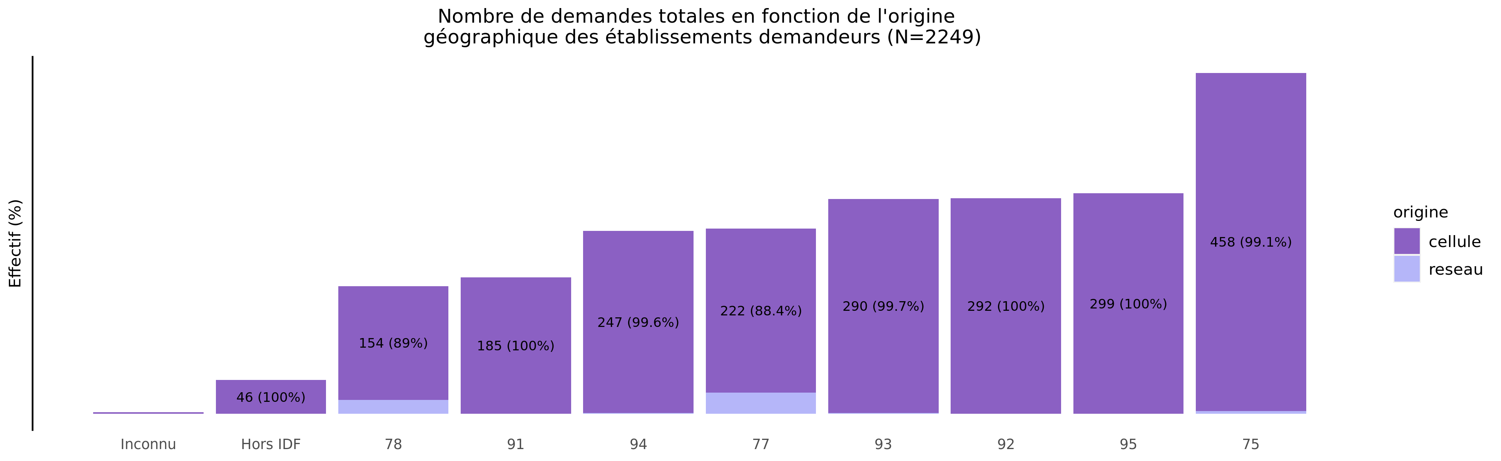
origine géographique des établissements demandeurs de TIU en 2022
02/11/2023
origine | Inconnu | Hors IDF | 78 | 91 | 94 | 77 | 93 | 92 | 95 | 75 | Total
cellule | 2 (0.1%) | 46 (2.1%) | 154 (7.0%) | 185 (8.4%) | 247 (11.3%) | 222 (10.1%) | 290 (13.2%) | 292 (13.3%) | 299 (13.6%) | 458 (20.9%) | 2195
reseau | 0 (0.0%) | 0 (0.0%) | 19 (35.2%) | 0 (0.0%) | 1 (1.9%) | 29 (53.7%) | 1 (1.9%) | 0 (0.0%) | 0 (0.0%) | 4 (7.4%) | 54
Total | 2 (0.1%) | 46 (2.0%) | 173 (7.7%) | 185 (8.2%) | 248 (11.0%) | 251 (11.2%) | 291 (12.9%) | 292 (13.0%) | 299 (13.3%) | 462 (20.5%) | 2249

Slide 10
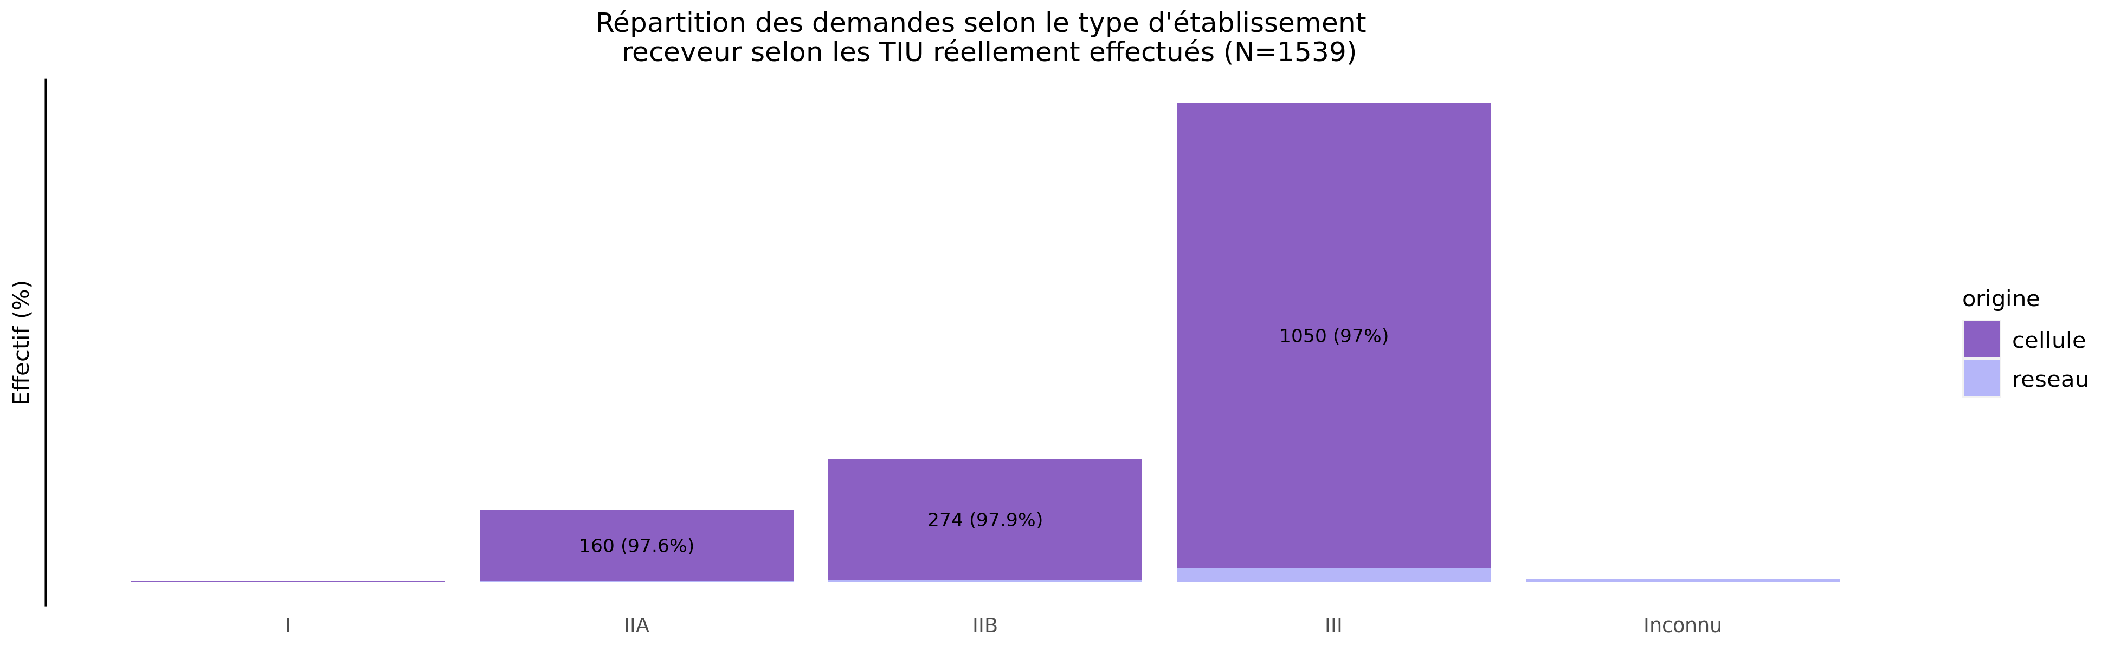
TIU par type d'établissement receveur en 2022
02/11/2023
origine | I | IIA | IIB | III | Urgence | Inconnu | Total
cellule | 3 (0.2%) | 160 (10.8%) | 274 (18.4%) | 1050 (70.6%) | 0 (0%) | 0 (0.0%) | 1487
reseau | 0 (0.0%) | 4 (7.7%) | 6 (11.5%) | 33 (63.5%) | 0 (0%) | 9 (17.3%) | 52
Total | 3 (0.2%) | 164 (10.7%) | 280 (18.2%) | 1083 (70.4%) | 0 (0%) | 9 (0.6%) | 1539

Slide 11
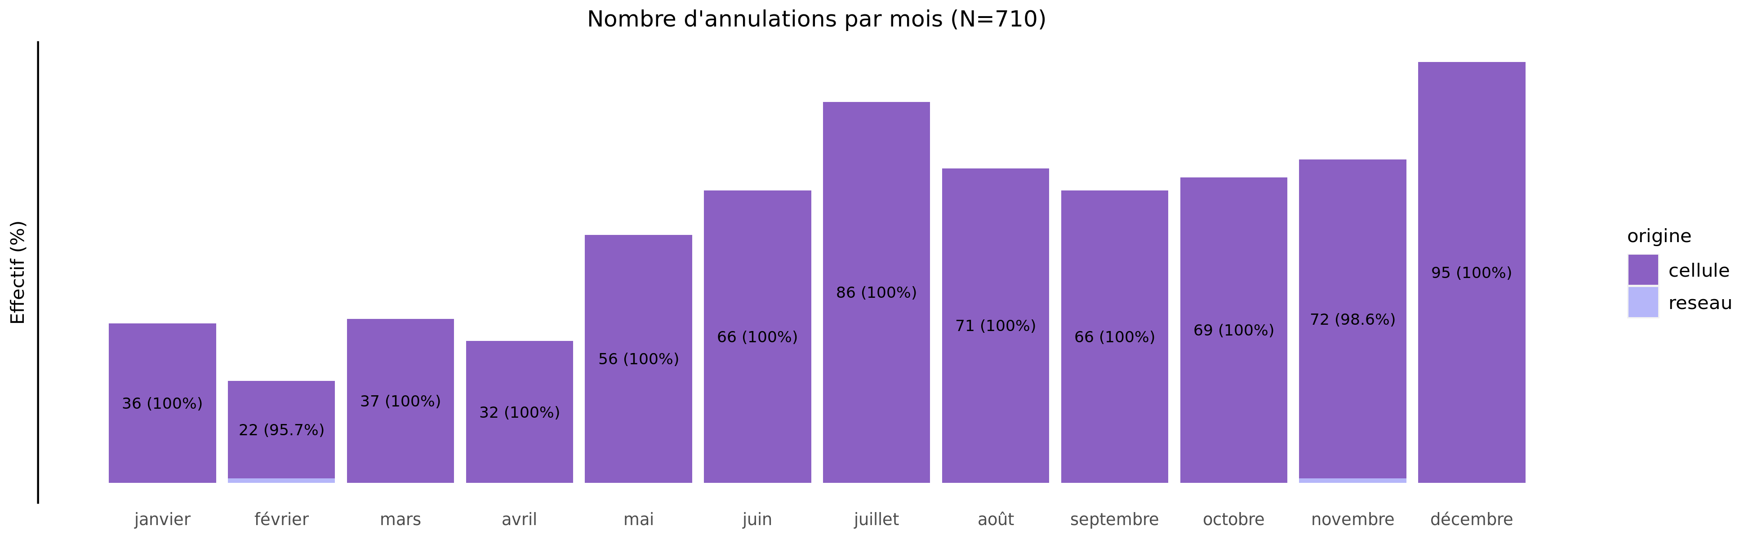
Annulation des demandes de TIU en 2022
02/11/2023
origine | janvier | février | mars | avril | mai | juin | juillet | août | septembre | octobre | novembre | décembre | Total
cellule | 36 (5.1%) | 22 (3.1%) | 37 (5.2%) | 32 (4.5%) | 56 (7.9%) | 66 (9.3%) | 86 (12.1%) | 71 (10%) | 66 (9.3%) | 69 (9.7%) | 72 (10.2%) | 95 (13.4%) | 708
reseau | 0 (0.0%) | 1 (50.0%) | 0 (0.0%) | 0 (0.0%) | 0 (0.0%) | 0 (0.0%) | 0 (0.0%) | 0 (0%) | 0 (0.0%) | 0 (0.0%) | 1 (50.0%) | 0 (0.0%) | 2
Total | 36 (5.1%) | 23 (3.2%) | 37 (5.2%) | 32 (4.5%) | 56 (7.9%) | 66 (9.3%) | 86 (12.1%) | 71 (10%) | 66 (9.3%) | 69 (9.7%) | 73 (10.3%) | 95 (13.4%) | 710

Slide 12
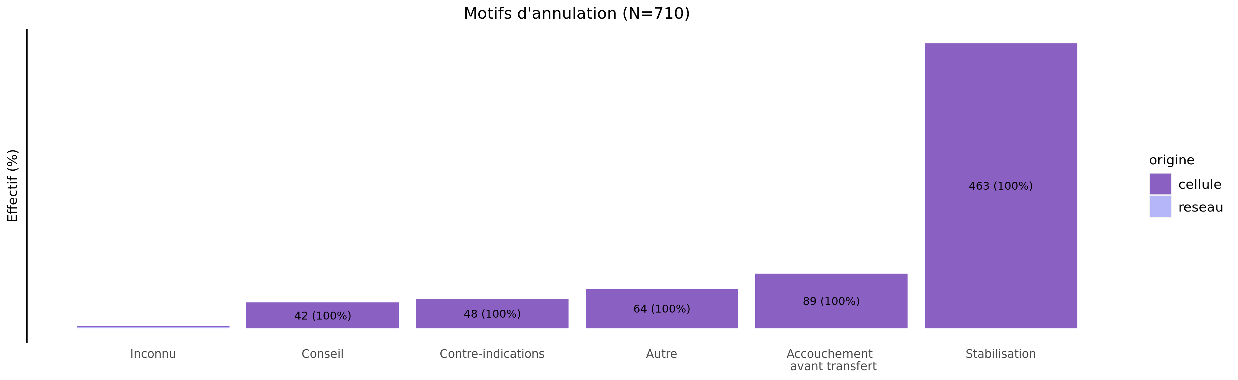
Motif d'annulation des demandes de TIU en 2022
02/11/2023
origine | Inconnu | Conseil | Contre-indications | Autre | Accouchement avant transfert | Stabilisation | Total
cellule | 2 (0.3%) | 42 (5.9%) | 48 (6.8%) | 64 (9%) | 89 (12.6%) | 463 (65.4%) | 708
reseau | 2 (100.0%) | 0 (0.0%) | 0 (0.0%) | 0 (0%) | 0 (0.0%) | 0 (0.0%) | 2
Total | 4 (0.6%) | 42 (5.9%) | 48 (6.8%) | 64 (9%) | 89 (12.5%) | 463 (65.2%) | 710

Slide 13
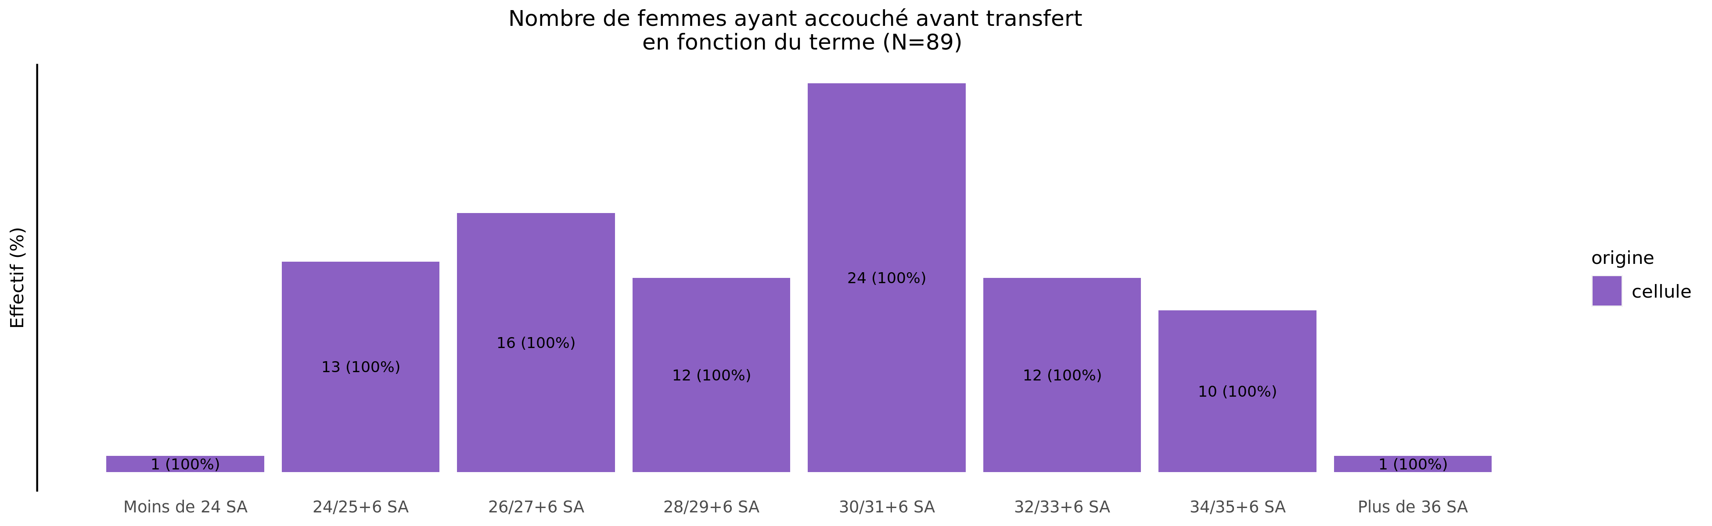
Termes des femmes ayant accouché avant transfert en 2022 (99 N.nés cellule et 0 N.nés réseaux)
02/11/2023
origine | Moins de 24 SA | 24/25+6 SA | 26/27+6 SA | 28/29+6 SA | 30/31+6 SA | 32/33+6 SA | 34/35+6 SA | Plus de 36 SA | Inconnu | Total
cellule | 1 (1.1%) | 13 (14.6%) | 16 (18%) | 12 (13.5%) | 24 (27%) | 12 (13.5%) | 10 (11.2%) | 1 (1.1%) | 0 (0%) | 89
Total | 1 (1.1%) | 13 (14.6%) | 16 (18%) | 12 (13.5%) | 24 (27%) | 12 (13.5%) | 10 (11.2%) | 1 (1.1%) | 0 (0%) | 89

Slide 14
Répartition des TIU en 2022 (Total des transferts)
02/11/2023
301 (13.4%)
85 (5.5%)
173 (7.7%)
434 (19.3%)
95 (6.2%)
314 (20.4%)
292 (13.0%)
462 (20.5%)
259 (16.8%)
416 (27.0%)
248 (11.0%)
188 (12.2%)
291 (12.9%)
46 (2.0%)
98 (6.4%)
75 (4.9%)
2 (0.1%)
9 (0.6%)

Slide 15
Répartition des TIU en 2022 (Transferts cellule)
02/11/2023
301 (13.7%)
84 (5.6%)
154 (7.0%)
408 (18.6%)
82 (5.5%)
294 (19.8%)
292 (13.3%)
458 (20.9%)
257 (17.3%)
411 (27.6%)
247 (11.3%)
186 (12.5%)
287 (13.1%)
46 (2.1%)
98 (6.6%)
75 (5.0%)
2 (0.1%)
0 (0.0%)

Slide 16
Répartition des TIU en 2022 (Transferts réseaux)
02/11/2023
0 (0.0%)
1 (1.9%)
19 (35.2%)
26 (48.1%)
13 (25.0%)
20 (38.5%)
0 (0.0%)
4 (7.4%)
2 (3.8%)
5 (9.6%)
1 (1.9%)
2 (3.8%)
4 (7.4%)
0 (0.0%)
0 (0.0%)
0 (0.0%)
0 (0.0%)
9 (17.3%)

Slide 17
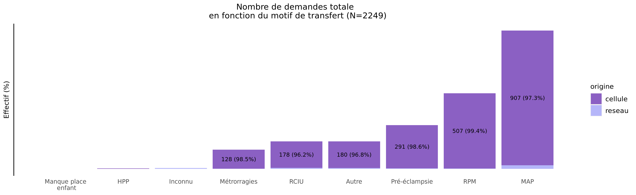
Motif de transfert principal en 2022
02/11/2023
origine | Manque place enfant | HPP | Inconnu | Métrorragies | RCIU | Autre | Pré-éclampsie | RPM | MAP | Total
cellule | 0 (0.0%) | 4 (0.2%) | 0 (0.0%) | 128 (5.8%) | 178 (8.1%) | 180 (8.2%) | 291 (13.3%) | 507 (23.1%) | 907 (41.3%) | 2195
reseau | 1 (1.9%) | 0 (0.0%) | 6 (11.1%) | 2 (3.7%) | 7 (13.0%) | 6 (11.1%) | 4 (7.4%) | 3 (5.6%) | 25 (46.3%) | 54
Total | 1 (0.0%) | 4 (0.2%) | 6 (0.3%) | 130 (5.8%) | 185 (8.2%) | 186 (8.3%) | 295 (13.1%) | 510 (22.7%) | 932 (41.4%) | 2249

Slide 18
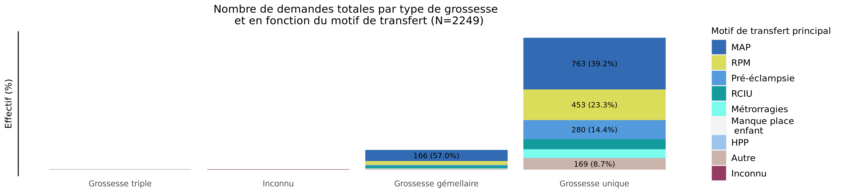
Type de grossesse par motif de transfert en 2022 (Total des transferts)
02/11/2023
Motif | Grossesse triple | Inconnu | Grossesse gémellaire | Grossesse unique | Total
MAP | 3 (0.3%) | 0 (0.0%) | 166 (17.8%) | 763 (81.9%) | 932
RPM | 2 (0.4%) | 0 (0.0%) | 55 (10.8%) | 453 (88.8%) | 510
Pré-éclampsie | 0 (0.0%) | 0 (0.0%) | 15 (5.1%) | 280 (94.9%) | 295
RCIU | 0 (0.0%) | 1 (0.5%) | 34 (18.4%) | 150 (81.1%) | 185
Métrorragies | 0 (0.0%) | 0 (0.0%) | 4 (3.1%) | 126 (96.9%) | 130
Manque place mère | 0 (0.0%) | 0 (0.0%) | 0 (0.0%) | 0 (0.0%) | 0
Manque place enfant | 0 (0.0%) | 0 (0.0%) | 0 (0.0%) | 1 (100.0%) | 1
HPP | 0 (0.0%) | 0 (0.0%) | 0 (0.0%) | 4 (100.0%) | 4
Autre | 0 (0.0%) | 0 (0.0%) | 17 (9.1%) | 169 (90.9%) | 186
Inconnu | 0 (0.0%) | 6 (100.0%) | 0 (0.0%) | 0 (0.0%) | 6
Total | 5 (0.2%) | 7 (0.3%) | 291 (12.9%) | 1946 (86.5%) | 2249

Slide 19
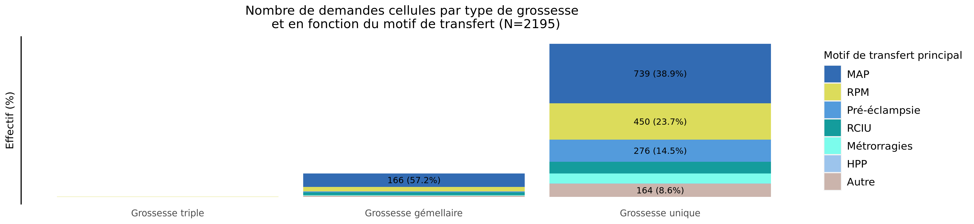
Type de grossesse par motif de transfert en 2022 (Transferts cellule)
02/11/2023
Motif | Grossesse triple | Grossesse gémellaire | Grossesse unique | Total
MAP | 2 (0.2%) | 166 (18.3%) | 739 (81.5%) | 907
RPM | 2 (0.4%) | 55 (10.8%) | 450 (88.8%) | 507
Pré-éclampsie | 0 (0.0%) | 15 (5.2%) | 276 (94.8%) | 291
RCIU | 0 (0.0%) | 34 (19.1%) | 144 (80.9%) | 178
Métrorragies | 0 (0.0%) | 4 (3.1%) | 124 (96.9%) | 128
Manque place mère | 0 (0.0%) | 0 (0.0%) | 0 (0.0%) | 0
Manque place enfant | 0 (0.0%) | 0 (0.0%) | 0 (0.0%) | 0
HPP | 0 (0.0%) | 0 (0.0%) | 4 (100.0%) | 4
Autre | 0 (0.0%) | 16 (8.9%) | 164 (91.1%) | 180
Inconnu | 0 (0.0%) | 0 (0.0%) | 0 (0.0%) | 0
Total | 4 (0.2%) | 290 (13.2%) | 1901 (86.6%) | 2195

Slide 20
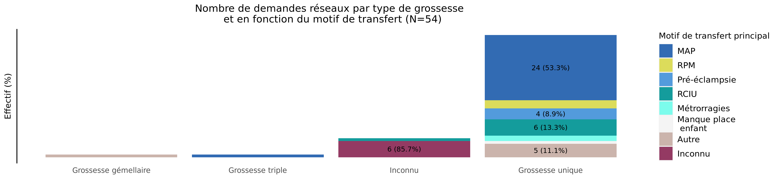
Type de grossesse par motif de transfert en 2022 (Transferts réseaux)
02/11/2023
Motif | Grossesse gémellaire | Grossesse triple | Inconnu | Grossesse unique | Total
MAP | 0 (0.0%) | 1 (4.0%) | 0 (0.0%) | 24 (96.0%) | 25
RPM | 0 (0.0%) | 0 (0.0%) | 0 (0.0%) | 3 (100.0%) | 3
Pré-éclampsie | 0 (0.0%) | 0 (0.0%) | 0 (0.0%) | 4 (100.0%) | 4
RCIU | 0 (0.0%) | 0 (0.0%) | 1 (14.3%) | 6 (85.7%) | 7
Métrorragies | 0 (0.0%) | 0 (0.0%) | 0 (0.0%) | 2 (100.0%) | 2
Manque place mère | 0 (0.0%) | 0 (0.0%) | 0 (0.0%) | 0 (0.0%) | 0
Manque place enfant | 0 (0.0%) | 0 (0.0%) | 0 (0.0%) | 1 (100.0%) | 1
HPP | 0 (0.0%) | 0 (0.0%) | 0 (0.0%) | 0 (0.0%) | 0
Autre | 1 (16.7%) | 0 (0.0%) | 0 (0.0%) | 5 (83.3%) | 6
Inconnu | 0 (0.0%) | 0 (0.0%) | 6 (100.0%) | 0 (0.0%) | 6
Total | 1 (1.9%) | 1 (1.9%) | 7 (13.0%) | 45 (83.3%) | 54

Slide 21
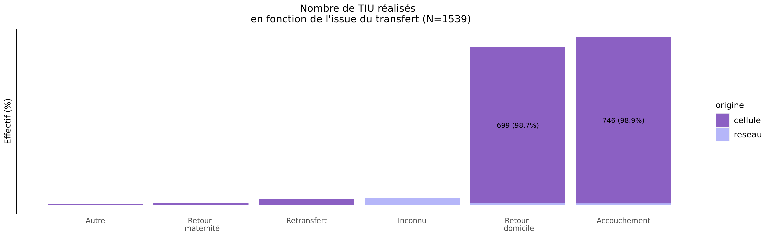
issue des transferts réalisés en 2022
02/11/2023
origine | Autre | Retour maternité | Retransfert | Inconnu | Retour domicile | Accouchement | Total
cellule | 4 (0.3%) | 10 (0.7%) | 28 (1.9%) | 0 (0.0%) | 699 (47.0%) | 746 (50.2%) | 1487
reseau | 1 (1.9%) | 2 (3.8%) | 0 (0.0%) | 32 (61.5%) | 9 (17.3%) | 8 (15.4%) | 52
Total | 5 (0.3%) | 12 (0.8%) | 28 (1.8%) | 32 (2.1%) | 708 (46.0%) | 754 (49.0%) | 1539

Slide 22
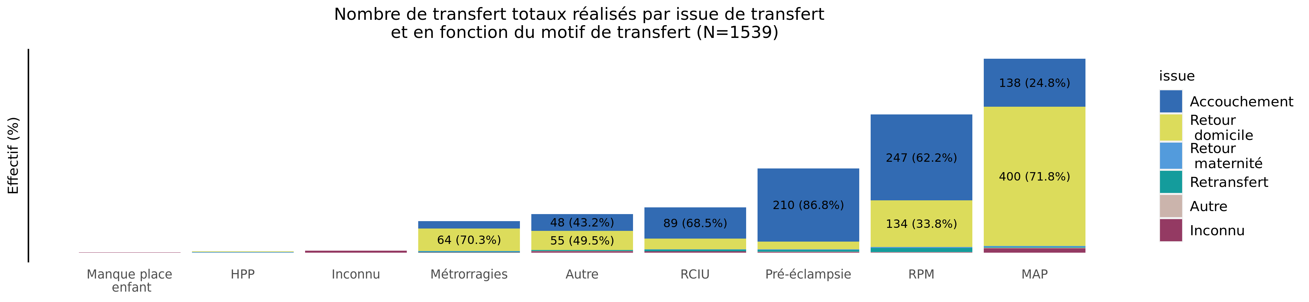
Issue de transfert réalisé selon le motif de TIU en 2022 (Total des transferts)
02/11/2023
issue | Manque place enfant | HPP | Inconnu | Métrorragies | Autre | RCIU | Pré-éclampsie | RPM | MAP | Total
Accouchement | 0 (0.0%) | 0 (0.0%) | 0 (0.0%) | 22 (2.9%) | 48 (6.4%) | 89 (11.8%) | 210 (27.9%) | 247 (32.8%) | 138 (18.3%) | 754
Retour domicile | 0 (0.0%) | 2 (0.3%) | 0 (0.0%) | 64 (9.0%) | 55 (7.8%) | 31 (4.4%) | 22 (3.1%) | 134 (18.9%) | 400 (56.5%) | 708
Retour maternité | 0 (0.0%) | 2 (16.7%) | 0 (0.0%) | 2 (16.7%) | 0 (0.0%) | 1 (8.3%) | 2 (16.7%) | 2 (16.7%) | 3 (25.0%) | 12
Retransfert | 0 (0.0%) | 0 (0.0%) | 0 (0.0%) | 2 (7.1%) | 3 (10.7%) | 5 (17.9%) | 5 (17.9%) | 12 (42.9%) | 1 (3.6%) | 28
Autre | 0 (0.0%) | 0 (0.0%) | 0 (0.0%) | 0 (0.0%) | 1 (20.0%) | 0 (0.0%) | 1 (20.0%) | 1 (20.0%) | 2 (40.0%) | 5
Inconnu | 1 (3.1%) | 0 (0.0%) | 6 (18.8%) | 1 (3.1%) | 4 (12.5%) | 4 (12.5%) | 2 (6.2%) | 1 (3.1%) | 13 (40.6%) | 32
Total | 1 (0.1%) | 4 (0.3%) | 6 (0.4%) | 91 (5.9%) | 111 (7.2%) | 130 (8.4%) | 242 (15.7%) | 397 (25.8%) | 557 (36.2%) | 1539

Slide 23
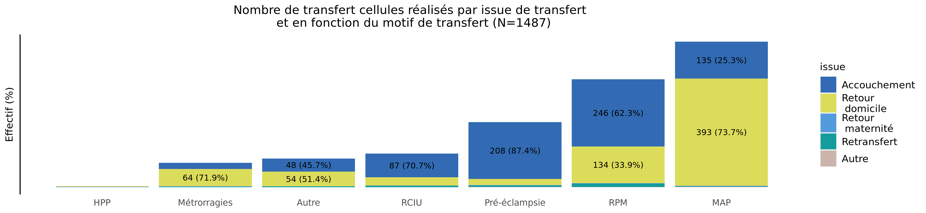
Issue de transfert réalisé selon le motif de TIU en 2022 (Transferts cellule)
02/11/2023
issue | HPP | Métrorragies | Autre | RCIU | Pré-éclampsie | RPM | MAP | Total
Accouchement | 0 (0.0%) | 22 (2.9%) | 48 (6.4%) | 87 (11.7%) | 208 (27.9%) | 246 (33.0%) | 135 (18.1%) | 746
Retour domicile | 2 (0.3%) | 64 (9.2%) | 54 (7.7%) | 30 (4.3%) | 22 (3.1%) | 134 (19.2%) | 393 (56.2%) | 699
Retour maternité | 2 (20.0%) | 1 (10.0%) | 0 (0.0%) | 1 (10.0%) | 2 (20.0%) | 2 (20.0%) | 2 (20.0%) | 10
Retransfert | 0 (0.0%) | 2 (7.1%) | 3 (10.7%) | 5 (17.9%) | 5 (17.9%) | 12 (42.9%) | 1 (3.6%) | 28
Autre | 0 (0.0%) | 0 (0.0%) | 0 (0.0%) | 0 (0.0%) | 1 (25.0%) | 1 (25.0%) | 2 (50.0%) | 4
Inconnu | 0 (0.0%) | 0 (0.0%) | 0 (0.0%) | 0 (0.0%) | 0 (0.0%) | 0 (0.0%) | 0 (0.0%) | 0
Total | 4 (0.3%) | 89 (6.0%) | 105 (7.1%) | 123 (8.3%) | 238 (16.0%) | 395 (26.6%) | 533 (35.8%) | 1487

Slide 24
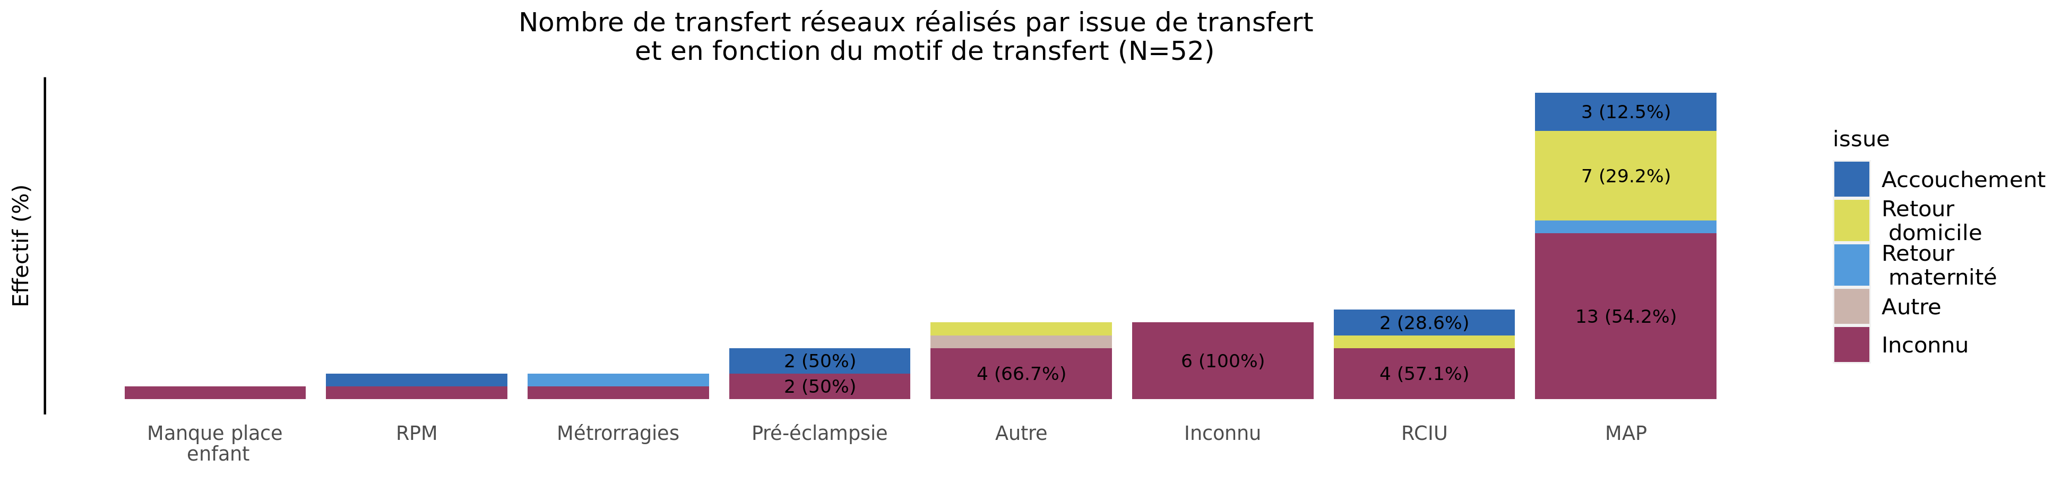
Issue de transfert réalisé selon le motif de TIU en 2022 (Transferts réseaux)
02/11/2023
issue | Manque place enfant | RPM | Métrorragies | Pré-éclampsie | Autre | Inconnu | RCIU | MAP | Total
Accouchement | 0 (0.0%) | 1 (12.5%) | 0 (0.0%) | 2 (25.0%) | 0 (0.0%) | 0 (0.0%) | 2 (25.0%) | 3 (37.5%) | 8
Retour domicile | 0 (0.0%) | 0 (0.0%) | 0 (0.0%) | 0 (0.0%) | 1 (11.1%) | 0 (0.0%) | 1 (11.1%) | 7 (77.8%) | 9
Retour maternité | 0 (0.0%) | 0 (0.0%) | 1 (50.0%) | 0 (0.0%) | 0 (0.0%) | 0 (0.0%) | 0 (0.0%) | 1 (50.0%) | 2
Retransfert | 0 (0.0%) | 0 (0.0%) | 0 (0.0%) | 0 (0.0%) | 0 (0.0%) | 0 (0.0%) | 0 (0.0%) | 0 (0.0%) | 0
Autre | 0 (0.0%) | 0 (0.0%) | 0 (0.0%) | 0 (0.0%) | 1 (100.0%) | 0 (0.0%) | 0 (0.0%) | 0 (0.0%) | 1
Inconnu | 1 (3.1%) | 1 (3.1%) | 1 (3.1%) | 2 (6.2%) | 4 (12.5%) | 6 (18.8%) | 4 (12.5%) | 13 (40.6%) | 32
Total | 1 (1.9%) | 2 (3.8%) | 2 (3.8%) | 4 (7.7%) | 6 (11.5%) | 6 (11.5%) | 7 (13.5%) | 24 (46.2%) | 52

Slide 25
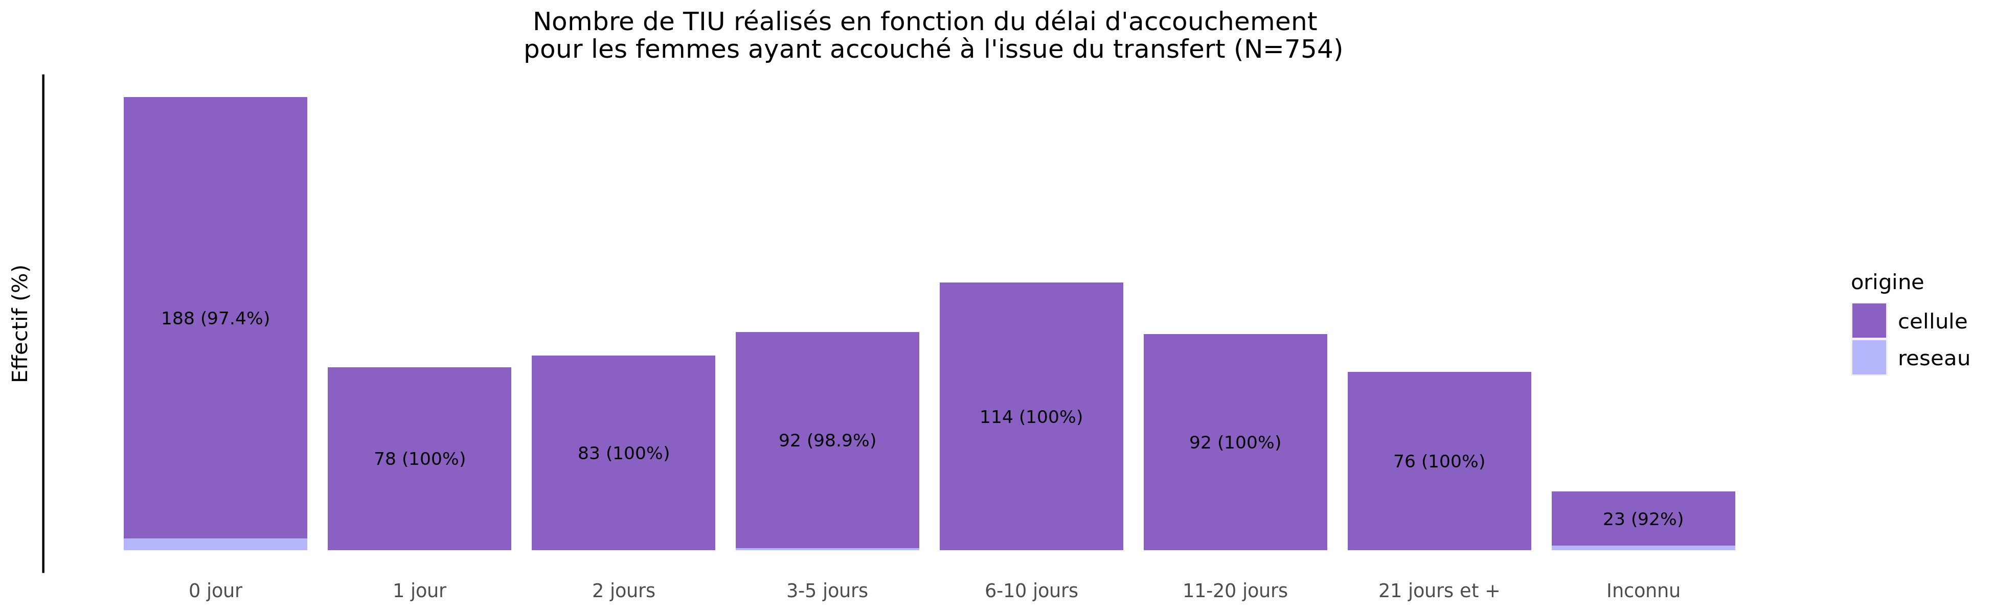
Délai d'accouchement des TIU réalisés en 2022
02/11/2023
origine | 0 jour | 1 jour | 2 jours | 3-5 jours | 6-10 jours | 11-20 jours | 21 jours et + | Inconnu | Total
cellule | 188 (25.2%) | 78 (10.5%) | 83 (11.1%) | 92 (12.3%) | 114 (15.3%) | 92 (12.3%) | 76 (10.2%) | 23 (3.1%) | 746
reseau | 5 (62.5%) | 0 (0.0%) | 0 (0.0%) | 1 (12.5%) | 0 (0.0%) | 0 (0.0%) | 0 (0.0%) | 2 (25.0%) | 8
Total | 193 (25.6%) | 78 (10.3%) | 83 (11.0%) | 93 (12.3%) | 114 (15.1%) | 92 (12.2%) | 76 (10.1%) | 25 (3.3%) | 754

Slide 26
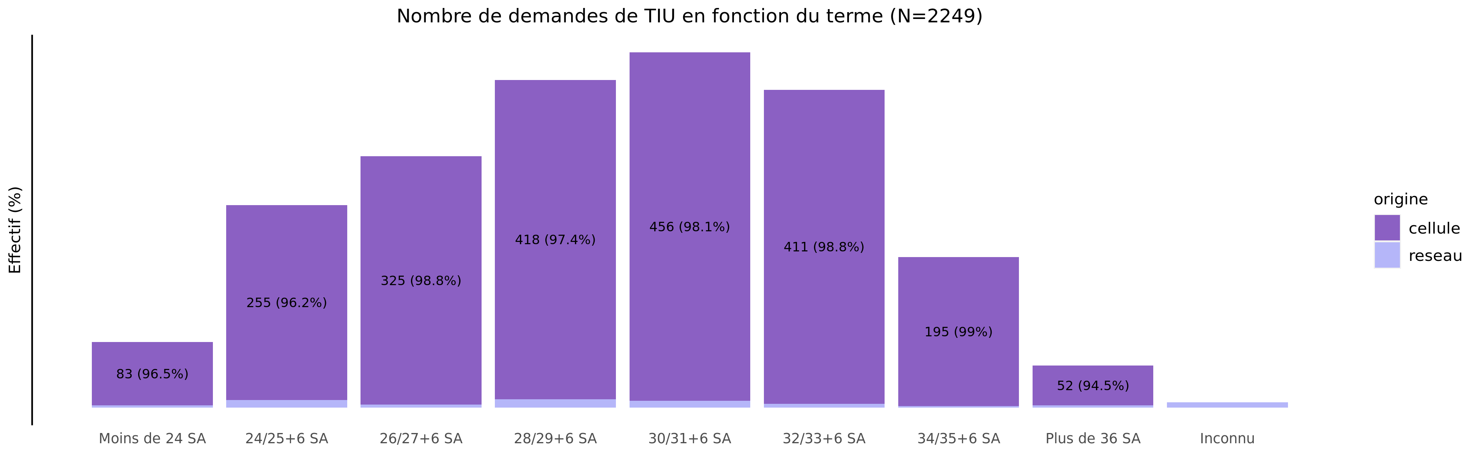
Termes des demandes de transfert en 2022
02/11/2023
origine | Moins de 24 SA | 24/25+6 SA | 26/27+6 SA | 28/29+6 SA | 30/31+6 SA | 32/33+6 SA | 34/35+6 SA | Plus de 36 SA | Inconnu | Total
cellule | 83 (3.8%) | 255 (11.6%) | 325 (14.8%) | 418 (19.0%) | 456 (20.8%) | 411 (18.7%) | 195 (8.9%) | 52 (2.4%) | 0 (0.0%) | 2195
reseau | 3 (5.6%) | 10 (18.5%) | 4 (7.4%) | 11 (20.4%) | 9 (16.7%) | 5 (9.3%) | 2 (3.7%) | 3 (5.6%) | 7 (13.0%) | 54
Total | 86 (3.8%) | 265 (11.8%) | 329 (14.6%) | 429 (19.1%) | 465 (20.7%) | 416 (18.5%) | 197 (8.8%) | 55 (2.4%) | 7 (0.3%) | 2249

Slide 27
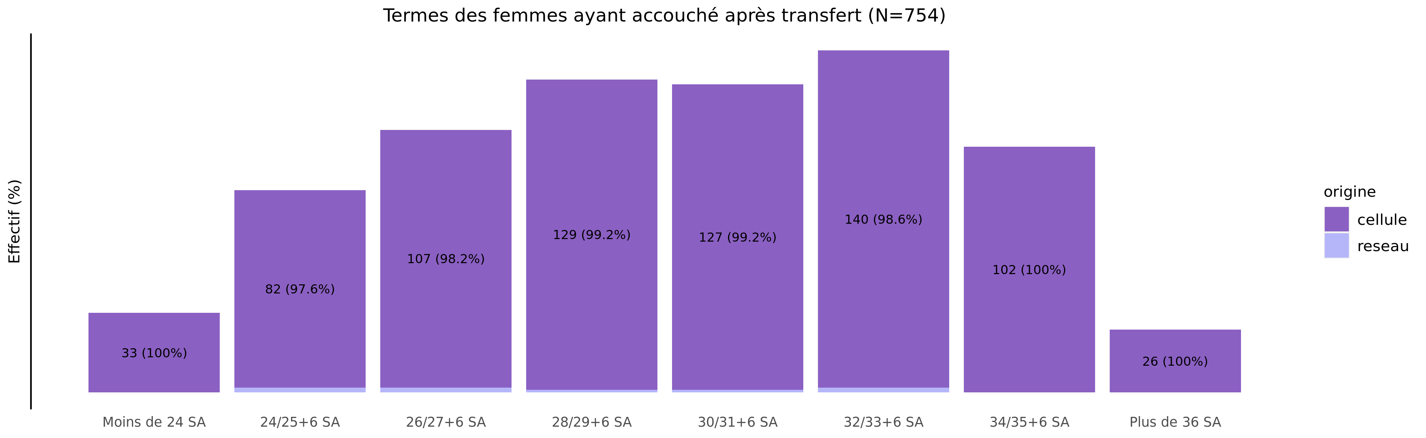
Les accouchements suite à TIU en 2022 - terme
02/11/2023
origine | Moins de 24 SA | 24/25+6 SA | 26/27+6 SA | 28/29+6 SA | 30/31+6 SA | 32/33+6 SA | 34/35+6 SA | Plus de 36 SA | Inconnu | Total
cellule | 33 (4.4%) | 82 (11.0%) | 107 (14.3%) | 129 (17.3%) | 127 (17.0%) | 140 (18.8%) | 102 (13.7%) | 26 (3.5%) | 0 (0%) | 746
reseau | 0 (0.0%) | 2 (25.0%) | 2 (25.0%) | 1 (12.5%) | 1 (12.5%) | 2 (25.0%) | 0 (0.0%) | 0 (0.0%) | 0 (0%) | 8
Total | 33 (4.4%) | 84 (11.1%) | 109 (14.5%) | 130 (17.2%) | 128 (17.0%) | 142 (18.8%) | 102 (13.5%) | 26 (3.4%) | 0 (0%) | 754

Slide 28
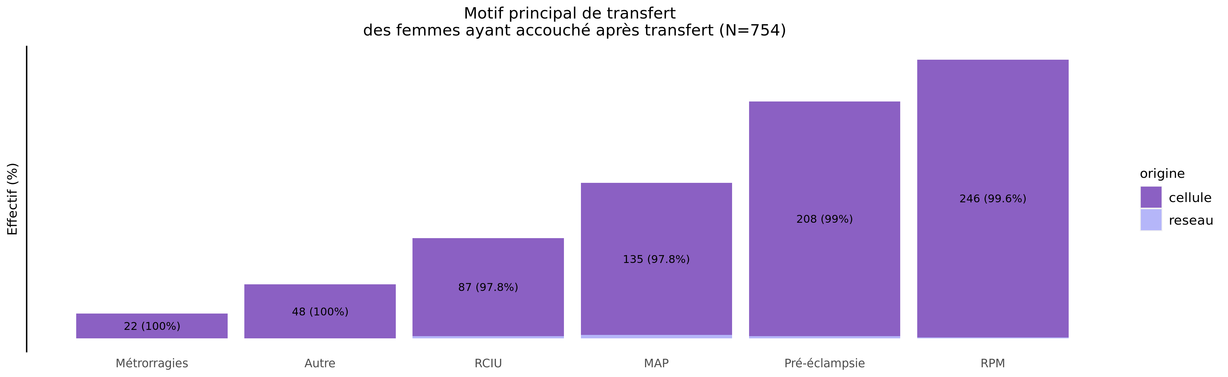
Les accouchements suite à TIU en 2022 - motif de transfert
02/11/2023
origine | MAP | RPM | Pré-éclampsie | RCIU | Métrorragies | Manque place mère | Manque place enfant | HPP | Autre | Inconnu | Total
cellule | 135 (18.1%) | 246 (33.0%) | 208 (27.9%) | 87 (11.7%) | 22 (2.9%) | 0 (0%) | 0 (0%) | 0 (0%) | 48 (6.4%) | 0 (0%) | 746
reseau | 3 (37.5%) | 1 (12.5%) | 2 (25.0%) | 2 (25.0%) | 0 (0.0%) | 0 (0%) | 0 (0%) | 0 (0%) | 0 (0.0%) | 0 (0%) | 8
Total | 138 (18.3%) | 247 (32.8%) | 210 (27.9%) | 89 (11.8%) | 22 (2.9%) | 0 (0%) | 0 (0%) | 0 (0%) | 48 (6.4%) | 0 (0%) | 754

Slide 29
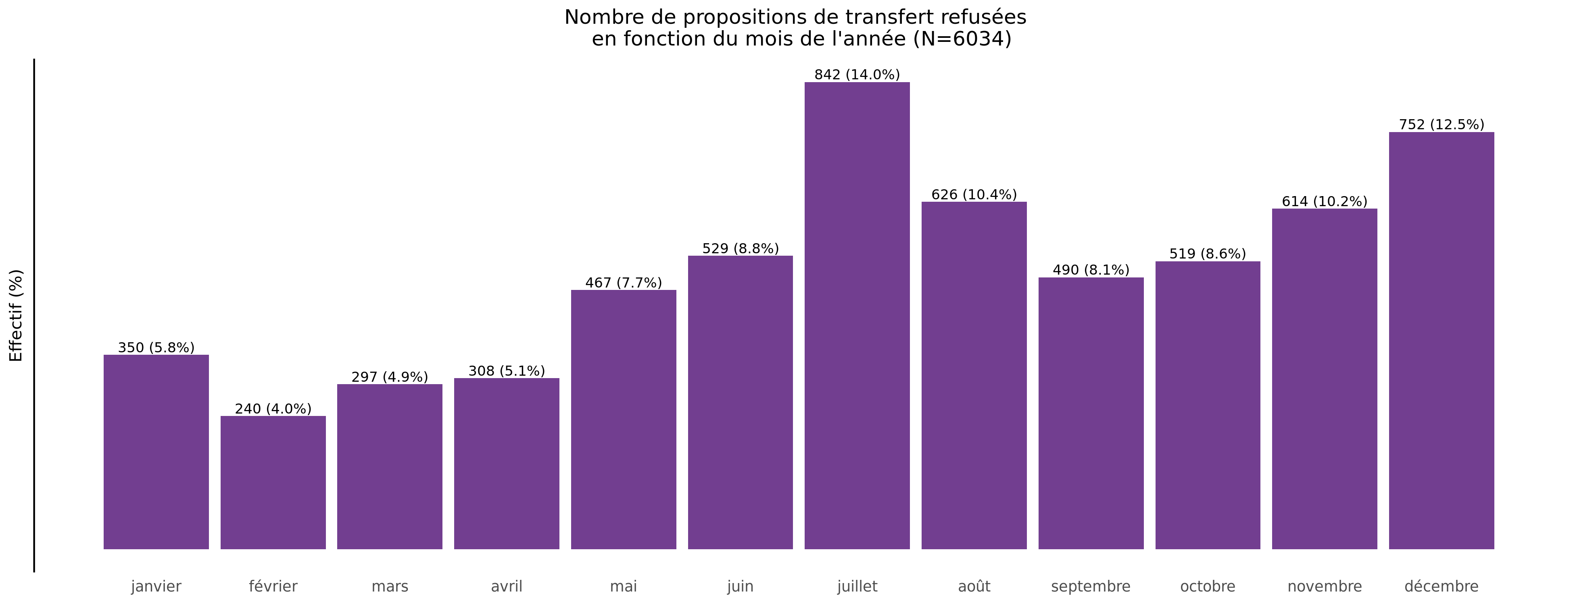
Nombre de propositions de transfert refusées en 2022
02/11/2023

Slide 30
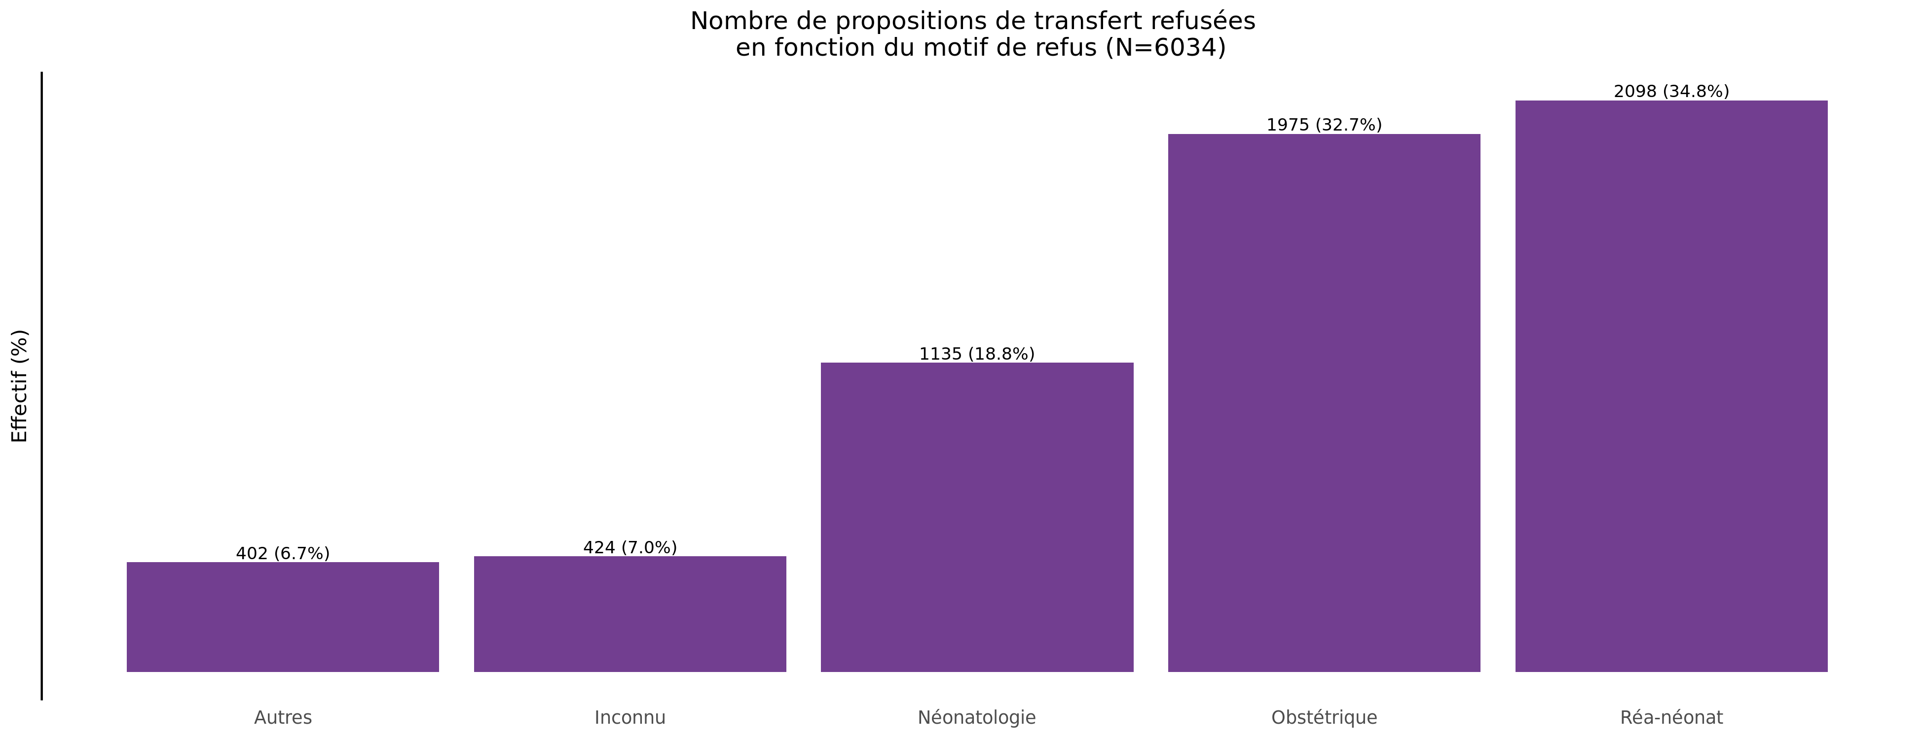
Motif des propositions de transfert refusées en 2022
02/11/2023

Slide 31
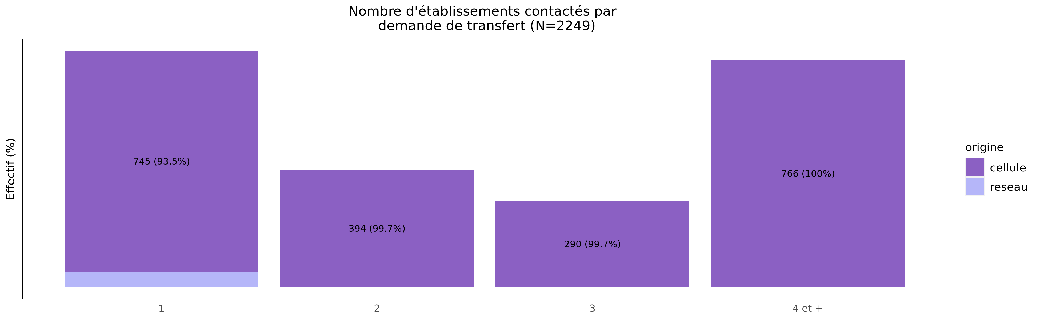
Nombre d'établissements contactés par demande en 2022
02/11/2023
origine | 1 | 2 | 3 | 4 et + | Total
cellule | 745 (33.9%) | 394 (17.9%) | 290 (13.2%) | 766 (34.9%) | 2195
reseau | 52 (96.3%) | 1 (1.9%) | 1 (1.9%) | 0 (0.0%) | 54
Total | 797 (35.4%) | 395 (17.6%) | 291 (12.9%) | 766 (34.1%) | 2249

Slide 32
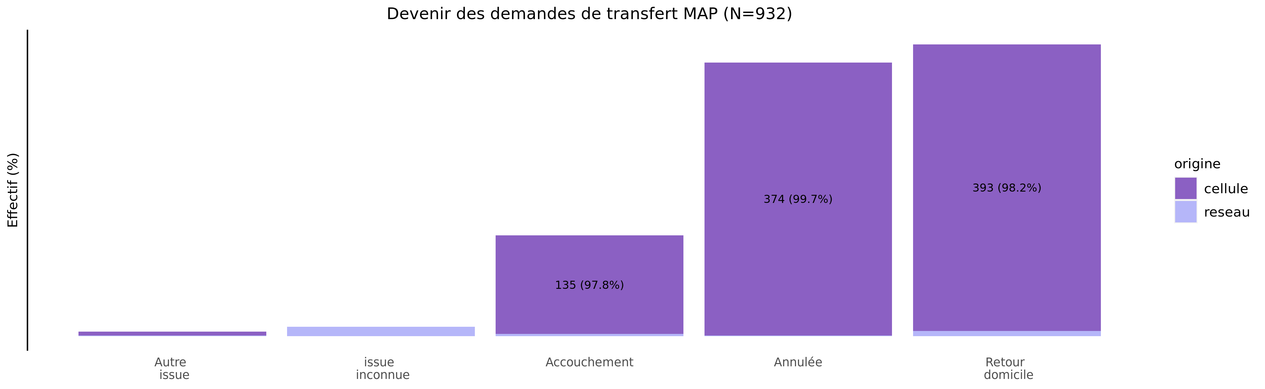
Devenir des demandes de MAP en 2022
02/11/2023
origine | Autre issue | issue inconnue | Accouchement | Annulée | Retour domicile | Total
cellule | 5 (0.6%) | 0 (0.0%) | 135 (14.9%) | 374 (41.2%) | 393 (43.3%) | 907
reseau | 1 (4.0%) | 13 (52.0%) | 3 (12.0%) | 1 (4.0%) | 7 (28.0%) | 25
Total | 6 (0.6%) | 13 (1.4%) | 138 (14.8%) | 375 (40.2%) | 400 (42.9%) | 932

Slide 33
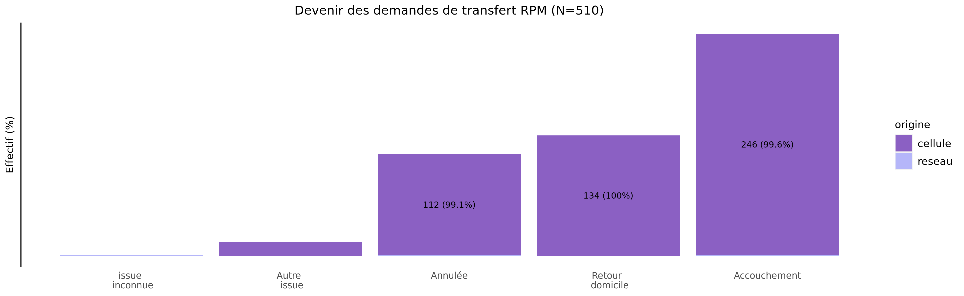
Devenir des demandes de RPM en 2022
02/11/2023
origine | issue inconnue | Autre issue | Annulée | Retour domicile | Accouchement | Total
cellule | 0 (0.0%) | 15 (3.0%) | 112 (22.1%) | 134 (26.4%) | 246 (48.5%) | 507
reseau | 1 (33.3%) | 0 (0.0%) | 1 (33.3%) | 0 (0.0%) | 1 (33.3%) | 3
Total | 1 (0.2%) | 15 (2.9%) | 113 (22.2%) | 134 (26.3%) | 247 (48.4%) | 510

