Slide 1
Île de France
Jeudi 2 Novembre 2023

Slide 2
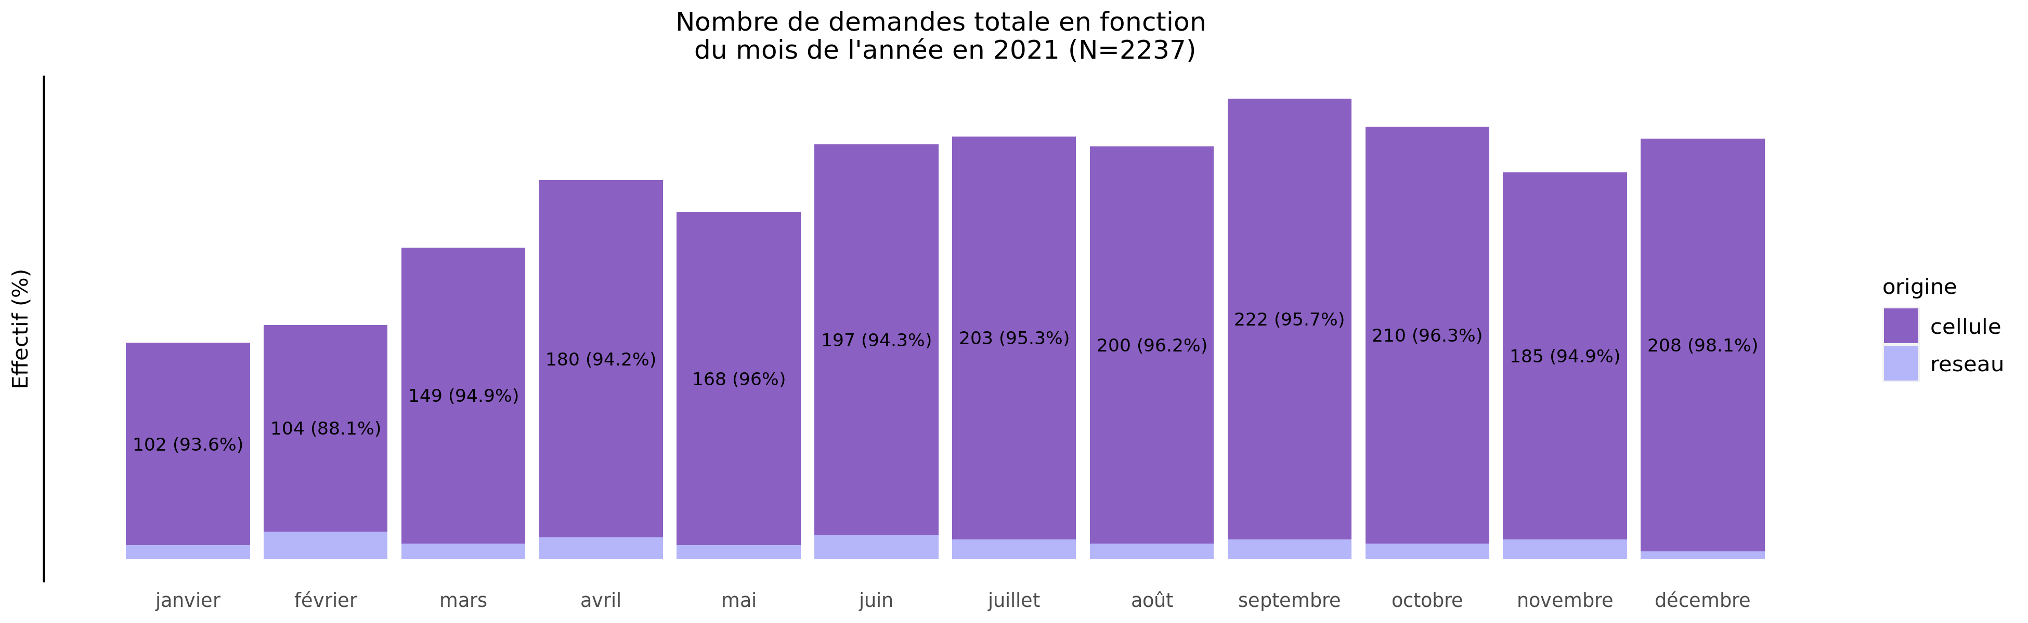
Nombre de demandes de TIU en 2021
02/11/2023
origine | janvier | février | mars | avril | mai | juin | juillet | août | septembre | octobre | novembre | décembre | Total
cellule | 102 (4.8%) | 104 (4.9%) | 149 (7.0%) | 180 (8.5%) | 168 (7.9%) | 197 (9.3%) | 203 (9.5%) | 200 (9.4%) | 222 (10.4%) | 210 (9.9%) | 185 (8.7%) | 208 (9.8%) | 2128
reseau | 7 (6.4%) | 14 (12.8%) | 8 (7.3%) | 11 (10.1%) | 7 (6.4%) | 12 (11.0%) | 10 (9.2%) | 8 (7.3%) | 10 (9.2%) | 8 (7.3%) | 10 (9.2%) | 4 (3.7%) | 109
Total | 109 (4.9%) | 118 (5.3%) | 157 (7.0%) | 191 (8.5%) | 175 (7.8%) | 209 (9.3%) | 213 (9.5%) | 208 (9.3%) | 232 (10.4%) | 218 (9.7%) | 195 (8.7%) | 212 (9.5%) | 2237

Slide 3
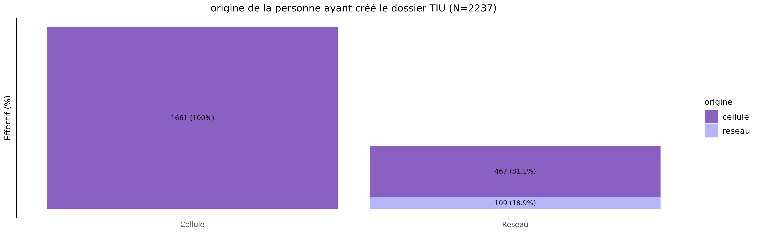
origine des demandes de TIU en 2021
02/11/2023
origine | Cellule | Reseau | Total
cellule | 1661 (78.1%) | 467 (21.9%) | 2128
reseau | 0 (0.0%) | 109 (100.0%) | 109
Total | 1661 (74.3%) | 576 (25.7%) | 2237

Slide 4
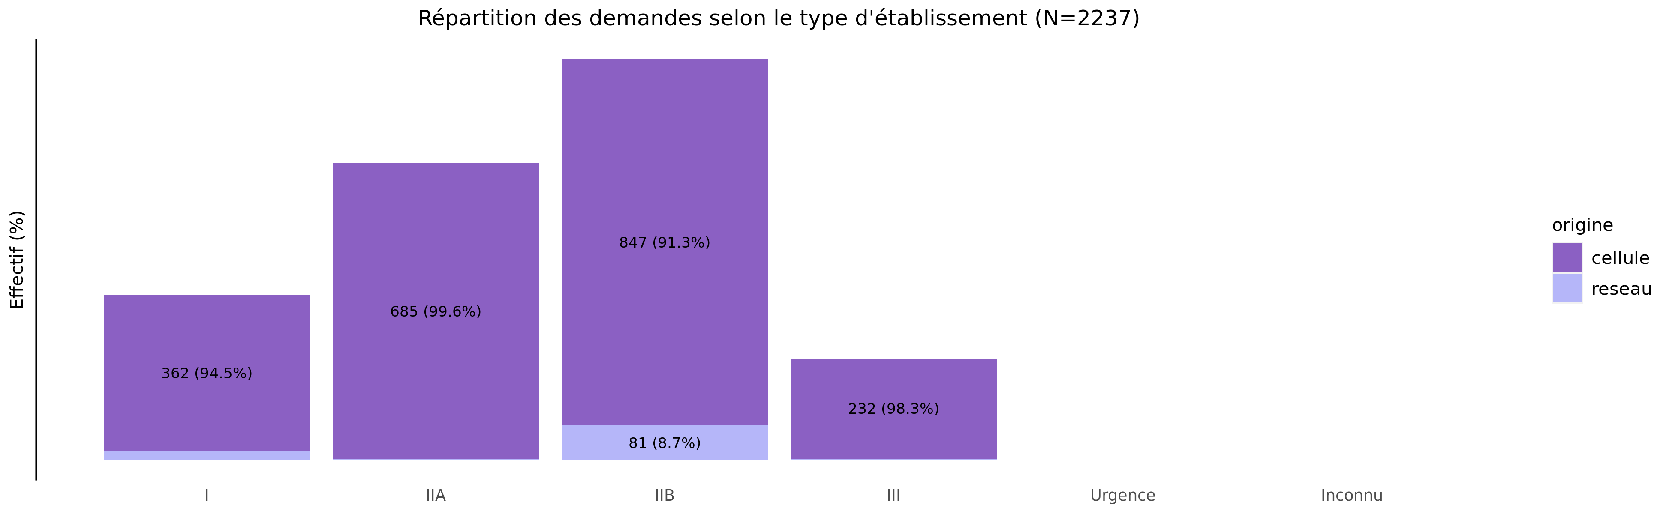
TIU par type d'établissement demandeur en 2021
02/11/2023
origine | I | IIA | IIB | III | Urgence | Inconnu | Total
cellule | 362 (17.0%) | 685 (32.2%) | 847 (39.8%) | 232 (10.9%) | 1 (0%) | 1 (0%) | 2128
reseau | 21 (19.3%) | 3 (2.8%) | 81 (74.3%) | 4 (3.7%) | 0 (0%) | 0 (0%) | 109
Total | 383 (17.1%) | 688 (30.8%) | 928 (41.5%) | 236 (10.5%) | 1 (0%) | 1 (0%) | 2237

Slide 5
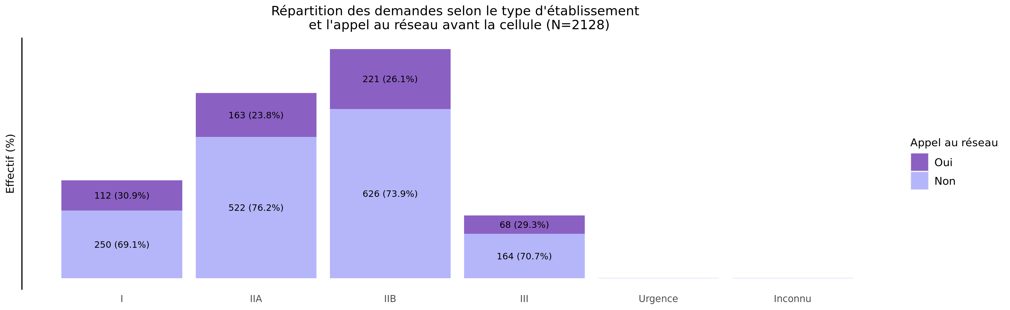
L'établissement a-t-il appelé le réseau avant la cellule?
02/11/2023
Appel | I | IIA | IIB | III | Urgence | Inconnu | Total
Oui | 112 (19.9%) | 163 (28.9%) | 221 (39.2%) | 68 (12.1%) | 0 (0.0%) | 0 (0.0%) | 564
Non | 250 (16.0%) | 522 (33.4%) | 626 (40.0%) | 164 (10.5%) | 1 (0.1%) | 1 (0.1%) | 1564
Inconnu | 0 (0.0%) | 0 (0.0%) | 0 (0.0%) | 0 (0.0%) | 0 (0.0%) | 0 (0.0%) | 0
Total | 362 (17.0%) | 685 (32.2%) | 847 (39.8%) | 232 (10.9%) | 1 (0.0%) | 1 (0.0%) | 2128

Slide 6
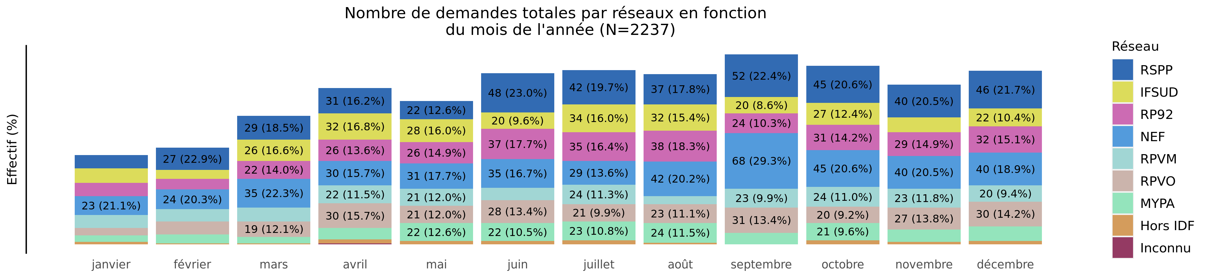
Nombre de demandes de TIU par réseau en 2021 (Total des transferts)
02/11/2023
Reseau | janvier | février | mars | avril | mai | juin | juillet | août | septembre | octobre | novembre | décembre | Total
RSPP | 16 (3.7%) | 27 (6.2%) | 29 (6.7%) | 31 (7.1%) | 22 (5.1%) | 48 (11.0%) | 42 (9.7%) | 37 (8.5%) | 52 (12.0%) | 45 (10.3%) | 40 (9.2%) | 46 (10.6%) | 435
IFSUD | 18 (6.2%) | 11 (3.8%) | 26 (9.0%) | 32 (11.1%) | 28 (9.7%) | 20 (6.9%) | 34 (11.8%) | 32 (11.1%) | 20 (6.9%) | 27 (9.4%) | 18 (6.2%) | 22 (7.6%) | 288
RP92 | 16 (4.9%) | 13 (4.0%) | 22 (6.7%) | 26 (7.9%) | 26 (7.9%) | 37 (11.2%) | 35 (10.6%) | 38 (11.6%) | 24 (7.3%) | 31 (9.4%) | 29 (8.8%) | 32 (9.7%) | 329
NEF | 23 (5.2%) | 24 (5.4%) | 35 (7.9%) | 30 (6.8%) | 31 (7.0%) | 35 (7.9%) | 29 (6.6%) | 42 (9.5%) | 68 (15.4%) | 45 (10.2%) | 40 (9.0%) | 40 (9.0%) | 442
RPVM | 16 (7.0%) | 15 (6.5%) | 17 (7.4%) | 22 (9.6%) | 21 (9.1%) | 15 (6.5%) | 24 (10.4%) | 10 (4.3%) | 23 (10.0%) | 24 (10.4%) | 23 (10.0%) | 20 (8.7%) | 230
RPVO | 9 (3.3%) | 16 (5.8%) | 19 (6.9%) | 30 (10.9%) | 21 (7.6%) | 28 (10.2%) | 21 (7.6%) | 23 (8.4%) | 31 (11.3%) | 20 (7.3%) | 27 (9.8%) | 30 (10.9%) | 275
MYPA | 8 (4.0%) | 11 (5.5%) | 8 (4.0%) | 14 (7.0%) | 22 (11.0%) | 22 (11.0%) | 23 (11.5%) | 24 (12.0%) | 14 (7.0%) | 21 (10.5%) | 15 (7.5%) | 18 (9.0%) | 200
Hors IDF | 3 (8.1%) | 1 (2.7%) | 1 (2.7%) | 5 (13.5%) | 4 (10.8%) | 4 (10.8%) | 5 (13.5%) | 2 (5.4%) | 0 (0.0%) | 5 (13.5%) | 3 (8.1%) | 4 (10.8%) | 37
Inconnu | 0 (0.0%) | 0 (0.0%) | 0 (0.0%) | 1 (100.0%) | 0 (0.0%) | 0 (0.0%) | 0 (0.0%) | 0 (0.0%) | 0 (0.0%) | 0 (0.0%) | 0 (0.0%) | 0 (0.0%) | 1
Total | 109 (4.9%) | 118 (5.3%) | 157 (7.0%) | 191 (8.5%) | 175 (7.8%) | 209 (9.3%) | 213 (9.5%) | 208 (9.3%) | 232 (10.4%) | 218 (9.7%) | 195 (8.7%) | 212 (9.5%) | 2237

Slide 7
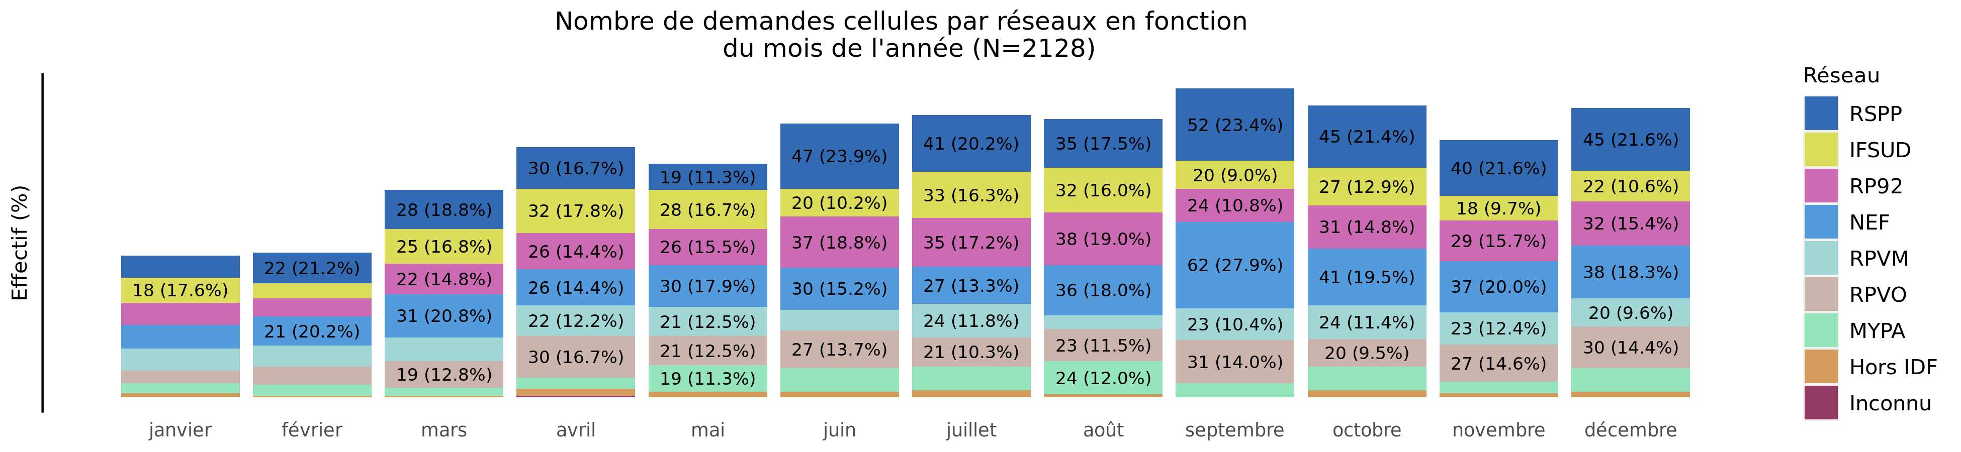
Nombre de demandes de TIU par réseau en 2021 (Transferts cellule)
02/11/2023
Variable | janvier | février | mars | avril | mai | juin | juillet | août | septembre | octobre | novembre | décembre | Total
RSPP | 16 (3.8%) | 22 (5.2%) | 28 (6.7%) | 30 (7.1%) | 19 (4.5%) | 47 (11.2%) | 41 (9.8%) | 35 (8.3%) | 52 (12.4%) | 45 (10.7%) | 40 (9.5%) | 45 (10.7%) | 420
IFSUD | 18 (6.3%) | 11 (3.8%) | 25 (8.7%) | 32 (11.2%) | 28 (9.8%) | 20 (7.0%) | 33 (11.5%) | 32 (11.2%) | 20 (7.0%) | 27 (9.4%) | 18 (6.3%) | 22 (7.7%) | 286
RP92 | 16 (4.9%) | 13 (4.0%) | 22 (6.7%) | 26 (7.9%) | 26 (7.9%) | 37 (11.2%) | 35 (10.6%) | 38 (11.6%) | 24 (7.3%) | 31 (9.4%) | 29 (8.8%) | 32 (9.7%) | 329
NEF | 17 (4.3%) | 21 (5.3%) | 31 (7.8%) | 26 (6.6%) | 30 (7.6%) | 30 (7.6%) | 27 (6.8%) | 36 (9.1%) | 62 (15.7%) | 41 (10.4%) | 37 (9.3%) | 38 (9.6%) | 396
RPVM | 16 (7.0%) | 15 (6.5%) | 17 (7.4%) | 22 (9.6%) | 21 (9.1%) | 15 (6.5%) | 24 (10.4%) | 10 (4.3%) | 23 (10.0%) | 24 (10.4%) | 23 (10.0%) | 20 (8.7%) | 230
RPVO | 9 (3.3%) | 13 (4.8%) | 19 (7.0%) | 30 (11.1%) | 21 (7.7%) | 27 (10.0%) | 21 (7.7%) | 23 (8.5%) | 31 (11.4%) | 20 (7.4%) | 27 (10.0%) | 30 (11.1%) | 271
MYPA | 7 (4.4%) | 8 (5.1%) | 6 (3.8%) | 8 (5.1%) | 19 (12.0%) | 17 (10.8%) | 17 (10.8%) | 24 (15.2%) | 10 (6.3%) | 17 (10.8%) | 8 (5.1%) | 17 (10.8%) | 158
Hors IDF | 3 (8.1%) | 1 (2.7%) | 1 (2.7%) | 5 (13.5%) | 4 (10.8%) | 4 (10.8%) | 5 (13.5%) | 2 (5.4%) | 0 (0.0%) | 5 (13.5%) | 3 (8.1%) | 4 (10.8%) | 37
Inconnu | 0 (0.0%) | 0 (0.0%) | 0 (0.0%) | 1 (100.0%) | 0 (0.0%) | 0 (0.0%) | 0 (0.0%) | 0 (0.0%) | 0 (0.0%) | 0 (0.0%) | 0 (0.0%) | 0 (0.0%) | 1
Total | 102 (4.8%) | 104 (4.9%) | 149 (7.0%) | 180 (8.5%) | 168 (7.9%) | 197 (9.3%) | 203 (9.5%) | 200 (9.4%) | 222 (10.4%) | 210 (9.9%) | 185 (8.7%) | 208 (9.8%) | 2128

Slide 8
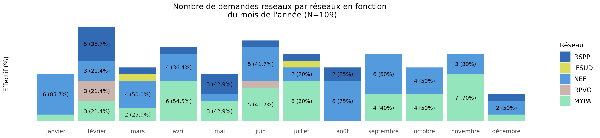
Nombre de demandes de TIU par réseau en 2021 (Transferts réseaux)
02/11/2023
Reseau | janvier | février | mars | avril | mai | juin | juillet | août | septembre | octobre | novembre | décembre | Total
RSPP | 0 (0.0%) | 5 (33.3%) | 1 (6.7%) | 1 (6.7%) | 3 (20.0%) | 1 (6.7%) | 1 (6.7%) | 2 (13.3%) | 0 (0.0%) | 0 (0.0%) | 0 (0.0%) | 1 (6.7%) | 15
IFSUD | 0 (0.0%) | 0 (0.0%) | 1 (50.0%) | 0 (0.0%) | 0 (0.0%) | 0 (0.0%) | 1 (50.0%) | 0 (0.0%) | 0 (0.0%) | 0 (0.0%) | 0 (0.0%) | 0 (0.0%) | 2
RP92 | 0 (0.0%) | 0 (0.0%) | 0 (0.0%) | 0 (0.0%) | 0 (0.0%) | 0 (0.0%) | 0 (0.0%) | 0 (0.0%) | 0 (0.0%) | 0 (0.0%) | 0 (0.0%) | 0 (0.0%) | 0
NEF | 6 (13.0%) | 3 (6.5%) | 4 (8.7%) | 4 (8.7%) | 1 (2.2%) | 5 (10.9%) | 2 (4.3%) | 6 (13.0%) | 6 (13.0%) | 4 (8.7%) | 3 (6.5%) | 2 (4.3%) | 46
RPVM | 0 (0.0%) | 0 (0.0%) | 0 (0.0%) | 0 (0.0%) | 0 (0.0%) | 0 (0.0%) | 0 (0.0%) | 0 (0.0%) | 0 (0.0%) | 0 (0.0%) | 0 (0.0%) | 0 (0.0%) | 0
RPVO | 0 (0.0%) | 3 (75.0%) | 0 (0.0%) | 0 (0.0%) | 0 (0.0%) | 1 (25.0%) | 0 (0.0%) | 0 (0.0%) | 0 (0.0%) | 0 (0.0%) | 0 (0.0%) | 0 (0.0%) | 4
MYPA | 1 (2.4%) | 3 (7.1%) | 2 (4.8%) | 6 (14.3%) | 3 (7.1%) | 5 (11.9%) | 6 (14.3%) | 0 (0.0%) | 4 (9.5%) | 4 (9.5%) | 7 (16.7%) | 1 (2.4%) | 42
Hors IDF | 0 (0.0%) | 0 (0.0%) | 0 (0.0%) | 0 (0.0%) | 0 (0.0%) | 0 (0.0%) | 0 (0.0%) | 0 (0.0%) | 0 (0.0%) | 0 (0.0%) | 0 (0.0%) | 0 (0.0%) | 0
Inconnu | 0 (0.0%) | 0 (0.0%) | 0 (0.0%) | 0 (0.0%) | 0 (0.0%) | 0 (0.0%) | 0 (0.0%) | 0 (0.0%) | 0 (0.0%) | 0 (0.0%) | 0 (0.0%) | 0 (0.0%) | 0
Total | 7 (6.4%) | 14 (12.8%) | 8 (7.3%) | 11 (10.1%) | 7 (6.4%) | 12 (11.0%) | 10 (9.2%) | 8 (7.3%) | 10 (9.2%) | 8 (7.3%) | 10 (9.2%) | 4 (3.7%) | 109

Slide 9
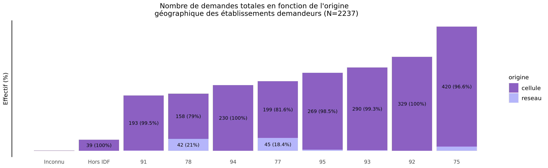
origine géographique des établissements demandeurs de TIU en 2021
02/11/2023
origine | Inconnu | Hors IDF | 91 | 78 | 94 | 77 | 95 | 93 | 92 | 75 | Total
cellule | 1 (0%) | 39 (1.8%) | 193 (9.1%) | 158 (7.4%) | 230 (10.8%) | 199 (9.4%) | 269 (12.6%) | 290 (13.6%) | 329 (15.5%) | 420 (19.7%) | 2128
reseau | 0 (0%) | 0 (0.0%) | 1 (0.9%) | 42 (38.5%) | 0 (0.0%) | 45 (41.3%) | 4 (3.7%) | 2 (1.8%) | 0 (0.0%) | 15 (13.8%) | 109
Total | 1 (0%) | 39 (1.7%) | 194 (8.7%) | 200 (8.9%) | 230 (10.3%) | 244 (10.9%) | 273 (12.2%) | 292 (13.1%) | 329 (14.7%) | 435 (19.4%) | 2237

Slide 10
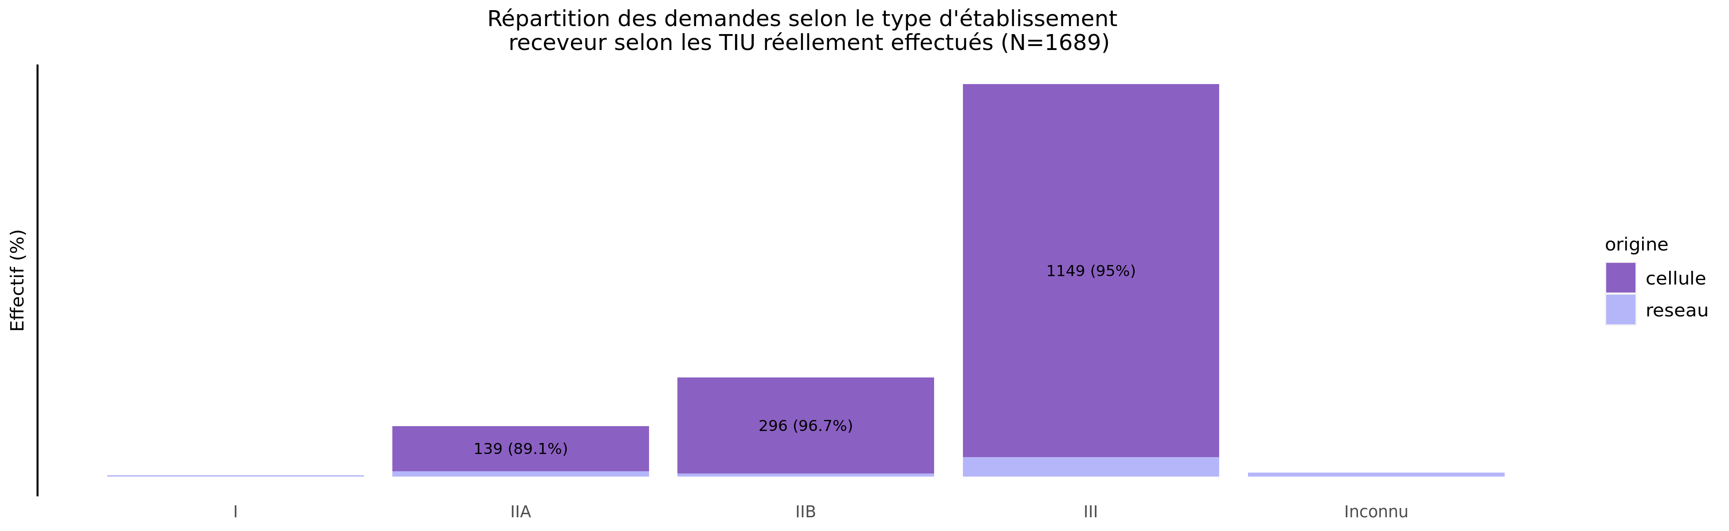
TIU par type d'établissement receveur en 2021
02/11/2023
origine | I | IIA | IIB | III | Urgence | Inconnu | Total
cellule | 1 (0.1%) | 139 (8.8%) | 296 (18.7%) | 1149 (72.5%) | 0 (0%) | 0 (0.0%) | 1585
reseau | 4 (3.8%) | 17 (16.3%) | 10 (9.6%) | 60 (57.7%) | 0 (0%) | 13 (12.5%) | 104
Total | 5 (0.3%) | 156 (9.2%) | 306 (18.1%) | 1209 (71.6%) | 0 (0%) | 13 (0.8%) | 1689

Slide 11
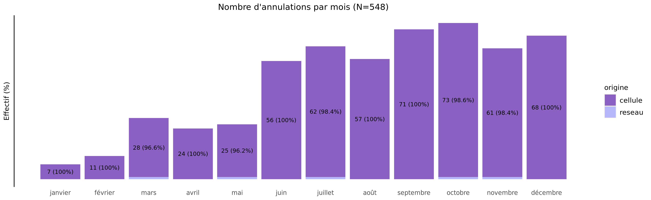
Annulation des demandes de TIU en 2021
02/11/2023
origine | janvier | février | mars | avril | mai | juin | juillet | août | septembre | octobre | novembre | décembre | Total
cellule | 7 (1.3%) | 11 (2%) | 28 (5.2%) | 24 (4.4%) | 25 (4.6%) | 56 (10.3%) | 62 (11.4%) | 57 (10.5%) | 71 (13.1%) | 73 (13.4%) | 61 (11.2%) | 68 (12.5%) | 543
reseau | 0 (0.0%) | 0 (0%) | 1 (20.0%) | 0 (0.0%) | 1 (20.0%) | 0 (0.0%) | 1 (20.0%) | 0 (0.0%) | 0 (0.0%) | 1 (20.0%) | 1 (20.0%) | 0 (0.0%) | 5
Total | 7 (1.3%) | 11 (2%) | 29 (5.3%) | 24 (4.4%) | 26 (4.7%) | 56 (10.2%) | 63 (11.5%) | 57 (10.4%) | 71 (13.0%) | 74 (13.5%) | 62 (11.3%) | 68 (12.4%) | 548

Slide 12
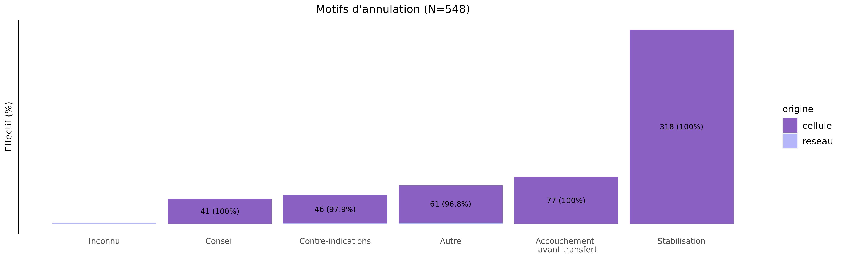
Motif d'annulation des demandes de TIU en 2021
02/11/2023
origine | Inconnu | Conseil | Contre-indications | Autre | Accouchement avant transfert | Stabilisation | Total
cellule | 0 (0.0%) | 41 (7.6%) | 46 (8.5%) | 61 (11.2%) | 77 (14.2%) | 318 (58.6%) | 543
reseau | 2 (40.0%) | 0 (0.0%) | 1 (20.0%) | 2 (40.0%) | 0 (0.0%) | 0 (0.0%) | 5
Total | 2 (0.4%) | 41 (7.5%) | 47 (8.6%) | 63 (11.5%) | 77 (14.1%) | 318 (58.0%) | 548

Slide 13
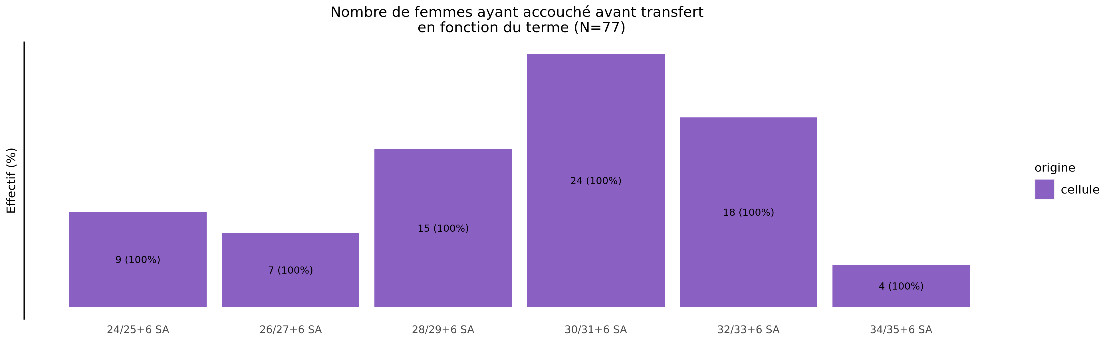
Termes des femmes ayant accouché avant transfert en 2021 (82 N.nés cellule et 0 N.nés réseaux)
02/11/2023
origine | Moins de 24 SA | 24/25+6 SA | 26/27+6 SA | 28/29+6 SA | 30/31+6 SA | 32/33+6 SA | 34/35+6 SA | Plus de 36 SA | Inconnu | Total
cellule | 0 (0%) | 9 (11.7%) | 7 (9.1%) | 15 (19.5%) | 24 (31.2%) | 18 (23.4%) | 4 (5.2%) | 0 (0%) | 0 (0%) | 77
Total | 0 (0%) | 9 (11.7%) | 7 (9.1%) | 15 (19.5%) | 24 (31.2%) | 18 (23.4%) | 4 (5.2%) | 0 (0%) | 0 (0%) | 77

Slide 14
Répartition des TIU en 2021 (Total des transferts)
02/11/2023
275 (12.3%)
120 (7.1%)
200 (8.9%)
442 (19.8%)
119 (7.0%)
312 (18.5%)
329 (14.7%)
435 (19.4%)
277 (16.4%)
476 (28.2%)
230 (10.3%)
199 (11.8%)
288 (12.9%)
37 (1.7%)
127 (7.5%)
46 (2.7%)
1 (0.0%)
13 (0.8%)

Slide 15
Répartition des TIU en 2021 (Transferts cellule)
02/11/2023
271 (12.7%)
117 (7.4%)
158 (7.4%)
396 (18.6%)
96 (6.1%)
278 (17.5%)
329 (15.5%)
420 (19.7%)
271 (17.1%)
459 (29.0%)
230 (10.8%)
191 (12.1%)
286 (13.4%)
37 (1.7%)
127 (8.0%)
46 (2.9%)
1 (0.0%)
0 (0.0%)

Slide 16
Répartition des TIU en 2021 (Transferts réseaux)
02/11/2023
4 (3.7%)
3 (2.9%)
42 (38.5%)
46 (42.2%)
23 (22.1%)
34 (32.7%)
0 (0.0%)
15 (13.8%)
6 (5.8%)
17 (16.3%)
0 (0.0%)
8 (7.7%)
2 (1.8%)
0 (0.0%)
0 (0.0%)
0 (0.0%)
0 (0.0%)
13 (12.5%)

Slide 17
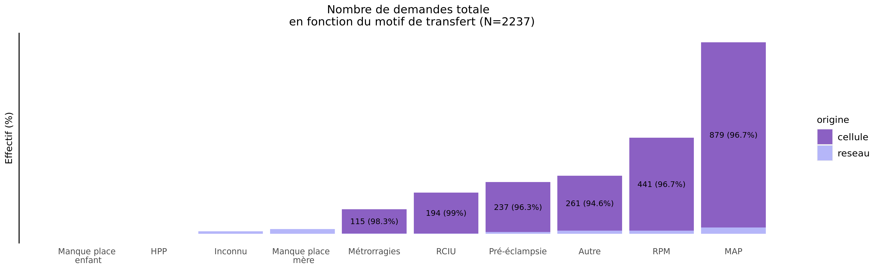
Motif de transfert principal en 2021
02/11/2023
origine | Manque place enfant | HPP | Inconnu | Manque place mère | Métrorragies | RCIU | Pré-éclampsie | Autre | RPM | MAP | Total
cellule | 0 (0.0%) | 1 (0%) | 0 (0.0%) | 0 (0.0%) | 115 (5.4%) | 194 (9.1%) | 237 (11.1%) | 261 (12.3%) | 441 (20.7%) | 879 (41.3%) | 2128
reseau | 1 (0.9%) | 0 (0%) | 12 (11.0%) | 23 (21.1%) | 2 (1.8%) | 2 (1.8%) | 9 (8.3%) | 15 (13.8%) | 15 (13.8%) | 30 (27.5%) | 109
Total | 1 (0.0%) | 1 (0%) | 12 (0.5%) | 23 (1.0%) | 117 (5.2%) | 196 (8.8%) | 246 (11.0%) | 276 (12.3%) | 456 (20.4%) | 909 (40.6%) | 2237

Slide 18
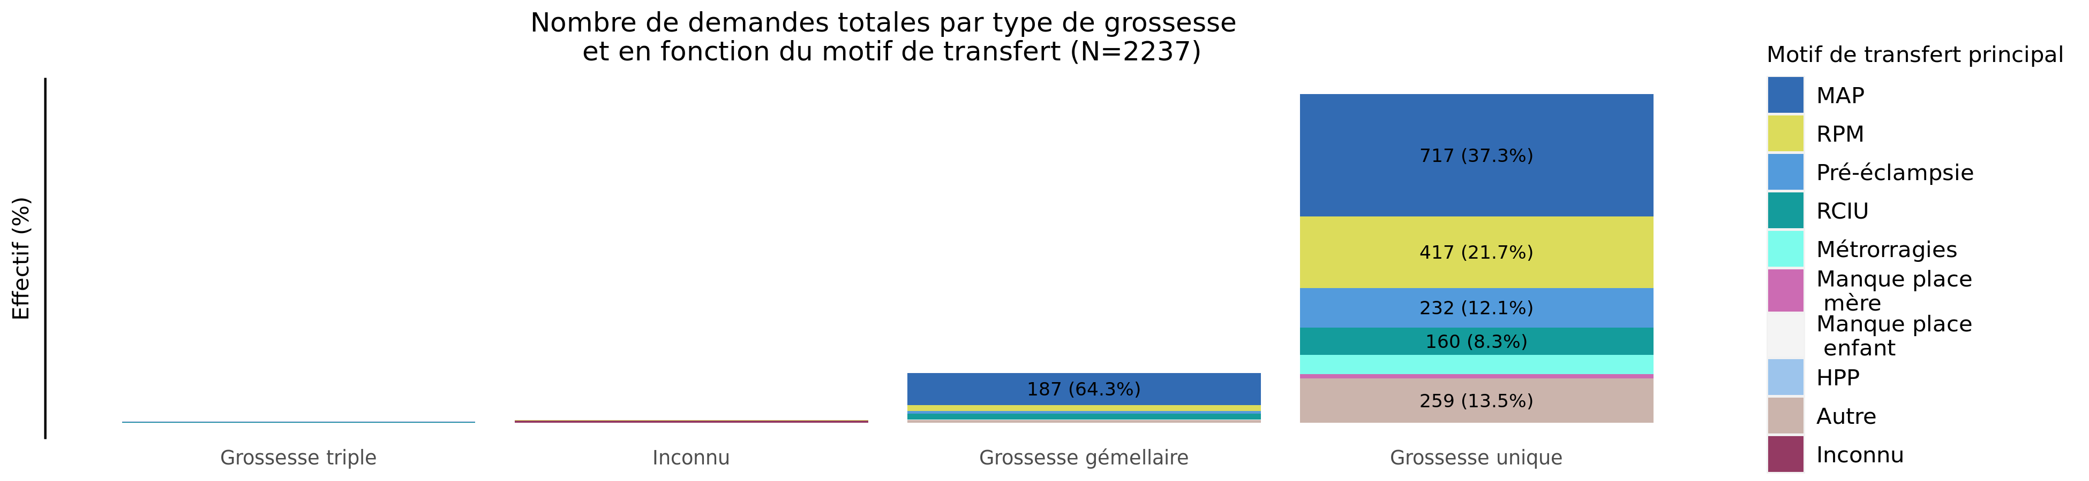
Type de grossesse par motif de transfert en 2021 (Total des transferts)
02/11/2023
Motif | Grossesse triple | Inconnu | Grossesse gémellaire | Grossesse unique | Total
MAP | 3 (0.3%) | 2 (0.2%) | 187 (20.6%) | 717 (78.9%) | 909
RPM | 1 (0.2%) | 1 (0.2%) | 37 (8.1%) | 417 (91.4%) | 456
Pré-éclampsie | 0 (0.0%) | 0 (0.0%) | 14 (5.7%) | 232 (94.3%) | 246
RCIU | 2 (1.0%) | 1 (0.5%) | 33 (16.8%) | 160 (81.6%) | 196
Métrorragies | 0 (0.0%) | 0 (0.0%) | 3 (2.6%) | 114 (97.4%) | 117
Manque place mère | 0 (0.0%) | 0 (0.0%) | 0 (0.0%) | 23 (100.0%) | 23
Manque place enfant | 0 (0.0%) | 0 (0.0%) | 1 (100.0%) | 0 (0.0%) | 1
HPP | 0 (0.0%) | 0 (0.0%) | 0 (0.0%) | 1 (100.0%) | 1
Autre | 0 (0.0%) | 1 (0.4%) | 16 (5.8%) | 259 (93.8%) | 276
Inconnu | 0 (0.0%) | 11 (91.7%) | 0 (0.0%) | 1 (8.3%) | 12
Total | 6 (0.3%) | 16 (0.7%) | 291 (13.0%) | 1924 (86.0%) | 2237

Slide 19
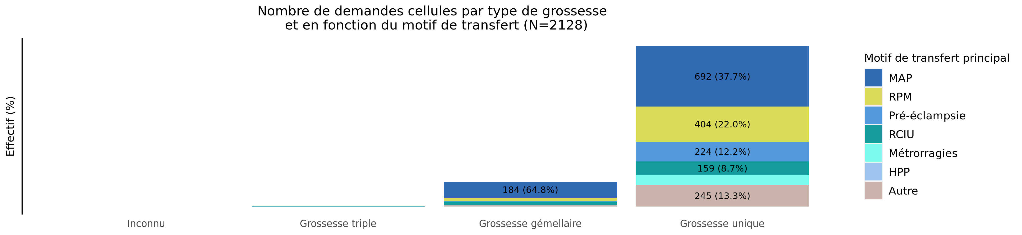
Type de grossesse par motif de transfert en 2021 (Transferts cellule)
02/11/2023
Motif | Inconnu | Grossesse triple | Grossesse gémellaire | Grossesse unique | Total
MAP | 0 (0.0%) | 3 (0.3%) | 184 (20.9%) | 692 (78.7%) | 879
RPM | 0 (0.0%) | 1 (0.2%) | 36 (8.2%) | 404 (91.6%) | 441
Pré-éclampsie | 0 (0.0%) | 0 (0.0%) | 13 (5.5%) | 224 (94.5%) | 237
RCIU | 0 (0.0%) | 2 (1.0%) | 33 (17.0%) | 159 (82.0%) | 194
Métrorragies | 0 (0.0%) | 0 (0.0%) | 3 (2.6%) | 112 (97.4%) | 115
Manque place mère | 0 (0.0%) | 0 (0.0%) | 0 (0.0%) | 0 (0.0%) | 0
Manque place enfant | 0 (0.0%) | 0 (0.0%) | 0 (0.0%) | 0 (0.0%) | 0
HPP | 0 (0.0%) | 0 (0.0%) | 0 (0.0%) | 1 (100.0%) | 1
Autre | 1 (0.4%) | 0 (0.0%) | 15 (5.7%) | 245 (93.9%) | 261
Inconnu | 0 (0.0%) | 0 (0.0%) | 0 (0.0%) | 0 (0.0%) | 0
Total | 1 (0.0%) | 6 (0.3%) | 284 (13.3%) | 1837 (86.3%) | 2128

Slide 20
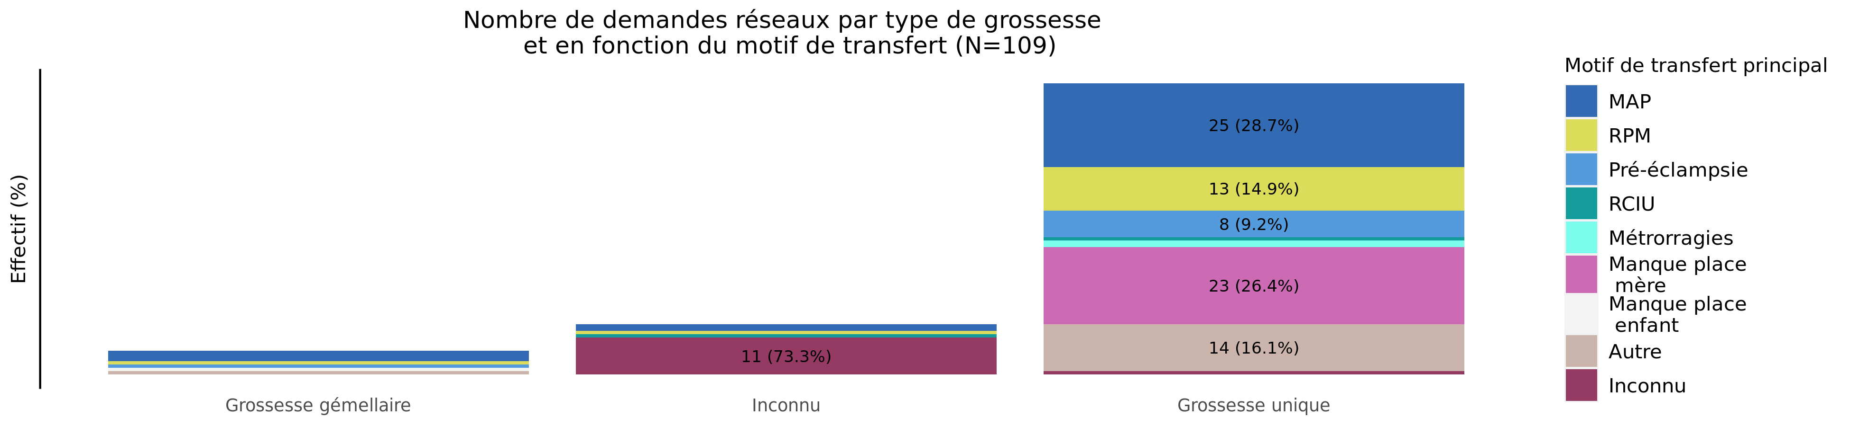
Type de grossesse par motif de transfert en 2021 (Transferts réseaux)
02/11/2023
Motif | Grossesse gémellaire | Inconnu | Grossesse unique | Total
MAP | 3 (10.0%) | 2 (6.7%) | 25 (83.3%) | 30
RPM | 1 (6.7%) | 1 (6.7%) | 13 (86.7%) | 15
Pré-éclampsie | 1 (11.1%) | 0 (0.0%) | 8 (88.9%) | 9
RCIU | 0 (0.0%) | 1 (50.0%) | 1 (50.0%) | 2
Métrorragies | 0 (0.0%) | 0 (0.0%) | 2 (100.0%) | 2
Manque place mère | 0 (0.0%) | 0 (0.0%) | 23 (100.0%) | 23
Manque place enfant | 1 (100.0%) | 0 (0.0%) | 0 (0.0%) | 1
HPP | 0 (0.0%) | 0 (0.0%) | 0 (0.0%) | 0
Autre | 1 (6.7%) | 0 (0.0%) | 14 (93.3%) | 15
Inconnu | 0 (0.0%) | 11 (91.7%) | 1 (8.3%) | 12
Total | 7 (6.4%) | 15 (13.8%) | 87 (79.8%) | 109

Slide 21
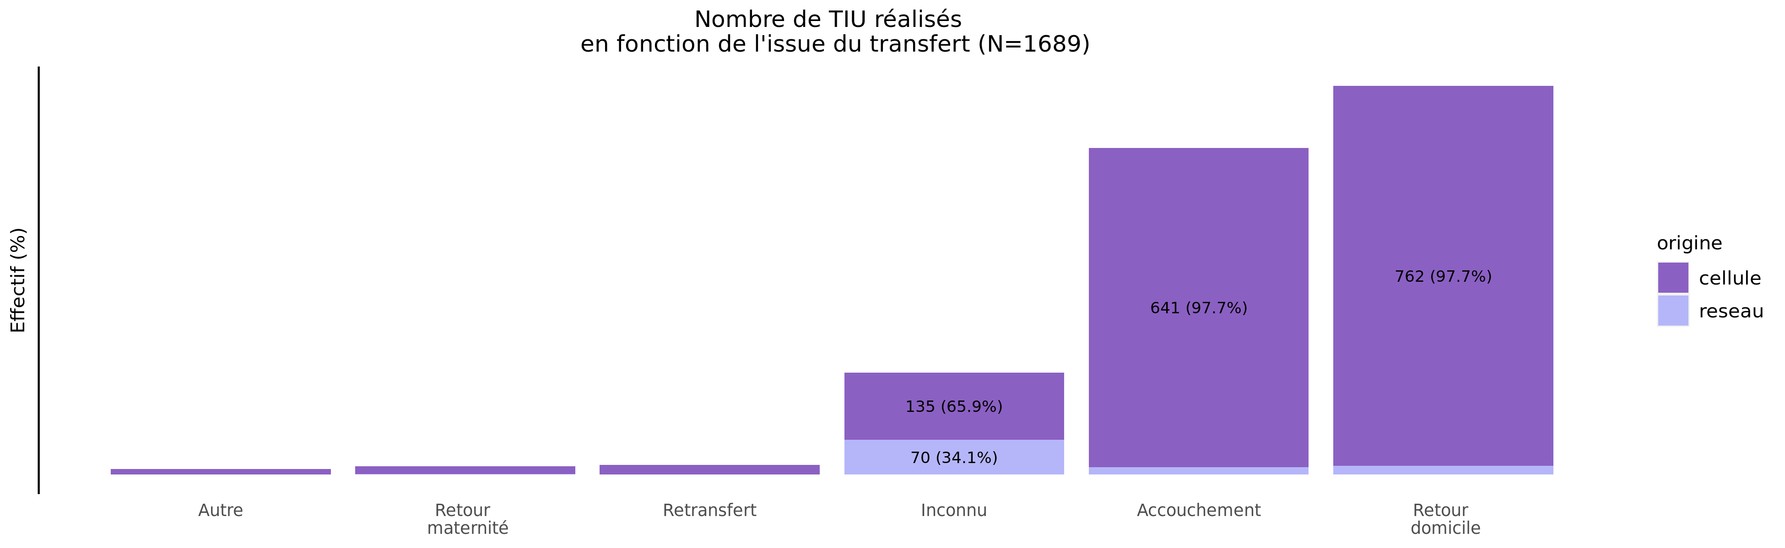
issue des transferts réalisés en 2021
02/11/2023
origine | Autre | Retour maternité | Retransfert | Inconnu | Accouchement | Retour domicile | Total
cellule | 11 (0.7%) | 16 (1%) | 20 (1.3%) | 135 (8.5%) | 641 (40.4%) | 762 (48.1%) | 1585
reseau | 0 (0.0%) | 1 (1%) | 0 (0.0%) | 70 (67.3%) | 15 (14.4%) | 18 (17.3%) | 104
Total | 11 (0.7%) | 17 (1%) | 20 (1.2%) | 205 (12.1%) | 656 (38.8%) | 780 (46.2%) | 1689

Slide 22
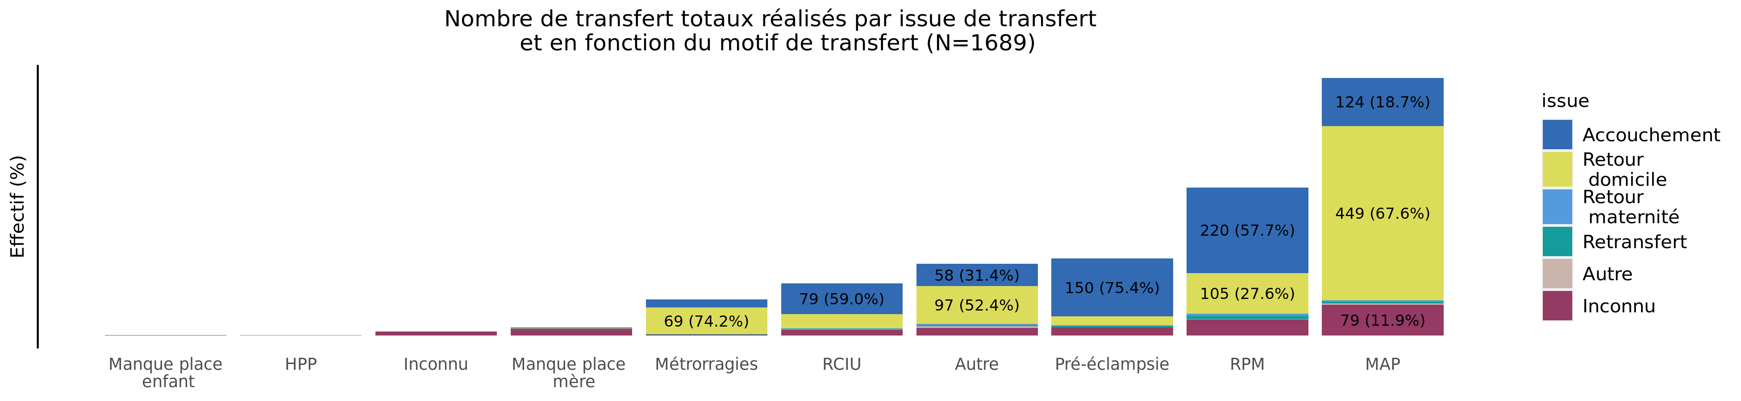
Issue de transfert réalisé selon le motif de TIU en 2021 (Total des transferts)
02/11/2023
issue | Manque place enfant | HPP | Inconnu | Manque place mère | Métrorragies | RCIU | Autre | Pré-éclampsie | RPM | MAP | Total
Accouchement | 1 (0.2%) | 0 (0.0%) | 0 (0.0%) | 3 (0.5%) | 21 (3.2%) | 79 (12.0%) | 58 (8.8%) | 150 (22.9%) | 220 (33.5%) | 124 (18.9%) | 656
Retour domicile | 0 (0.0%) | 0 (0.0%) | 0 (0.0%) | 1 (0.1%) | 69 (8.8%) | 37 (4.7%) | 97 (12.4%) | 22 (2.8%) | 105 (13.5%) | 449 (57.6%) | 780
Retour maternité | 0 (0.0%) | 1 (5.9%) | 0 (0.0%) | 0 (0.0%) | 0 (0.0%) | 1 (5.9%) | 3 (17.6%) | 3 (17.6%) | 5 (29.4%) | 4 (23.5%) | 17
Retransfert | 0 (0.0%) | 0 (0.0%) | 0 (0.0%) | 0 (0.0%) | 1 (5.0%) | 1 (5.0%) | 3 (15.0%) | 3 (15.0%) | 8 (40.0%) | 4 (20.0%) | 20
Autre | 0 (0.0%) | 0 (0.0%) | 0 (0.0%) | 0 (0.0%) | 0 (0.0%) | 1 (9.1%) | 4 (36.4%) | 0 (0.0%) | 2 (18.2%) | 4 (36.4%) | 11
Inconnu | 0 (0.0%) | 0 (0.0%) | 10 (4.9%) | 17 (8.3%) | 2 (1.0%) | 15 (7.3%) | 20 (9.8%) | 21 (10.2%) | 41 (20.0%) | 79 (38.5%) | 205
Total | 1 (0.1%) | 1 (0.1%) | 10 (0.6%) | 21 (1.2%) | 93 (5.5%) | 134 (7.9%) | 185 (11.0%) | 199 (11.8%) | 381 (22.6%) | 664 (39.3%) | 1689

Slide 23
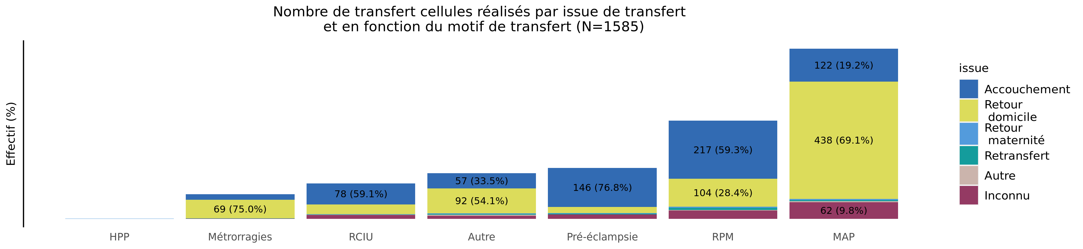
Issue de transfert réalisé selon le motif de TIU en 2021 (Transferts cellule)
02/11/2023
issue | HPP | Métrorragies | RCIU | Autre | Pré-éclampsie | RPM | MAP | Total
Accouchement | 0 (0.0%) | 21 (3.3%) | 78 (12.2%) | 57 (8.9%) | 146 (22.8%) | 217 (33.9%) | 122 (19.0%) | 641
Retour domicile | 0 (0.0%) | 69 (9.1%) | 37 (4.9%) | 92 (12.1%) | 22 (2.9%) | 104 (13.6%) | 438 (57.5%) | 762
Retour maternité | 1 (6.2%) | 0 (0.0%) | 1 (6.2%) | 3 (18.8%) | 3 (18.8%) | 4 (25.0%) | 4 (25.0%) | 16
Retransfert | 0 (0.0%) | 1 (5.0%) | 1 (5.0%) | 3 (15.0%) | 3 (15.0%) | 8 (40.0%) | 4 (20.0%) | 20
Autre | 0 (0.0%) | 0 (0.0%) | 1 (9.1%) | 4 (36.4%) | 0 (0.0%) | 2 (18.2%) | 4 (36.4%) | 11
Inconnu | 0 (0.0%) | 1 (0.7%) | 14 (10.4%) | 11 (8.1%) | 16 (11.9%) | 31 (23.0%) | 62 (45.9%) | 135
Total | 1 (0.1%) | 92 (5.8%) | 132 (8.3%) | 170 (10.7%) | 190 (12.0%) | 366 (23.1%) | 634 (40.0%) | 1585

Slide 24
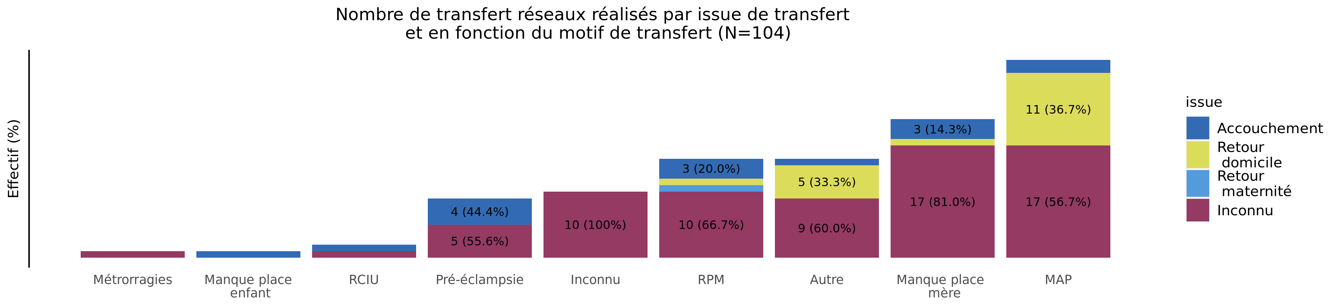
Issue de transfert réalisé selon le motif de TIU en 2021 (Transferts réseaux)
02/11/2023
issue | Métrorragies | Manque place enfant | RCIU | Pré-éclampsie | Inconnu | RPM | Autre | Manque place mère | MAP | Total
Accouchement | 0 (0.0%) | 1 (6.7%) | 1 (6.7%) | 4 (26.7%) | 0 (0.0%) | 3 (20.0%) | 1 (6.7%) | 3 (20.0%) | 2 (13.3%) | 15
Retour domicile | 0 (0.0%) | 0 (0.0%) | 0 (0.0%) | 0 (0.0%) | 0 (0.0%) | 1 (5.6%) | 5 (27.8%) | 1 (5.6%) | 11 (61.1%) | 18
Retour maternité | 0 (0.0%) | 0 (0.0%) | 0 (0.0%) | 0 (0.0%) | 0 (0.0%) | 1 (100.0%) | 0 (0.0%) | 0 (0.0%) | 0 (0.0%) | 1
Retransfert | 0 (0.0%) | 0 (0.0%) | 0 (0.0%) | 0 (0.0%) | 0 (0.0%) | 0 (0.0%) | 0 (0.0%) | 0 (0.0%) | 0 (0.0%) | 0
Autre | 0 (0.0%) | 0 (0.0%) | 0 (0.0%) | 0 (0.0%) | 0 (0.0%) | 0 (0.0%) | 0 (0.0%) | 0 (0.0%) | 0 (0.0%) | 0
Inconnu | 1 (1.4%) | 0 (0.0%) | 1 (1.4%) | 5 (7.1%) | 10 (14.3%) | 10 (14.3%) | 9 (12.9%) | 17 (24.3%) | 17 (24.3%) | 70
Total | 1 (1.0%) | 1 (1.0%) | 2 (1.9%) | 9 (8.7%) | 10 (9.6%) | 15 (14.4%) | 15 (14.4%) | 21 (20.2%) | 30 (28.8%) | 104

Slide 25
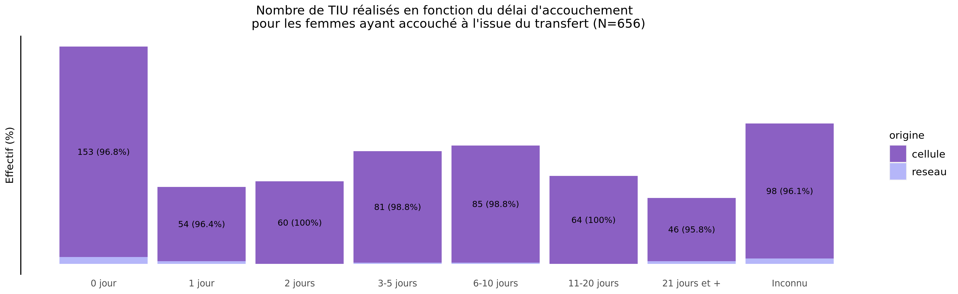
Délai d'accouchement des TIU réalisés en 2021
02/11/2023
origine | 0 jour | 1 jour | 2 jours | 3-5 jours | 6-10 jours | 11-20 jours | 21 jours et + | Inconnu | Total
cellule | 153 (23.9%) | 54 (8.4%) | 60 (9.4%) | 81 (12.6%) | 85 (13.3%) | 64 (10.0%) | 46 (7.2%) | 98 (15.3%) | 641
reseau | 5 (33.3%) | 2 (13.3%) | 0 (0.0%) | 1 (6.7%) | 1 (6.7%) | 0 (0.0%) | 2 (13.3%) | 4 (26.7%) | 15
Total | 158 (24.1%) | 56 (8.5%) | 60 (9.1%) | 82 (12.5%) | 86 (13.1%) | 64 (9.8%) | 48 (7.3%) | 102 (15.5%) | 656

Slide 26
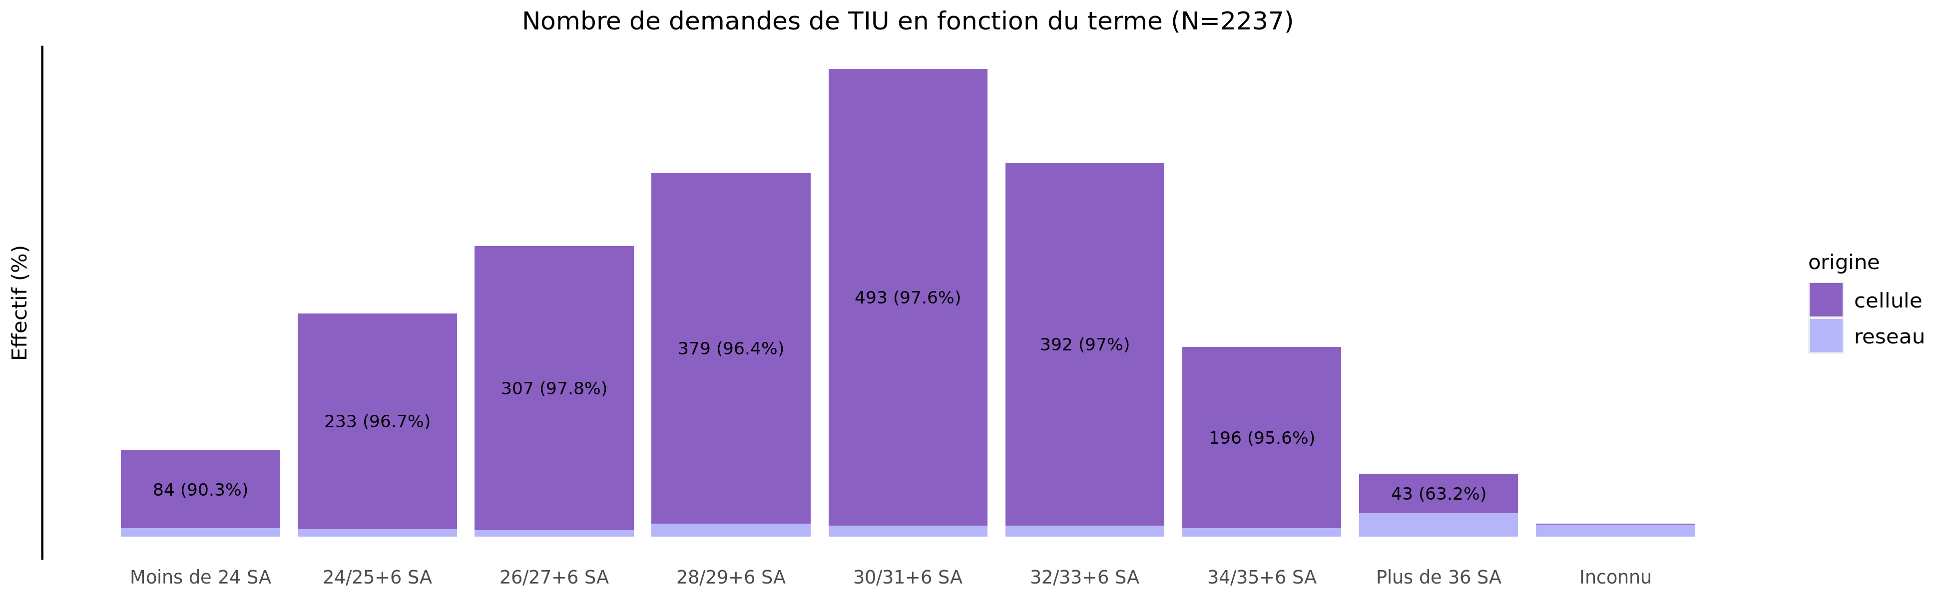
Termes des demandes de transfert en 2021
02/11/2023
origine | Moins de 24 SA | 24/25+6 SA | 26/27+6 SA | 28/29+6 SA | 30/31+6 SA | 32/33+6 SA | 34/35+6 SA | Plus de 36 SA | Inconnu | Total
cellule | 84 (3.9%) | 233 (10.9%) | 307 (14.4%) | 379 (17.8%) | 493 (23.2%) | 392 (18.4%) | 196 (9.2%) | 43 (2.0%) | 1 (0.0%) | 2128
reseau | 9 (8.3%) | 8 (7.3%) | 7 (6.4%) | 14 (12.8%) | 12 (11.0%) | 12 (11.0%) | 9 (8.3%) | 25 (22.9%) | 13 (11.9%) | 109
Total | 93 (4.2%) | 241 (10.8%) | 314 (14.0%) | 393 (17.6%) | 505 (22.6%) | 404 (18.1%) | 205 (9.2%) | 68 (3.0%) | 14 (0.6%) | 2237

Slide 27
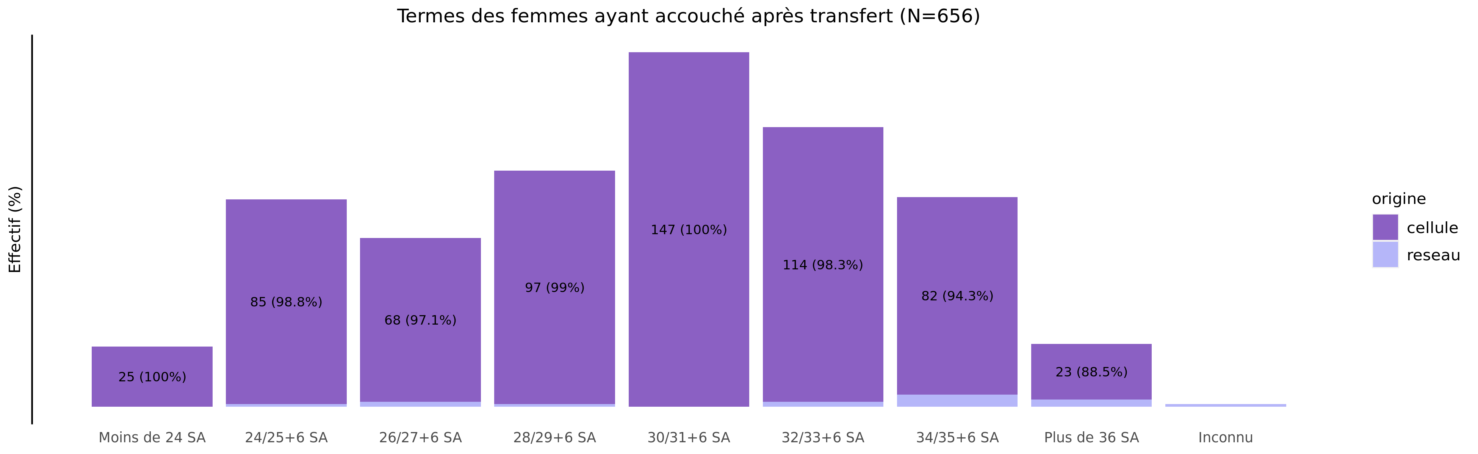
Les accouchements suite à TIU en 2021 - terme
02/11/2023
origine | Moins de 24 SA | 24/25+6 SA | 26/27+6 SA | 28/29+6 SA | 30/31+6 SA | 32/33+6 SA | 34/35+6 SA | Plus de 36 SA | Inconnu | Total
cellule | 25 (3.9%) | 85 (13.3%) | 68 (10.6%) | 97 (15.1%) | 147 (22.9%) | 114 (17.8%) | 82 (12.8%) | 23 (3.6%) | 0 (0.0%) | 641
reseau | 0 (0.0%) | 1 (6.7%) | 2 (13.3%) | 1 (6.7%) | 0 (0.0%) | 2 (13.3%) | 5 (33.3%) | 3 (20.0%) | 1 (6.7%) | 15
Total | 25 (3.8%) | 86 (13.1%) | 70 (10.7%) | 98 (14.9%) | 147 (22.4%) | 116 (17.7%) | 87 (13.3%) | 26 (4.0%) | 1 (0.2%) | 656

Slide 28
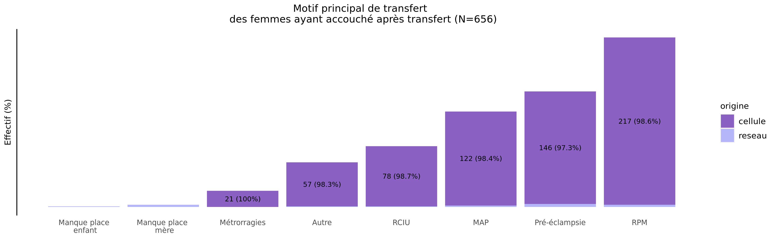
Les accouchements suite à TIU en 2021 - motif de transfert
02/11/2023
origine | MAP | RPM | Pré-éclampsie | RCIU | Métrorragies | Manque place mère | Manque place enfant | HPP | Autre | Inconnu | Total
cellule | 122 (19.0%) | 217 (33.9%) | 146 (22.8%) | 78 (12.2%) | 21 (3.3%) | 0 (0.0%) | 0 (0.0%) | 0 (0%) | 57 (8.9%) | 0 (0%) | 641
reseau | 2 (13.3%) | 3 (20.0%) | 4 (26.7%) | 1 (6.7%) | 0 (0.0%) | 3 (20.0%) | 1 (6.7%) | 0 (0%) | 1 (6.7%) | 0 (0%) | 15
Total | 124 (18.9%) | 220 (33.5%) | 150 (22.9%) | 79 (12.0%) | 21 (3.2%) | 3 (0.5%) | 1 (0.2%) | 0 (0%) | 58 (8.8%) | 0 (0%) | 656

Slide 29
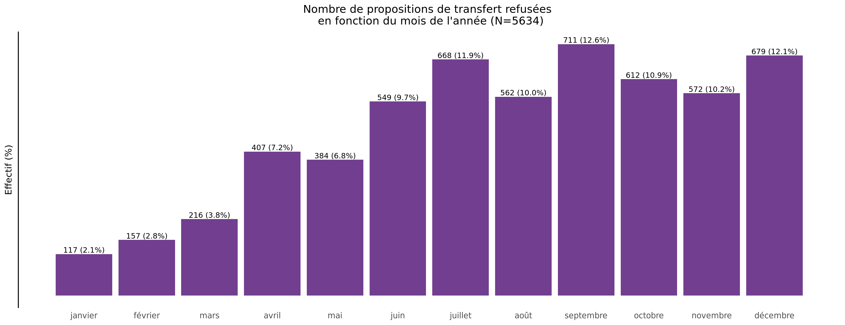
Nombre de propositions de transfert refusées en 2021
02/11/2023

Slide 30
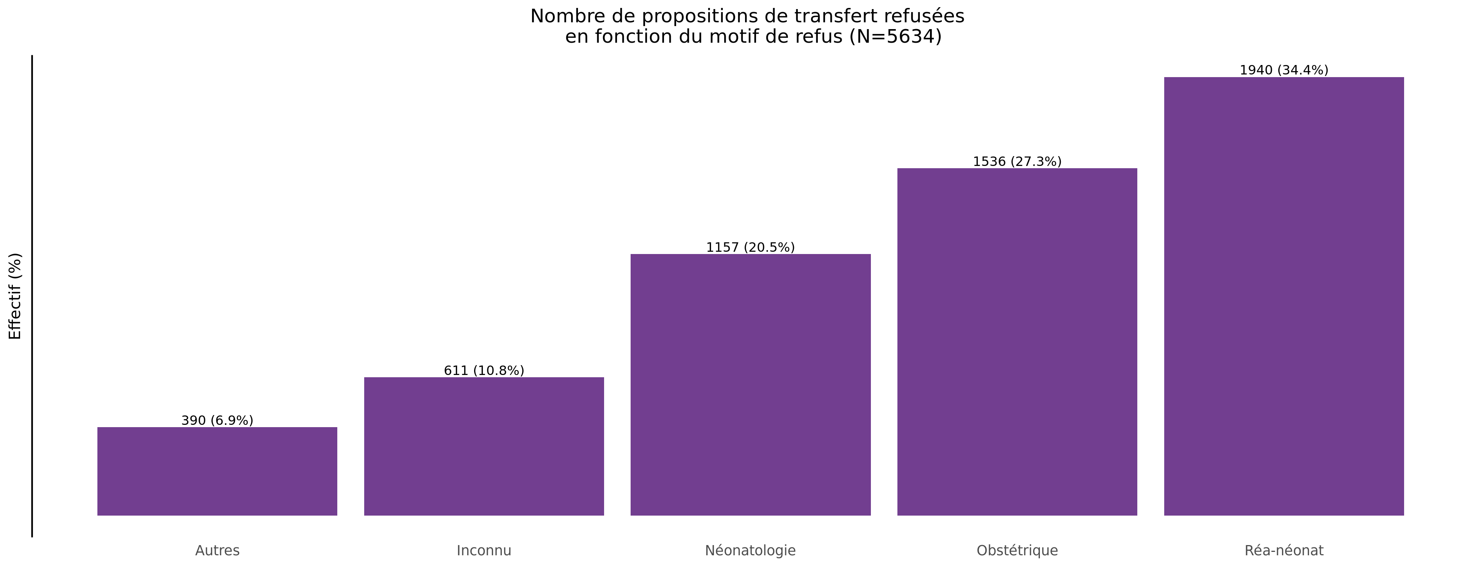
Motif des propositions de transfert refusées en 2021
02/11/2023

Slide 31
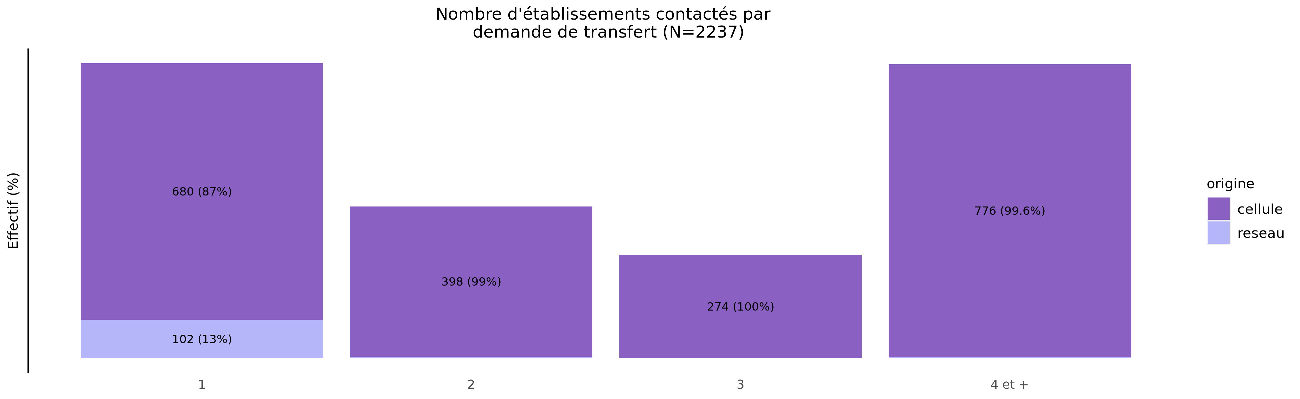
Nombre d'établissements contactés par demande en 2021
02/11/2023
origine | 1 | 2 | 3 | 4 et + | Total
cellule | 680 (32.0%) | 398 (18.7%) | 274 (12.9%) | 776 (36.5%) | 2128
reseau | 102 (93.6%) | 4 (3.7%) | 0 (0.0%) | 3 (2.8%) | 109
Total | 782 (35.0%) | 402 (18.0%) | 274 (12.2%) | 779 (34.8%) | 2237

Slide 32
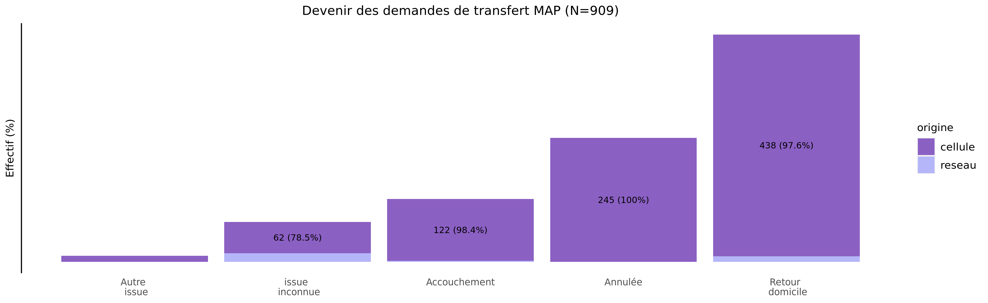
Devenir des demandes de MAP en 2021
02/11/2023
origine | Autre issue | issue inconnue | Accouchement | Annulée | Retour domicile | Total
cellule | 12 (1.4%) | 62 (7.1%) | 122 (13.9%) | 245 (27.9%) | 438 (49.8%) | 879
reseau | 0 (0.0%) | 17 (56.7%) | 2 (6.7%) | 0 (0.0%) | 11 (36.7%) | 30
Total | 12 (1.3%) | 79 (8.7%) | 124 (13.6%) | 245 (27.0%) | 449 (49.4%) | 909

Slide 33
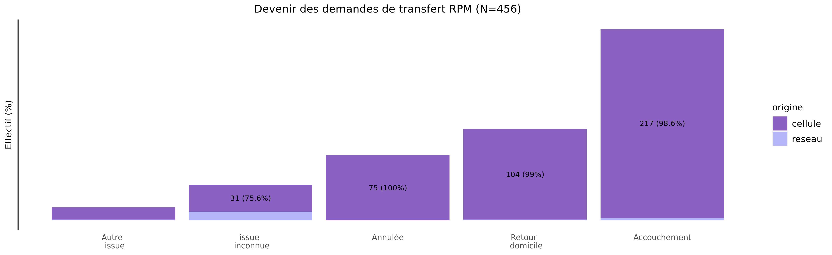
Devenir des demandes de RPM en 2021
02/11/2023
origine | Autre issue | issue inconnue | Annulée | Retour domicile | Accouchement | Total
cellule | 14 (3.2%) | 31 (7.0%) | 75 (17.0%) | 104 (23.6%) | 217 (49.2%) | 441
reseau | 1 (6.7%) | 10 (66.7%) | 0 (0.0%) | 1 (6.7%) | 3 (20.0%) | 15
Total | 15 (3.3%) | 41 (9.0%) | 75 (16.4%) | 105 (23.0%) | 220 (48.2%) | 456

