Slide 1
Île de France
Jeudi 29 Juillet 2021

Slide 2
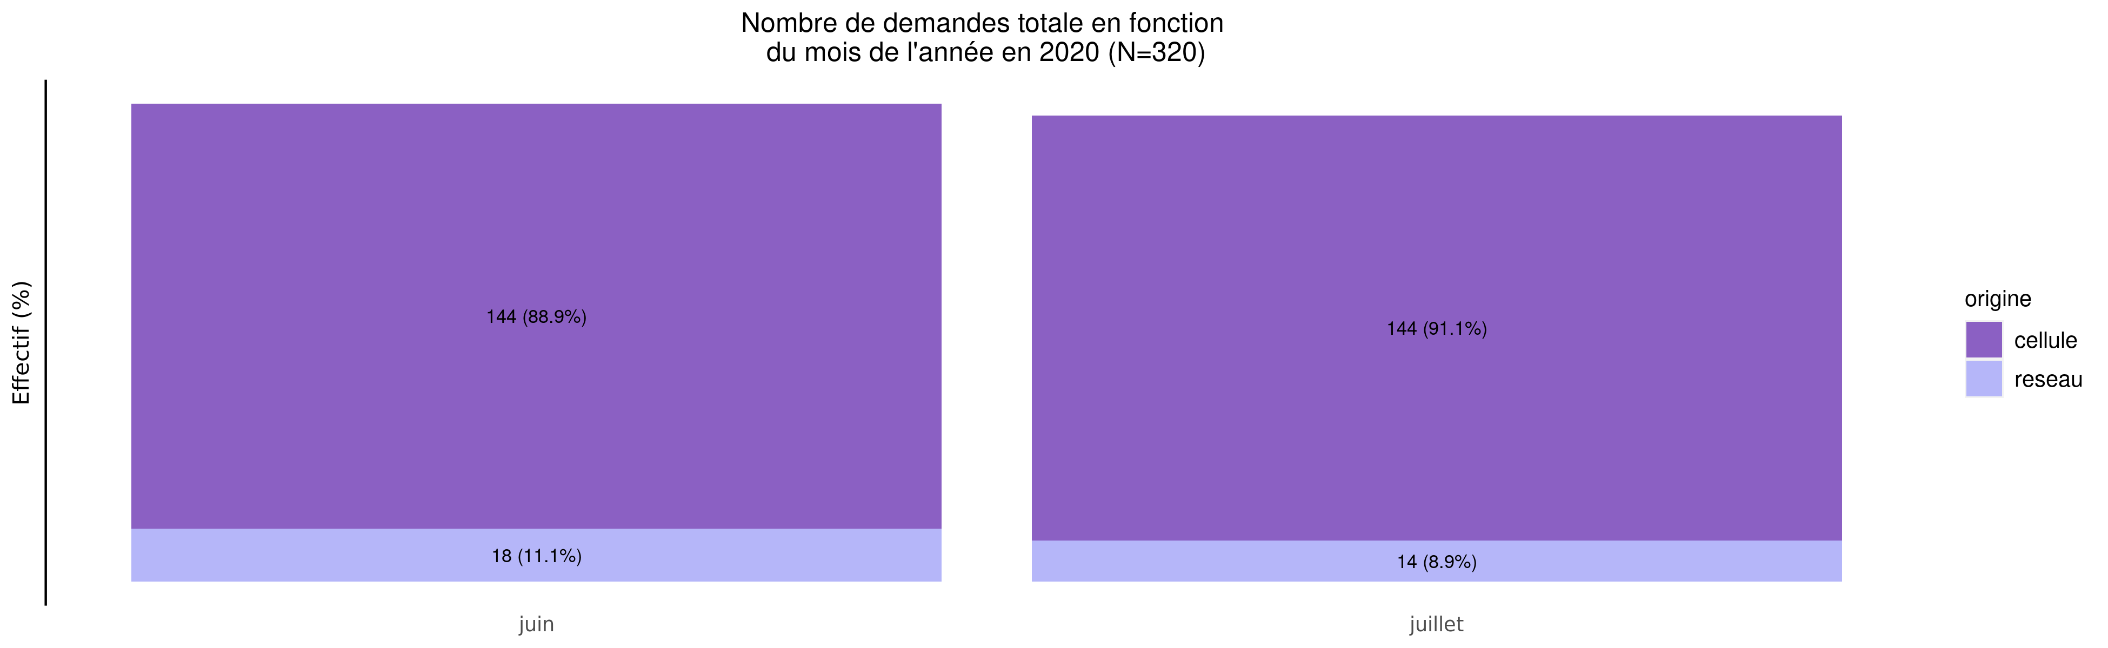
Nombre de demandes de TIU en 2020
29/07/2021
origine | janvier | février | mars | avril | mai | juin | juillet | août | septembre | octobre | novembre | décembre | Total
cellule | 0 (0%) | 0 (0%) | 0 (0%) | 0 (0%) | 0 (0%) | 144 (50.0%) | 144 (50.0%) | 0 (0%) | 0 (0%) | 0 (0%) | 0 (0%) | 0 (0%) | 288
reseau | 0 (0%) | 0 (0%) | 0 (0%) | 0 (0%) | 0 (0%) | 18 (56.2%) | 14 (43.8%) | 0 (0%) | 0 (0%) | 0 (0%) | 0 (0%) | 0 (0%) | 32
Total | 0 (0%) | 0 (0%) | 0 (0%) | 0 (0%) | 0 (0%) | 162 (50.6%) | 158 (49.4%) | 0 (0%) | 0 (0%) | 0 (0%) | 0 (0%) | 0 (0%) | 320

Slide 3
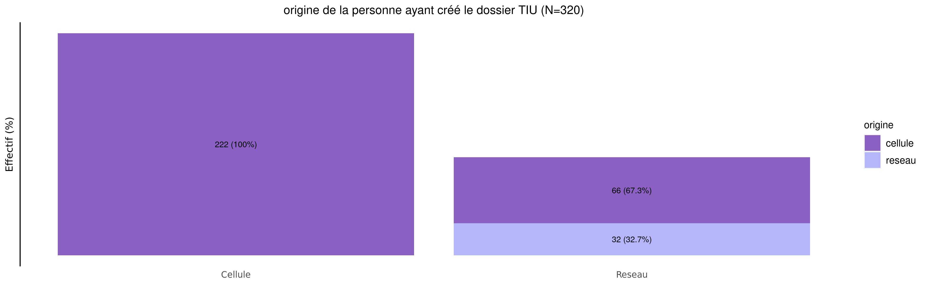
origine des demandes de TIU en 2020
29/07/2021
origine | Cellule | Reseau | Total
cellule | 222 (77.1%) | 66 (22.9%) | 288
reseau | 0 (0.0%) | 32 (100.0%) | 32
Total | 222 (69.4%) | 98 (30.6%) | 320

Slide 4
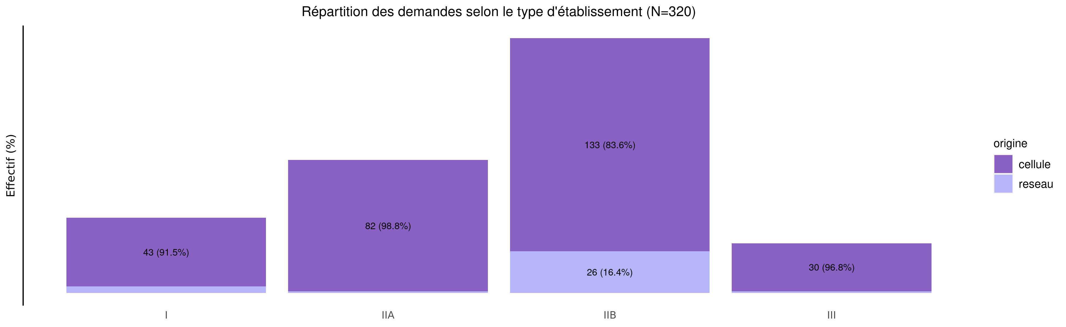
TIU par type d'établissement demandeur en 2020
29/07/2021
origine | I | IIA | IIB | III | Urgence | Inconnu | Total
cellule | 43 (14.9%) | 82 (28.5%) | 133 (46.2%) | 30 (10.4%) | 0 (0%) | 0 (0%) | 288
reseau | 4 (12.5%) | 1 (3.1%) | 26 (81.2%) | 1 (3.1%) | 0 (0%) | 0 (0%) | 32
Total | 47 (14.7%) | 83 (25.9%) | 159 (49.7%) | 31 (9.7%) | 0 (0%) | 0 (0%) | 320

Slide 5
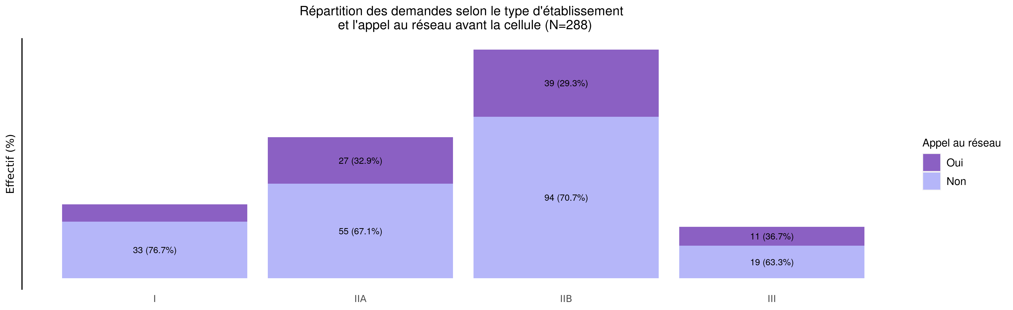
L'établissement a-t-il appelé le réseau avant la cellule?
29/07/2021
Appel | I | IIA | IIB | III | Urgence | Inconnu | Total
Oui | 10 (11.5%) | 27 (31.0%) | 39 (44.8%) | 11 (12.6%) | 0 (0%) | 0 (0%) | 87
Non | 33 (16.4%) | 55 (27.4%) | 94 (46.8%) | 19 (9.5%) | 0 (0%) | 0 (0%) | 201
Inconnu | 0 (0.0%) | 0 (0.0%) | 0 (0.0%) | 0 (0.0%) | 0 (0.0%) | 0 (0.0%) | 0
Total | 43 (14.9%) | 82 (28.5%) | 133 (46.2%) | 30 (10.4%) | 0 (0%) | 0 (0%) | 288

Slide 6
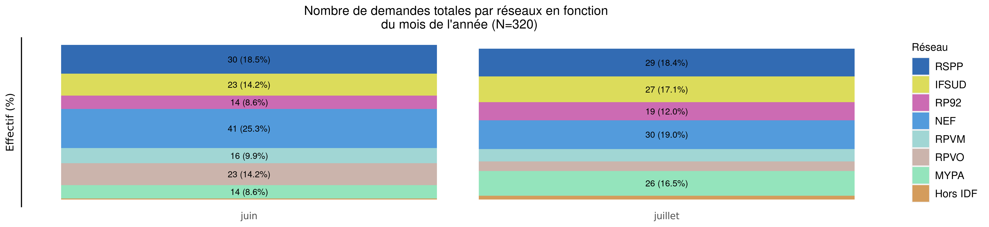
Nombre de demandes de TIU par réseau en 2020 (Total des transferts)
29/07/2021
Reseau | janvier | février | mars | avril | mai | juin | juillet | août | septembre | octobre | novembre | décembre | Total
RSPP | 0 (0%) | 0 (0%) | 0 (0%) | 0 (0%) | 0 (0%) | 30 (50.8%) | 29 (49.2%) | 0 (0%) | 0 (0%) | 0 (0%) | 0 (0%) | 0 (0%) | 59
IFSUD | 0 (0%) | 0 (0%) | 0 (0%) | 0 (0%) | 0 (0%) | 23 (46.0%) | 27 (54.0%) | 0 (0%) | 0 (0%) | 0 (0%) | 0 (0%) | 0 (0%) | 50
RP92 | 0 (0%) | 0 (0%) | 0 (0%) | 0 (0%) | 0 (0%) | 14 (42.4%) | 19 (57.6%) | 0 (0%) | 0 (0%) | 0 (0%) | 0 (0%) | 0 (0%) | 33
NEF | 0 (0%) | 0 (0%) | 0 (0%) | 0 (0%) | 0 (0%) | 41 (57.7%) | 30 (42.3%) | 0 (0%) | 0 (0%) | 0 (0%) | 0 (0%) | 0 (0%) | 71
RPVM | 0 (0%) | 0 (0%) | 0 (0%) | 0 (0%) | 0 (0%) | 16 (55.2%) | 13 (44.8%) | 0 (0%) | 0 (0%) | 0 (0%) | 0 (0%) | 0 (0%) | 29
RPVO | 0 (0%) | 0 (0%) | 0 (0%) | 0 (0%) | 0 (0%) | 23 (69.7%) | 10 (30.3%) | 0 (0%) | 0 (0%) | 0 (0%) | 0 (0%) | 0 (0%) | 33
MYPA | 0 (0%) | 0 (0%) | 0 (0%) | 0 (0%) | 0 (0%) | 14 (35.0%) | 26 (65.0%) | 0 (0%) | 0 (0%) | 0 (0%) | 0 (0%) | 0 (0%) | 40
Hors IDF | 0 (0%) | 0 (0%) | 0 (0%) | 0 (0%) | 0 (0%) | 1 (20.0%) | 4 (80.0%) | 0 (0%) | 0 (0%) | 0 (0%) | 0 (0%) | 0 (0%) | 5
Inconnu | 0 (0.0%) | 0 (0.0%) | 0 (0.0%) | 0 (0.0%) | 0 (0.0%) | 0 (0.0%) | 0 (0.0%) | 0 (0.0%) | 0 (0.0%) | 0 (0.0%) | 0 (0.0%) | 0 (0.0%) | 0
Total | 0 (0%) | 0 (0%) | 0 (0%) | 0 (0%) | 0 (0%) | 162 (50.6%) | 158 (49.4%) | 0 (0%) | 0 (0%) | 0 (0%) | 0 (0%) | 0 (0%) | 320

Slide 7
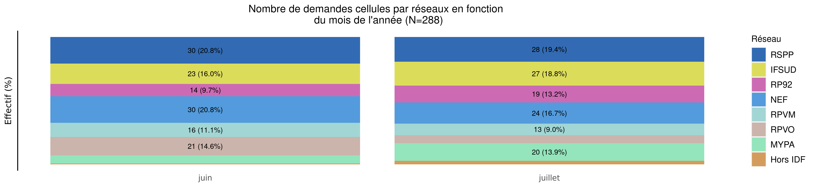
Nombre de demandes de TIU par réseau en 2020 (Transferts cellule)
29/07/2021
Variable | janvier | février | mars | avril | mai | juin | juillet | août | septembre | octobre | novembre | décembre | Total
RSPP | 0 (0%) | 0 (0%) | 0 (0%) | 0 (0%) | 0 (0%) | 30 (51.7%) | 28 (48.3%) | 0 (0%) | 0 (0%) | 0 (0%) | 0 (0%) | 0 (0%) | 58
IFSUD | 0 (0%) | 0 (0%) | 0 (0%) | 0 (0%) | 0 (0%) | 23 (46.0%) | 27 (54.0%) | 0 (0%) | 0 (0%) | 0 (0%) | 0 (0%) | 0 (0%) | 50
RP92 | 0 (0%) | 0 (0%) | 0 (0%) | 0 (0%) | 0 (0%) | 14 (42.4%) | 19 (57.6%) | 0 (0%) | 0 (0%) | 0 (0%) | 0 (0%) | 0 (0%) | 33
NEF | 0 (0%) | 0 (0%) | 0 (0%) | 0 (0%) | 0 (0%) | 30 (55.6%) | 24 (44.4%) | 0 (0%) | 0 (0%) | 0 (0%) | 0 (0%) | 0 (0%) | 54
RPVM | 0 (0%) | 0 (0%) | 0 (0%) | 0 (0%) | 0 (0%) | 16 (55.2%) | 13 (44.8%) | 0 (0%) | 0 (0%) | 0 (0%) | 0 (0%) | 0 (0%) | 29
RPVO | 0 (0%) | 0 (0%) | 0 (0%) | 0 (0%) | 0 (0%) | 21 (70.0%) | 9 (30.0%) | 0 (0%) | 0 (0%) | 0 (0%) | 0 (0%) | 0 (0%) | 30
MYPA | 0 (0%) | 0 (0%) | 0 (0%) | 0 (0%) | 0 (0%) | 9 (31.0%) | 20 (69.0%) | 0 (0%) | 0 (0%) | 0 (0%) | 0 (0%) | 0 (0%) | 29
Hors IDF | 0 (0%) | 0 (0%) | 0 (0%) | 0 (0%) | 0 (0%) | 1 (20.0%) | 4 (80.0%) | 0 (0%) | 0 (0%) | 0 (0%) | 0 (0%) | 0 (0%) | 5
Inconnu | 0 (0.0%) | 0 (0.0%) | 0 (0.0%) | 0 (0.0%) | 0 (0.0%) | 0 (0.0%) | 0 (0.0%) | 0 (0.0%) | 0 (0.0%) | 0 (0.0%) | 0 (0.0%) | 0 (0.0%) | 0
Total | 0 (0%) | 0 (0%) | 0 (0%) | 0 (0%) | 0 (0%) | 144 (50.0%) | 144 (50.0%) | 0 (0%) | 0 (0%) | 0 (0%) | 0 (0%) | 0 (0%) | 288

Slide 8
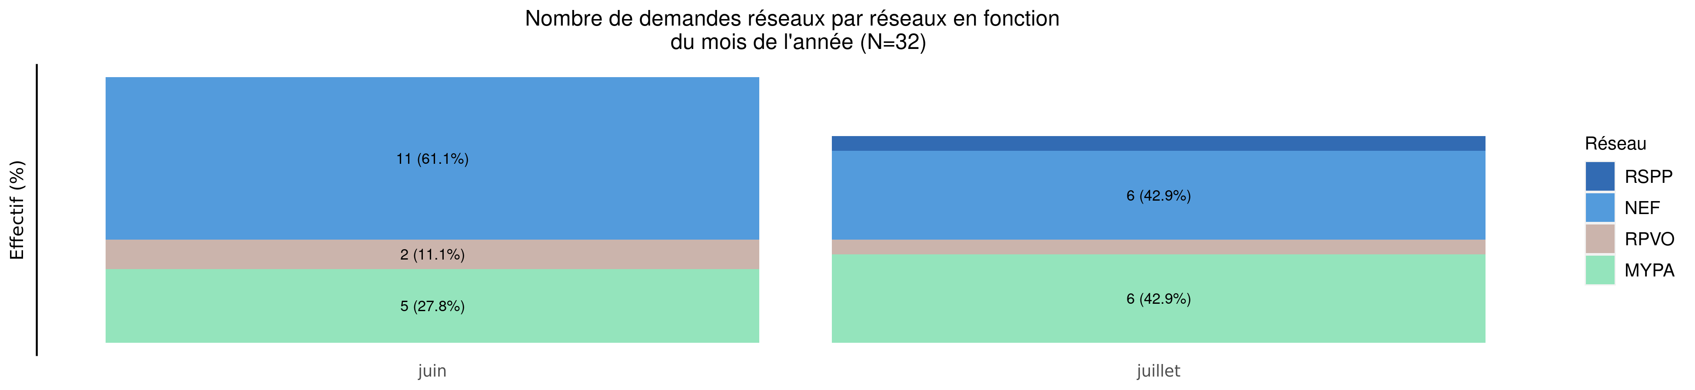
Nombre de demandes de TIU par réseau en 2020 (Transferts réseaux)
29/07/2021
Reseau | janvier | février | mars | avril | mai | juin | juillet | août | septembre | octobre | novembre | décembre | Total
RSPP | 0 (0%) | 0 (0%) | 0 (0%) | 0 (0%) | 0 (0%) | 0 (0.0%) | 1 (100.0%) | 0 (0%) | 0 (0%) | 0 (0%) | 0 (0%) | 0 (0%) | 1
IFSUD | 0 (0.0%) | 0 (0.0%) | 0 (0.0%) | 0 (0.0%) | 0 (0.0%) | 0 (0.0%) | 0 (0.0%) | 0 (0.0%) | 0 (0.0%) | 0 (0.0%) | 0 (0.0%) | 0 (0.0%) | 0
RP92 | 0 (0.0%) | 0 (0.0%) | 0 (0.0%) | 0 (0.0%) | 0 (0.0%) | 0 (0.0%) | 0 (0.0%) | 0 (0.0%) | 0 (0.0%) | 0 (0.0%) | 0 (0.0%) | 0 (0.0%) | 0
NEF | 0 (0%) | 0 (0%) | 0 (0%) | 0 (0%) | 0 (0%) | 11 (64.7%) | 6 (35.3%) | 0 (0%) | 0 (0%) | 0 (0%) | 0 (0%) | 0 (0%) | 17
RPVM | 0 (0.0%) | 0 (0.0%) | 0 (0.0%) | 0 (0.0%) | 0 (0.0%) | 0 (0.0%) | 0 (0.0%) | 0 (0.0%) | 0 (0.0%) | 0 (0.0%) | 0 (0.0%) | 0 (0.0%) | 0
RPVO | 0 (0%) | 0 (0%) | 0 (0%) | 0 (0%) | 0 (0%) | 2 (66.7%) | 1 (33.3%) | 0 (0%) | 0 (0%) | 0 (0%) | 0 (0%) | 0 (0%) | 3
MYPA | 0 (0%) | 0 (0%) | 0 (0%) | 0 (0%) | 0 (0%) | 5 (45.5%) | 6 (54.5%) | 0 (0%) | 0 (0%) | 0 (0%) | 0 (0%) | 0 (0%) | 11
Hors IDF | 0 (0.0%) | 0 (0.0%) | 0 (0.0%) | 0 (0.0%) | 0 (0.0%) | 0 (0.0%) | 0 (0.0%) | 0 (0.0%) | 0 (0.0%) | 0 (0.0%) | 0 (0.0%) | 0 (0.0%) | 0
Inconnu | 0 (0.0%) | 0 (0.0%) | 0 (0.0%) | 0 (0.0%) | 0 (0.0%) | 0 (0.0%) | 0 (0.0%) | 0 (0.0%) | 0 (0.0%) | 0 (0.0%) | 0 (0.0%) | 0 (0.0%) | 0
Total | 0 (0%) | 0 (0%) | 0 (0%) | 0 (0%) | 0 (0%) | 18 (56.2%) | 14 (43.8%) | 0 (0%) | 0 (0%) | 0 (0%) | 0 (0%) | 0 (0%) | 32

Slide 9
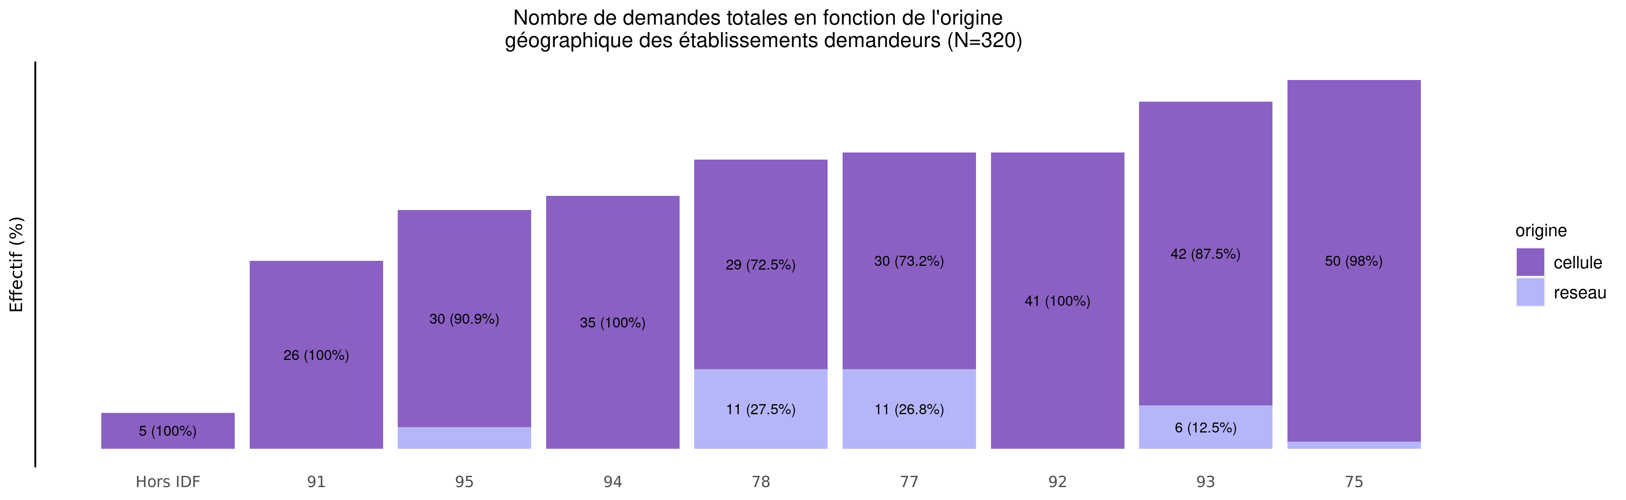
origine géographique des établissements demandeurs de TIU en 2020
29/07/2021
origine | Hors IDF | 91 | 95 | 94 | 78 | 77 | 92 | 93 | 75 | Total
cellule | 5 (1.7%) | 26 (9.0%) | 30 (10.4%) | 35 (12.2%) | 29 (10.1%) | 30 (10.4%) | 41 (14.2%) | 42 (14.6%) | 50 (17.4%) | 288
reseau | 0 (0.0%) | 0 (0.0%) | 3 (9.4%) | 0 (0.0%) | 11 (34.4%) | 11 (34.4%) | 0 (0.0%) | 6 (18.8%) | 1 (3.1%) | 32
Total | 5 (1.6%) | 26 (8.1%) | 33 (10.3%) | 35 (10.9%) | 40 (12.5%) | 41 (12.8%) | 41 (12.8%) | 48 (15.0%) | 51 (15.9%) | 320

Slide 10
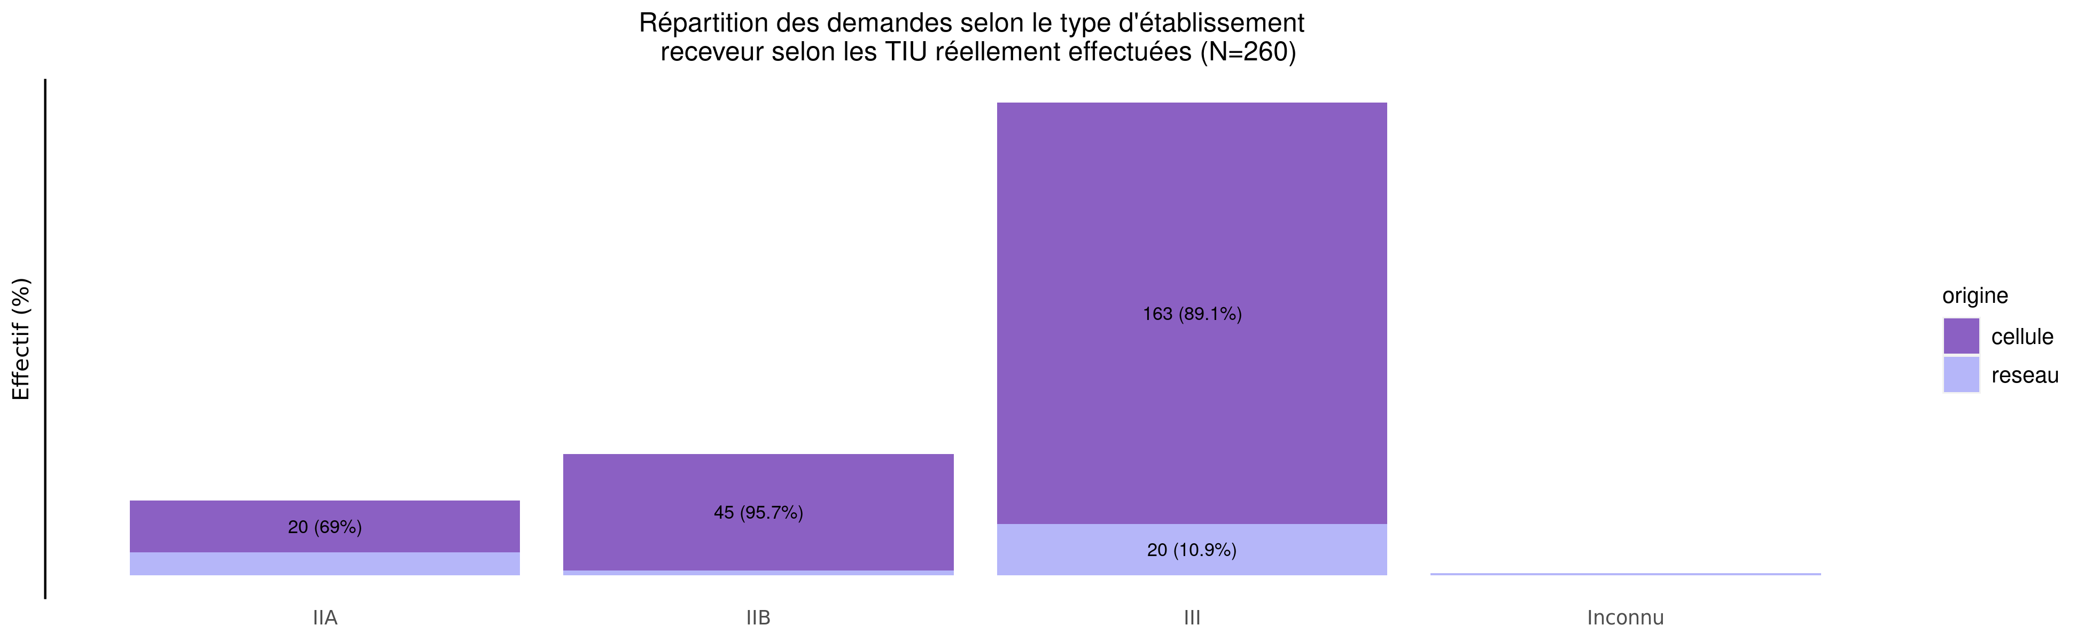
TIU par type d'établissement receveur en 2020
29/07/2021
origine | I | IIA | IIB | III | Urgence | Inconnu | Total
cellule | 0 (0%) | 20 (8.8%) | 45 (19.7%) | 163 (71.5%) | 0 (0%) | 0 (0.0%) | 228
reseau | 0 (0%) | 9 (28.1%) | 2 (6.2%) | 20 (62.5%) | 0 (0%) | 1 (3.1%) | 32
Total | 0 (0%) | 29 (11.2%) | 47 (18.1%) | 183 (70.4%) | 0 (0%) | 1 (0.4%) | 260

Slide 11
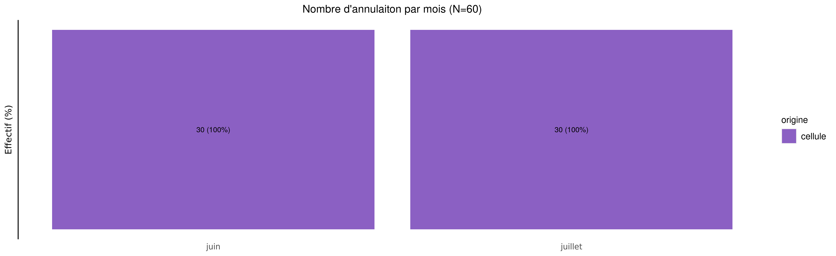
Annulation des demandes de TIU en 2020
29/07/2021
origine | janvier | février | mars | avril | mai | juin | juillet | août | septembre | octobre | novembre | décembre | Total
cellule | 0 (0%) | 0 (0%) | 0 (0%) | 0 (0%) | 0 (0%) | 30 (50%) | 30 (50%) | 0 (0%) | 0 (0%) | 0 (0%) | 0 (0%) | 0 (0%) | 60
Total | 0 (0%) | 0 (0%) | 0 (0%) | 0 (0%) | 0 (0%) | 30 (50%) | 30 (50%) | 0 (0%) | 0 (0%) | 0 (0%) | 0 (0%) | 0 (0%) | 60

Slide 12
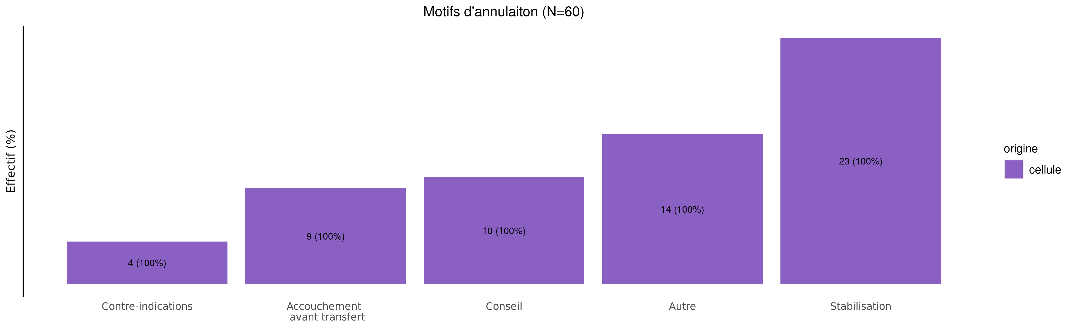
Motif d'annulation des demandes de TIU en 2020
29/07/2021
origine | Contre-indications | Accouchement avant transfert | Conseil | Autre | Stabilisation | Total
cellule | 4 (6.7%) | 9 (15%) | 10 (16.7%) | 14 (23.3%) | 23 (38.3%) | 60
Total | 4 (6.7%) | 9 (15%) | 10 (16.7%) | 14 (23.3%) | 23 (38.3%) | 60

Slide 13
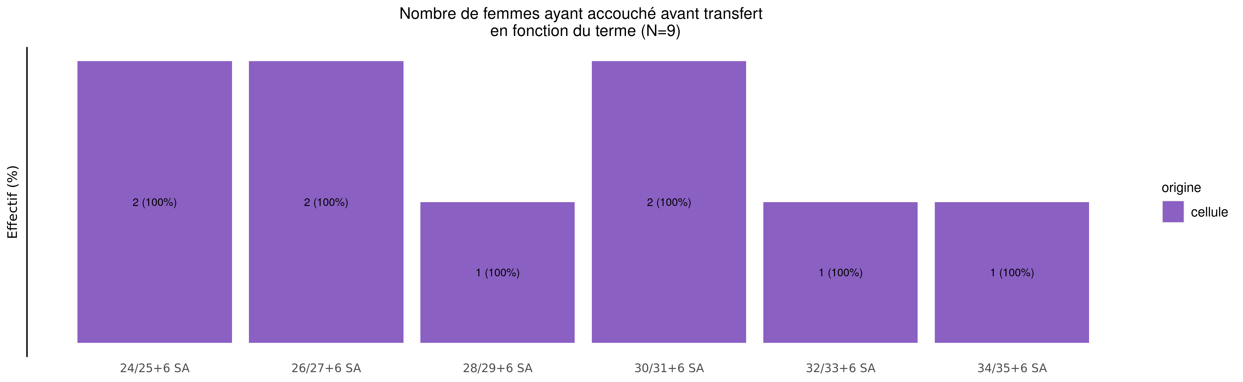
Termes des femmes ayant accouché avant transfert en 2020 (9 N.nés cellule et 0 N.nés réseaux)
29/07/2021
origine | Moins de 24 SA | 24/25+6 SA | 26/27+6 SA | 28/29+6 SA | 30/31+6 SA | 32/33+6 SA | 34/35+6 SA | Plus de 36 SA | Inconnu | Total
cellule | 0 (0%) | 2 (22.2%) | 2 (22.2%) | 1 (11.1%) | 2 (22.2%) | 1 (11.1%) | 1 (11.1%) | 0 (0%) | 0 (0%) | 9
Total | 0 (0%) | 2 (22.2%) | 2 (22.2%) | 1 (11.1%) | 2 (22.2%) | 1 (11.1%) | 1 (11.1%) | 0 (0%) | 0 (0%) | 9

Slide 14
Répartition des TIU en 2020 (Total des transferts)
29/07/2021
33 (10.3%)
14 (5.4%)
40 (12.5%)
71 (22.2%)
23 (8.8%)
66 (25.4%)
33 (10.3%)
59 (18.4%)
42 (16.2%)
72 (27.7%)
29 (9.1%)
24 (9.2%)
50 (15.6%)
5 (1.6%)
16 (6.2%)
2 (0.8%)
0 (0.0%)
1 (0.4%)

Slide 15
Répartition des TIU en 2020 (Transferts cellule)
29/07/2021
30 (10.4%)
11 (4.8%)
29 (10.1%)
54 (18.8%)
13 (5.7%)
53 (23.2%)
33 (11.5%)
58 (20.1%)
41 (18.0%)
70 (30.7%)
29 (10.1%)
22 (9.6%)
50 (17.4%)
5 (1.7%)
16 (7.0%)
2 (0.9%)
0 (0.0%)
0 (0.0%)

Slide 16
Répartition des TIU en 2020 (Transferts réseaux)
29/07/2021
3 (9.4%)
3 (9.4%)
11 (34.4%)
17 (53.1%)
10 (31.2%)
13 (40.6%)
0 (0.0%)
1 (3.1%)
1 (3.1%)
2 (6.2%)
0 (0.0%)
2 (6.2%)
0 (0.0%)
0 (0.0%)
0 (0.0%)
0 (0.0%)
0 (0.0%)
1 (3.1%)

Slide 17
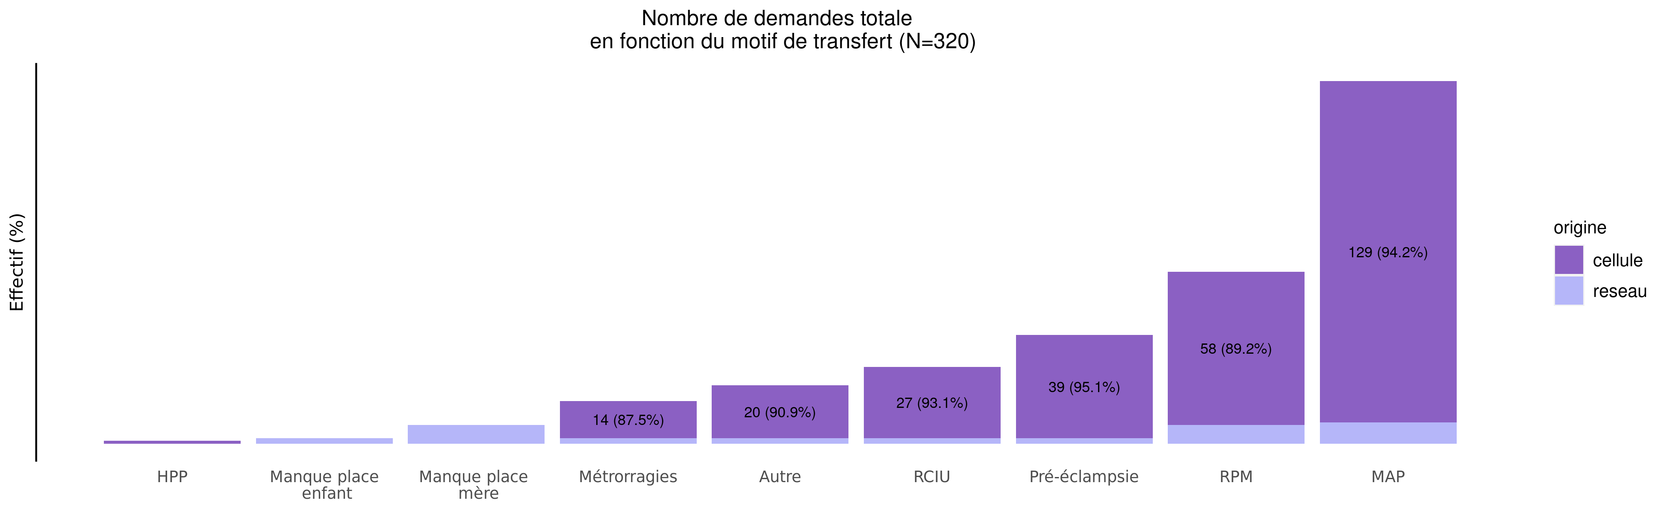
Motif de transfert principal en 2020
29/07/2021
origine | HPP | Manque place enfant | Manque place mère | Métrorragies | Autre | RCIU | Pré-éclampsie | RPM | MAP | Total
cellule | 1 (0.3%) | 0 (0.0%) | 0 (0.0%) | 14 (4.9%) | 20 (6.9%) | 27 (9.4%) | 39 (13.5%) | 58 (20.1%) | 129 (44.8%) | 288
reseau | 0 (0.0%) | 2 (6.2%) | 7 (21.9%) | 2 (6.2%) | 2 (6.2%) | 2 (6.2%) | 2 (6.2%) | 7 (21.9%) | 8 (25.0%) | 32
Total | 1 (0.3%) | 2 (0.6%) | 7 (2.2%) | 16 (5.0%) | 22 (6.9%) | 29 (9.1%) | 41 (12.8%) | 65 (20.3%) | 137 (42.8%) | 320

Slide 18
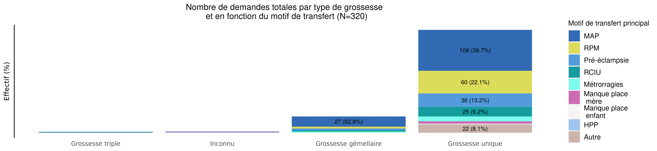
Type de grossesse par motif de transfert en 2020 (Total des transferts)
29/07/2021
Motif | Grossesse triple | Inconnu | Grossesse gémellaire | Grossesse unique | Total
MAP | 1 (0.7%) | 1 (0.7%) | 27 (19.7%) | 108 (78.8%) | 137
RPM | 0 (0.0%) | 0 (0.0%) | 5 (7.7%) | 60 (92.3%) | 65
Pré-éclampsie | 0 (0.0%) | 0 (0.0%) | 5 (12.2%) | 36 (87.8%) | 41
RCIU | 1 (3.4%) | 0 (0.0%) | 3 (10.3%) | 25 (86.2%) | 29
Métrorragies | 0 (0.0%) | 0 (0.0%) | 3 (18.8%) | 13 (81.2%) | 16
Manque place mère | 0 (0.0%) | 1 (14.3%) | 0 (0.0%) | 6 (85.7%) | 7
Manque place enfant | 0 (0.0%) | 0 (0.0%) | 0 (0.0%) | 2 (100.0%) | 2
HPP | 0 (0.0%) | 1 (100.0%) | 0 (0.0%) | 0 (0.0%) | 1
Autre | 0 (0.0%) | 0 (0.0%) | 0 (0.0%) | 22 (100.0%) | 22
Inconnu | 0 (0.0%) | 0 (0.0%) | 0 (0.0%) | 0 (0.0%) | 0
Total | 2 (0.6%) | 3 (0.9%) | 43 (13.4%) | 272 (85.0%) | 320

Slide 19
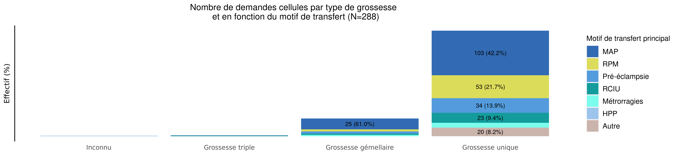
Type de grossesse par motif de transfert en 2020 (Transferts cellule)
29/07/2021
Motif | Inconnu | Grossesse triple | Grossesse gémellaire | Grossesse unique | Total
MAP | 0 (0.0%) | 1 (0.8%) | 25 (19.4%) | 103 (79.8%) | 129
RPM | 0 (0.0%) | 0 (0.0%) | 5 (8.6%) | 53 (91.4%) | 58
Pré-éclampsie | 0 (0.0%) | 0 (0.0%) | 5 (12.8%) | 34 (87.2%) | 39
RCIU | 0 (0.0%) | 1 (3.7%) | 3 (11.1%) | 23 (85.2%) | 27
Métrorragies | 0 (0.0%) | 0 (0.0%) | 3 (21.4%) | 11 (78.6%) | 14
Manque place mère | 0 (0.0%) | 0 (0.0%) | 0 (0.0%) | 0 (0.0%) | 0
Manque place enfant | 0 (0.0%) | 0 (0.0%) | 0 (0.0%) | 0 (0.0%) | 0
HPP | 1 (100.0%) | 0 (0.0%) | 0 (0.0%) | 0 (0.0%) | 1
Autre | 0 (0.0%) | 0 (0.0%) | 0 (0.0%) | 20 (100.0%) | 20
Inconnu | 0 (0.0%) | 0 (0.0%) | 0 (0.0%) | 0 (0.0%) | 0
Total | 1 (0.3%) | 2 (0.7%) | 41 (14.2%) | 244 (84.7%) | 288

Slide 20
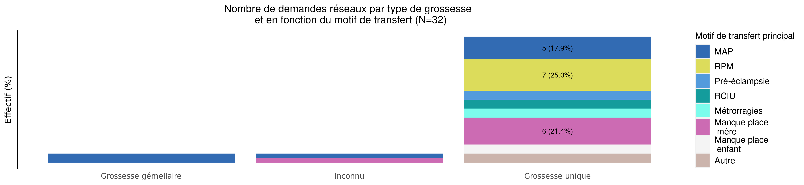
Type de grossesse par motif de transfert en 2020 (Transferts réseaux)
29/07/2021
Motif | Grossesse gémellaire | Inconnu | Grossesse unique | Total
MAP | 2 (25.0%) | 1 (12.5%) | 5 (62.5%) | 8
RPM | 0 (0.0%) | 0 (0.0%) | 7 (100.0%) | 7
Pré-éclampsie | 0 (0.0%) | 0 (0.0%) | 2 (100.0%) | 2
RCIU | 0 (0.0%) | 0 (0.0%) | 2 (100.0%) | 2
Métrorragies | 0 (0.0%) | 0 (0.0%) | 2 (100.0%) | 2
Manque place mère | 0 (0.0%) | 1 (14.3%) | 6 (85.7%) | 7
Manque place enfant | 0 (0.0%) | 0 (0.0%) | 2 (100.0%) | 2
HPP | 0 (0.0%) | 0 (0.0%) | 0 (0.0%) | 0
Autre | 0 (0.0%) | 0 (0.0%) | 2 (100.0%) | 2
Inconnu | 0 (0.0%) | 0 (0.0%) | 0 (0.0%) | 0
Total | 2 (6.2%) | 2 (6.2%) | 28 (87.5%) | 32

Slide 21
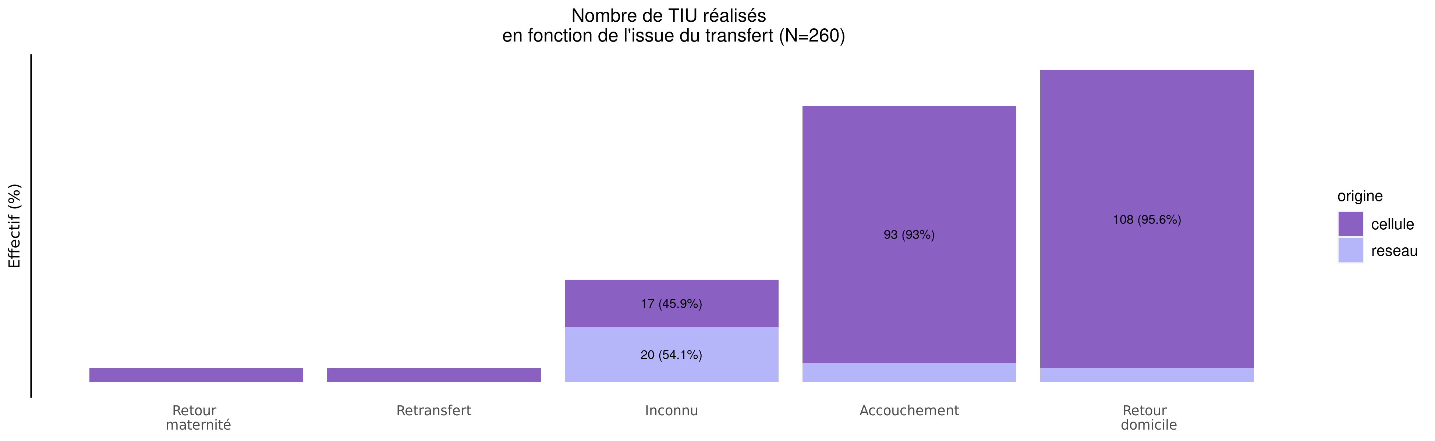
issue des transferts réalisés en 2020
29/07/2021
origine | Retour maternité | Retransfert | Inconnu | Accouchement | Retour domicile | Total
cellule | 5 (2.2%) | 5 (2.2%) | 17 (7.5%) | 93 (40.8%) | 108 (47.4%) | 228
reseau | 0 (0.0%) | 0 (0.0%) | 20 (62.5%) | 7 (21.9%) | 5 (15.6%) | 32
Total | 5 (1.9%) | 5 (1.9%) | 37 (14.2%) | 100 (38.5%) | 113 (43.5%) | 260

Slide 22
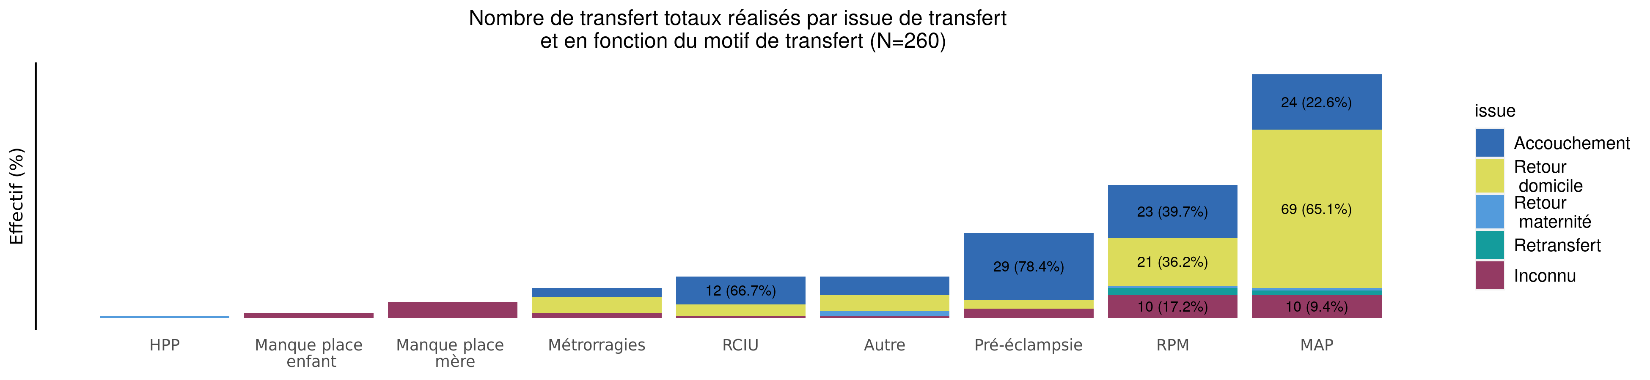
Motif des TIU réalisés par issue de transfert en 2020 (Total des transferts)
29/07/2021
issue | HPP | Manque place enfant | Manque place mère | Métrorragies | RCIU | Autre | Pré-éclampsie | RPM | MAP | Total
Accouchement | 0 (0.0%) | 0 (0.0%) | 0 (0.0%) | 4 (4.0%) | 12 (12.0%) | 8 (8.0%) | 29 (29.0%) | 23 (23.0%) | 24 (24.0%) | 100
Retour domicile | 0 (0.0%) | 0 (0.0%) | 0 (0.0%) | 7 (6.2%) | 5 (4.4%) | 7 (6.2%) | 4 (3.5%) | 21 (18.6%) | 69 (61.1%) | 113
Retour maternité | 1 (20.0%) | 0 (0.0%) | 0 (0.0%) | 0 (0.0%) | 0 (0.0%) | 2 (40.0%) | 0 (0.0%) | 1 (20.0%) | 1 (20.0%) | 5
Retransfert | 0 (0.0%) | 0 (0.0%) | 0 (0.0%) | 0 (0.0%) | 0 (0.0%) | 0 (0.0%) | 0 (0.0%) | 3 (60.0%) | 2 (40.0%) | 5
Autre | 0 (0.0%) | 0 (0.0%) | 0 (0.0%) | 0 (0.0%) | 0 (0.0%) | 0 (0.0%) | 0 (0.0%) | 0 (0.0%) | 0 (0.0%) | 0
Inconnu | 0 (0.0%) | 2 (5.4%) | 7 (18.9%) | 2 (5.4%) | 1 (2.7%) | 1 (2.7%) | 4 (10.8%) | 10 (27.0%) | 10 (27.0%) | 37
Total | 1 (0.4%) | 2 (0.8%) | 7 (2.7%) | 13 (5.0%) | 18 (6.9%) | 18 (6.9%) | 37 (14.2%) | 58 (22.3%) | 106 (40.8%) | 260

Slide 23
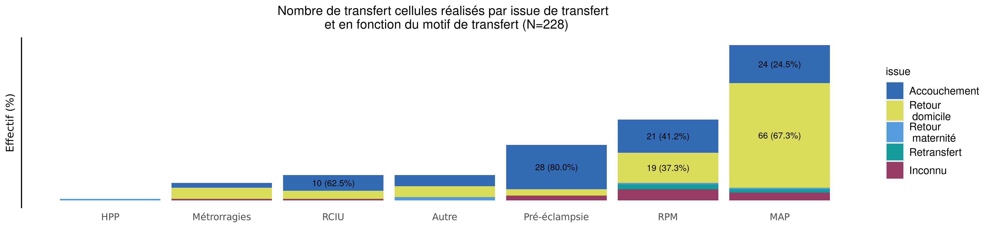
Motif des TIU réalisés par issue de transfert en 2020 (Transferts cellule)
29/07/2021
issue | HPP | Métrorragies | RCIU | Autre | Pré-éclampsie | RPM | MAP | Total
Accouchement | 0 (0.0%) | 3 (3.2%) | 10 (10.8%) | 7 (7.5%) | 28 (30.1%) | 21 (22.6%) | 24 (25.8%) | 93
Retour domicile | 0 (0.0%) | 7 (6.5%) | 5 (4.6%) | 7 (6.5%) | 4 (3.7%) | 19 (17.6%) | 66 (61.1%) | 108
Retour maternité | 1 (20.0%) | 0 (0.0%) | 0 (0.0%) | 2 (40.0%) | 0 (0.0%) | 1 (20.0%) | 1 (20.0%) | 5
Retransfert | 0 (0.0%) | 0 (0.0%) | 0 (0.0%) | 0 (0.0%) | 0 (0.0%) | 3 (60.0%) | 2 (40.0%) | 5
Autre | 0 (0.0%) | 0 (0.0%) | 0 (0.0%) | 0 (0.0%) | 0 (0.0%) | 0 (0.0%) | 0 (0.0%) | 0
Inconnu | 0 (0.0%) | 1 (5.9%) | 1 (5.9%) | 0 (0.0%) | 3 (17.6%) | 7 (41.2%) | 5 (29.4%) | 17
Total | 1 (0.4%) | 11 (4.8%) | 16 (7.0%) | 16 (7.0%) | 35 (15.4%) | 51 (22.4%) | 98 (43.0%) | 228

Slide 24
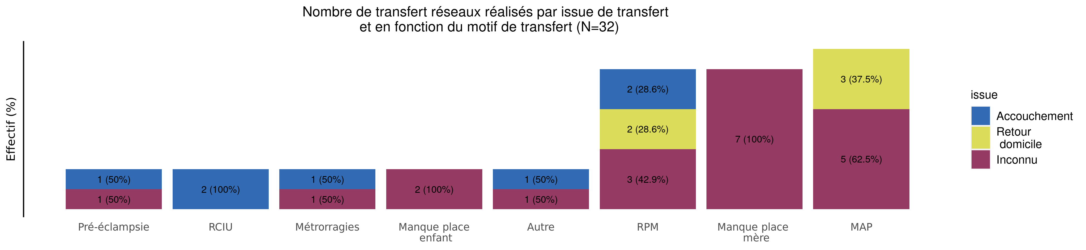
Motif des TIU réalisés par issue de transfert en 2020 (Transferts réseaux)
29/07/2021
issue | Pré-éclampsie | RCIU | Métrorragies | Manque place enfant | Autre | RPM | Manque place mère | MAP | Total
Accouchement | 1 (14.3%) | 2 (28.6%) | 1 (14.3%) | 0 (0.0%) | 1 (14.3%) | 2 (28.6%) | 0 (0.0%) | 0 (0%) | 7
Retour domicile | 0 (0.0%) | 0 (0.0%) | 0 (0.0%) | 0 (0.0%) | 0 (0.0%) | 2 (40.0%) | 0 (0.0%) | 3 (60%) | 5
Retour maternité | 0 (0.0%) | 0 (0.0%) | 0 (0.0%) | 0 (0.0%) | 0 (0.0%) | 0 (0.0%) | 0 (0.0%) | 0 (0.0%) | 0
Retransfert | 0 (0.0%) | 0 (0.0%) | 0 (0.0%) | 0 (0.0%) | 0 (0.0%) | 0 (0.0%) | 0 (0.0%) | 0 (0.0%) | 0
Autre | 0 (0.0%) | 0 (0.0%) | 0 (0.0%) | 0 (0.0%) | 0 (0.0%) | 0 (0.0%) | 0 (0.0%) | 0 (0.0%) | 0
Inconnu | 1 (5.0%) | 0 (0.0%) | 1 (5.0%) | 2 (10.0%) | 1 (5.0%) | 3 (15.0%) | 7 (35.0%) | 5 (25%) | 20
Total | 2 (6.2%) | 2 (6.2%) | 2 (6.2%) | 2 (6.2%) | 2 (6.2%) | 7 (21.9%) | 7 (21.9%) | 8 (25%) | 32

Slide 25
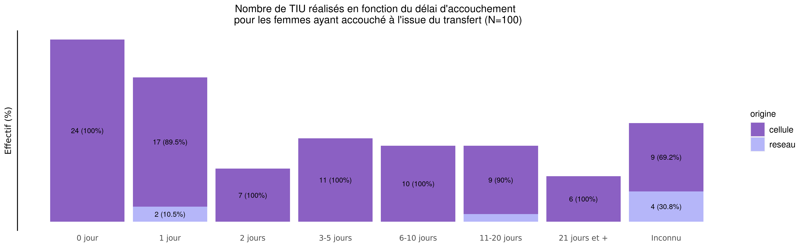
Délai d'accouchement des TIU réalisés en 2020
29/07/2021
origine | 0 jour | 1 jour | 2 jours | 3-5 jours | 6-10 jours | 11-20 jours | 21 jours et + | Inconnu | Total
cellule | 24 (25.8%) | 17 (18.3%) | 7 (7.5%) | 11 (11.8%) | 10 (10.8%) | 9 (9.7%) | 6 (6.5%) | 9 (9.7%) | 93
reseau | 0 (0.0%) | 2 (28.6%) | 0 (0.0%) | 0 (0.0%) | 0 (0.0%) | 1 (14.3%) | 0 (0.0%) | 4 (57.1%) | 7
Total | 24 (24.0%) | 19 (19.0%) | 7 (7.0%) | 11 (11.0%) | 10 (10.0%) | 10 (10.0%) | 6 (6.0%) | 13 (13.0%) | 100

Slide 26
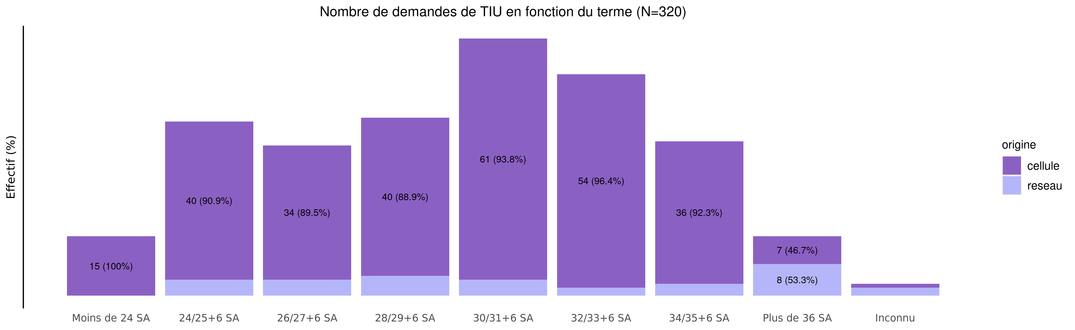
Termes des demandes de transfert en 2020
29/07/2021
origine | Moins de 24 SA | 24/25+6 SA | 26/27+6 SA | 28/29+6 SA | 30/31+6 SA | 32/33+6 SA | 34/35+6 SA | Plus de 36 SA | Inconnu | Total
cellule | 15 (5.2%) | 40 (13.9%) | 34 (11.8%) | 40 (13.9%) | 61 (21.2%) | 54 (18.8%) | 36 (12.5%) | 7 (2.4%) | 1 (0.3%) | 288
reseau | 0 (0.0%) | 4 (12.5%) | 4 (12.5%) | 5 (15.6%) | 4 (12.5%) | 2 (6.2%) | 3 (9.4%) | 8 (25.0%) | 2 (6.2%) | 32
Total | 15 (4.7%) | 44 (13.8%) | 38 (11.9%) | 45 (14.1%) | 65 (20.3%) | 56 (17.5%) | 39 (12.2%) | 15 (4.7%) | 3 (0.9%) | 320

Slide 27
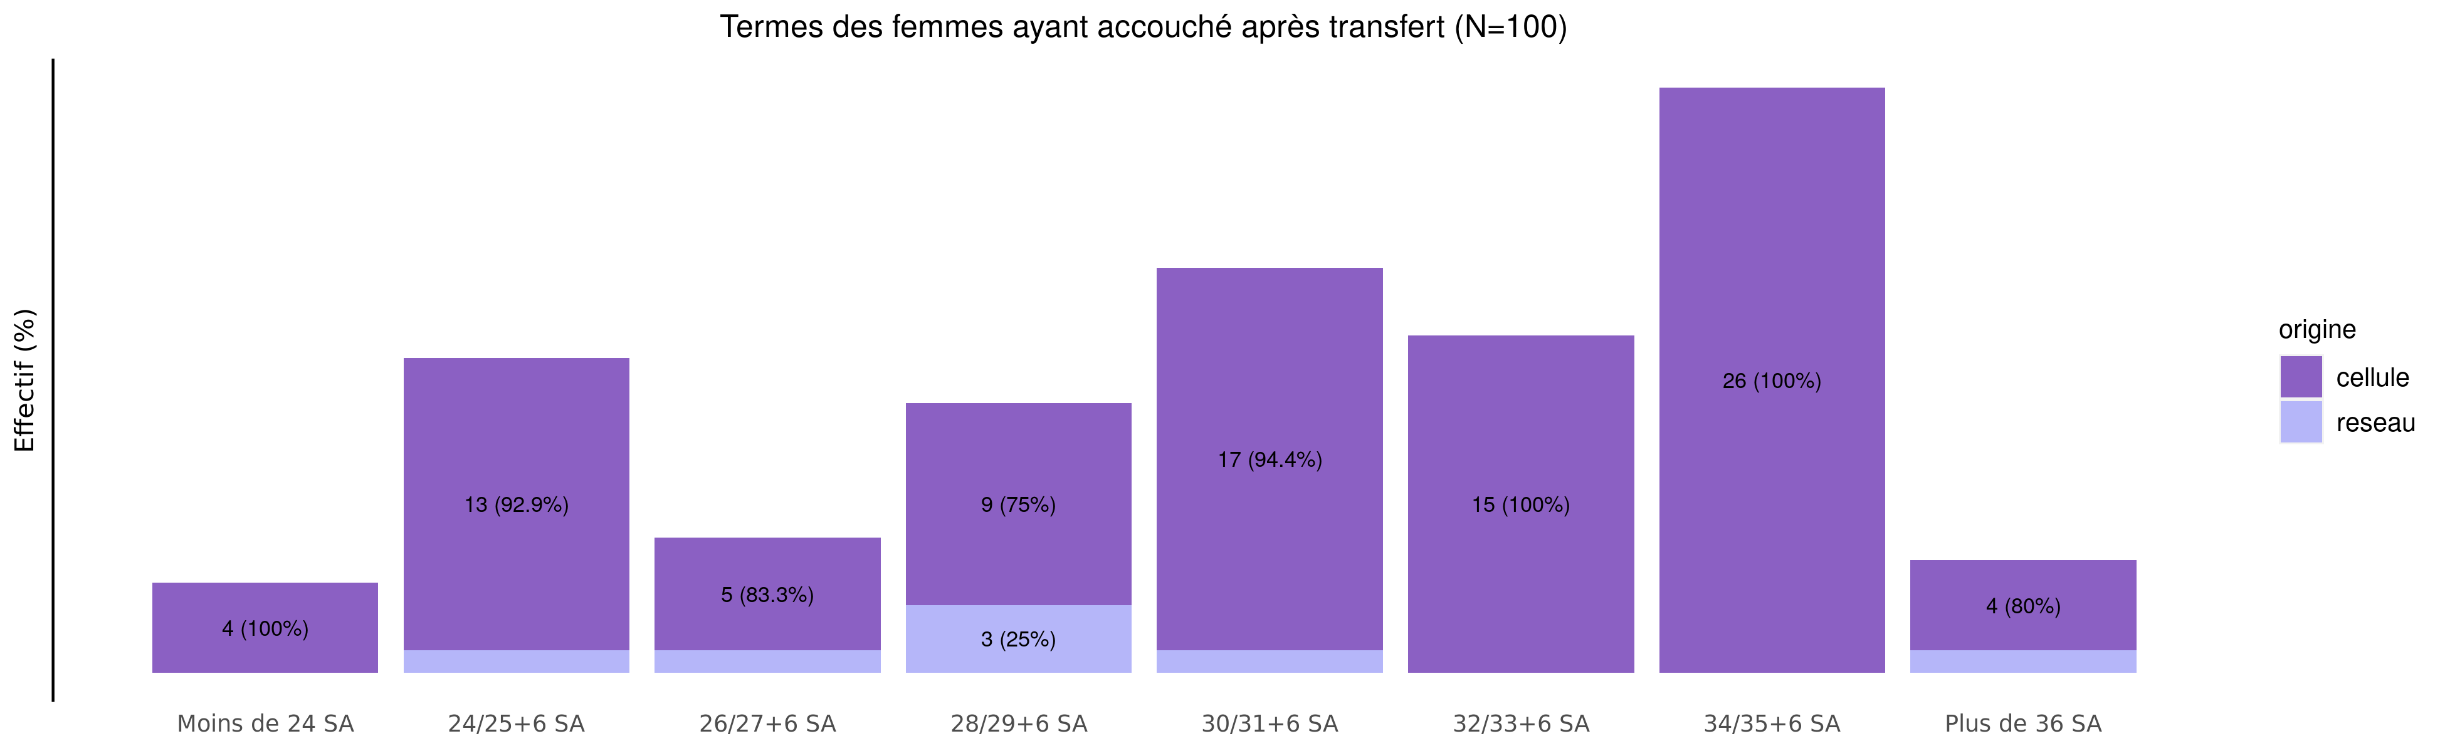
Les accouchements suite à TIU en 2020 - terme
29/07/2021
origine | Moins de 24 SA | 24/25+6 SA | 26/27+6 SA | 28/29+6 SA | 30/31+6 SA | 32/33+6 SA | 34/35+6 SA | Plus de 36 SA | Inconnu | Total
cellule | 4 (4.3%) | 13 (14.0%) | 5 (5.4%) | 9 (9.7%) | 17 (18.3%) | 15 (16.1%) | 26 (28%) | 4 (4.3%) | 0 (0%) | 93
reseau | 0 (0.0%) | 1 (14.3%) | 1 (14.3%) | 3 (42.9%) | 1 (14.3%) | 0 (0.0%) | 0 (0%) | 1 (14.3%) | 0 (0%) | 7
Total | 4 (4.0%) | 14 (14.0%) | 6 (6.0%) | 12 (12.0%) | 18 (18.0%) | 15 (15.0%) | 26 (26%) | 5 (5.0%) | 0 (0%) | 100

Slide 28
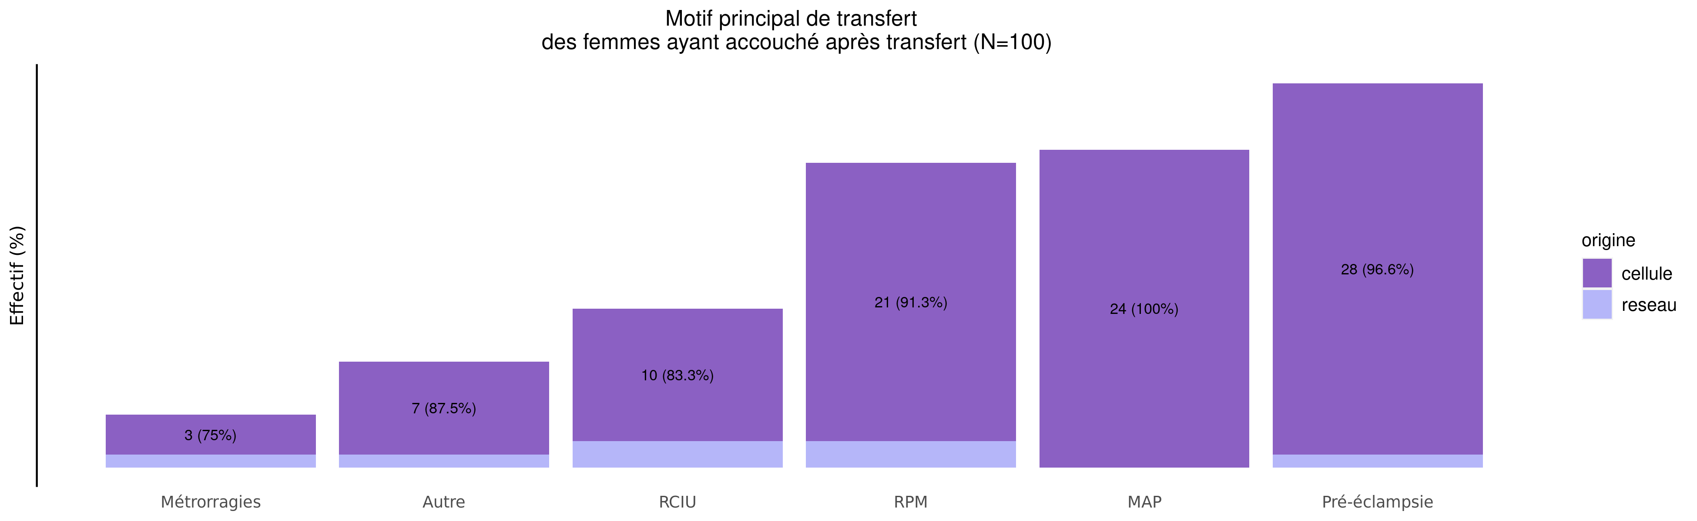
Les accouchements suite à TIU en 2020 - motif de transfert
29/07/2021
origine | MAP | RPM | Pré-éclampsie | RCIU | Métrorragies | Manque place mère | Manque place enfant | HPP | Autre | Inconnu | Total
cellule | 24 (25.8%) | 21 (22.6%) | 28 (30.1%) | 10 (10.8%) | 3 (3.2%) | 0 (0%) | 0 (0%) | 0 (0%) | 7 (7.5%) | 0 (0%) | 93
reseau | 0 (0.0%) | 2 (28.6%) | 1 (14.3%) | 2 (28.6%) | 1 (14.3%) | 0 (0%) | 0 (0%) | 0 (0%) | 1 (14.3%) | 0 (0%) | 7
Total | 24 (24.0%) | 23 (23.0%) | 29 (29.0%) | 12 (12.0%) | 4 (4.0%) | 0 (0%) | 0 (0%) | 0 (0%) | 8 (8.0%) | 0 (0%) | 100

Slide 29
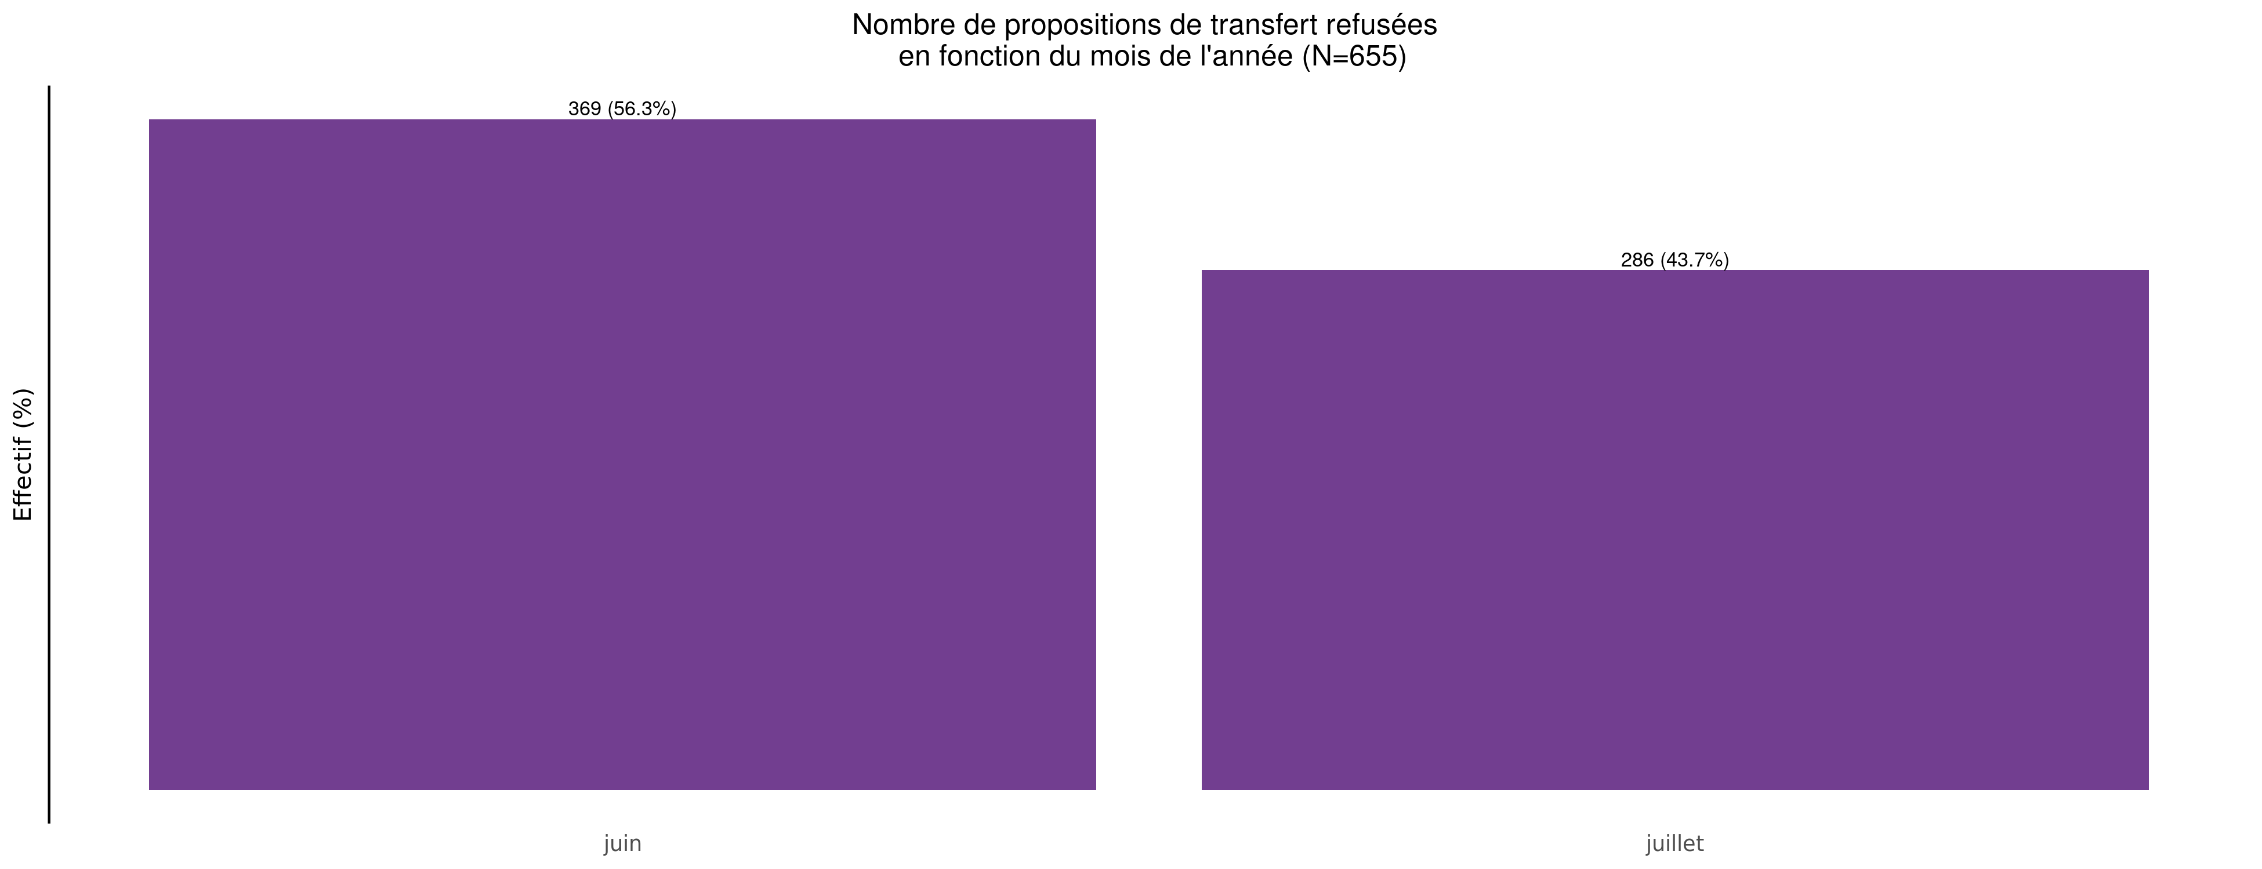
Nombre de propositions de transfert refusées en 2020
29/07/2021

Slide 30
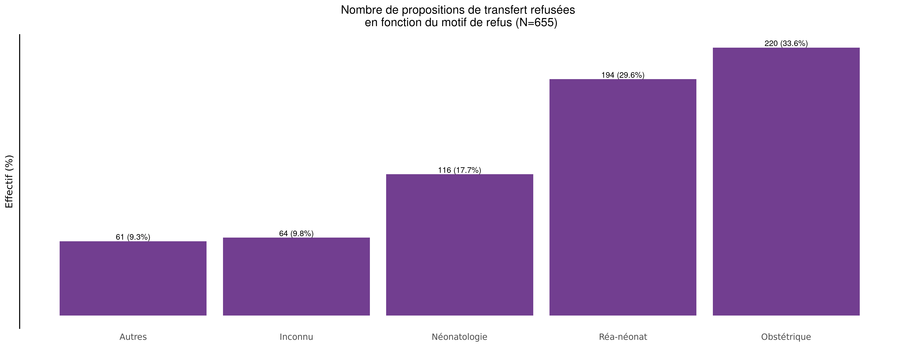
Motif des propositions de transfert refusées en 2020
29/07/2021

Slide 31
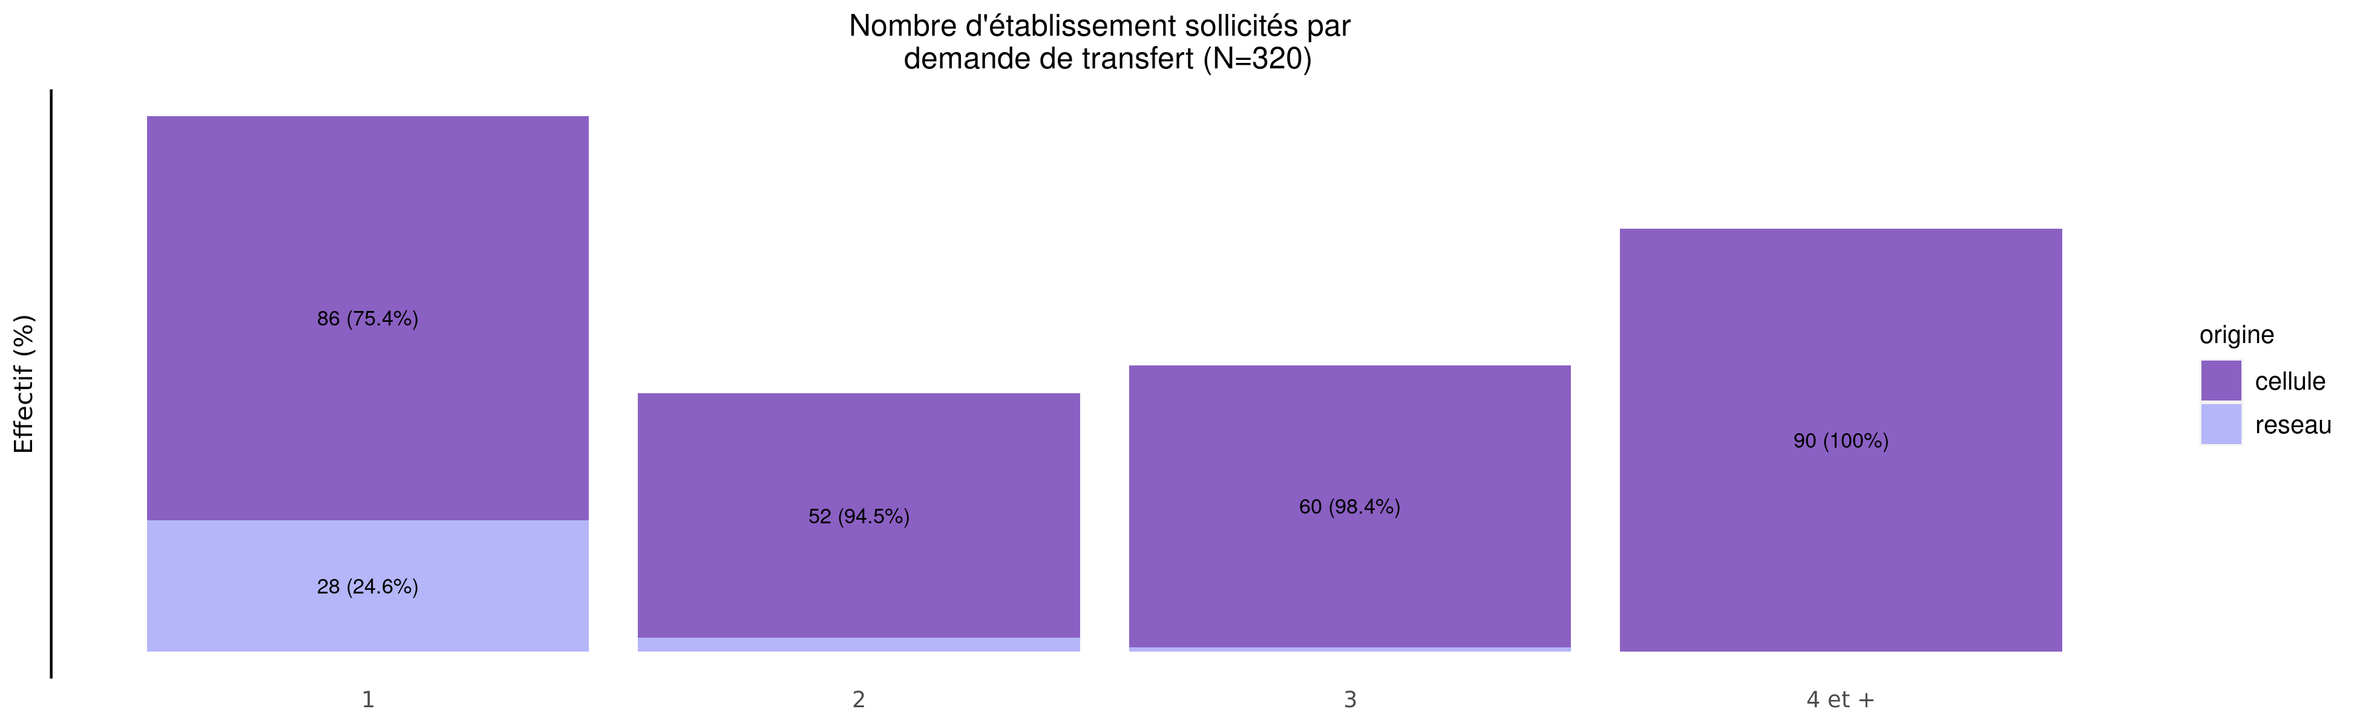
Nombre d'établissements sollicités par demande en 2020
29/07/2021
origine | 1 | 2 | 3 | 4 et + | Total
cellule | 86 (29.9%) | 52 (18.1%) | 60 (20.8%) | 90 (31.2%) | 288
reseau | 28 (87.5%) | 3 (9.4%) | 1 (3.1%) | 0 (0.0%) | 32
Total | 114 (35.6%) | 55 (17.2%) | 61 (19.1%) | 90 (28.1%) | 320

Slide 32
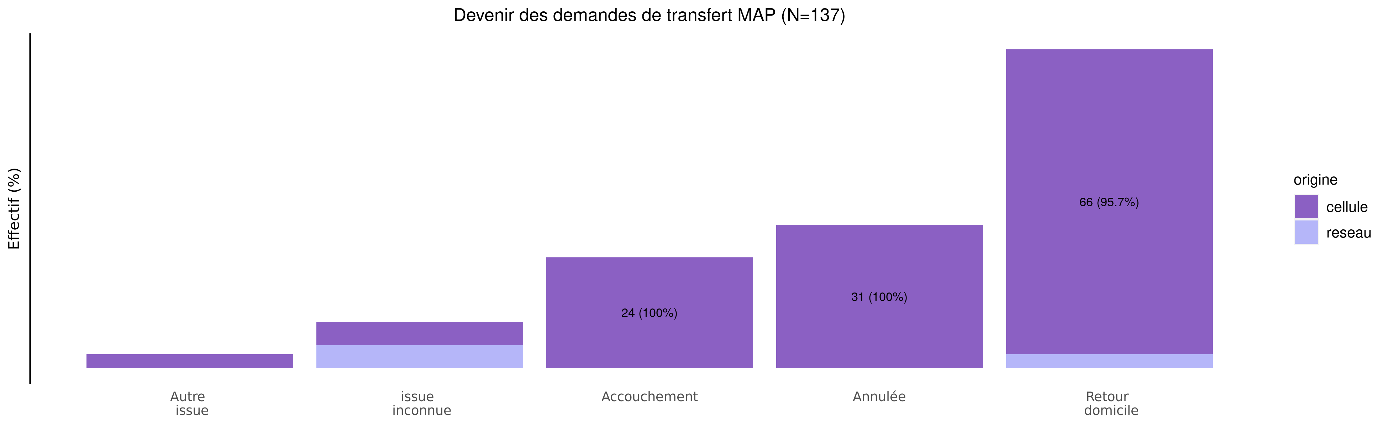
Devenir des demandes de MAP en 2020
29/07/2021
origine | Autre issue | issue inconnue | Accouchement | Annulée | Retour domicile | Total
cellule | 3 (2.3%) | 5 (3.9%) | 24 (18.6%) | 31 (24.0%) | 66 (51.2%) | 129
reseau | 0 (0.0%) | 5 (62.5%) | 0 (0.0%) | 0 (0.0%) | 3 (37.5%) | 8
Total | 3 (2.2%) | 10 (7.3%) | 24 (17.5%) | 31 (22.6%) | 69 (50.4%) | 137

Slide 33
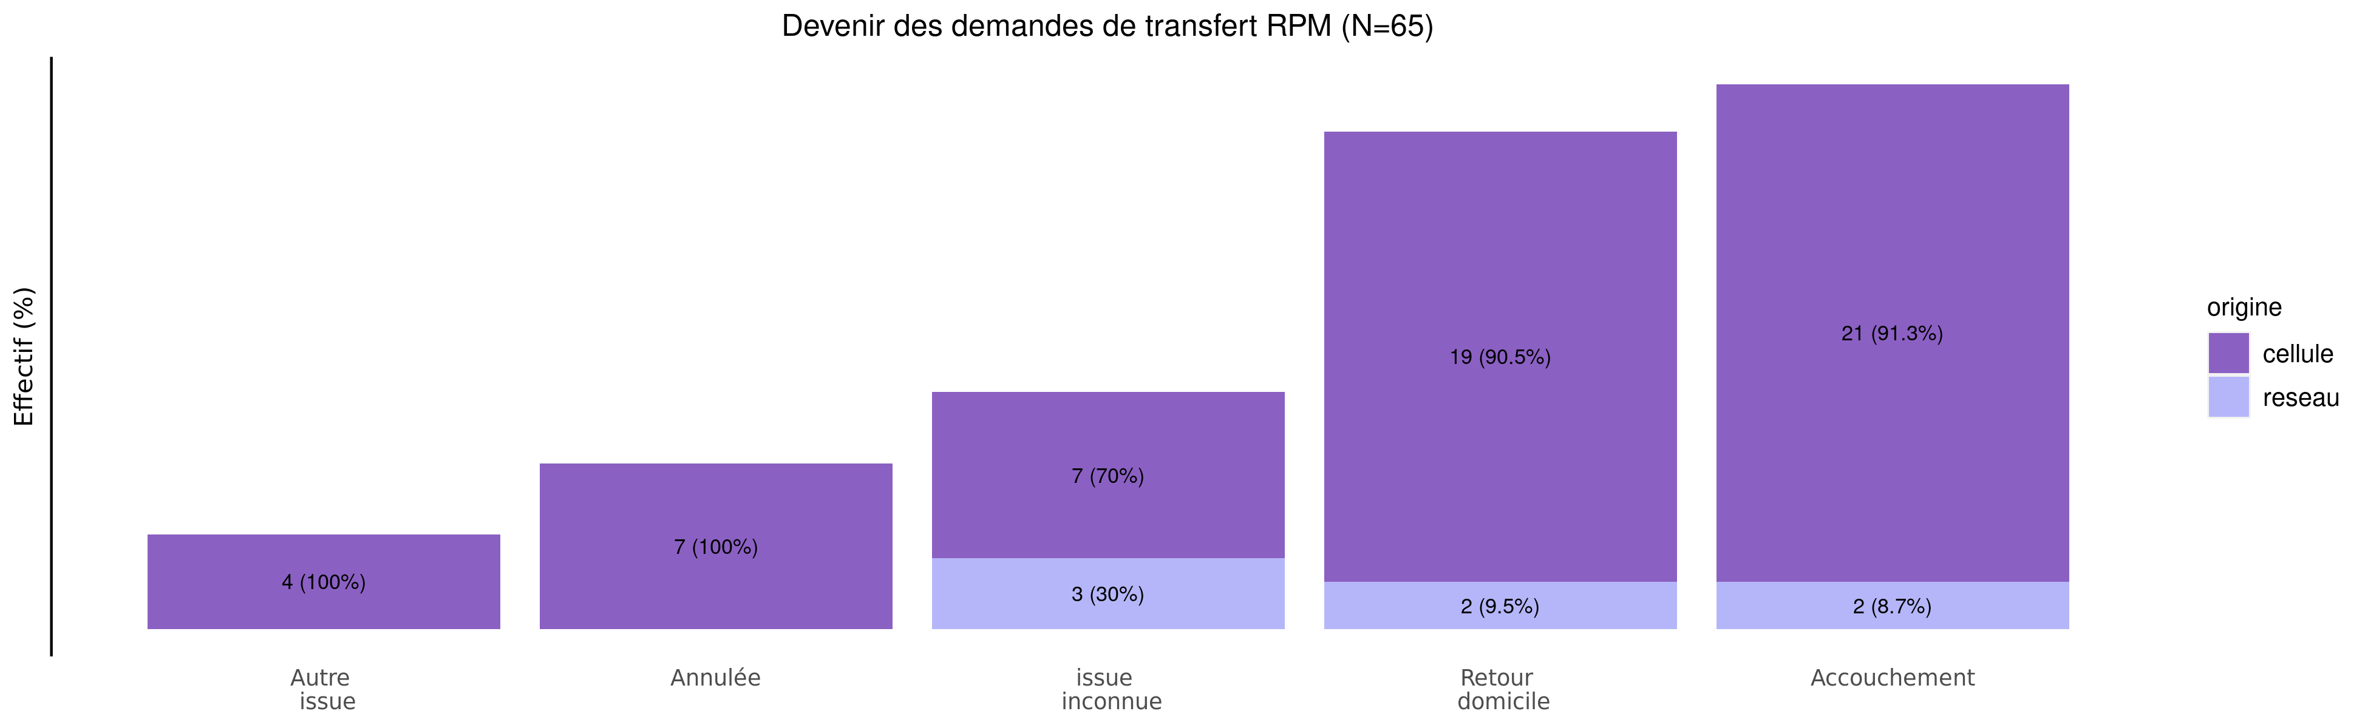
Devenir des demandes de RPM en 2020
29/07/2021
origine | Autre issue | Annulée | issue inconnue | Retour domicile | Accouchement | Total
cellule | 4 (6.9%) | 7 (12.1%) | 7 (12.1%) | 19 (32.8%) | 21 (36.2%) | 58
reseau | 0 (0.0%) | 0 (0.0%) | 3 (42.9%) | 2 (28.6%) | 2 (28.6%) | 7
Total | 4 (6.2%) | 7 (10.8%) | 10 (15.4%) | 21 (32.3%) | 23 (35.4%) | 65

