Slide 1
Île de France
Jeudi 13 Février 2020

Slide 2
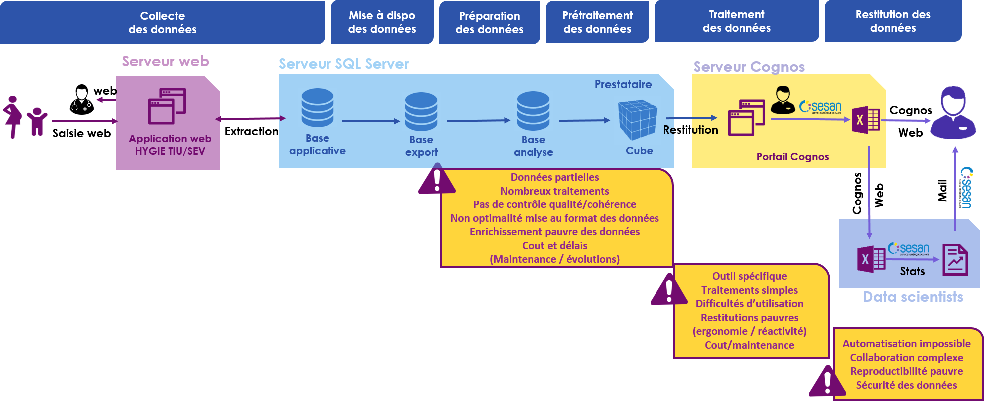
Acquisition des données - Architecture antérieure
13/02/2020

Slide 3
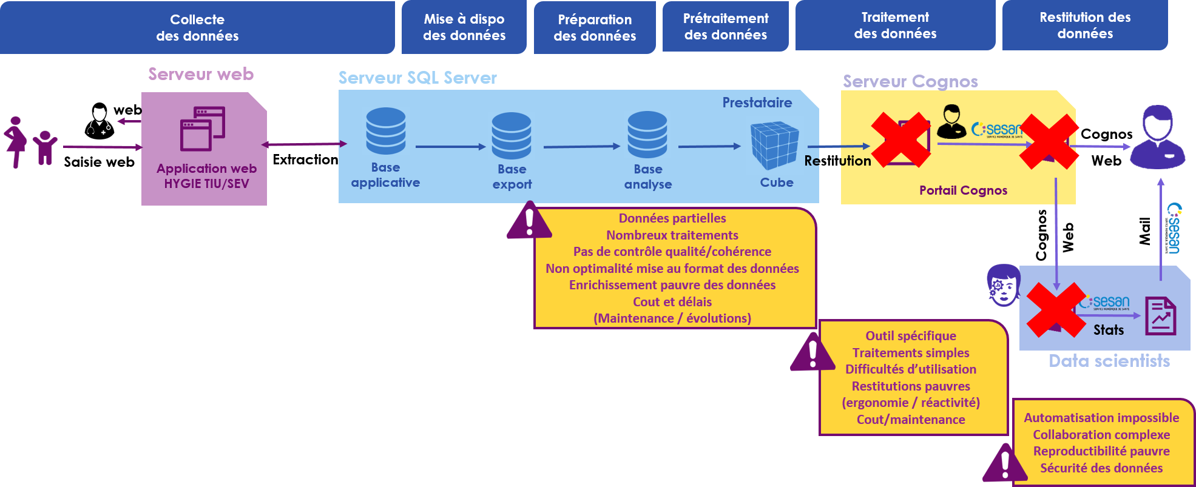
Acquisition des données - Modification de l'architecture (1/2)
13/02/2020

Slide 4
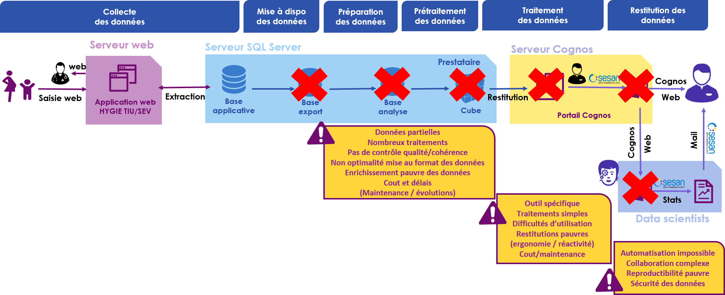
Acquisition des données - Modification de l'architecture (2/2)
13/02/2020

Slide 5
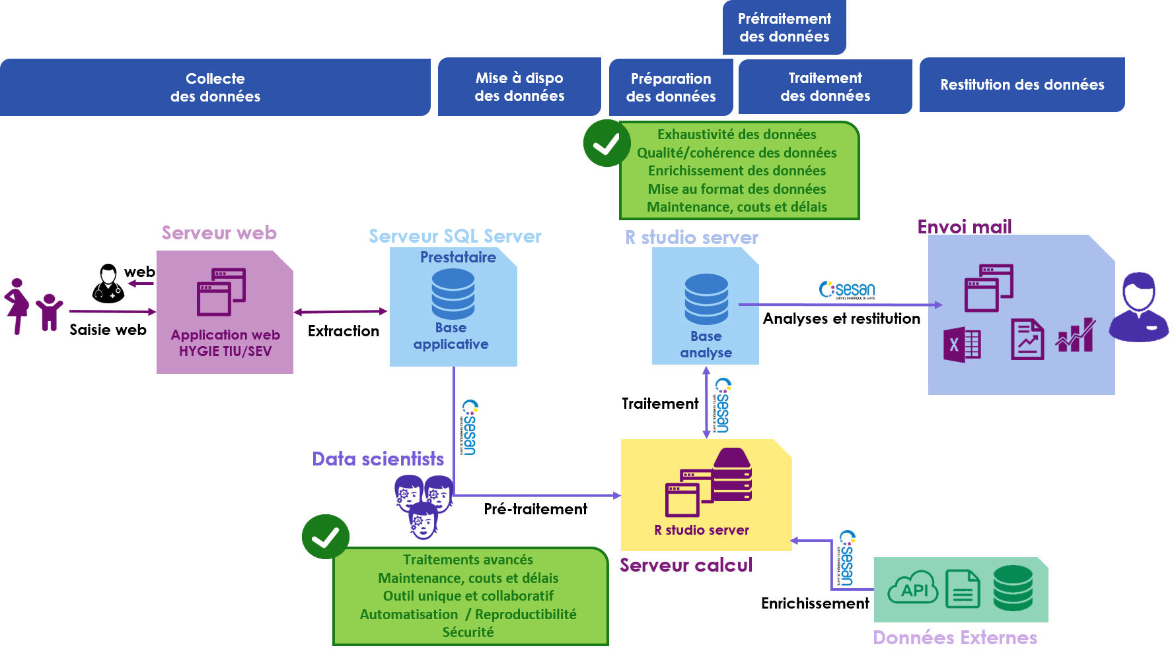
Acquisition des données - Architecture actuelle
13/02/2020

Slide 6
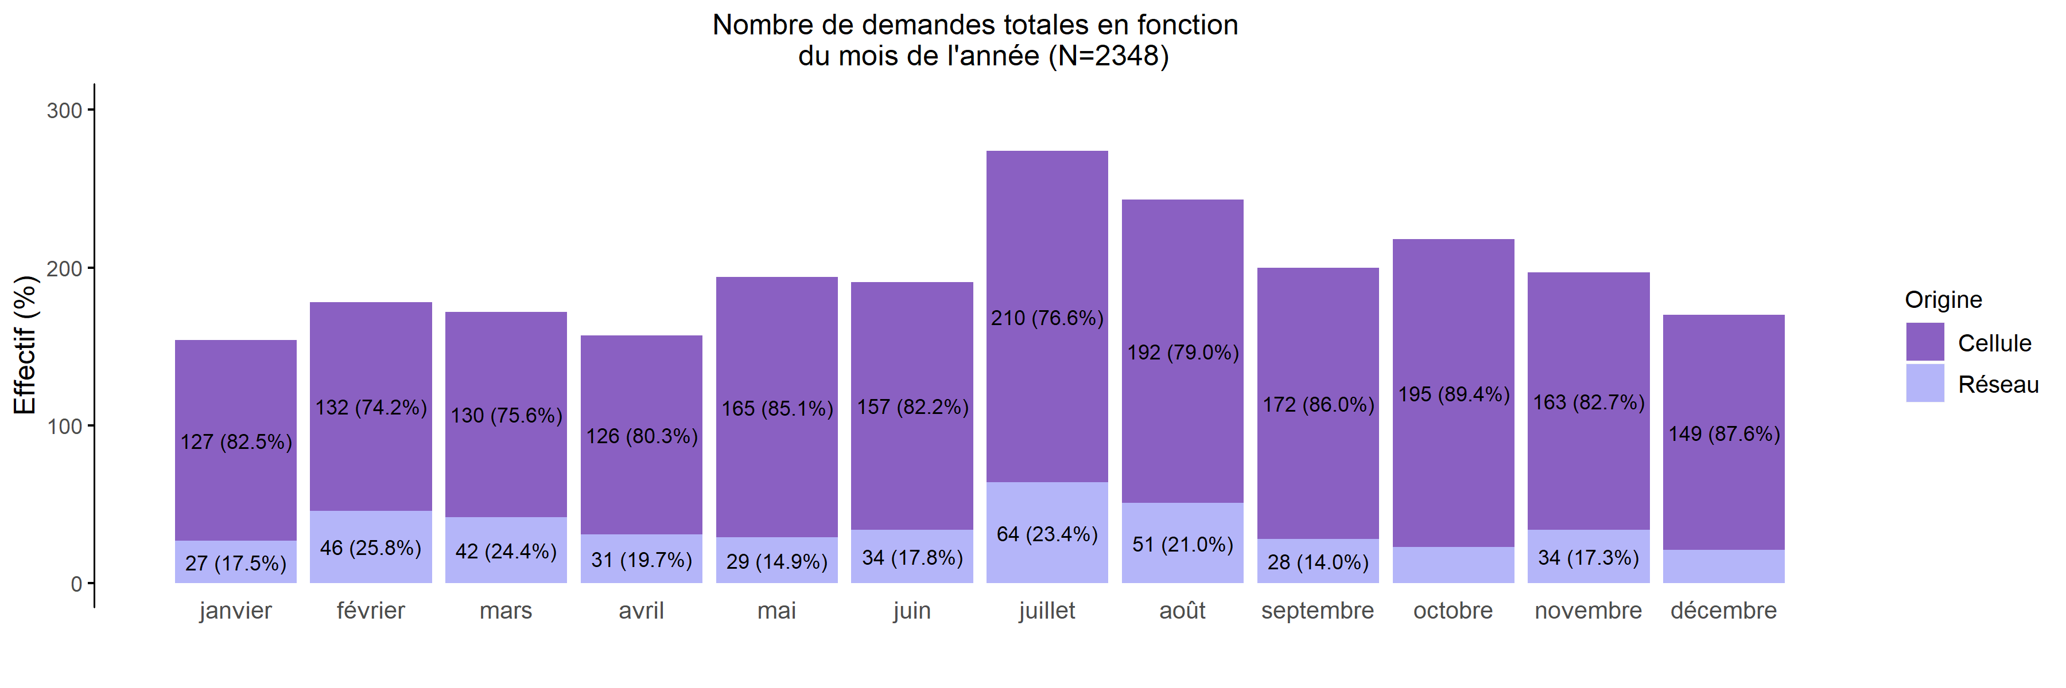
Nombre de demandes de TIU en 2019
13/02/2020
Création | janvier | février | mars | avril | mai | juin | juillet | août | septembre | octobre | novembre | décembre | Total
Cellule | 127 (6.6%) | 132 (6.9%) | 130 (6.8%) | 126 (6.6%) | 165 (8.6%) | 157 (8.2%) | 210 (10.9%) | 192 (10.0%) | 172 (9.0%) | 195 (10.2%) | 163 (8.5%) | 149 (7.8%) | 1918
Réseau | 27 (6.3%) | 46 (10.7%) | 42 (9.8%) | 31 (7.2%) | 29 (6.7%) | 34 (7.9%) | 64 (14.9%) | 51 (11.9%) | 28 (6.5%) | 23 (5.3%) | 34 (7.9%) | 21 (4.9%) | 430
Total | 154 (6.6%) | 178 (7.6%) | 172 (7.3%) | 157 (6.7%) | 194 (8.3%) | 191 (8.1%) | 274 (11.7%) | 243 (10.3%) | 200 (8.5%) | 218 (9.3%) | 197 (8.4%) | 170 (7.2%) | 2348
Nb: la majorité les demandes émanent des maternités mais la saisie HYGIE-TIU est effectuée soit par la cellule soit par la maternité après appel auprès des maternités du réseau

Slide 7
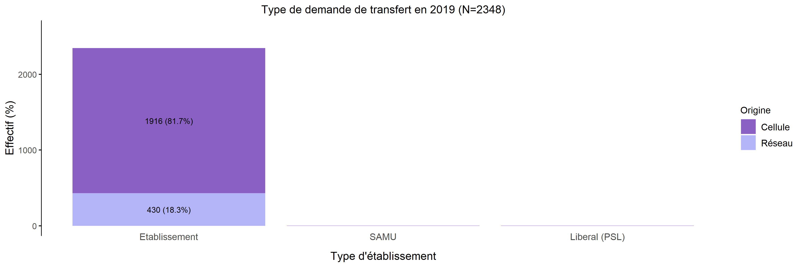
Origine des demandes de TIU en 2019
13/02/2020
Création | Etablissement | SAMU | Libéral (PSL) | Total
Cellule | 1916 (99.9%) | 1 (0.1%) | 1 (0.1%) | 1918
Réseau | 430 (100.0%) | 0 (0.0%) | 0 (0.0%) | 430
Total | 2346 (99.9%) | 1 (0.0%) | 1 (0.0%) | 2348

Slide 8
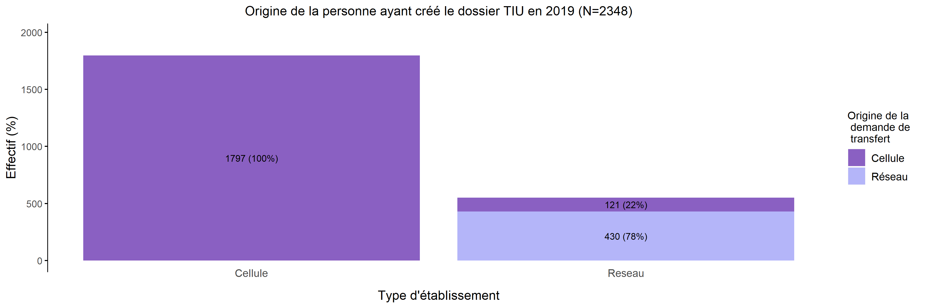
Origine des créations de dossier de demande de TIU en 2019
13/02/2020
« Réseau » =
Maternité du réseau
Création | Cellule | Reseau | Total
Cellule | 1797 (93.7%) | 121 (6.3%) | 1918
Réseau | 0 (0.0%) | 430 (100.0%) | 430
Total | 1797 (76.5%) | 551 (23.5%) | 2348

Slide 9
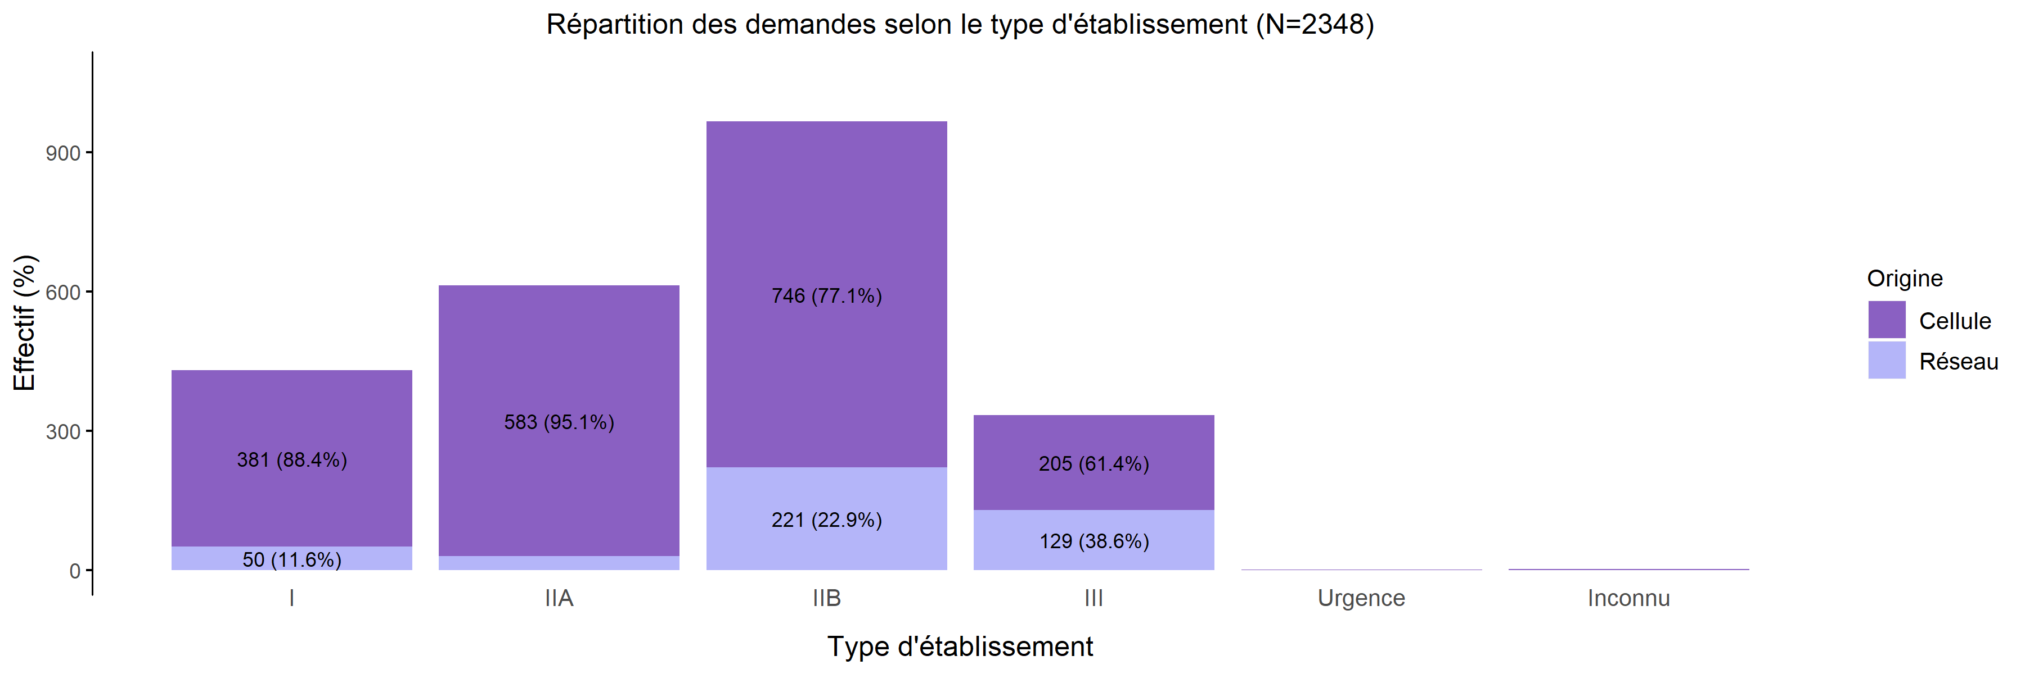
Type d'établissement demandeur de TIU en 2019
13/02/2020
Création | I | IIA | IIB | III | Urgence | Inconnu | Total
Cellule | 381 (19.9%) | 583 (30.4%) | 746 (38.9%) | 205 (10.7%) | 1 (0.1%) | 2 (0.1%) | 1918
Réseau | 50 (11.6%) | 30 (7.0%) | 221 (51.4%) | 129 (30.0%) | 0 (0.0%) | 0 (0.0%) | 430
Total | 431 (18.4%) | 613 (26.1%) | 967 (41.2%) | 334 (14.2%) | 1 (0.0%) | 2 (0.1%) | 2348

Slide 10
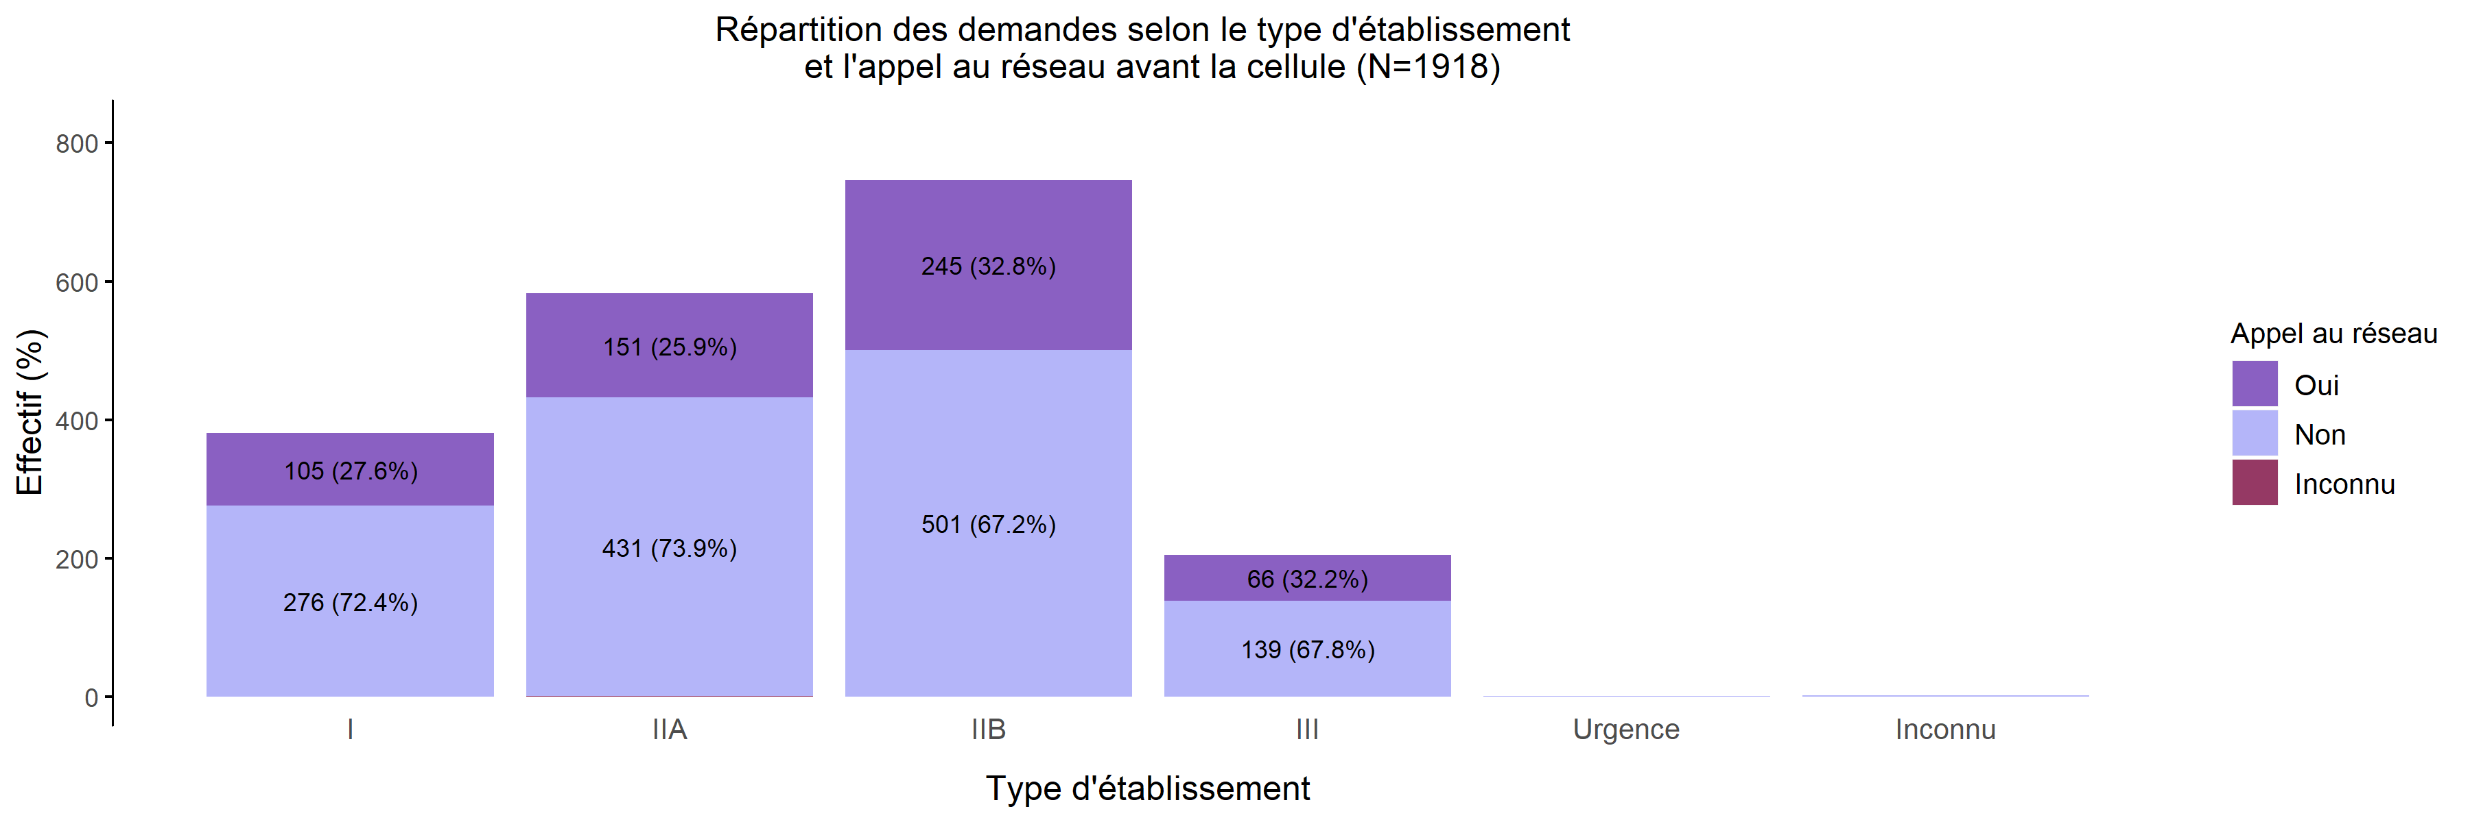
L'établissement a-t-il appelé une maternité du réseau avant la cellule?
13/02/2020
Appel du réseau | I | IIA | IIB | III | Urgence | Inconnu | Total
Oui | 105 (18.5%) | 151 (26.6%) | 245 (43.2%) | 66 (11.6%) | 0 (0.0%) | 0 (0.0%) | 567
Non | 276 (20.4%) | 431 (31.9%) | 501 (37.1%) | 139 (10.3%) | 1 (0.1%) | 2 (0.1%) | 1350
Inconnu | 0 (0.0%) | 1 (100.0%) | 0 (0.0%) | 0 (0.0%) | 0 (0.0%) | 0 (0.0%) | 1
Total | 381 (19.9%) | 583 (30.4%) | 746 (38.9%) | 205 (10.7%) | 1 (0.1%) | 2 (0.1%) | 1918

Slide 11
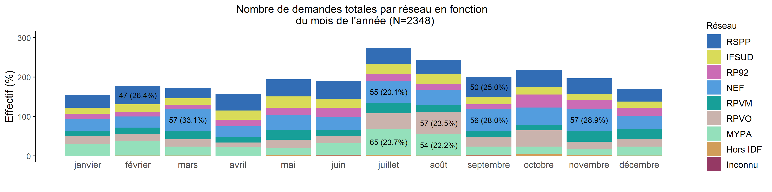
Nombre de demandes de TIU par réseau en 2019 (Total des transferts)
13/02/2020
Réseau | janvier | février | mars | avril | mai | juin | juillet | août | septembre | octobre | novembre | décembre | Total
RSPP | 32 (6.7%) | 47 (9.9%) | 26 (5.5%) | 42 (8.8%) | 43 (9.1%) | 46 (9.7%) | 40 (8.4%) | 34 (7.2%) | 50 (10.5%) | 43 (9.1%) | 40 (8.4%) | 32 (6.7%) | 475
IFSUD | 15 (6.1%) | 20 (8.1%) | 16 (6.5%) | 23 (9.3%) | 29 (11.7%) | 23 (9.3%) | 26 (10.5%) | 26 (10.5%) | 19 (7.7%) | 19 (7.7%) | 15 (6.1%) | 16 (6.5%) | 247
RP92 | 14 (6.5%) | 11 (5.1%) | 10 (4.7%) | 17 (7.9%) | 18 (8.4%) | 23 (10.7%) | 18 (8.4%) | 16 (7.5%) | 12 (5.6%) | 33 (15.4%) | 22 (10.3%) | 20 (9.3%) | 214
NEF | 29 (5.8%) | 28 (5.6%) | 57 (11.4%) | 28 (5.6%) | 38 (7.6%) | 33 (6.6%) | 55 (11.0%) | 39 (7.8%) | 56 (11.2%) | 44 (8.8%) | 57 (11.4%) | 34 (6.8%) | 498
RPVM | 13 (5.7%) | 17 (7.4%) | 21 (9.2%) | 13 (5.7%) | 25 (10.9%) | 16 (7.0%) | 27 (11.8%) | 16 (7.0%) | 15 (6.6%) | 14 (6.1%) | 27 (11.8%) | 25 (10.9%) | 229
RPVO | 21 (6.9%) | 16 (5.2%) | 18 (5.9%) | 11 (3.6%) | 21 (6.9%) | 18 (5.9%) | 40 (13.1%) | 57 (18.7%) | 24 (7.9%) | 41 (13.4%) | 19 (6.2%) | 19 (6.2%) | 305
MYPA | 30 (8.3%) | 38 (10.6%) | 23 (6.4%) | 23 (6.4%) | 18 (5.0%) | 29 (8.1%) | 65 (18.1%) | 54 (15.0%) | 22 (6.1%) | 20 (5.6%) | 15 (4.2%) | 23 (6.4%) | 360
Hors IDF | 0 (0.0%) | 1 (5.6%) | 1 (5.6%) | 0 (0.0%) | 2 (11.1%) | 2 (11.1%) | 3 (16.7%) | 1 (5.6%) | 1 (5.6%) | 4 (22.2%) | 2 (11.1%) | 1 (5.6%) | 18
Inconnu | 0 (0.0%) | 0 (0.0%) | 0 (0.0%) | 0 (0.0%) | 0 (0.0%) | 1 (50.0%) | 0 (0.0%) | 0 (0.0%) | 1 (50.0%) | 0 (0.0%) | 0 (0.0%) | 0 (0.0%) | 2
Total | 154 (6.6%) | 178 (7.6%) | 172 (7.3%) | 157 (6.7%) | 194 (8.3%) | 191 (8.1%) | 274 (11.7%) | 243 (10.3%) | 200 (8.5%) | 218 (9.3%) | 197 (8.4%) | 170 (7.2%) | 2348

Slide 12
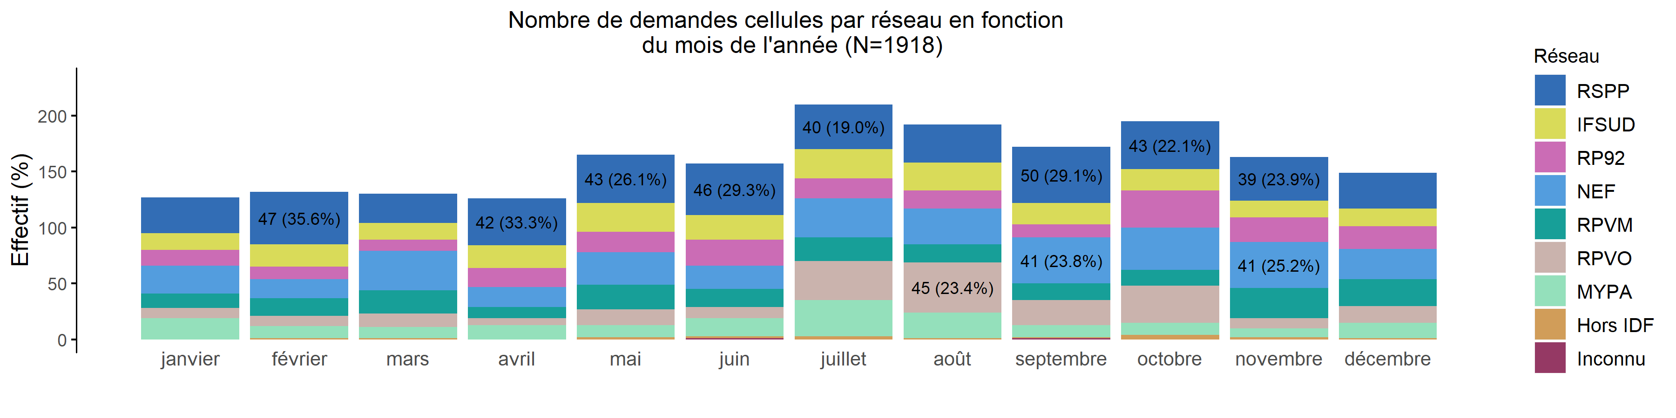
Nombre de demandes de TIU par réseau en 2019 (Transferts cellule)
13/02/2020
Réseau | janvier | février | mars | avril | mai | juin | juillet | août | septembre | octobre | novembre | décembre | Total
RSPP | 32 (6.8%) | 47 (9.9%) | 26 (5.5%) | 42 (8.9%) | 43 (9.1%) | 46 (9.7%) | 40 (8.4%) | 34 (7.2%) | 50 (10.5%) | 43 (9.1%) | 39 (8.2%) | 32 (6.8%) | 474
IFSUD | 15 (6.3%) | 20 (8.4%) | 15 (6.3%) | 20 (8.4%) | 26 (10.9%) | 22 (9.2%) | 26 (10.9%) | 25 (10.5%) | 19 (8.0%) | 19 (8.0%) | 15 (6.3%) | 16 (6.7%) | 238
RP92 | 14 (6.5%) | 11 (5.1%) | 10 (4.7%) | 17 (7.9%) | 18 (8.4%) | 23 (10.7%) | 18 (8.4%) | 16 (7.5%) | 12 (5.6%) | 33 (15.4%) | 22 (10.3%) | 20 (9.3%) | 214
NEF | 25 (7.0%) | 17 (4.7%) | 35 (9.7%) | 18 (5.0%) | 29 (8.1%) | 21 (5.8%) | 35 (9.7%) | 32 (8.9%) | 41 (11.4%) | 38 (10.6%) | 41 (11.4%) | 27 (7.5%) | 359
RPVM | 13 (6.0%) | 16 (7.4%) | 21 (9.8%) | 10 (4.7%) | 22 (10.2%) | 16 (7.4%) | 21 (9.8%) | 16 (7.4%) | 15 (7.0%) | 14 (6.5%) | 27 (12.6%) | 24 (11.2%) | 215
RPVO | 9 (4.1%) | 9 (4.1%) | 12 (5.5%) | 6 (2.7%) | 14 (6.4%) | 10 (4.6%) | 35 (16.0%) | 45 (20.5%) | 22 (10.0%) | 33 (15.1%) | 9 (4.1%) | 15 (6.8%) | 219
MYPA | 19 (10.6%) | 11 (6.1%) | 10 (5.6%) | 13 (7.3%) | 11 (6.1%) | 16 (8.9%) | 32 (17.9%) | 23 (12.8%) | 11 (6.1%) | 11 (6.1%) | 8 (4.5%) | 14 (7.8%) | 179
Hors IDF | 0 (0.0%) | 1 (5.6%) | 1 (5.6%) | 0 (0.0%) | 2 (11.1%) | 2 (11.1%) | 3 (16.7%) | 1 (5.6%) | 1 (5.6%) | 4 (22.2%) | 2 (11.1%) | 1 (5.6%) | 18
Inconnu | 0 (0.0%) | 0 (0.0%) | 0 (0.0%) | 0 (0.0%) | 0 (0.0%) | 1 (50.0%) | 0 (0.0%) | 0 (0.0%) | 1 (50.0%) | 0 (0.0%) | 0 (0.0%) | 0 (0.0%) | 2
Total | 127 (6.6%) | 132 (6.9%) | 130 (6.8%) | 126 (6.6%) | 165 (8.6%) | 157 (8.2%) | 210 (10.9%) | 192 (10.0%) | 172 (9.0%) | 195 (10.2%) | 163 (8.5%) | 149 (7.8%) | 1918

Slide 13
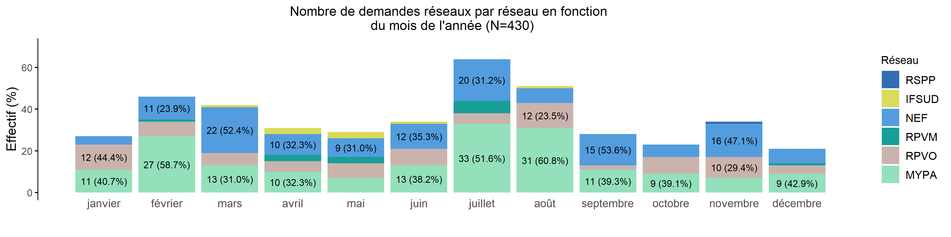
Nombre de demandes de TIU par réseau en 2019 (Transferts réseau)
13/02/2020
Réseau | janvier | février | mars | avril | mai | juin | juillet | août | septembre | octobre | novembre | décembre | Total
RSPP | 0 (0.0%) | 0 (0.0%) | 0 (0.0%) | 0 (0.0%) | 0 (0.0%) | 0 (0.0%) | 0 (0.0%) | 0 (0.0%) | 0 (0.0%) | 0 (0.0%) | 1 (100.0%) | 0 (0.0%) | 1
IFSUD | 0 (0.0%) | 0 (0.0%) | 1 (11.1%) | 3 (33.3%) | 3 (33.3%) | 1 (11.1%) | 0 (0.0%) | 1 (11.1%) | 0 (0.0%) | 0 (0.0%) | 0 (0.0%) | 0 (0.0%) | 9
RP92 | 0 (0%) | 0 (0%) | 0 (0%) | 0 (0%) | 0 (0%) | 0 (0%) | 0 (0%) | 0 (0%) | 0 (0%) | 0 (0%) | 0 (0%) | 0 (0%) | 0
NEF | 4 (2.9%) | 11 (7.9%) | 22 (15.8%) | 10 (7.2%) | 9 (6.5%) | 12 (8.6%) | 20 (14.4%) | 7 (5.0%) | 15 (10.8%) | 6 (4.3%) | 16 (11.5%) | 7 (5.0%) | 139
RPVM | 0 (0.0%) | 1 (7.1%) | 0 (0.0%) | 3 (21.4%) | 3 (21.4%) | 0 (0.0%) | 6 (42.9%) | 0 (0.0%) | 0 (0.0%) | 0 (0.0%) | 0 (0.0%) | 1 (7.1%) | 14
RPVO | 12 (14.0%) | 7 (8.1%) | 6 (7.0%) | 5 (5.8%) | 7 (8.1%) | 8 (9.3%) | 5 (5.8%) | 12 (14.0%) | 2 (2.3%) | 8 (9.3%) | 10 (11.6%) | 4 (4.7%) | 86
MYPA | 11 (6.1%) | 27 (14.9%) | 13 (7.2%) | 10 (5.5%) | 7 (3.9%) | 13 (7.2%) | 33 (18.2%) | 31 (17.1%) | 11 (6.1%) | 9 (5.0%) | 7 (3.9%) | 9 (5.0%) | 181
Hors IDF | 0 (0%) | 0 (0%) | 0 (0%) | 0 (0%) | 0 (0%) | 0 (0%) | 0 (0%) | 0 (0%) | 0 (0%) | 0 (0%) | 0 (0%) | 0 (0%) | 0
Inconnu | 0 (0%) | 0 (0%) | 0 (0%) | 0 (0%) | 0 (0%) | 0 (0%) | 0 (0%) | 0 (0%) | 0 (0%) | 0 (0%) | 0 (0%) | 0 (0%) | 0
Total | 27 (6.3%) | 46 (10.7%) | 42 (9.8%) | 31 (7.2%) | 29 (6.7%) | 34 (7.9%) | 64 (14.9%) | 51 (11.9%) | 28 (6.5%) | 23 (5.3%) | 34 (7.9%) | 21 (4.9%) | 430

Slide 14
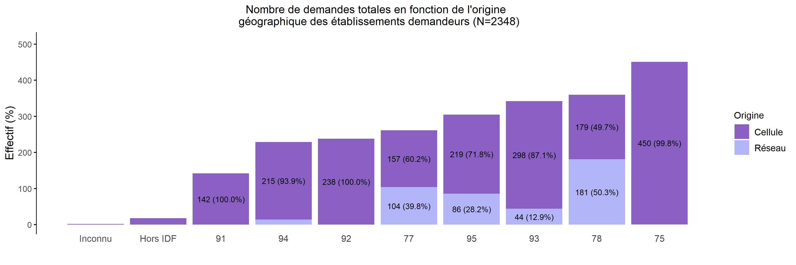
Origine géographique des établissements demandeurs de TIU en 2019
13/02/2020
Origine | Inconnu | Hors IDF | 91 | 94 | 77 | 92 | 95 | 78 | 93 | 75 | Total
Cellule | 2 (0.1%) | 18 (0.9%) | 142 (7.4%) | 215 (11.2%) | 157 (8.2%) | 238 (12.4%) | 219 (11.4%) | 179 (9.3%) | 298 (15.5%) | 450 (23.5%) | 1918
Réseau | 0 (0.0%) | 0 (0.0%) | 0 (0.0%) | 14 (3.3%) | 104 (24.2%) | 0 (0.0%) | 86 (20.0%) | 181 (42.1%) | 44 (10.2%) | 1 (0.2%) | 430
Total | 2 (0.1%) | 18 (0.8%) | 142 (6.0%) | 229 (9.8%) | 261 (11.1%) | 238 (10.1%) | 305 (13.0%) | 360 (15.3%) | 342 (14.6%) | 451 (19.2%) | 2348

Slide 15
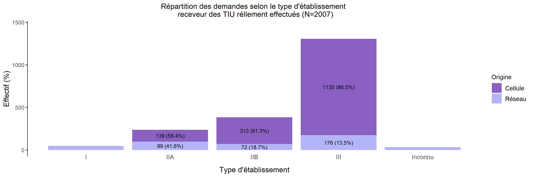
TIU par type d'établissement receveur en 2019
13/02/2020
Création | I | IIA | IIB | III | Urgence | Inconnu | Total
Cellule | 2 (0.1%) | 139 (8.8%) | 313 (19.7%) | 1130 (71.2%) | 0 (0%) | 2 (0.1%) | 1586
Réseau | 45 (10.7%) | 99 (23.5%) | 72 (17.1%) | 176 (41.8%) | 0 (0%) | 29 (6.9%) | 421
Total | 47 (2.3%) | 238 (11.9%) | 385 (19.2%) | 1306 (65.1%) | 0 (0%) | 31 (1.5%) | 2007

Slide 16
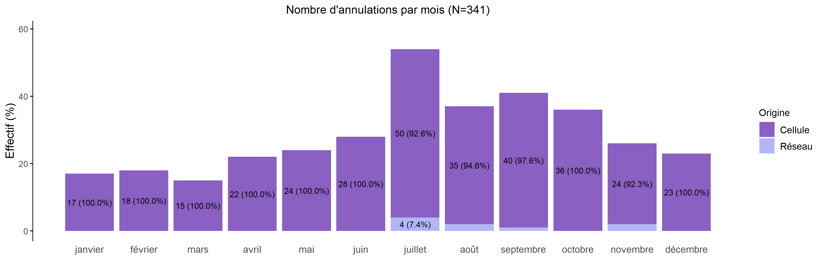
Annulation des demandes de TIU en 2019
13/02/2020
Création | janvier | février | mars | avril | mai | juin | juillet | août | septembre | octobre | novembre | décembre | Total
Cellule | 17 (5.1%) | 18 (5.4%) | 15 (4.5%) | 22 (6.6%) | 24 (7.2%) | 28 (8.4%) | 50 (15.1%) | 35 (10.5%) | 40 (12.0%) | 36 (10.8%) | 24 (7.2%) | 23 (6.9%) | 332
Réseau | 0 (0.0%) | 0 (0.0%) | 0 (0.0%) | 0 (0.0%) | 0 (0.0%) | 0 (0.0%) | 4 (44.4%) | 2 (22.2%) | 1 (11.1%) | 0 (0.0%) | 2 (22.2%) | 0 (0.0%) | 9
Total | 17 (5.0%) | 18 (5.3%) | 15 (4.4%) | 22 (6.5%) | 24 (7.0%) | 28 (8.2%) | 54 (15.8%) | 37 (10.9%) | 41 (12.0%) | 36 (10.6%) | 26 (7.6%) | 23 (6.7%) | 341

Slide 17
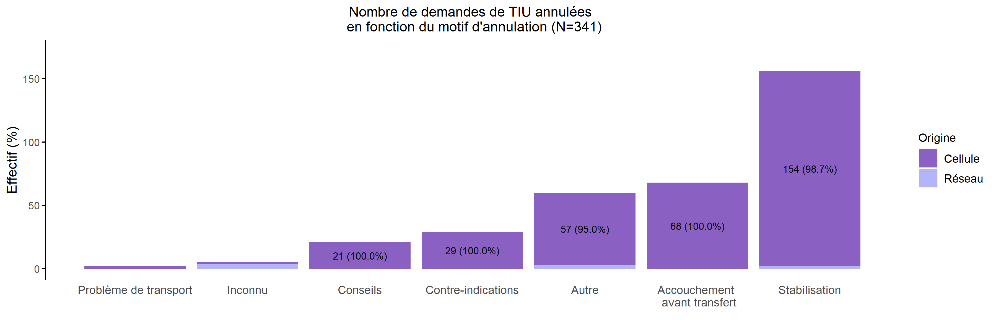
Motif d'annulation des demandes de TIU en 2019
13/02/2020
Création | Problème de transport | Inconnu | Conseils | Contre-indications | Autre | Accouchement avant transfert | Stabilisation | Total
Cellule | 2 (0.6%) | 1 (0.3%) | 21 (6.3%) | 29 (8.7%) | 57 (17.2%) | 68 (20.5%) | 154 (46.4%) | 332
Réseau | 0 (0.0%) | 4 (44.4%) | 0 (0.0%) | 0 (0.0%) | 3 (33.3%) | 0 (0.0%) | 2 (22.2%) | 9
Total | 2 (0.6%) | 5 (1.5%) | 21 (6.2%) | 29 (8.5%) | 60 (17.6%) | 68 (19.9%) | 156 (45.7%) | 341

Slide 18
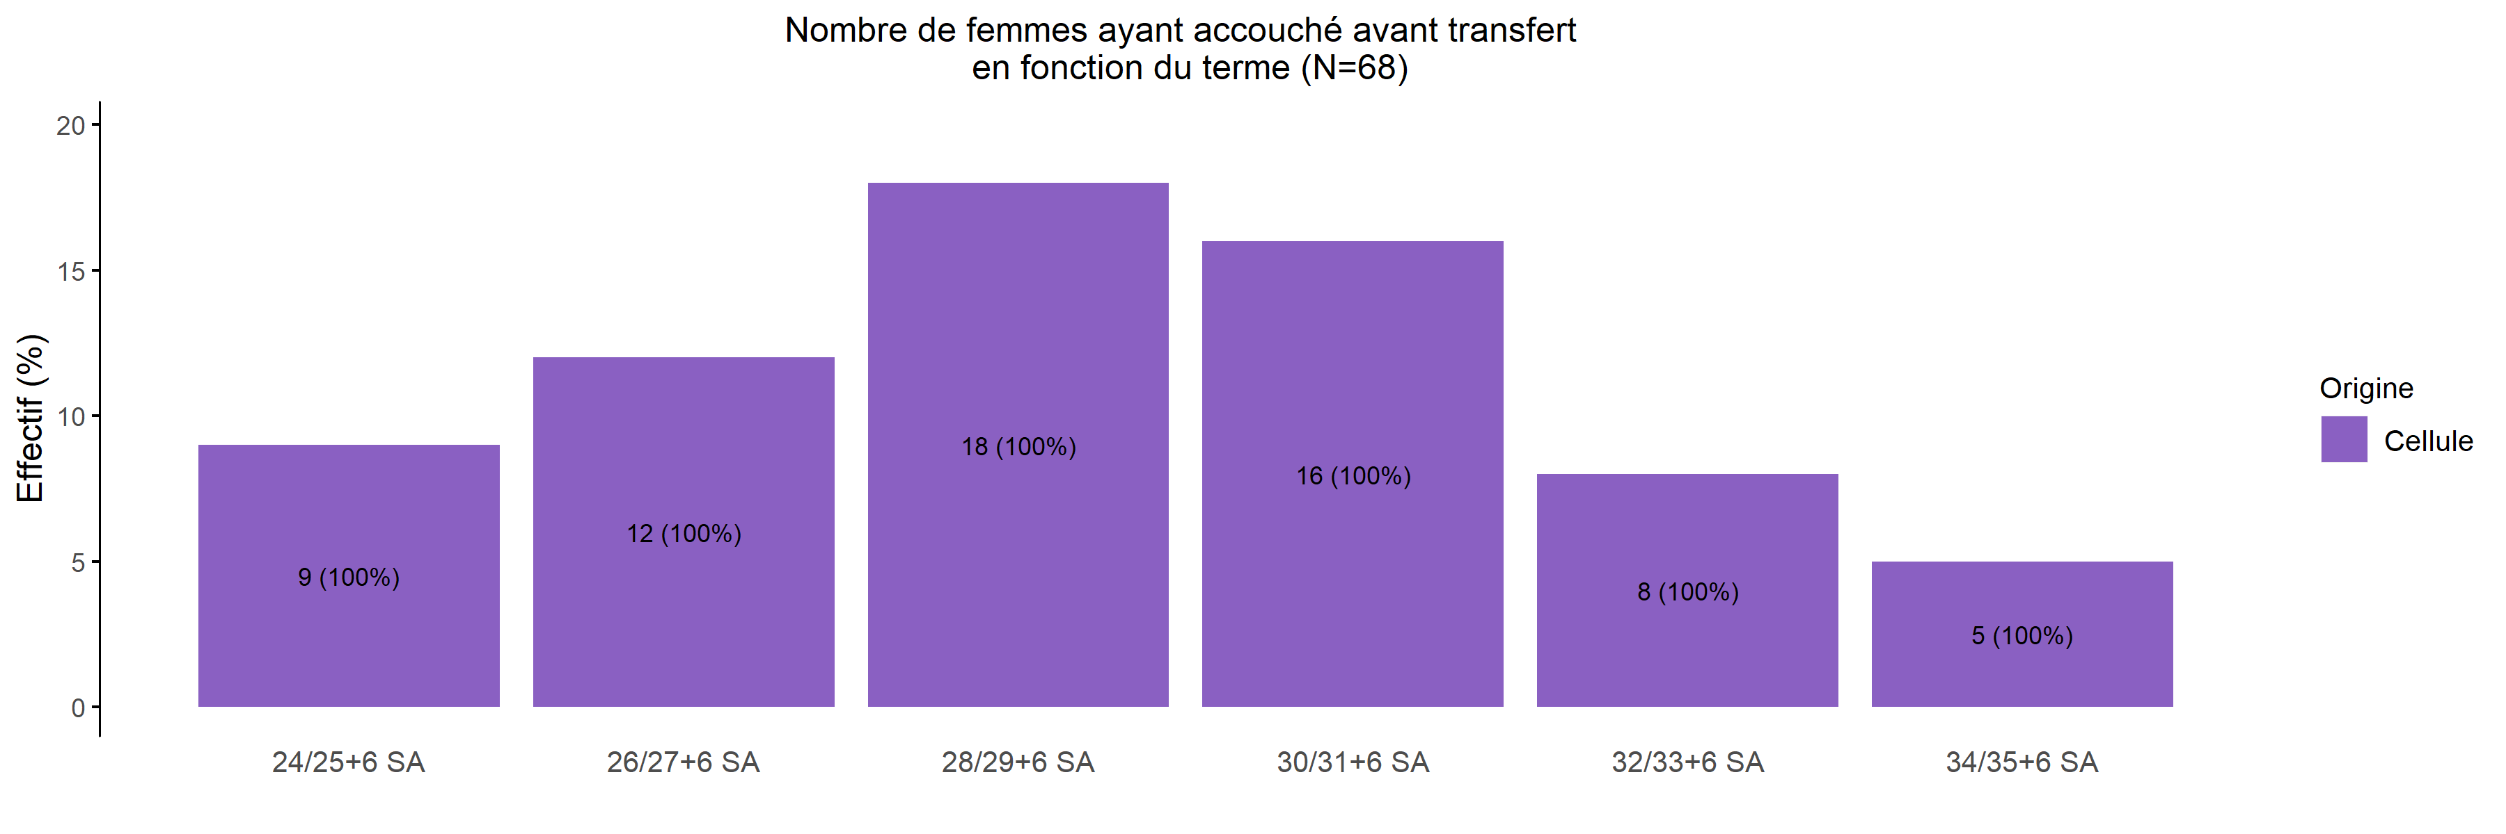
Termes des grossesses avec accouchement avant transfert en 2019
13/02/2020
Création | Moins de 24 SA | 24/25+6 SA | 26/27+6 SA | 28/29+6 SA | 30/31+6 SA | 32/33+6 SA | 34/35+6 SA | Plus de 36 SA | Inconnu | Total
Cellule | 0 (0%) | 9 (13.2%) | 12 (17.6%) | 18 (26.5%) | 16 (23.5%) | 8 (11.8%) | 5 (7.4%) | 0 (0%) | 0 (0%) | 68
Total | 0 (0%) | 9 (13.2%) | 12 (17.6%) | 18 (26.5%) | 16 (23.5%) | 8 (11.8%) | 5 (7.4%) | 0 (0%) | 0 (0%) | 68

Slide 19
Répartition des TIU en 2019 (Total des transferts)
13/02/2020
(N=2348)
(N=2007)
305
162
(13%)
(8.1%)
360
(15.3%)
498
454
475
(21.2%)
194
450
(22.6%)
214
(20.2%)
(9.7%)
349
(22.4%)
(9.1%)
(17.4%)
229
232
(9.8%)
(11.6%)
18
20
247
(0.8%)
115
(1%)
(10.5%)
(5.7%)
2
31
(0.1%)
(1.5%)

Slide 20
Répartition des TIU en 2019 (Transferts cellule)
13/02/2020
(N=1918)
(N=1586)
219
102
(11.4%)
(6.4%)
179
(9.3%)
359
334
474
(18.7%)
72
423
(21.1%)
214
(24.7%)
(4.5%)
321
(26.7%)
(11.2%)
(20.2%)
215
208
(11.2%)
(13.1%)
18
17
238
(0.9%)
107
(1.1%)
(12.4%)
(6.7%)
2
2
(0.1%)
(0.1%)

Slide 21
Répartition des TIU en 2019 (Transferts réseaux)
13/02/2020
(N=430)
(N=421)
86
60
(20.0%)
(14.3%)
181
(42.1%)
139
120
1
(32.3%)
122
27
(28.5%)
0
(0.2%)
(29.0%)
28
(6.4%)
(0.0%)
(6.7%)
14
24
(3.3%)
(5.7%)
0
3
9
(0.0%)
8
(0.7%)
(2.1%)
(1.9%)
0
29
(0.0%)
(6.9%)

Slide 22
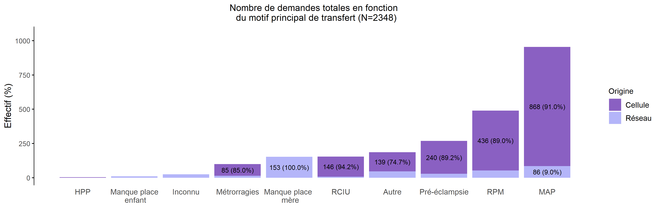
Motif de transfert principal en 2019
13/02/2020
Création | HPP | Manque de place pour enfant | Inconnu | Métrorragies | Manque de place pour mère | RCIU | Autre | Pré-éclampsie | RPM | MAP | Total
Cellule | 4 (0.2%) | 0 (0.0%) | 0 (0.0%) | 85 (4.4%) | 0 (0.0%) | 146 (7.6%) | 139 (7.2%) | 240 (12.5%) | 436 (22.7%) | 868 (45.3%) | 1918
Réseau | 0 (0.0%) | 11 (2.6%) | 26 (6.0%) | 15 (3.5%) | 153 (35.6%) | 9 (2.1%) | 47 (10.9%) | 29 (6.7%) | 54 (12.6%) | 86 (20.0%) | 430
Total | 4 (0.2%) | 11 (0.5%) | 26 (1.1%) | 100 (4.3%) | 153 (6.5%) | 155 (6.6%) | 186 (7.9%) | 269 (11.5%) | 490 (20.9%) | 954 (40.6%) | 2348

Slide 23
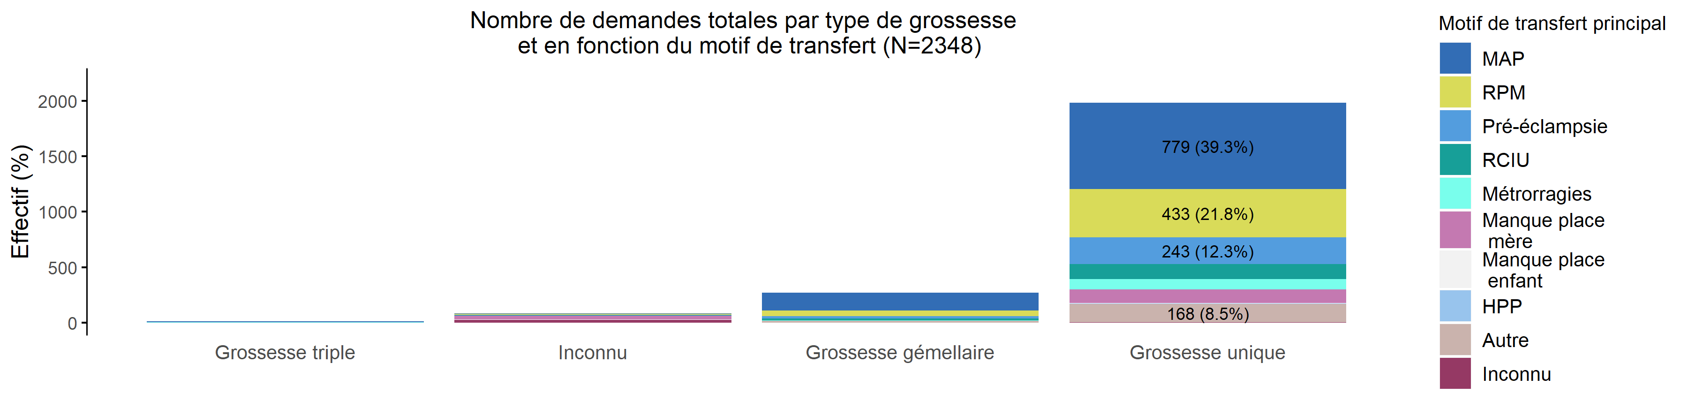
Motif de transfert et type de grossesse en 2019 (Total des transferts)
13/02/2020
Motif de transfert | Grossesse triple | Inconnu | Grossesse gémellaire | Grossesse unique | Total
MAP | 9 (0.9%) | 6 (0.6%) | 160 (16.8%) | 779 (81.7%) | 954
RPM | 0 (0.0%) | 6 (1.2%) | 51 (10.4%) | 433 (88.4%) | 490
Pré-éclampsie | 3 (1.1%) | 5 (1.9%) | 18 (6.7%) | 243 (90.3%) | 269
RCIU | 0 (0.0%) | 2 (1.3%) | 17 (11.0%) | 136 (87.7%) | 155
Métrorragies | 1 (1.0%) | 2 (2.0%) | 4 (4.0%) | 93 (93.0%) | 100
Manque place mère | 0 (0.0%) | 32 (20.9%) | 1 (0.7%) | 120 (78.4%) | 153
Manque place enfant | 0 (0.0%) | 5 (45.5%) | 1 (9.1%) | 5 (45.5%) | 11
HPP | 0 (0.0%) | 0 (0.0%) | 1 (25.0%) | 3 (75.0%) | 4
Autre | 1 (0.5%) | 3 (1.6%) | 14 (7.5%) | 168 (90.3%) | 186
Inconnu | 0 (0.0%) | 23 (88.5%) | 1 (3.8%) | 2 (7.7%) | 26
Total | 14 (0.6%) | 84 (3.6%) | 268 (11.4%) | 1982 (84.4%) | 2348

Slide 24
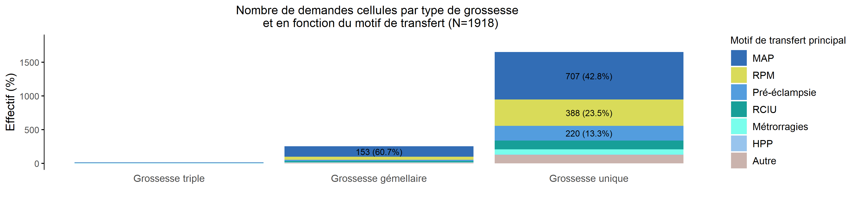
Motif de transfert et type de grossesse en 2019 (Transferts cellule)
13/02/2020
Motif de transfert | Inconnu | Grossesse triple | Grossesse gémellaire | Grossesse unique | Total
MAP | 0 (0%) | 8 (0.9%) | 153 (17.6%) | 707 (81.5%) | 868
RPM | 0 (0%) | 0 (0.0%) | 48 (11.0%) | 388 (89.0%) | 436
Pré-éclampsie | 0 (0%) | 3 (1.2%) | 17 (7.1%) | 220 (91.7%) | 240
RCIU | 0 (0%) | 0 (0.0%) | 17 (11.6%) | 129 (88.4%) | 146
Métrorragies | 0 (0%) | 1 (1.2%) | 4 (4.7%) | 80 (94.1%) | 85
Manque place mère | 0 (0%) | 0 (0%) | 0 (0%) | 0 (0%) | 0
Manque place enfant | 0 (0%) | 0 (0%) | 0 (0%) | 0 (0%) | 0
HPP | 0 (0%) | 0 (0.0%) | 1 (25.0%) | 3 (75.0%) | 4
Autre | 0 (0%) | 1 (0.7%) | 12 (8.6%) | 126 (90.6%) | 139
Inconnu | 0 (0%) | 0 (0%) | 0 (0%) | 0 (0%) | 0
Total | 0 (0%) | 13 (0.7%) | 252 (13.1%) | 1653 (86.2%) | 1918

Slide 25
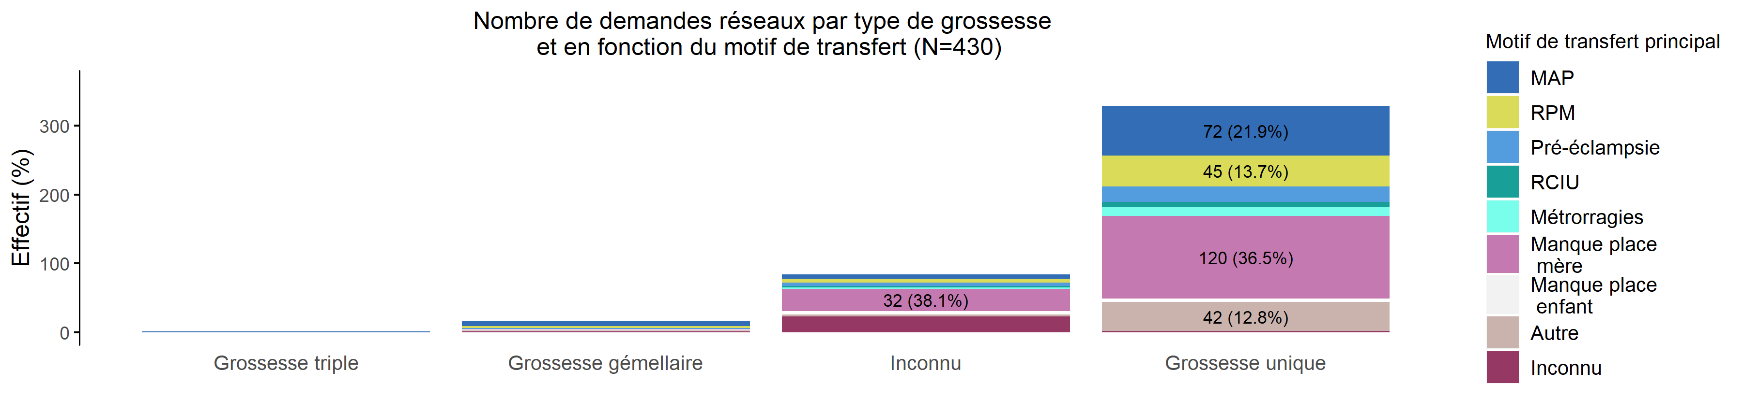
Motif de transfert et type de grossesse en 2019 (Transferts réseau)
13/02/2020
Motif de transfert | Grossesse triple | Grossesse gémellaire | Inconnu | Grossesse unique | Total
MAP | 1 (1.2%) | 7 (8.1%) | 6 (7.0%) | 72 (83.7%) | 86
RPM | 0 (0.0%) | 3 (5.6%) | 6 (11.1%) | 45 (83.3%) | 54
Pré-éclampsie | 0 (0.0%) | 1 (3.4%) | 5 (17.2%) | 23 (79.3%) | 29
RCIU | 0 (0.0%) | 0 (0.0%) | 2 (22.2%) | 7 (77.8%) | 9
Métrorragies | 0 (0.0%) | 0 (0.0%) | 2 (13.3%) | 13 (86.7%) | 15
Manque place mère | 0 (0.0%) | 1 (0.7%) | 32 (20.9%) | 120 (78.4%) | 153
Manque place enfant | 0 (0.0%) | 1 (9.1%) | 5 (45.5%) | 5 (45.5%) | 11
HPP | 0 (0%) | 0 (0%) | 0 (0%) | 0 (0%) | 0
Autre | 0 (0.0%) | 2 (4.3%) | 3 (6.4%) | 42 (89.4%) | 47
Inconnu | 0 (0.0%) | 1 (3.8%) | 23 (88.5%) | 2 (7.7%) | 26
Total | 1 (0.2%) | 16 (3.7%) | 84 (19.5%) | 329 (76.5%) | 430

Slide 26
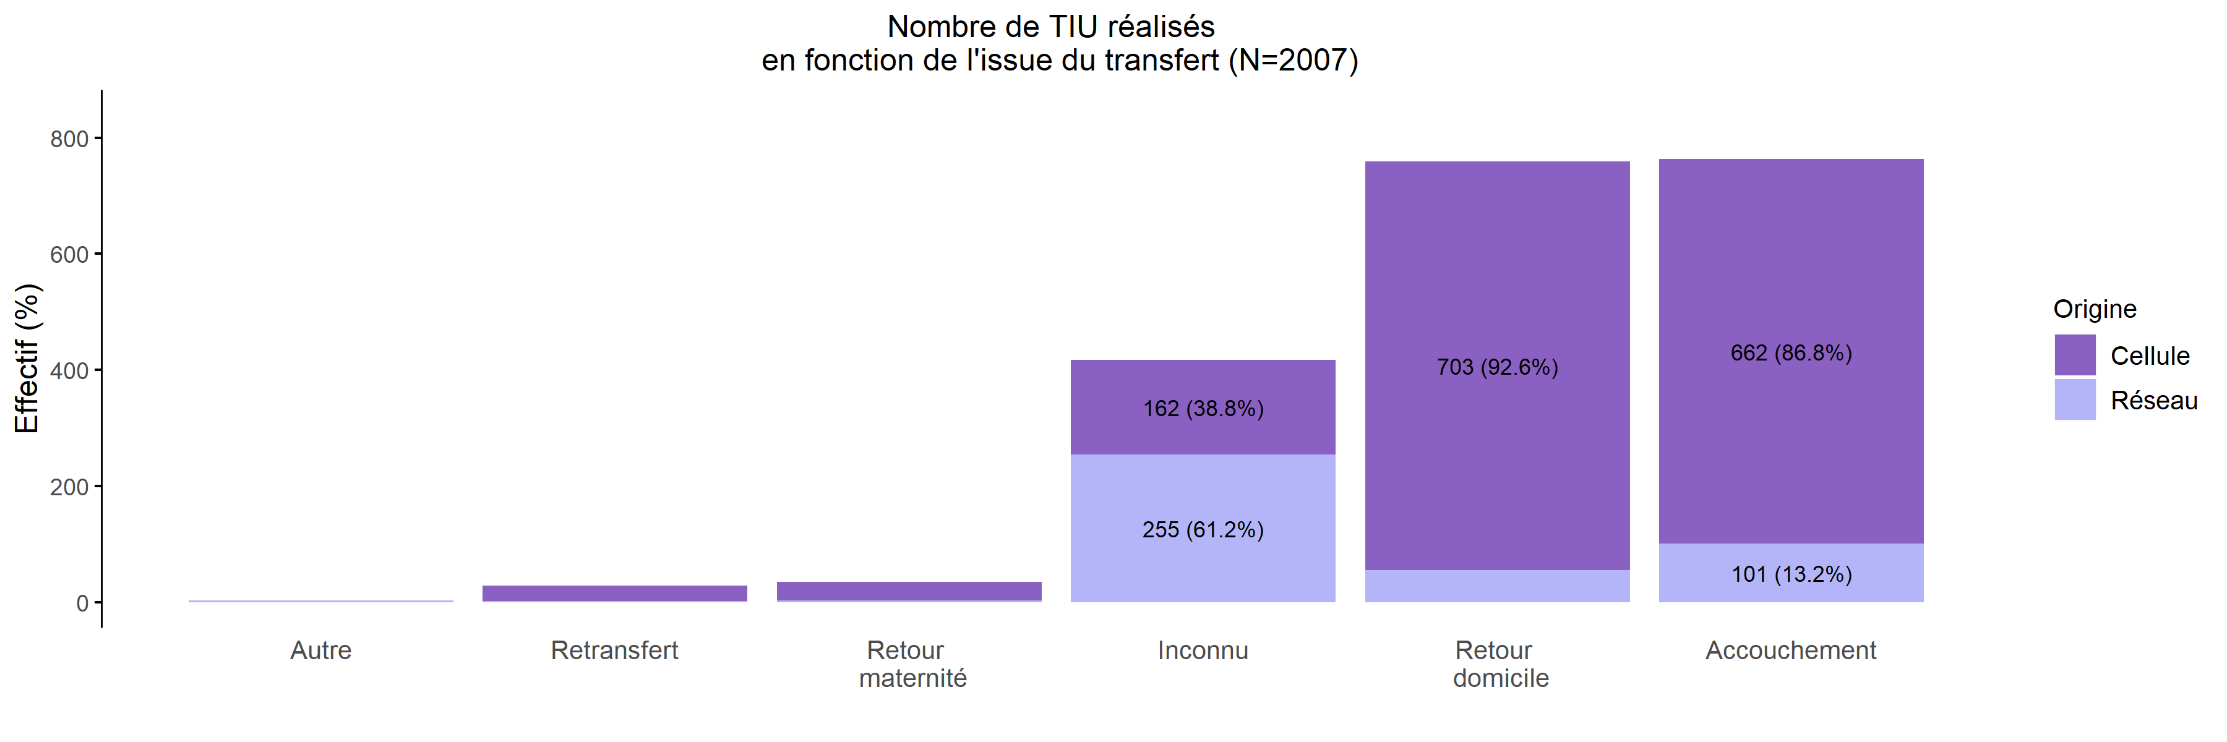
Issue des transferts réalisés en 2019
13/02/2020
Création | Autre | Retransfert | Retour maternité | Inconnu | Retour domicile | Accouchement | Total
Cellule | 0 (0.0%) | 27 (1.7%) | 32 (2.0%) | 162 (10.2%) | 703 (44.3%) | 662 (41.7%) | 1586
Réseau | 4 (1.0%) | 2 (0.5%) | 3 (0.7%) | 255 (60.6%) | 56 (13.3%) | 101 (24.0%) | 421
Total | 4 (0.2%) | 29 (1.4%) | 35 (1.7%) | 417 (20.8%) | 759 (37.8%) | 763 (38.0%) | 2007

Slide 27
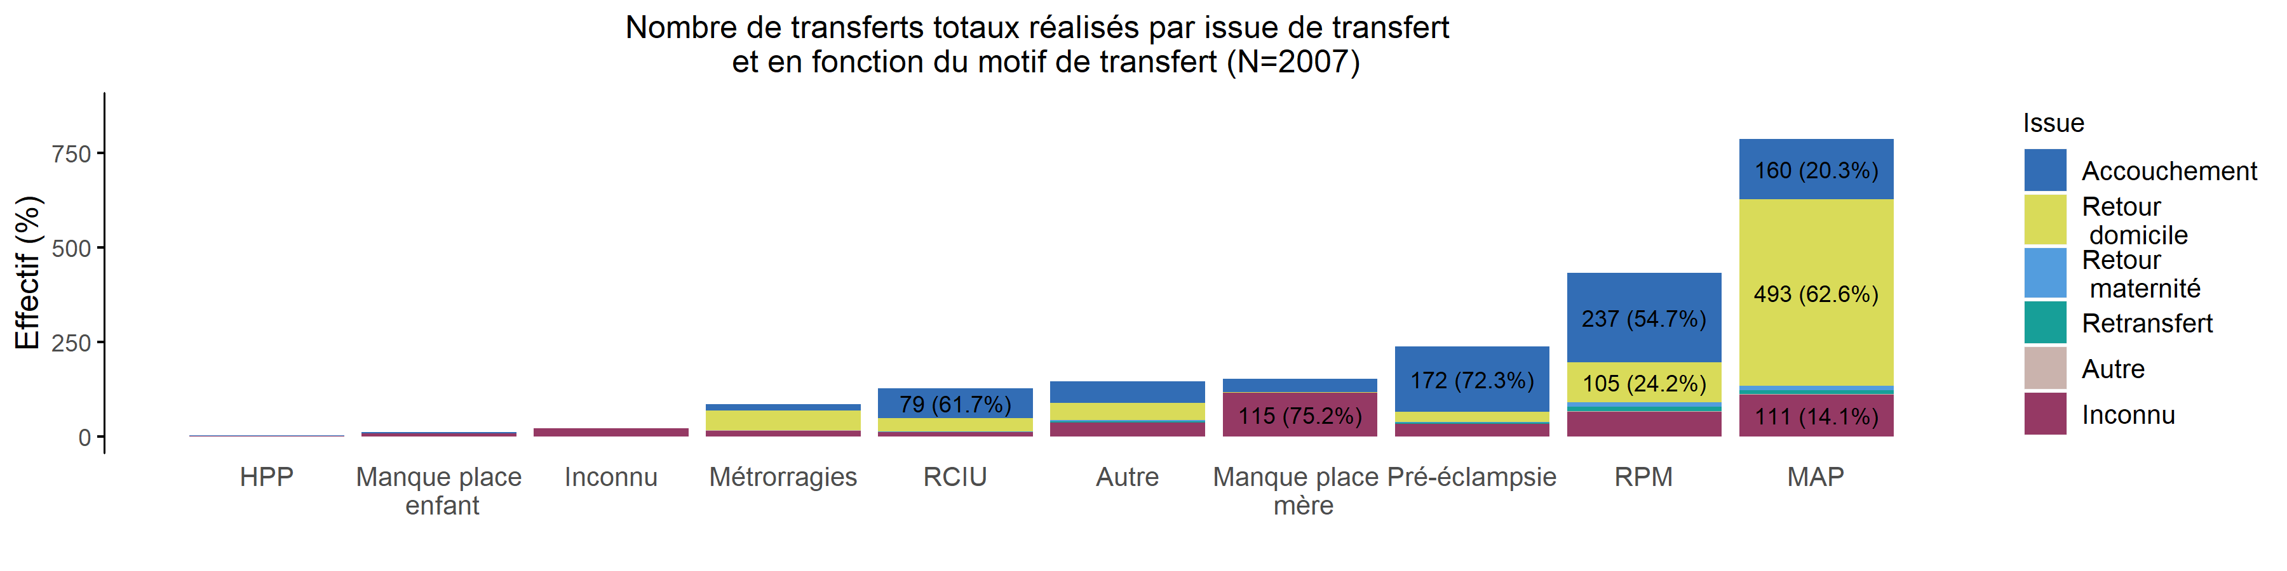
Issue du transfert selon le motif des TIU en 2019 (Total des transferts)
13/02/2020
Issue | HPP | Manque place enfant | Inconnu | Métrorragies | RCIU | Autre | Manque place mère | Pré-éclampsie | RPM | MAP | Total
Accouchement | 0 (0.0%) | 3 (0.4%) | 0 (0%) | 18 (2.4%) | 79 (10.4%) | 58 (7.6%) | 36 (4.7%) | 172 (22.5%) | 237 (31.1%) | 160 (21.0%) | 763
Retour domicile | 0 (0.0%) | 0 (0.0%) | 0 (0%) | 52 (6.9%) | 35 (4.6%) | 44 (5.8%) | 2 (0.3%) | 28 (3.7%) | 105 (13.8%) | 493 (65.0%) | 759
Retour maternité | 2 (5.7%) | 0 (0.0%) | 0 (0%) | 0 (0.0%) | 2 (5.7%) | 4 (11.4%) | 0 (0.0%) | 2 (5.7%) | 13 (37.1%) | 12 (34.3%) | 35
Retransfert | 1 (3.4%) | 0 (0.0%) | 0 (0%) | 0 (0.0%) | 1 (3.4%) | 3 (10.3%) | 0 (0.0%) | 3 (10.3%) | 11 (37.9%) | 10 (34.5%) | 29
Autre | 0 (0.0%) | 0 (0.0%) | 0 (0%) | 1 (25.0%) | 0 (0.0%) | 1 (25.0%) | 0 (0.0%) | 0 (0.0%) | 1 (25.0%) | 1 (25.0%) | 4
Inconnu | 1 (0.2%) | 8 (1.9%) | 21 (5%) | 15 (3.6%) | 11 (2.6%) | 36 (8.6%) | 115 (27.6%) | 33 (7.9%) | 66 (15.8%) | 111 (26.6%) | 417
Total | 4 (0.2%) | 11 (0.5%) | 21 (1%) | 86 (4.3%) | 128 (6.4%) | 146 (7.3%) | 153 (7.6%) | 238 (11.9%) | 433 (21.6%) | 787 (39.2%) | 2007

Slide 28
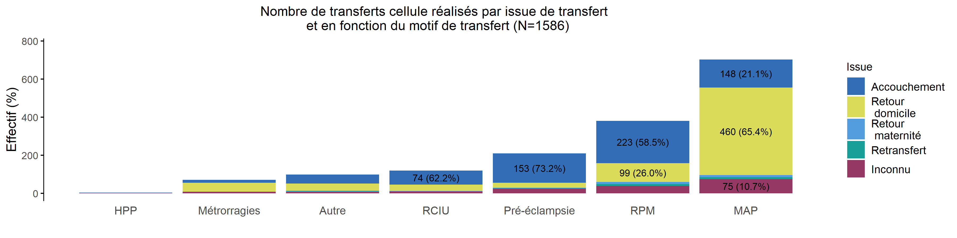
Issue du transfert selon le motif des TIU en 2019 (Transferts cellule)
13/02/2020
Issue | Manque place mère | Manque place enfant | Inconnu | HPP | Métrorragies | Autre | RCIU | Pré-éclampsie | RPM | MAP | Total
Accouchement | 0 (0%) | 0 (0%) | 0 (0%) | 0 (0.0%) | 16 (2.4%) | 48 (7.3%) | 74 (11.2%) | 153 (23.1%) | 223 (33.7%) | 148 (22.4%) | 662
Retour domicile | 0 (0%) | 0 (0%) | 0 (0%) | 0 (0.0%) | 47 (6.7%) | 37 (5.3%) | 33 (4.7%) | 27 (3.8%) | 99 (14.1%) | 460 (65.4%) | 703
Retour maternité | 0 (0%) | 0 (0%) | 0 (0%) | 2 (6.2%) | 0 (0.0%) | 4 (12.5%) | 2 (6.2%) | 2 (6.2%) | 11 (34.4%) | 11 (34.4%) | 32
Retransfert | 0 (0%) | 0 (0%) | 0 (0%) | 1 (3.7%) | 0 (0.0%) | 3 (11.1%) | 1 (3.7%) | 3 (11.1%) | 10 (37.0%) | 9 (33.3%) | 27
Autre | 0 (0%) | 0 (0%) | 0 (0%) | 0 (0%) | 0 (0%) | 0 (0%) | 0 (0%) | 0 (0%) | 0 (0%) | 0 (0%) | 0
Inconnu | 0 (0%) | 0 (0%) | 0 (0%) | 1 (0.6%) | 8 (4.9%) | 7 (4.3%) | 9 (5.6%) | 24 (14.8%) | 38 (23.5%) | 75 (46.3%) | 162
Total | 0 (0%) | 0 (0%) | 0 (0%) | 4 (0.3%) | 71 (4.5%) | 99 (6.2%) | 119 (7.5%) | 209 (13.2%) | 381 (24.0%) | 703 (44.3%) | 1586

Slide 29
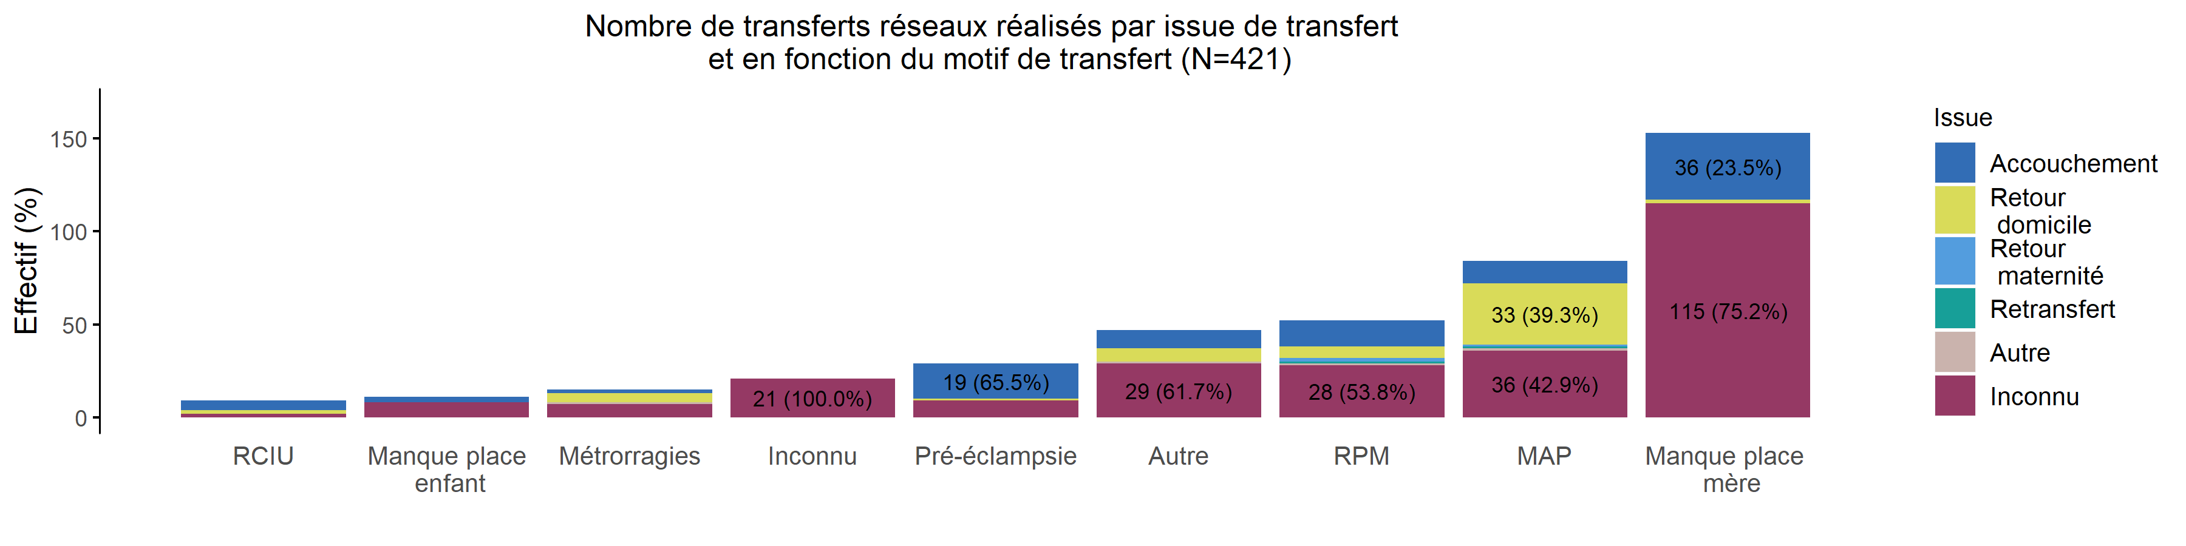
Issue du transfert selon le motif des TIU en 2019 (Transferts réseau)
13/02/2020
Issue | HPP | RCIU | Manque place enfant | Métrorragies | Inconnu | Pré-éclampsie | Autre | RPM | MAP | Manque place mère | Total
Accouchement | 0 (0%) | 5 (5.0%) | 3 (3.0%) | 2 (2.0%) | 0 (0.0%) | 19 (18.8%) | 10 (9.9%) | 14 (13.9%) | 12 (11.9%) | 36 (35.6%) | 101
Retour domicile | 0 (0%) | 2 (3.6%) | 0 (0.0%) | 5 (8.9%) | 0 (0.0%) | 1 (1.8%) | 7 (12.5%) | 6 (10.7%) | 33 (58.9%) | 2 (3.6%) | 56
Retour maternité | 0 (0%) | 0 (0.0%) | 0 (0.0%) | 0 (0.0%) | 0 (0.0%) | 0 (0.0%) | 0 (0.0%) | 2 (66.7%) | 1 (33.3%) | 0 (0.0%) | 3
Retransfert | 0 (0%) | 0 (0.0%) | 0 (0.0%) | 0 (0.0%) | 0 (0.0%) | 0 (0.0%) | 0 (0.0%) | 1 (50.0%) | 1 (50.0%) | 0 (0.0%) | 2
Autre | 0 (0%) | 0 (0.0%) | 0 (0.0%) | 1 (25.0%) | 0 (0.0%) | 0 (0.0%) | 1 (25.0%) | 1 (25.0%) | 1 (25.0%) | 0 (0.0%) | 4
Inconnu | 0 (0%) | 2 (0.8%) | 8 (3.1%) | 7 (2.7%) | 21 (8.2%) | 9 (3.5%) | 29 (11.4%) | 28 (11.0%) | 36 (14.1%) | 115 (45.1%) | 255
Total | 0 (0%) | 9 (2.1%) | 11 (2.6%) | 15 (3.6%) | 21 (5.0%) | 29 (6.9%) | 47 (11.2%) | 52 (12.4%) | 84 (20.0%) | 153 (36.3%) | 421

Slide 30
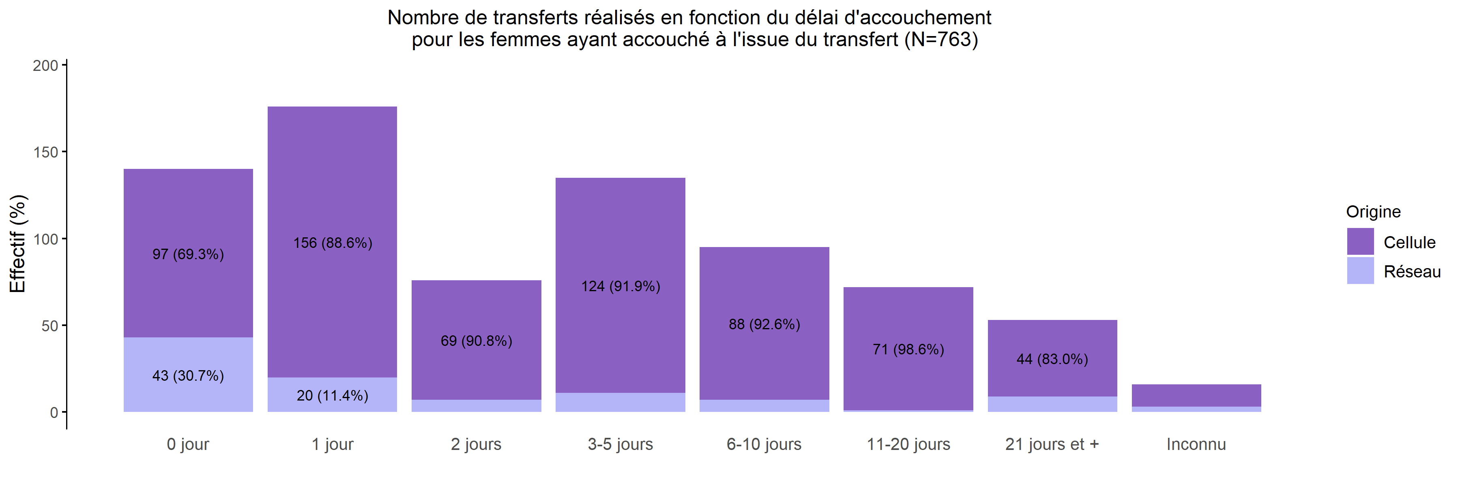
Délai d'accouchement après TIU réalisés en 2019
13/02/2020
Origine | 0 jour | 1 jour | 2 jours | 3-5 jours | 6-10 jours | 11-20 jours | 21 jours et + | Inconnu | Total
Cellule | 97 (14.7%) | 156 (23.6%) | 69 (10.4%) | 124 (18.7%) | 88 (13.3%) | 71 (10.7%) | 44 (6.6%) | 13 (2.0%) | 662
Réseau | 43 (42.6%) | 20 (19.8%) | 7 (6.9%) | 11 (10.9%) | 7 (6.9%) | 1 (1.0%) | 9 (8.9%) | 3 (3.0%) | 101
Total | 140 (18.3%) | 176 (23.1%) | 76 (10.0%) | 135 (17.7%) | 95 (12.5%) | 72 (9.4%) | 53 (6.9%) | 16 (2.1%) | 763

Slide 31
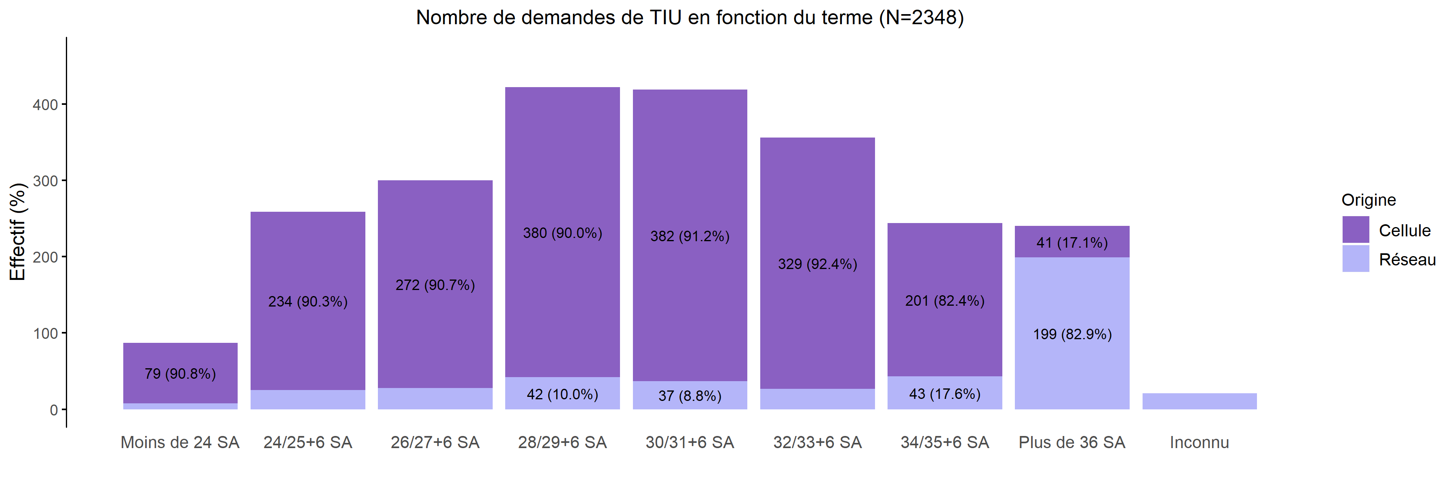
Termes des demandes de transfert en 2019
13/02/2020
Création | Moins de 24 SA | 24/25+6 SA | 26/27+6 SA | 28/29+6 SA | 30/31+6 SA | 32/33+6 SA | 34/35+6 SA | Plus de 36 SA | Inconnu | Total
Cellule | 79 (4.1%) | 234 (12.2%) | 272 (14.2%) | 380 (19.8%) | 382 (19.9%) | 329 (17.2%) | 201 (10.5%) | 41 (2.1%) | 0 (0.0%) | 1918
Réseau | 8 (1.9%) | 25 (5.8%) | 28 (6.5%) | 42 (9.8%) | 37 (8.6%) | 27 (6.3%) | 43 (10.0%) | 199 (46.3%) | 21 (4.9%) | 430
Total | 87 (3.7%) | 259 (11.0%) | 300 (12.8%) | 422 (18.0%) | 419 (17.8%) | 356 (15.2%) | 244 (10.4%) | 240 (10.2%) | 21 (0.9%) | 2348

Slide 32
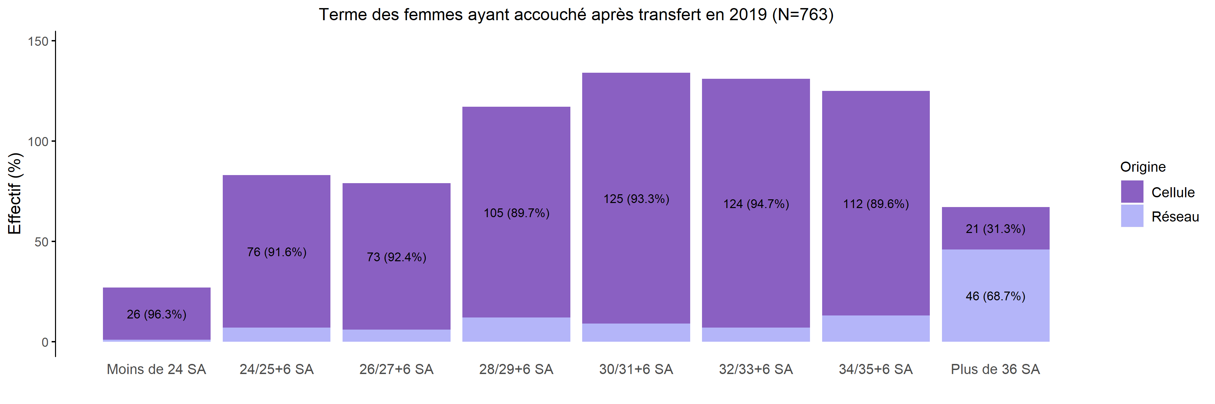
Les accouchements suite à TIU en 2019
13/02/2020
Création | Moins de 24 SA | 24/25+6 SA | 26/27+6 SA | 28/29+6 SA | 30/31+6 SA | 32/33+6 SA | 34/35+6 SA | Plus de 36 SA | Inconnu | Total
Cellule | 26 (3.9%) | 76 (11.5%) | 73 (11.0%) | 105 (15.9%) | 125 (18.9%) | 124 (18.7%) | 112 (16.9%) | 21 (3.2%) | 0 (0%) | 662
Réseau | 1 (1.0%) | 7 (6.9%) | 6 (5.9%) | 12 (11.9%) | 9 (8.9%) | 7 (6.9%) | 13 (12.9%) | 46 (45.5%) | 0 (0%) | 101
Total | 27 (3.5%) | 83 (10.9%) | 79 (10.4%) | 117 (15.3%) | 134 (17.6%) | 131 (17.2%) | 125 (16.4%) | 67 (8.8%) | 0 (0%) | 763

Slide 33
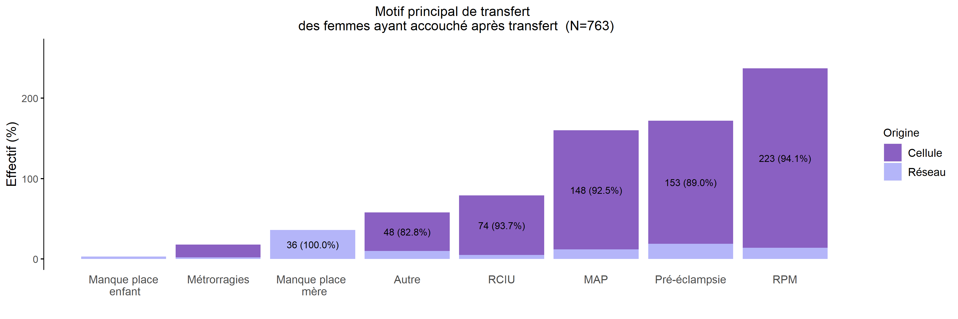
Les accouchements suite à TIU selon le motif en 2019
13/02/2020
Création | HPP | Inconnu | Manque de place pour enfant | Métrorragies | Manque de place pour mère | Autre | RCIU | MAP | Pré-éclampsie | RPM | Total
Cellule | 0 (0%) | 0 (0%) | 0 (0.0%) | 16 (2.4%) | 0 (0.0%) | 48 (7.3%) | 74 (11.2%) | 148 (22.4%) | 153 (23.1%) | 223 (33.7%) | 662
Réseau | 0 (0%) | 0 (0%) | 3 (3.0%) | 2 (2.0%) | 36 (35.6%) | 10 (9.9%) | 5 (5.0%) | 12 (11.9%) | 19 (18.8%) | 14 (13.9%) | 101
Total | 0 (0%) | 0 (0%) | 3 (0.4%) | 18 (2.4%) | 36 (4.7%) | 58 (7.6%) | 79 (10.4%) | 160 (21.0%) | 172 (22.5%) | 237 (31.1%) | 763

Slide 34
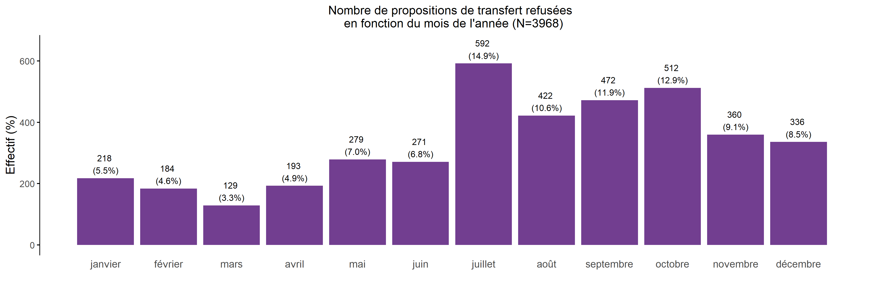
Nombre de propositions de transfert refusées en 2019
13/02/2020
Total | janvier | février | mars | avril | mai | juin | juillet | août | septembre | octobre | novembre | décembre
3968 | 218 | 184 | 129 | 193 | 279 | 271 | 592 | 422 | 472 | 512 | 360 | 336

Slide 35
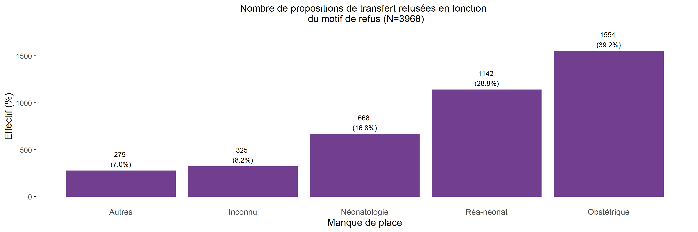
Motif des propositions de transfert refusées en 2019
13/02/2020
Total | Autres | Inconnu | Néonatologie | Réa-néonat | Obstétrique
3968 | 279 | 325 | 668 | 1142 | 1554

Slide 36
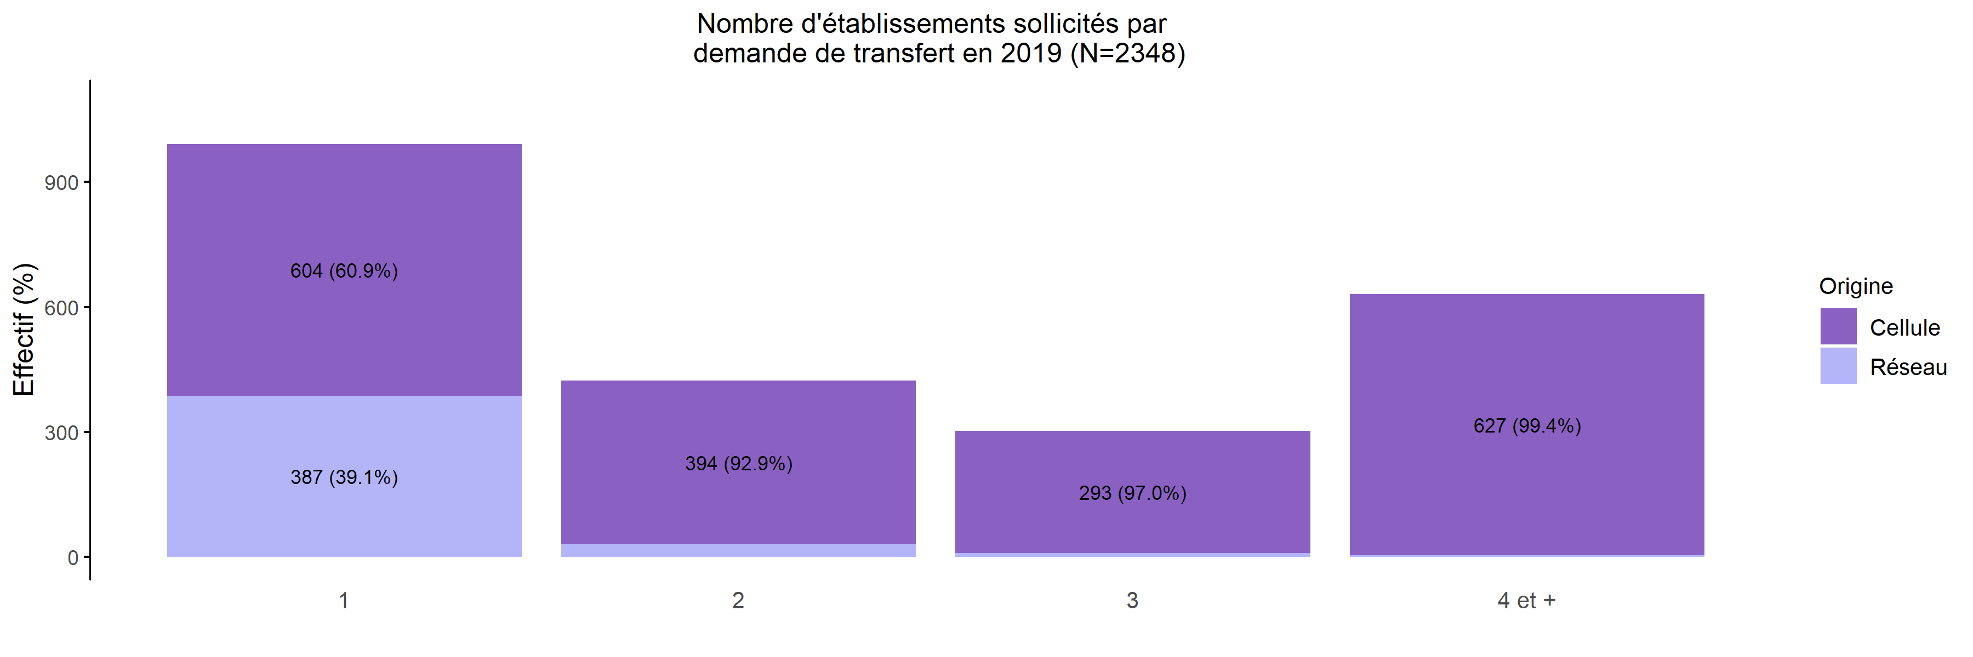
Nombre d'établissements sollicités par demande
13/02/2020
Création | 1 | 2 | 3 | 4 et + | Total
Cellule | 604 (31.5%) | 394 (20.5%) | 293 (15.3%) | 627 (32.7%) | 1918
Réseau | 387 (90.0%) | 30 (7.0%) | 9 (2.1%) | 4 (0.9%) | 430
Total | 991 (42.2%) | 424 (18.1%) | 302 (12.9%) | 631 (26.9%) | 2348

Slide 37
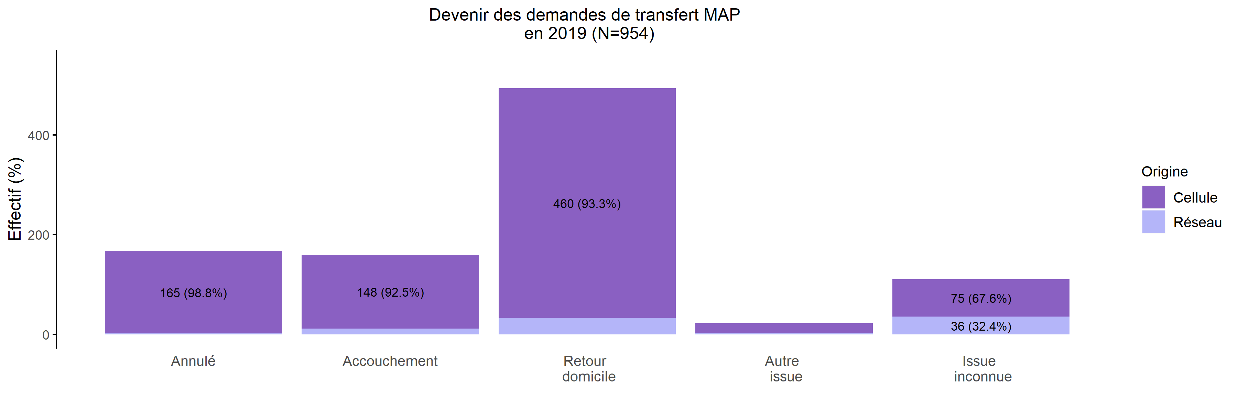
Devenir des demandes de TIU pour MAP
13/02/2020
Création | Annulé | Accouchement | Retour domicile | Autre issue | Issue inconnue | Total
Cellule | 165 (19.0%) | 148 (17.1%) | 460 (53.0%) | 20 (2.3%) | 75 (8.6%) | 868
Réseau | 2 (2.3%) | 12 (14.0%) | 33 (38.4%) | 3 (3.5%) | 36 (41.9%) | 86
Total | 167 (17.5%) | 160 (16.8%) | 493 (51.7%) | 23 (2.4%) | 111 (11.6%) | 954

Slide 38
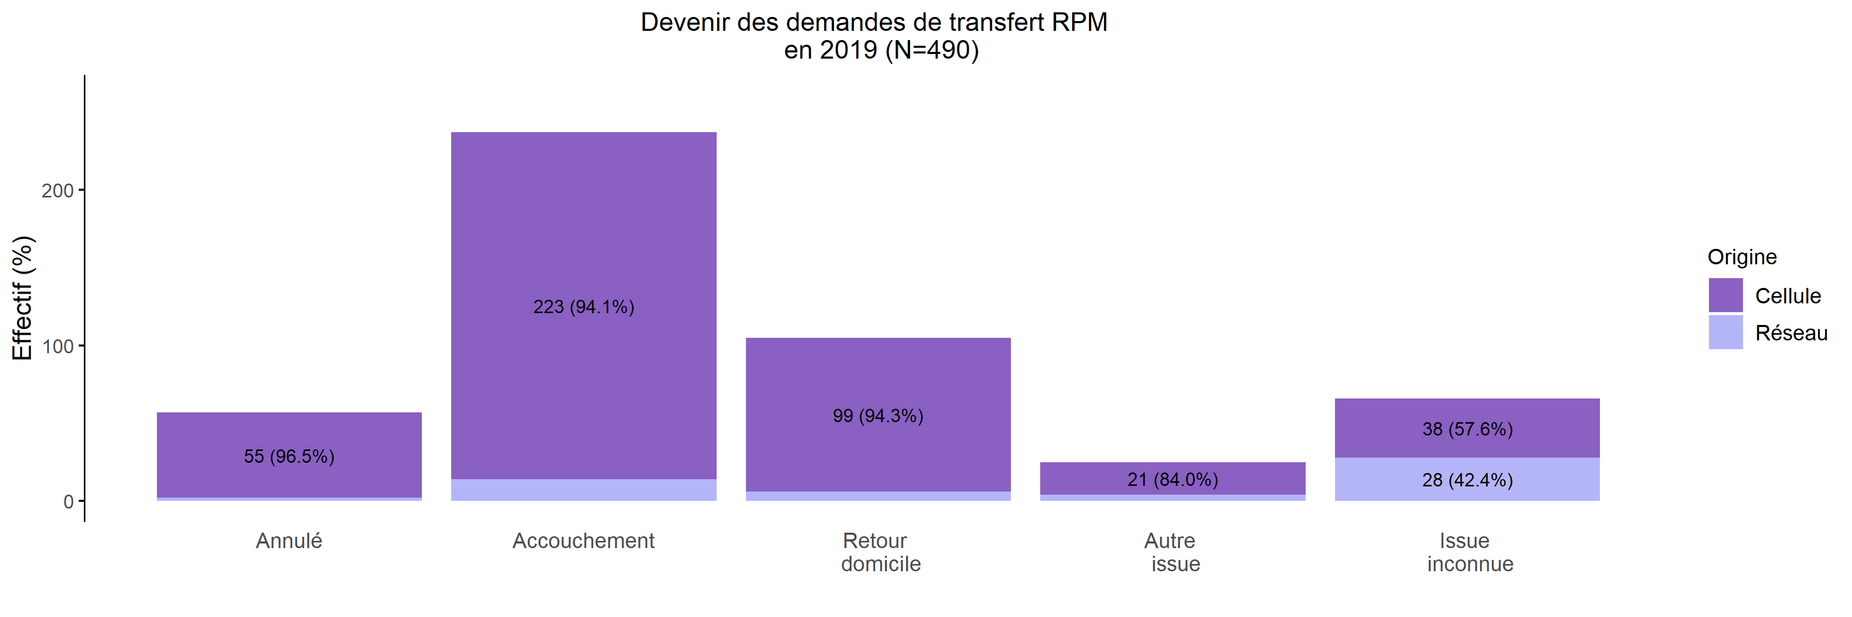
Devenir des demandes de TIU pour RPM
13/02/2020
Création | Annulé | Accouchement | Retour domicile | Autre issue | Issue inconnue | Total
Cellule | 55 (12.6%) | 223 (51.1%) | 99 (22.7%) | 21 (4.8%) | 38 (8.7%) | 436
Réseau | 2 (3.7%) | 14 (25.9%) | 6 (11.1%) | 4 (7.4%) | 28 (51.9%) | 54
Total | 57 (11.6%) | 237 (48.4%) | 105 (21.4%) | 25 (5.1%) | 66 (13.5%) | 490

